Slide 1
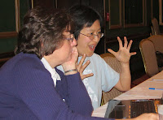
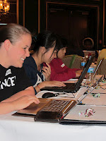
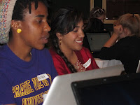
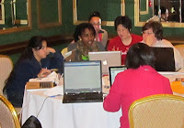
Welcome
Dayton Python Workshop

Slide 2
Workshop objective
Demonstrate mastery of Python programming techniques

Slide 3
Workshop objective
Demonstrate mastery of Python programming techniques

Slide 4
Workshop objective
Demonstrate mastery of Python programming techniques
Have FUN (with programming Python)

Slide 5
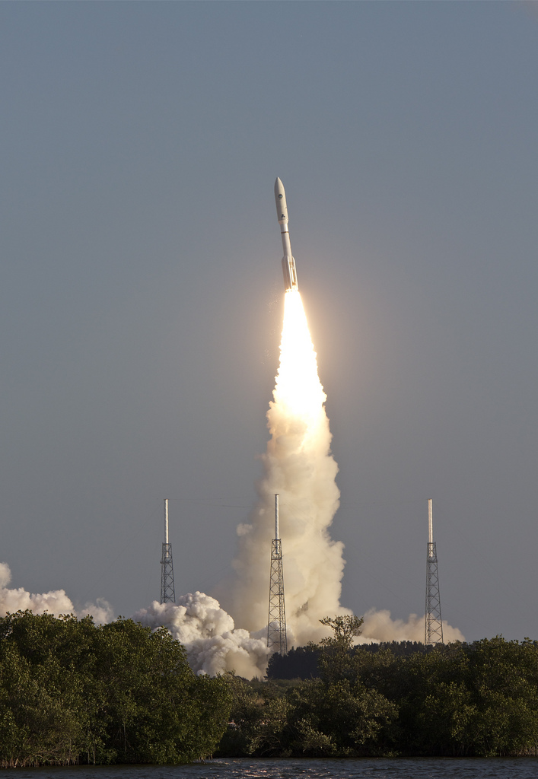
Not rocket science
Image by Flying Jenny, http://www.flickr.com/photos/forthebirds/
License: Creative Commons
Attribution-NonCommercial-ShareAlike 2.0 Generic

Slide 6
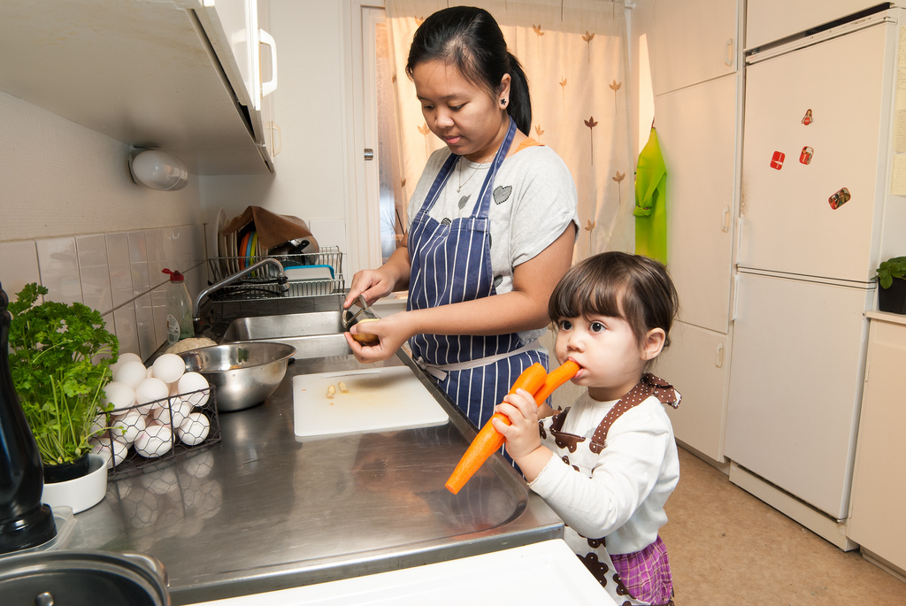
More like cooking
Image by rifqi dahlgren, http://www.flickr.com/photos/rifqidahlgren/
License: Creative Commons
Attribution-NonCommercial 2.0 Generic

Slide 7
Tonight
http://tinyurl.com/day-py-workshop
Prepare your computer
Run Python
Run a Python program
Basic tutorial
Snazzy tutorial with feedback
Leave by 9

Slide 8
Tomorrow (9:30)
Lecture
More snazzy tutorial
Lunch & demos
Color Wall project
Done by 4:30

Slide 9
http://tinyurl.com/day-py-workshop
Ask!

