Slide 1
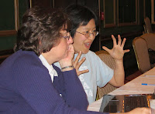
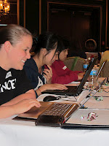
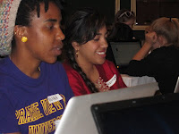
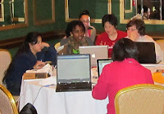
Thank you!
Dayton Python Workshop

Slide 2
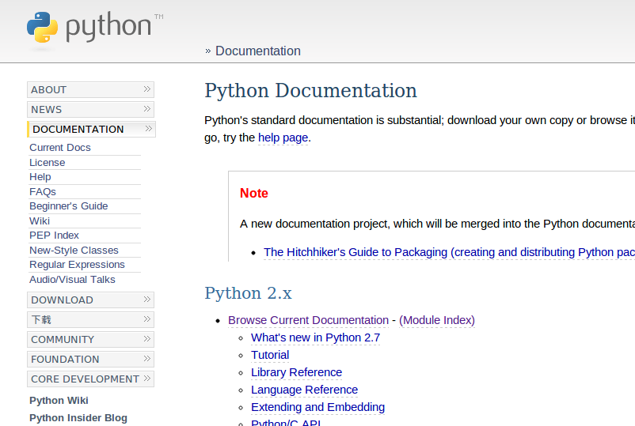
python.org

Slide 3
Online books
Think Python: openbookproject.net/thinkcs/python/english2e/
Learn Python the Hard Way: learnpythonthehardway.org
Learn Python with games: inventwithpython.com

Slide 4
Video courses
Google's Python class:
https://developers.google.com/edu/python/
Coursera
www.coursera.org/course/interactivepython
Videos from conferences
http://pyvideo.org

Slide 5
Interactive online tutorials
learnpython.org
pythontutor.com

Slide 6
Intermediate stuff
Python Cookbook
http://oreilly.com/python
Hitchhikers' Guide to Python
http://python-guide.readthedocs.org
Software Carpentry
http://software-carpentry.org/

Slide 7
Community
Dayton Dynamic Languages Group
dayton-dynamic.github.com
Meets 2nd Wednesdays, 7-9 pm
(next: April 10)
Dayton Chess Club

Slide 8

Last weekend each July
~ 200 attendees
All topics and levels

Slide 9
Talk back!
Please! tinyurl.com/ day-py-workshop-survey catherine.devlin@gmail.com

Slide 10
Tell your friends!
More Workshops coming up...

