Slide 1
ETLessons ETLearned
Columbus Women in Data Science, 2018
Catherine Devlin
@catherinedevlin
catherine.devlin@gmail.com
Notes:
Goal: 15m or less introduction
Problems, Goals
Solutions in Postgres of other DB problems

Slide 2
E: Extract
T: Transform
L: Load

Slide 3
About me
DBA 1999 -
Python programmer 2003 -
Founding chair, PyOhio
USAF, IT support, online retailer, ...
18F (but speaking unofficially)
Notes:
Plug PyOhio, PyCon, and 18F
One reason I’ve straddled the database/programmer divide is because ETL has been one of the biggest needs of most projects I’ve been on. It’s probably dominated my time.

Slide 4
E: Extract
T: Transform
L: Load
Physical location
Format
Shape

Slide 5
Public
App
DB
Source
Source
Source

Slide 6
Data sources
Flat files
Web services
Other databases
  Relational
  Non-relational

Slide 7
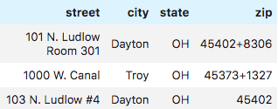
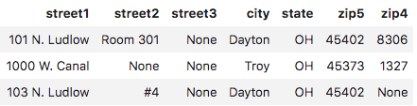
Reshaping
Notes:
There are many decisions under every data schema, whether enforced or not, explicit or not.
- What to name the columns?
- What merits a separate column?
- Normalizing / denormalizing; flat / nested

Slide 8
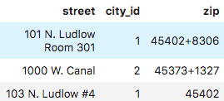


Normalizing
Notes:
There are many decisions under every data schema, whether enforced or not, explicit or not.
- What to name the columns?
- What merits a separate column?
- Normalizing / denormalizing; flat / nested

Slide 9
Lessons learned
Notes:
There are many decisions under every data schema, whether enforced or not, explicit or not.
- What to name the columns?
- What merits a separate column?
- Normalizing / denormalizing; flat / nested

Slide 10
1. Respect quantity

Slide 11
You think
You think
Out-of-band
Only once

Slide 12
You think
You’re wrong.
Time pressure
Many times

Slide 13
You think
Arithmetic
1000 rows / 30 seconds
10 M / (1000/30) > 83 hours
(if linear!)
Notes:
And will your connection last that long?

Slide 14
You think
Consider set-based
for row in rows:
row.name = row.name.strip().upper()
UPDATE my_table
SET name = UPPER(TRIM(name));
Notes:
And will your connection last that long?

Slide 15
You think
Set-based tech
SQL
Pandas
ORM bulk methods
  Ex: .bulk_create, .update
Notes:
And will your connection last that long?

Slide 16
2. Design Humbly

Slide 17
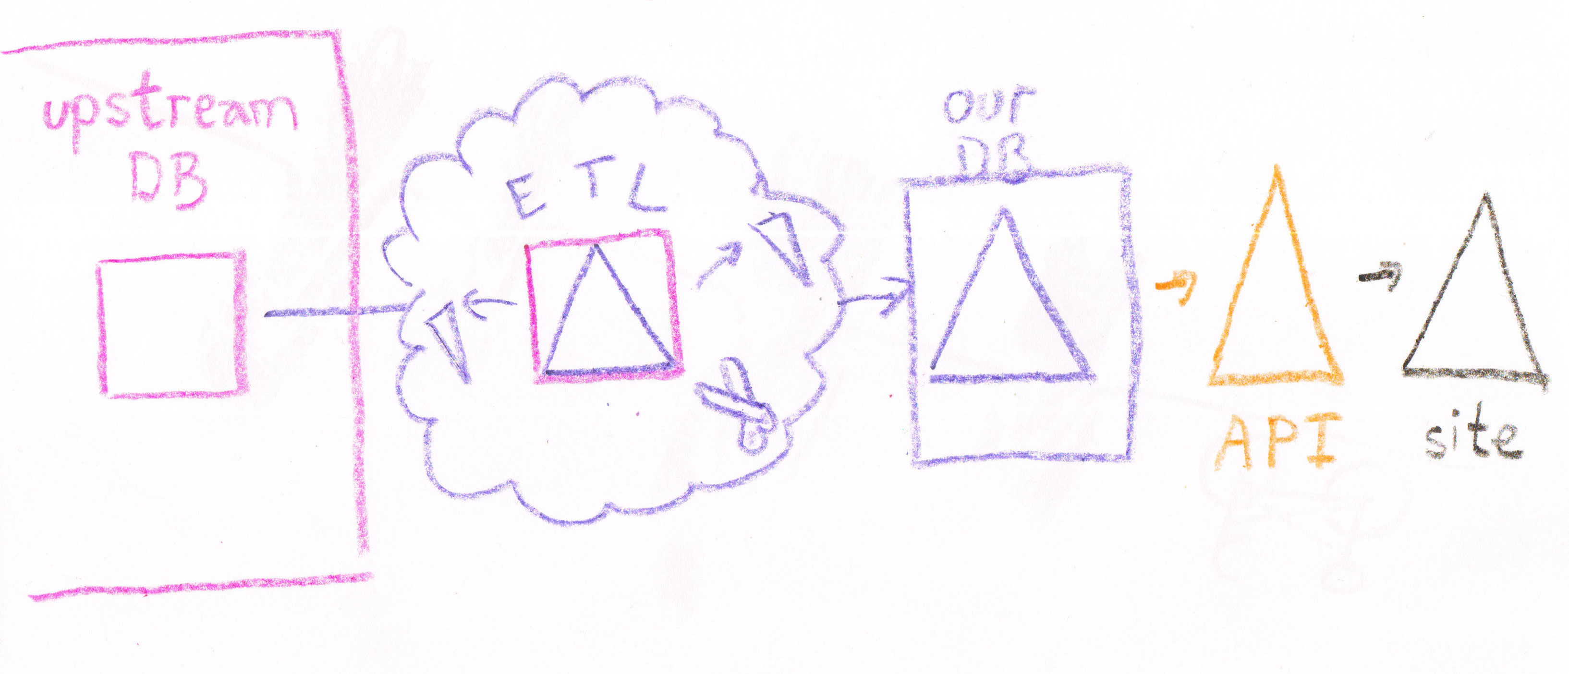
The Brilliant Plan

Slide 18
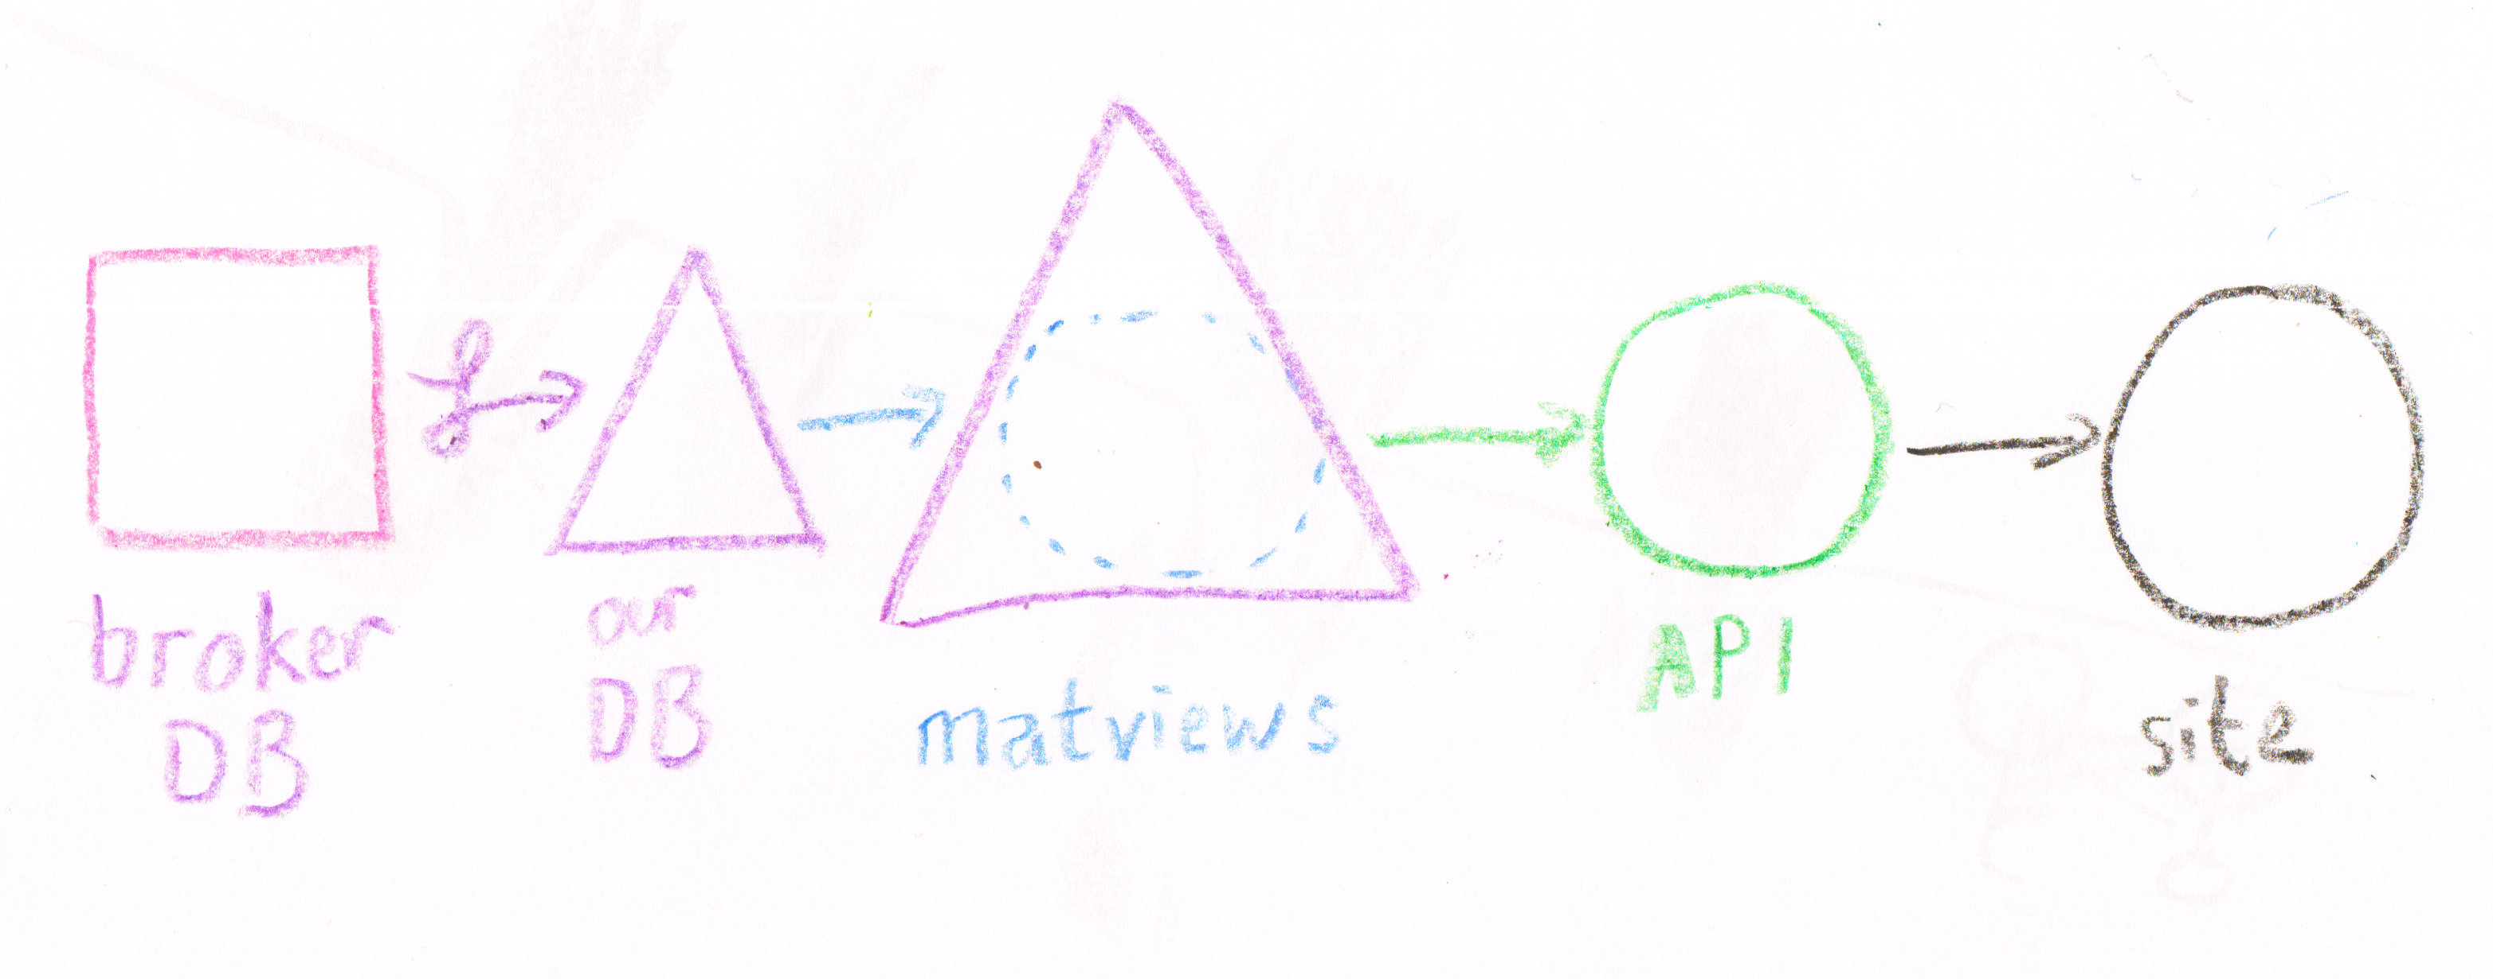
The Cruel Reality

Slide 19
From one shape...
Notes:
There are many decisions under every data schema, whether enforced or not, explicit or not.
- What to name the columns?
- What merits a separate column?
- Normalizing / denormalizing; flat / nested

Slide 20

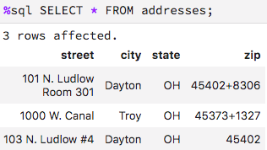
… masked with matview

Slide 21
So, is this good?
Notes:
There was a lot of labor, risk, and error in that little squiggle!

Slide 22
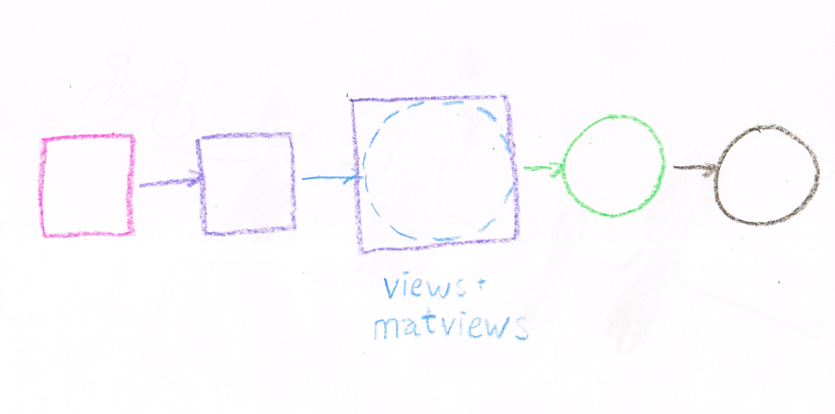
Simpler

Slide 23
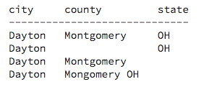
2b. Modesty:
Understand mandate

Slide 24
Fixing implies responsibility
Does the product owner want it?

Slide 25
3. Record history

Slide 26
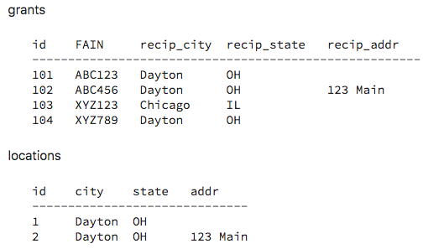

Slide 27
Idempotency (safe to repeat)
Explaining
Debugging

Slide 28
INSERT INTO locations (city, state, addr)
SELECT g.city,
g.state,
g.addr,
ARRAY_AGG(id)
FROM grants g
GROUP BY 1, 2, 3;

Slide 29
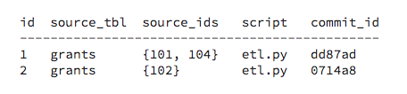
Even better

Slide 30
4. Fight With Tools

Slide 31
Big platforms: meh
Pentaho
Proprietary stuff

Slide 32
Small tools: w00t!
pawl/awesome-etl

Slide 33
1. Respect quantity
2. Design humbly
3. Record history
4. Fight with tools
Catherine.devlin@gmail.com
@catherinedevlin

