Slide 1
More ORM than good:
Stop not writing SQL
Catherine Devlin
PyOhio 2022
github.com/catherinedevlin
Pun courtesy (?) of Dan Griffith, who also introduced me to Python

Slide 2
Object-relational-mapping is the idea of being able to write queries like the one above, as well as much more complicated ones, using the object-oriented paradigm of your preferred programming language.
Long story short, we are trying to interact with our database using our language of choice instead of SQL.
https://blog.bitsrc.io/what-is-an-orm-and-why-you-should-use-it-b2b6f75f5e2a

Slide 3
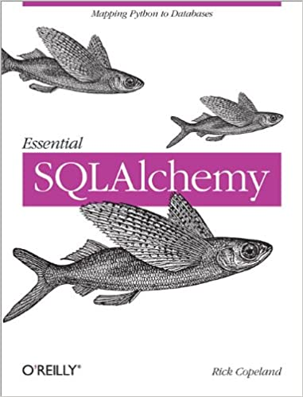
- 240 pages

Slide 4
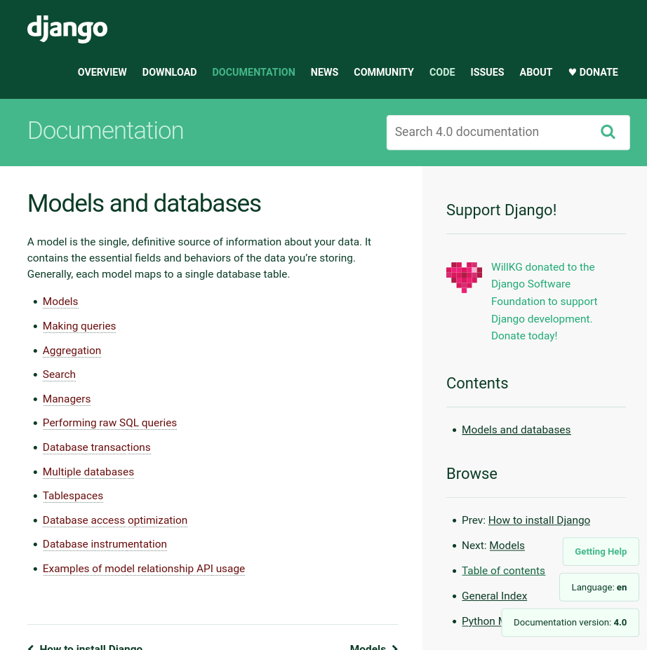

Slide 5
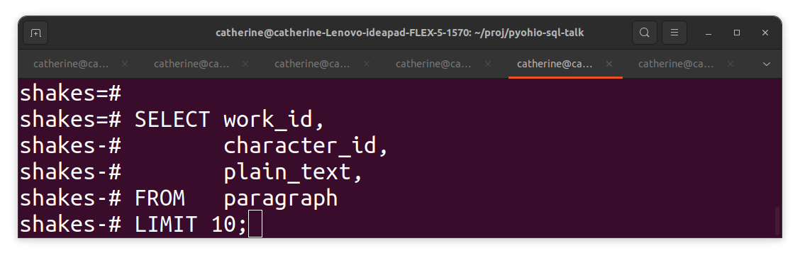

Slide 6
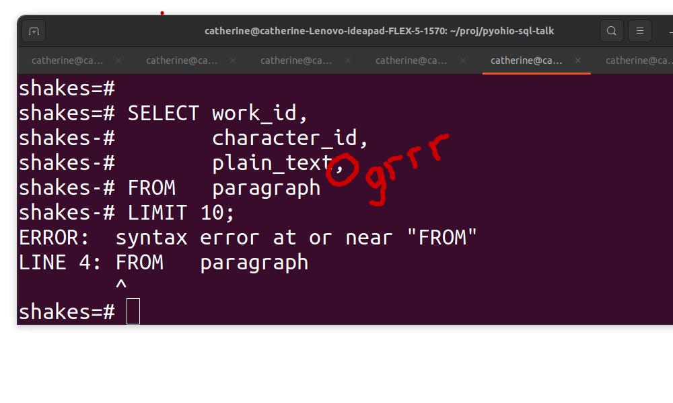

Slide 7
Well-known
Well-supported
Well-documented
Readable

Slide 8
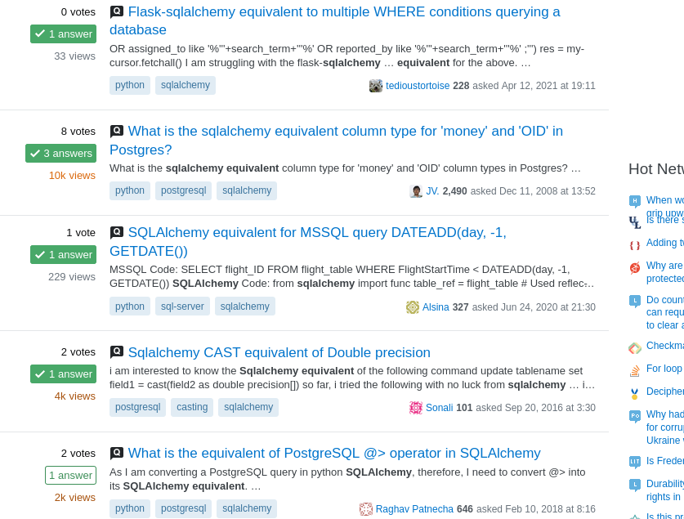

Slide 9
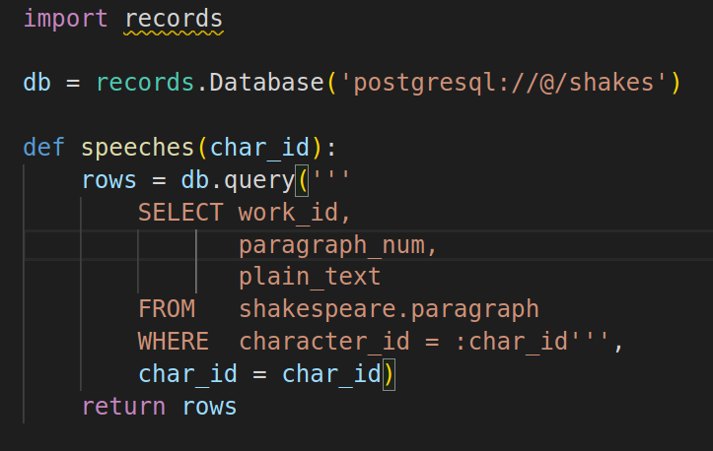

Slide 10
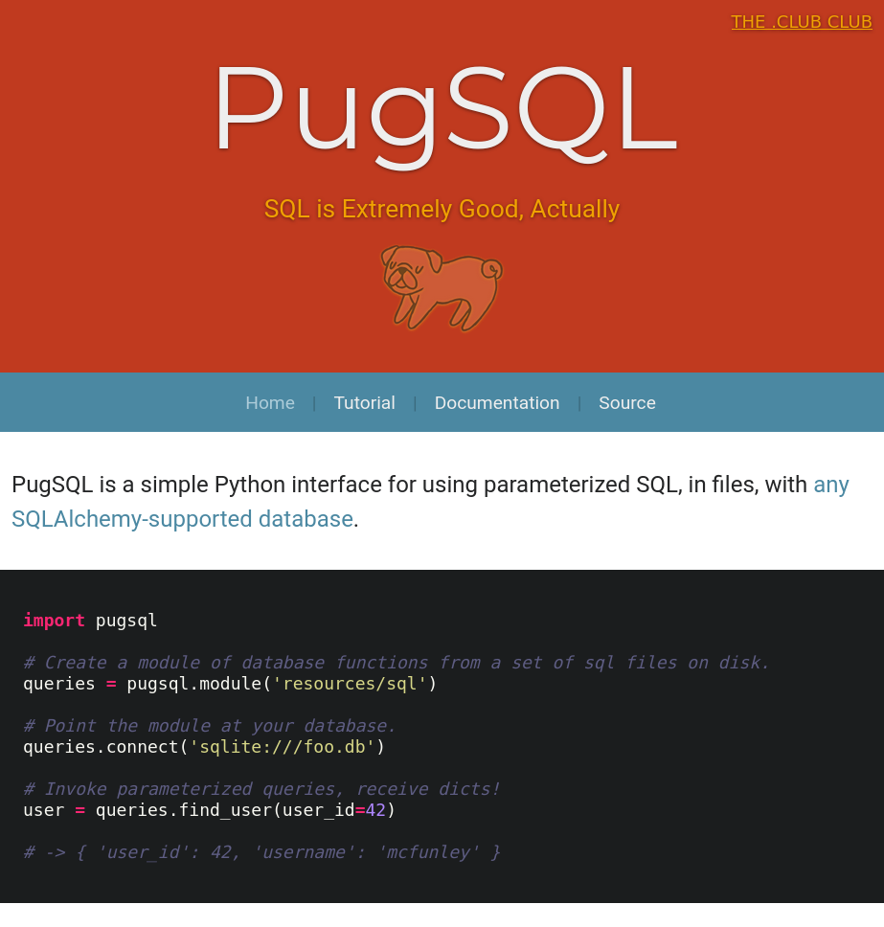

Slide 11
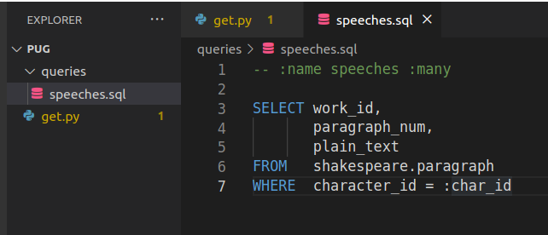

Slide 12
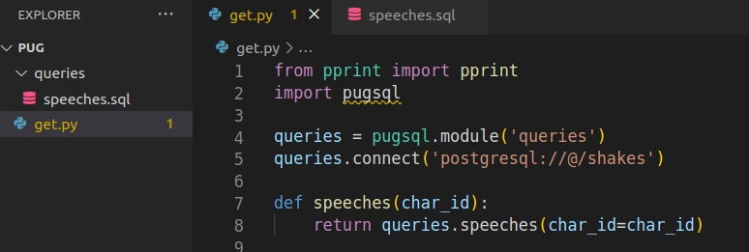

Slide 13
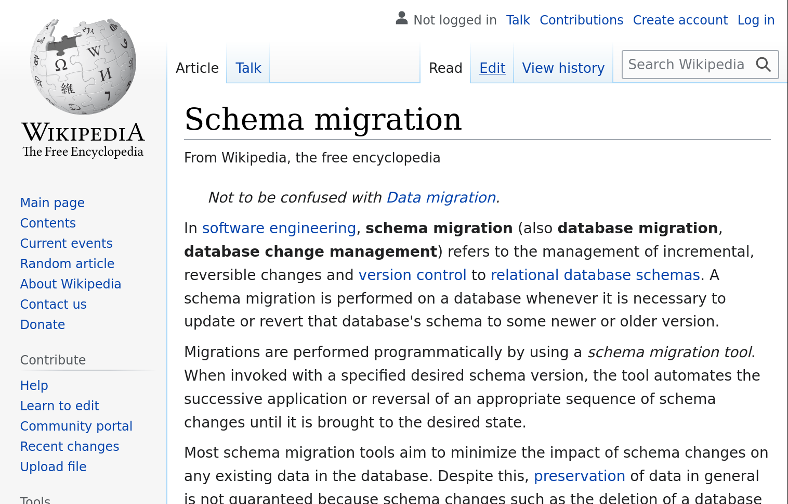

Slide 14
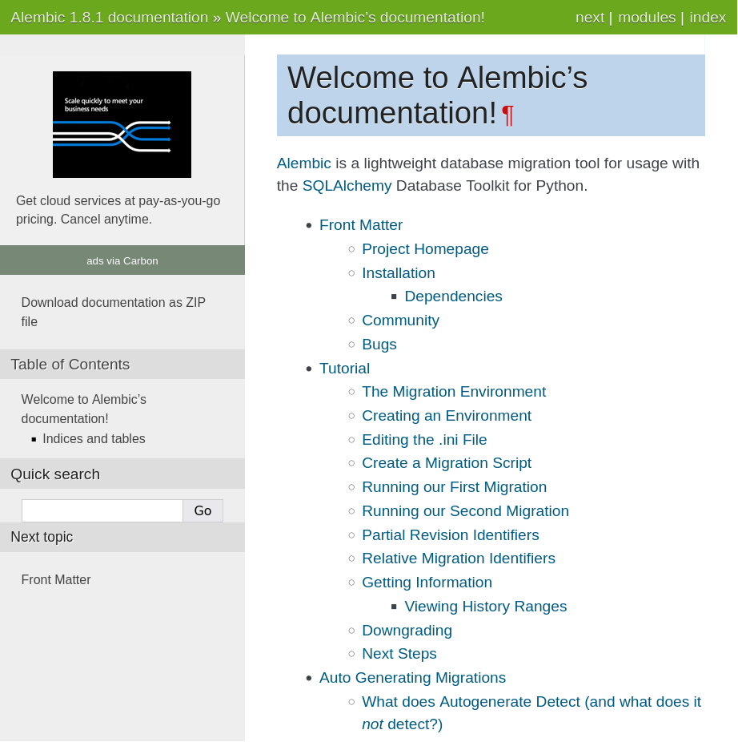

Slide 15
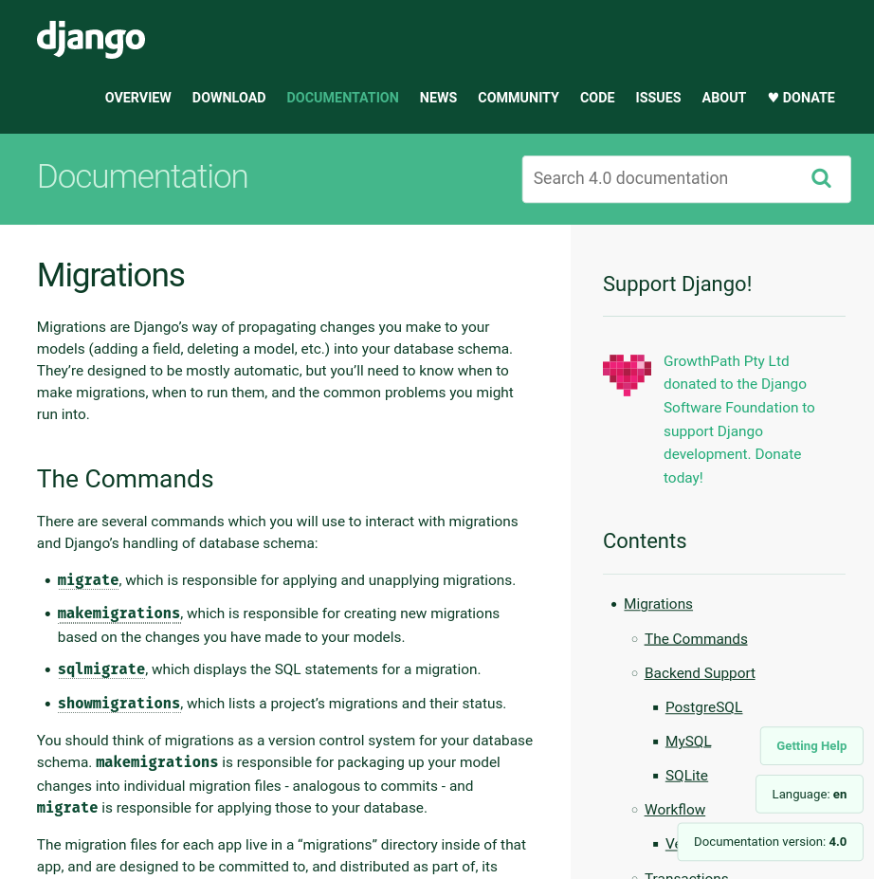

Slide 16
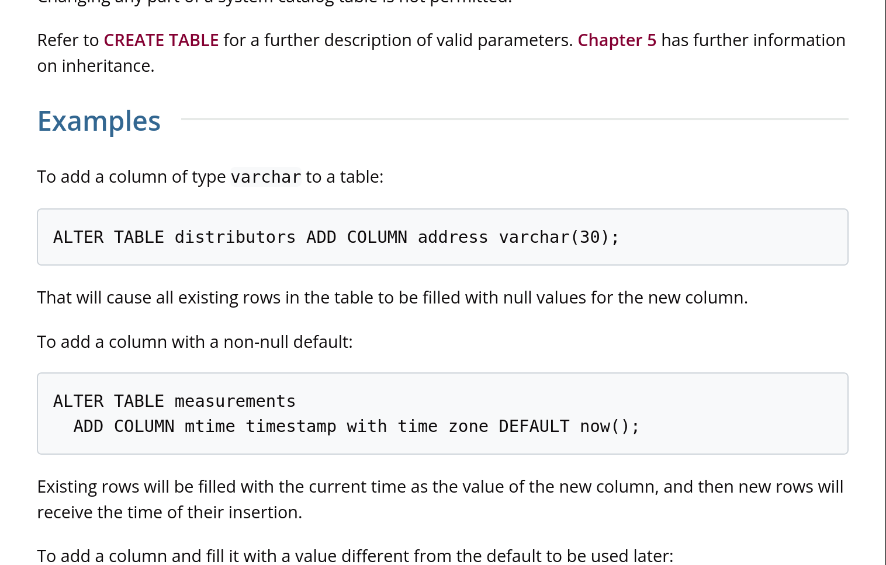

Slide 18
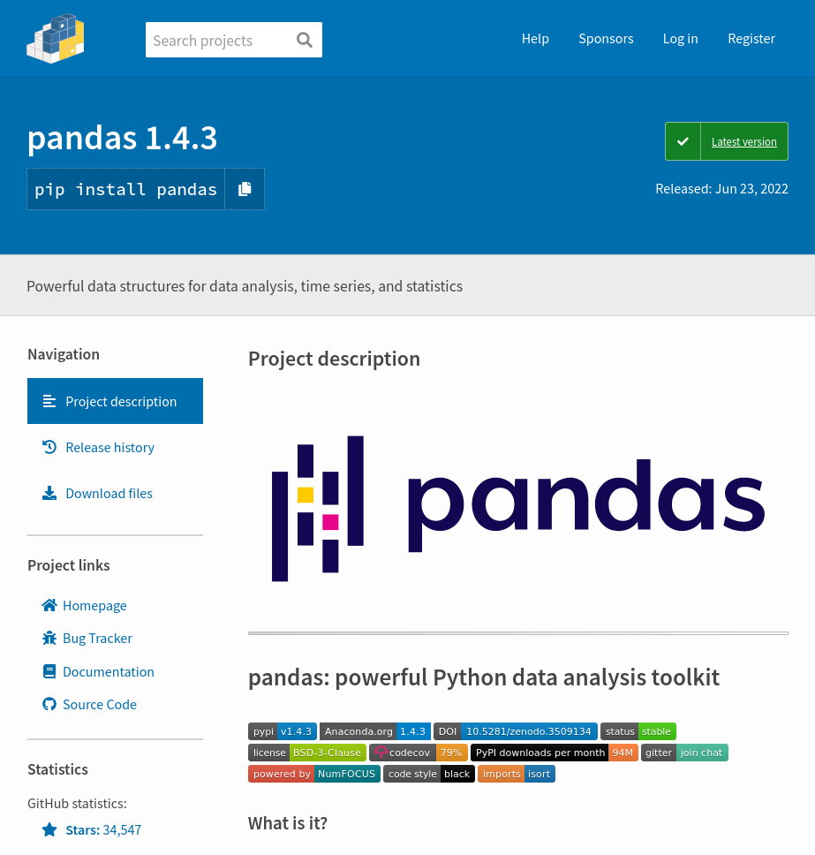

Slide 19
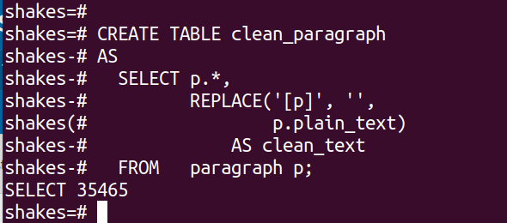

Slide 20
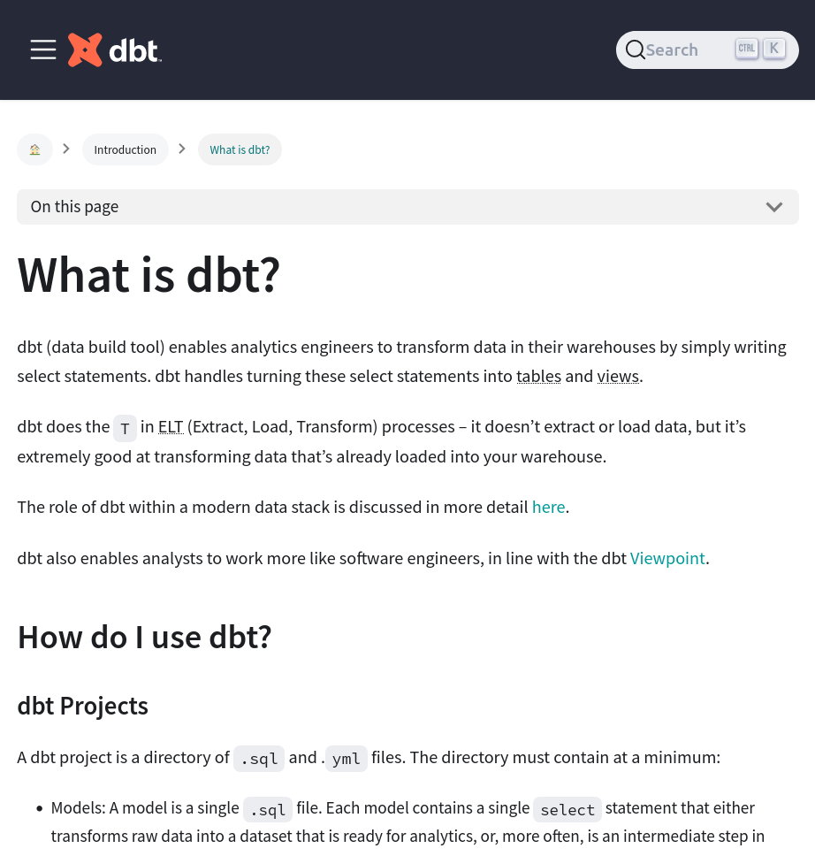

Slide 21
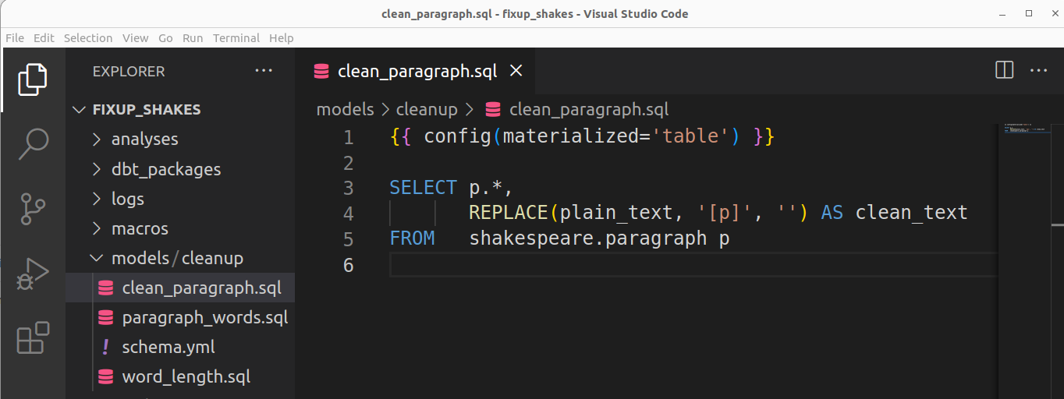

Slide 22
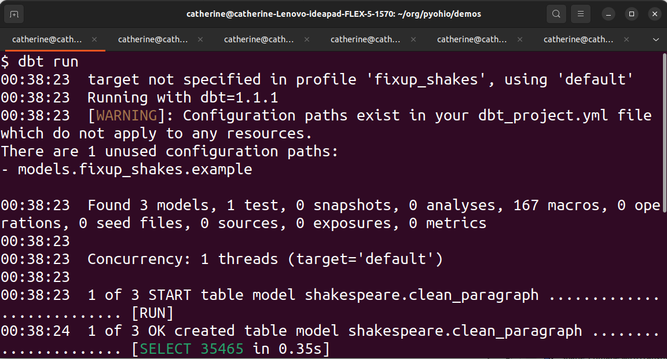

Slide 23
Long live SQL!
(With Python’s supervision)
PugSQL
Agnostic
dbt
github.com/catherinedevlin

