Slide 1
Classifiction
Model
Catherine Miao

Slide 2
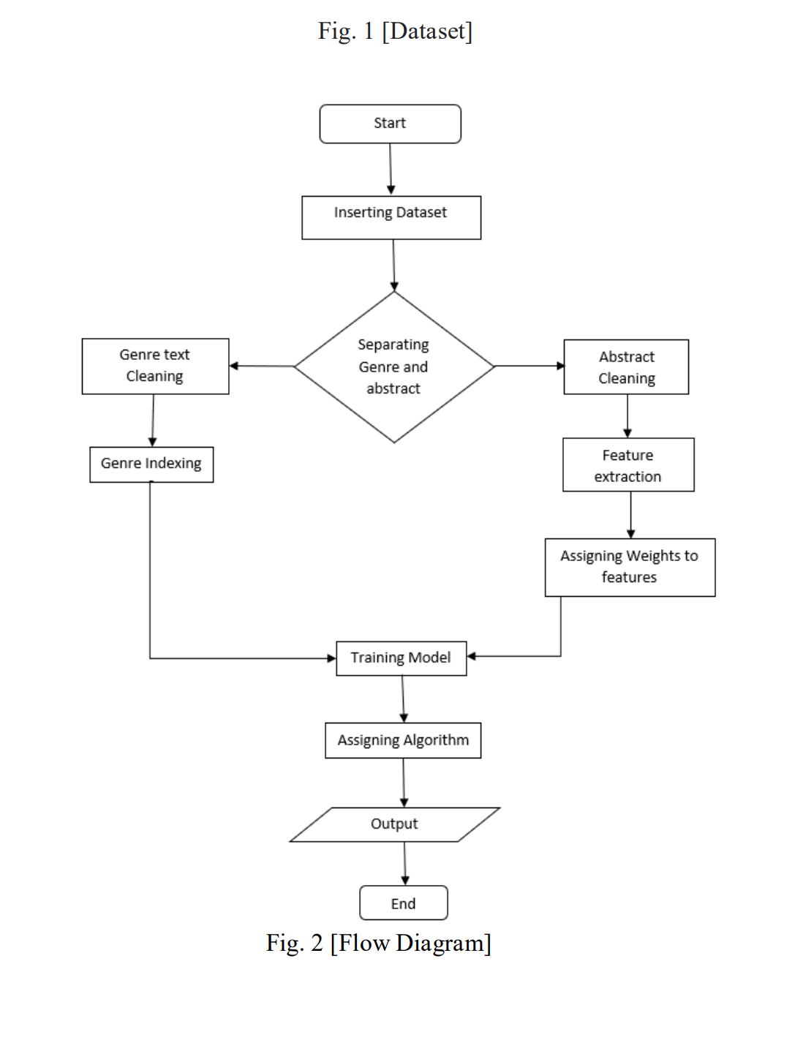

Slide 3
01
Dataset
Deal with imbalance dataset
02
Data pre-processing
Here libraries like tqdm, pandas, matplotlib, etc. are used for pre-processing of data
03
Training model with Algorithms
Here imported train_test_spllit function from sklearn.model_selection function to train model.
04
Result Evaluation
Thresholds moving, metrics performance

Slide 4
Dataset

Slide 5
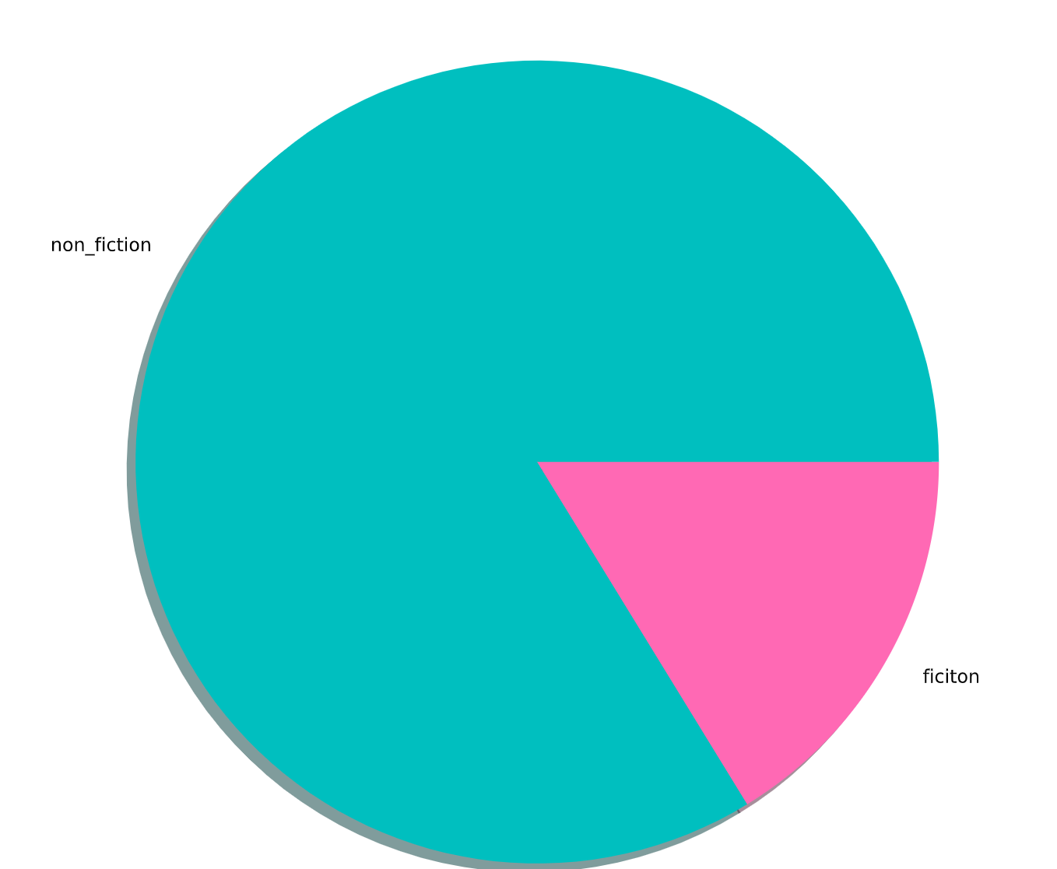
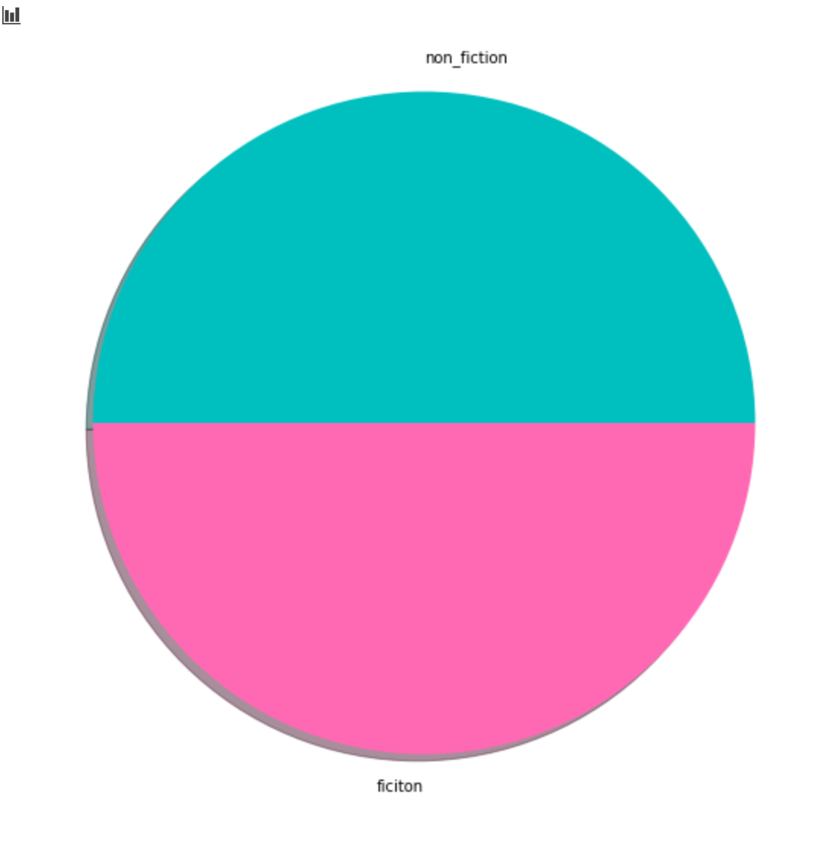
Modern Portfolio Presentation
Get a modern PowerPoint Presentation that is beautifully designed.
You can simply impress your audience and add a unique zing and appeal to your Presentations. Easy to change colors, photos and Text. Get a modern PowerPoint Presentation that is beautifully designed. I hope and I believe that this Template will your Time, Money and Reputation. You can simply impress your audience and add a unique zing and appeal to your Presentations.
Modern PowerPoint Presentation

Slide 6
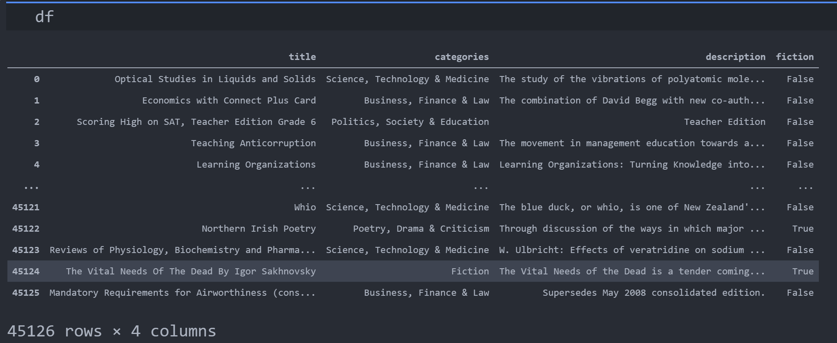
Features
Target

Slide 7
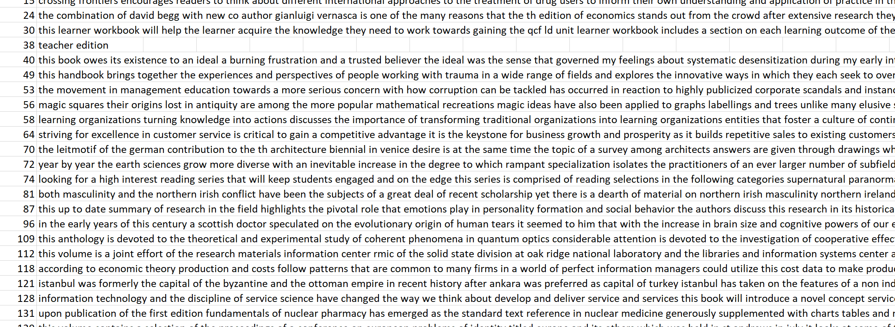
We Create
Quality Professional
PPT Presentation
Clean Description
Here re library is used to remove unwanted spacing and remove all unwanted characters

Slide 8
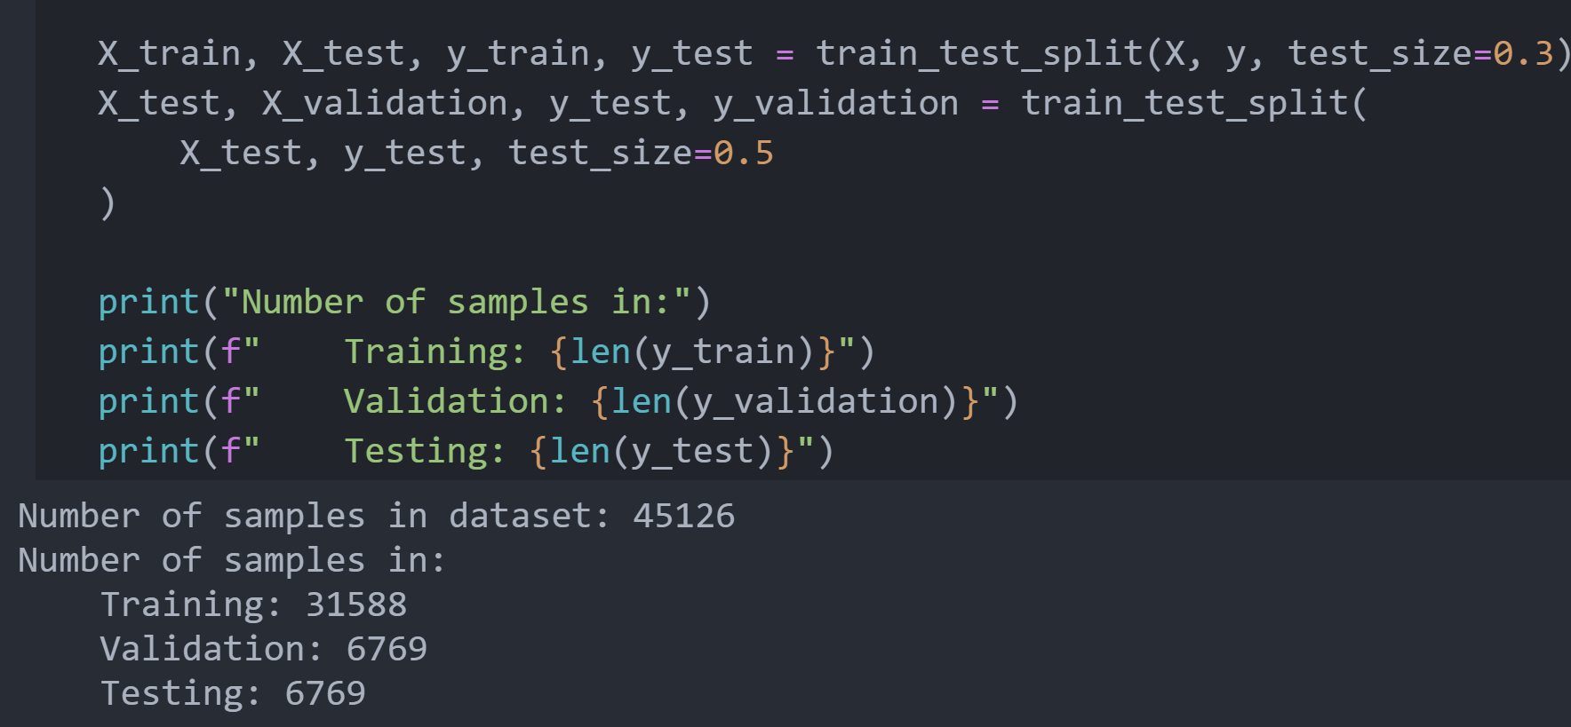
Trian Test split
Train Data set
70%
Your Content Here
Test Data Set
15%
Your Content Here
Your Content Here
Validation Data set
15%

Slide 9
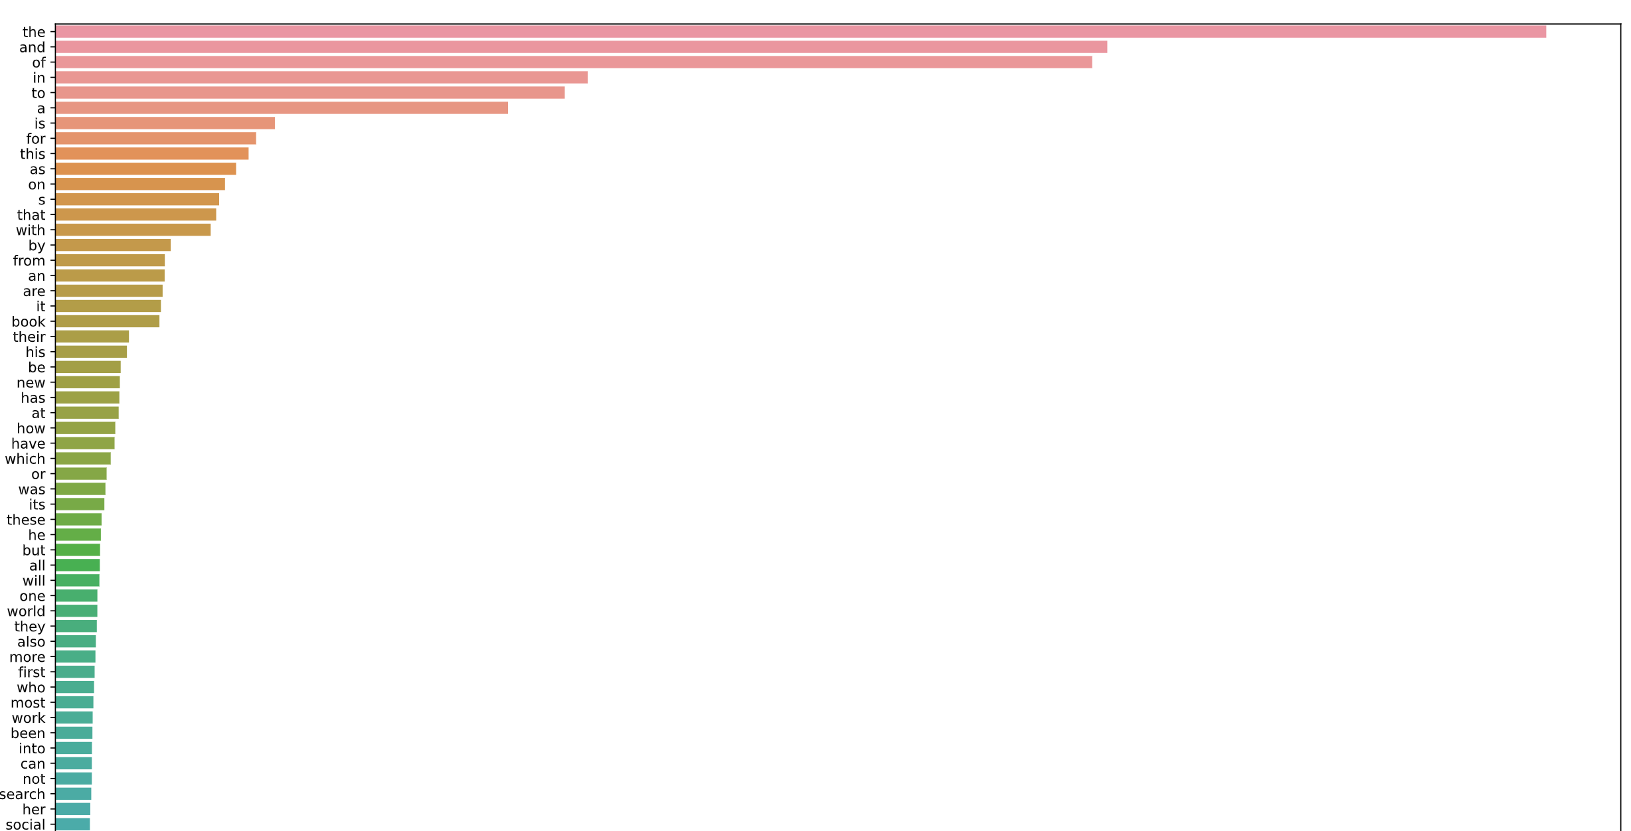
Text normalistion
TfidVectorizer function from sklearn library is used to extract features from abstract and assigning weights to the feature values. Parameter stop_words = ENGLISH_STOP_WORDS
i.e., if sentence is" Books are important to read" will become "Books important read"

Slide 10
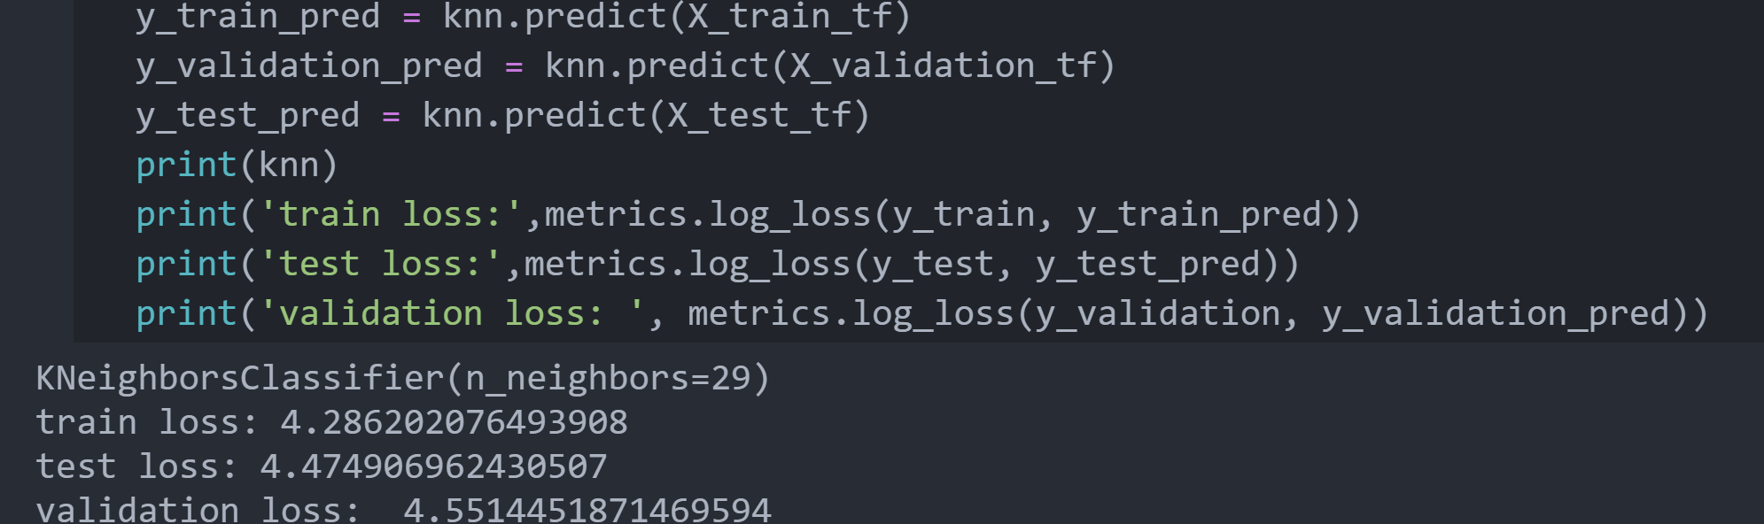
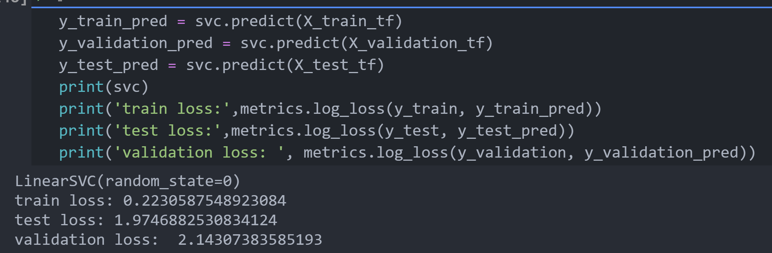
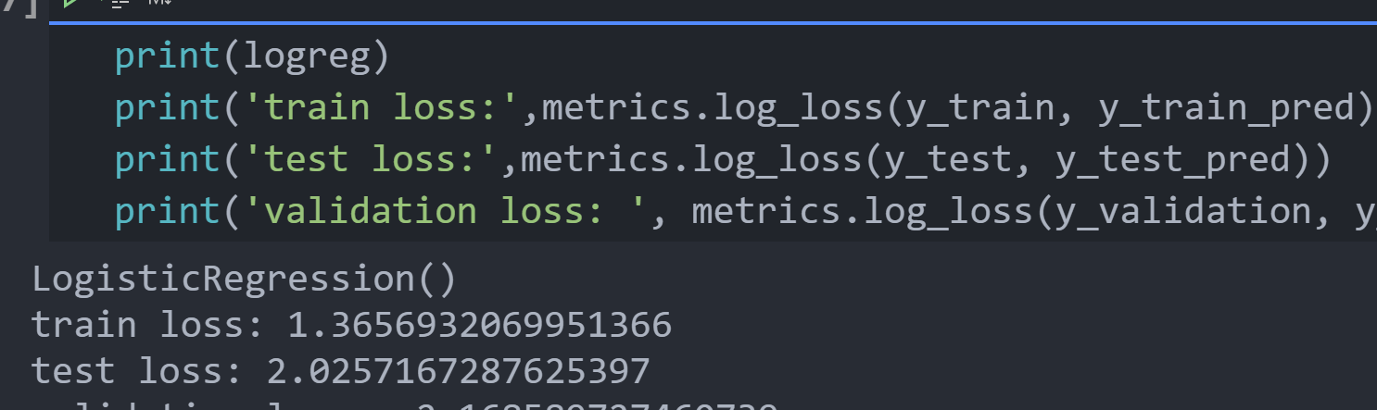
KNN
LinearSVC
Logistic Regression
Training model with Algorithms

Slide 11
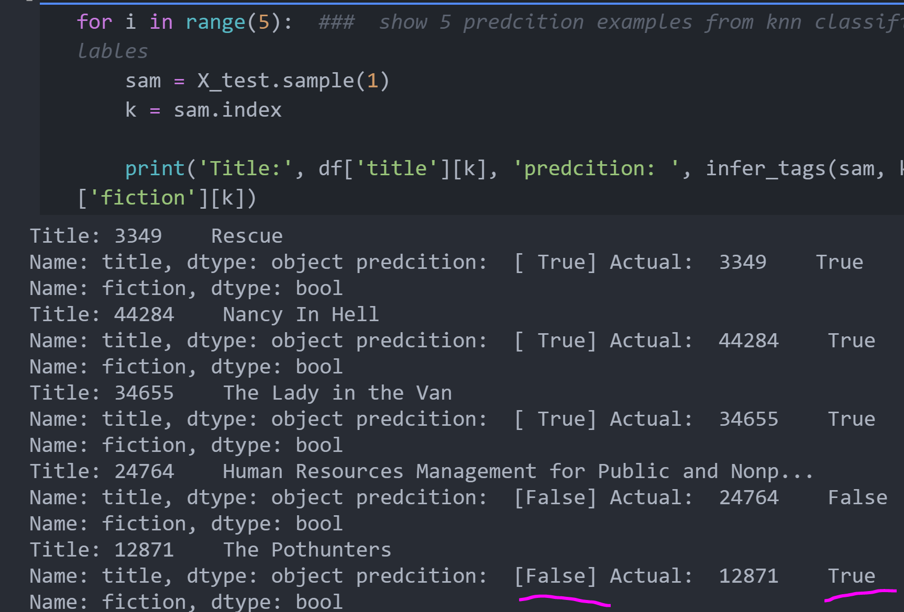
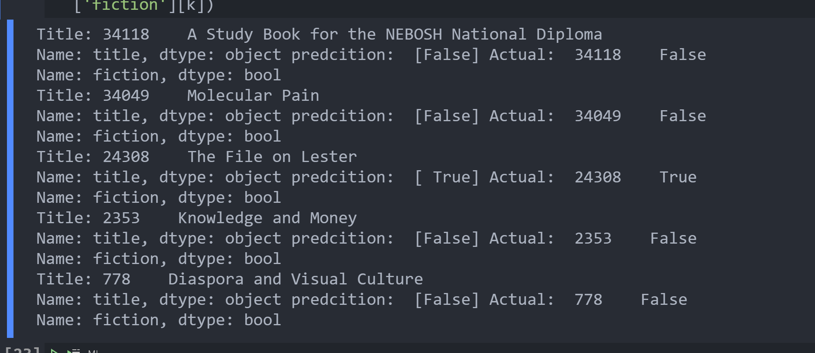






Slide 12
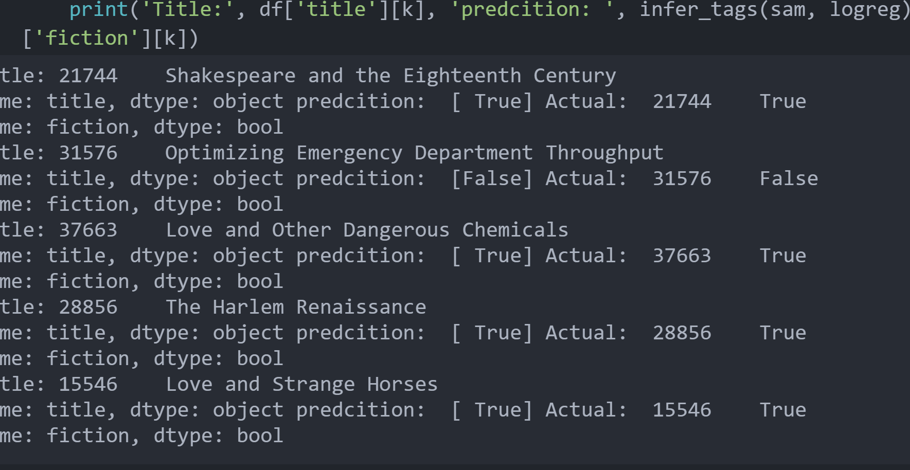

Slide 13
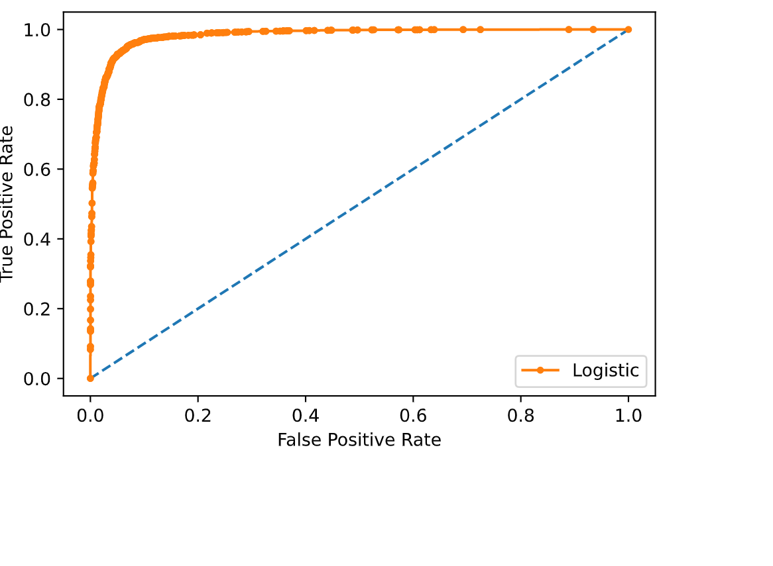
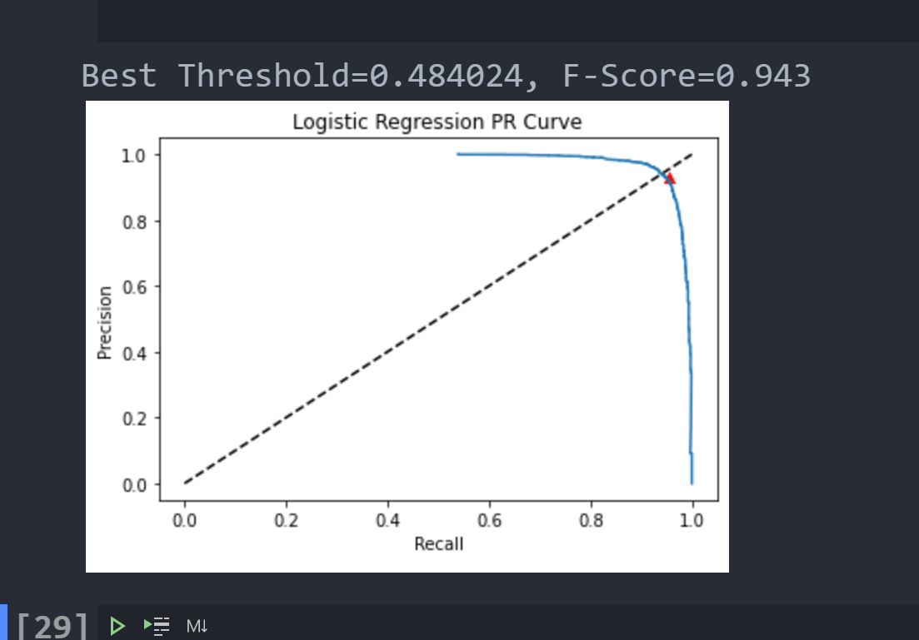

Slide 14
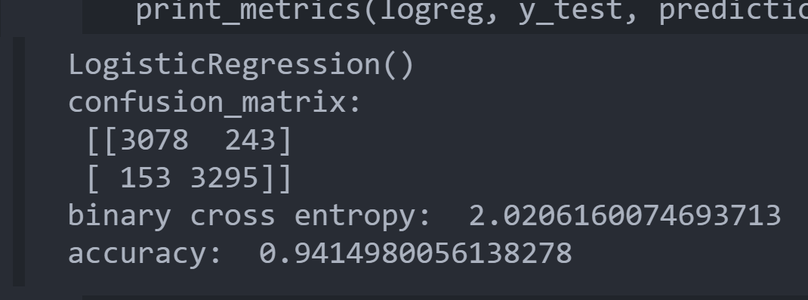

Slide 15
Thank You

