Slide 1
Edo’s Powerpoint Slides
Inspired by presentation delivered on Wednesday 30 September, 2026.
psuedonym

Slide 2
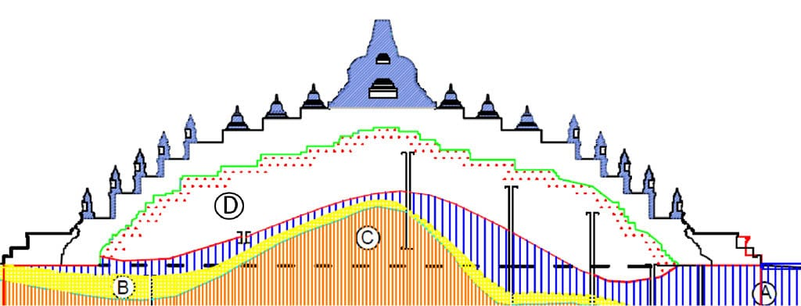
I looked for something similar in Indonesia

Slide 3

I looked for something similar in Indonesia

Slide 4
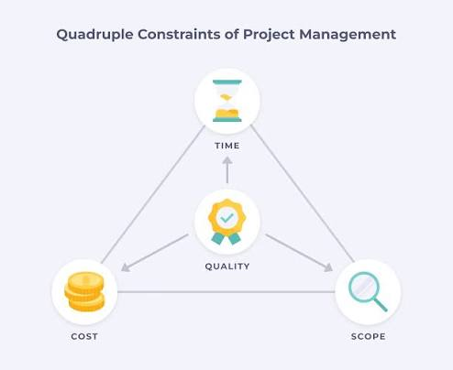
The Iron Triangle of Project Management
Translates “Strategy into Execution”

