Slide 1
Introduction to Programming I in Java (CSE8A)
Winter 2020
Lecture Feb 11, Java Arrays & Sounds

Slide 2
Upcoming Due Dates
PA5 (sounds 1) due tonight
Submit to the autograder now!

Slide 3
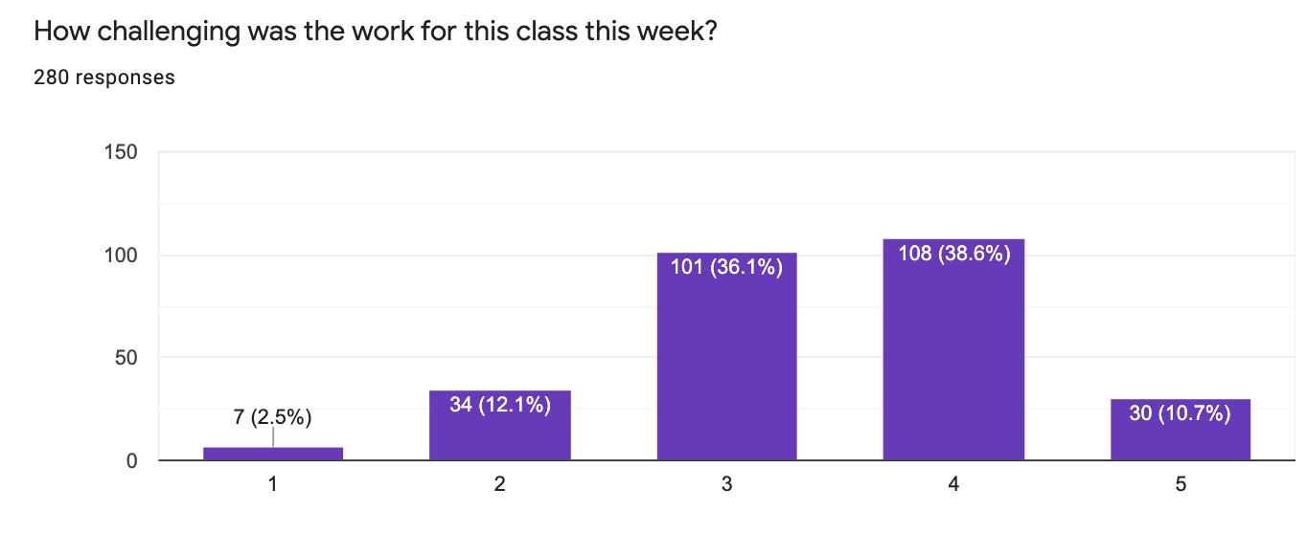
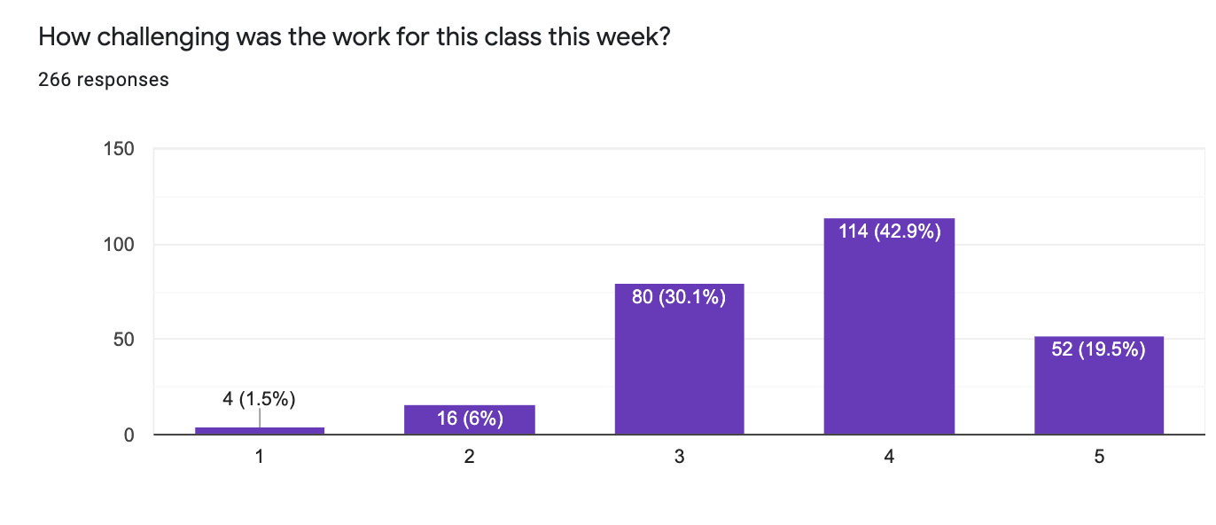
Surveys

Slide 4
Surveys
Week 2 – mean 6hr/median 5hr/stdev 3hr per week of work
Week 4 – mean 7hr/median 6hr/stdev 4hr per week of work
7-9 hours of outside-of-class work is my goal range as an instructor, so we'll be staying at roughly this level.
If you're spending more than 10 hours per week outside of class we want to hear from you, and can help strategize.

Slide 5

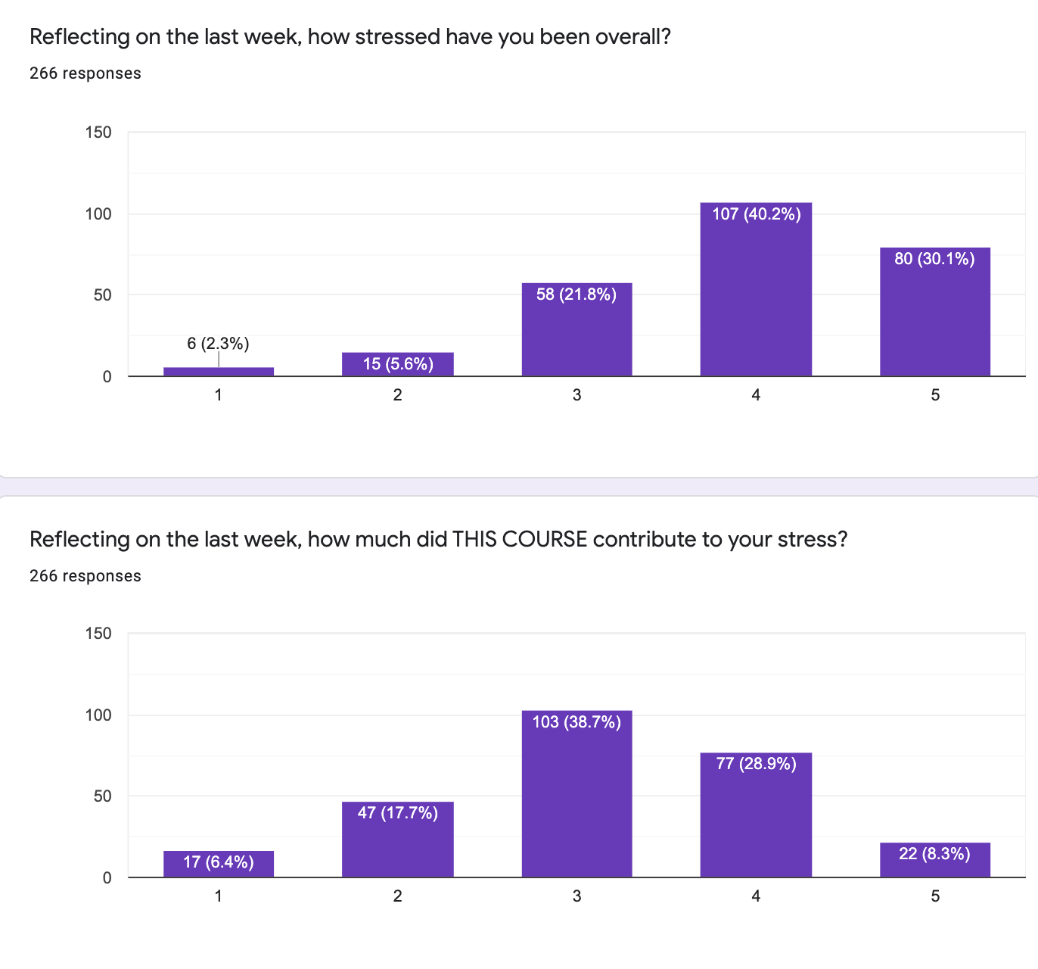

Slide 6
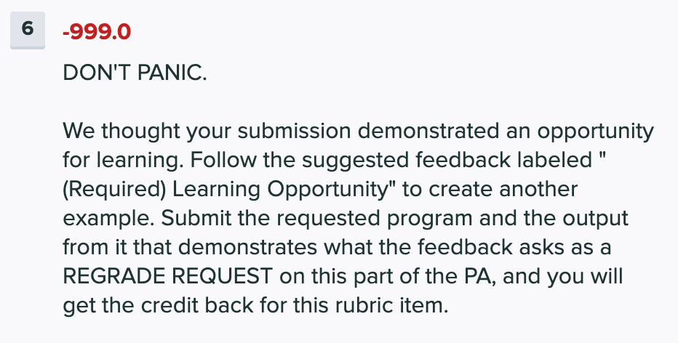
A note on PA4 grading
Make sure to check your feedback
If you get -999 as a rubric item, DON'T PANIC

Slide 7
Assume the code is in main
String[] letters = {"a", "b", "c"};
String[] lettersAgain = {"a", "b", "c"};
letters = lettersAgain;
lettersAgain[0] = "Z";
System.out.println(letters[0] + "\t" + lettersAgain[0]);
What prints in the print statement?
A: a a
B: Z a
C: a Z
D: Z Z
E: None of the above

Slide 8
Assume the code is in main
String[] letters = {"a", "b", "c"};
String[] lettersAgain = {"a", "b", "c"};
lettersAgain[0] = "Z";
letters = lettersAgain;
System.out.println(letters[0] + "\t" + lettersAgain[0]);
What prints in the print statement?
A: a a
B: Z a
C: a Z
D: Z Z
E: None of the above

Slide 9
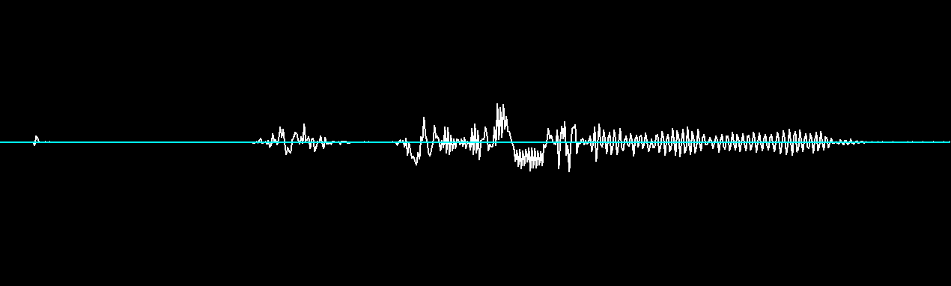
Sound
Pattern of waves of increasing / decreasing air pressure produces sound
Amplitude (height of waves) determines volume (loudness)
Frequency (number of up/down cycles per second) determines pitch
Louder: greater amplitude
Higher pitch: greater frequency

Slide 10
Sound
Pattern of waves of increasing / decreasing air pressure produces sound
Amplitude (height of waves) determines volume (loudness)
Frequency (number of up/down cycles per second) determines pitch
Digitizing sound: sampling (measuring) pressure and converting pressure level to positive / negative voltage.
int[] array representing a sound will have (sampling rate * number of seconds in the sound) many entries
Typical sampling rates are 22050 Hz (samples/second), 44100 Hz

Slide 11
reduceVolume – size
static int[] reduceVolume (int[] sound) {
int[] soundQuiet = new int[ FILL SIZE ];
for(int i = ; ; i += 1) {
soundQuiet[i] =
}
return soundQuiet;
}
... in main ...
int[] beforeQuiet = {220, -1000, 40};
int[] expect = {22, -100, 4};
int[] quieted = soundQuiet(startSound);
System.out.println("Expected:\t " + Arrays.toString(expect));
System.out.println("Actual:\t " + Arrays.toString(quieted));
What expression should we use for the the size of the new array?
3
sound.length
sound
i
None of the above

Slide 12
reduceVolume – loop conditions
static int[] reduceVolume (int[] sound) {
int[] soundQuiet = new int[ FILL SIZE ];
for(int i = FILL INIT; FILL CONDITION ; i += 1) {
soundQuiet[i] =
}
return soundQuiet;
}
... in main ...
int[] beforeQuiet = {220, -1000, 40};
int[] expect = {22, -100, 4};
int[] quieted = soundQuiet(startSound);
System.out.println("Expected:\t " + Arrays.toString(expect));
System.out.println("Actual:\t " + Arrays.toString(quieted));
What should the initial value of i be, and the stopping condition?
0 i < sound.length
1 i <= sound.length
sound.length i > 0
sound.length i >= 0
None of the above

Slide 13
reduceVolume – updated value
static int[] reduceVolume (int[] sound) {
int[] soundQuiet = new int[ FILL SIZE ];
for(int i = FILL INIT; FILL CONDITION ; i += 1) {
soundQuiet[i] = FILL NEWVAL
}
return soundQuiet;
}
... in main ...
int[] beforeQuiet = {220, -1000, 40};
int[] expect = {22, -100, 4};
int[] quieted = soundQuiet(startSound);
System.out.println("Expected:\t " + Arrays.toString(expect));
System.out.println("Actual:\t " + Arrays.toString(quieted));
What should the new value be?
i / 10
sound / i
sound[i] / 10
soundQuiet[i] / 10
None of the above

Slide 14
firstHalf – size
static int[] firstHalf(int[] sound) {
int[] halfSound = new int[ FILL SIZE ];
for(int i = ; ; i += 1) {
halfSound[i] =
}
return halfSound;
}
... in main ...
int[] beforeHalf = {4, 5, -3, 2, 1, 6};
int[] halved = firstHalf(beforeHalf);
int[] exHalf = {4, 5, -3};
System.out.println("Expected:\t " + Arrays.toString(exHalf));
System.out.println("Actual:\t " + Arrays.toString(halved));
What should the size of the new array be?
sound.length
sound.length / 2
3
halfSound.length
None of the above

Slide 15
firstHalf – loop conditions
static int[] firstHalf(int[] sound) {
int[] halfSound = new int[ FILL SIZE ];
for(int i = FILL INIT; FILL CONDITION ; i += 1) {
halfSound[i] =
}
return halfSound;
}
... in main ...
int[] beforeHalf = {4, 5, -3, 2, 1, 6};
int[] halved = firstHalf(beforeHalf);
int[] exHalf = {4, 5, -3};
System.out.println("Expected:\t " + Arrays.toString(exHalf));
System.out.println("Actual:\t " + Arrays.toString(halved));
What should the initial value of i and the condition?
sound.length / 2 i < sound.length
0 i < sound.length / 2
0 i < 3
sound.length / 2 i < sound.length / 2
None of the above

Slide 16
firstHalf – updated value
static int[] firstHalf(int[] sound) {
int[] halfSound = new int[ FILL SIZE ];
for(int i = FILL INIT; FILL CONDITION ; i += 1) {
halfSound[i] = FILL VALUE
}
return halfSound;
}
... in main ...
int[] beforeHalf = {4, 5, -3, 2, 1, 6};
int[] halved = firstHalf(beforeHalf);
int[] exHalf = {4, 5, -3};
System.out.println("Expected:\t " + Arrays.toString(exHalf));
System.out.println("Actual:\t " + Arrays.toString(halved));
What should be the value at index i?
sound[i]
sound[i / 2]
halfSound[i]
halfSound[i / 2]
None of the above

