Slide 1
Introduction to Programming I in Java (CSE8A)
Winter 2020
Lecture Jan 09, Functions

Slide 2
Account Setup
Make sure your account is set up in the CSE labs!
That's the account that's spelled cse8aw20XX
Feel free to ask for help getting set up in open lab hours
You will need this for the rest of the quarter!

Slide 3
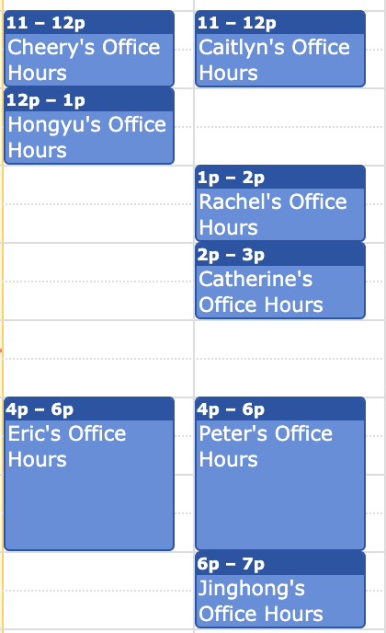
Getting Help
Open lab hours start today! https://ucsd-cse8a-w20.github.io/#staff
We also have office hours
Come chat with us about any questions you have about the course
Keep asking good questions on Canvas! (And check out what your classmates have already asked)

Slide 4
A bit more on course structure (somewhat subject to change)
Weeks 1-1.5ish
A quick introduction to the basics Python: lots of programming ideas, fewer cool applications
Week 1.5-3ish
Some more advanced Python applications, cool applications with data
Week 4
Reapply basics in Java, get used to Java
Weeks 5-10
Applications in Java

Slide 5
Calling a Function
function name
arguments
This entire expression is a function call or a use of a function.
The arguments can also be expressions.
>>> max(4, 5)
5
return value or result or answer from max

Slide 6
Terminology 1
How many function calls are in this expression?
iclicker frequency BA max(len("abcde"), len("z"))
1
2
3
4
More than 4

Slide 7
Terminology 2
Consider this expression: max(len("abcde"), len("z")) What is the first argument to max?
s1
s2
len
None of the above

Slide 8
Function Calls
What will this evaluate to? max(len("abcde"), len("z"))
1
2
3
4
None of the above

Slide 9
Reading input
What does this program do if the user enters hello as input? s = input() louder = s + "!"
It prints out "hello!"
It stores the string "hello!" in s
It stores the string "hello!" in louder
None of the above

Slide 10
Reading input
What does this program do if the user enters 5 as input? s = input() louder = s + "!"
It prints out "5!"
It stores the string "5!" in s
It stores the string "5!" in louder
It ends in an error because numbers and strings can't be added
None of the above

Slide 11
Reading input 2
Which of these programs calculates the sum of two numbers input by the user, and stores the sum in the variable result as a number?
num1 = input() num2 = input() result = int(num1 + num2)
num1 = input() num2 = input() result = num1 + num2
num1 = int(input()) num2 = int(input()) result = num1 + num2
None of these work
More than one of these works

Slide 12
Defining Functions
Demo code on worksheet...

Slide 13
Function Definitions
parameters or argument names
function name
def sum_of_squares(x, y):
return x * x + y * y
required indentation
indicates expression to evaluate + produce from function

Slide 14
Function Design
# sum_of_squares(x, y)
# takes two numbers and returns the sum of
# the two numbers squared
test1 = sum_of_squares(4, 5)
test2 = sum_of_squares(-2, 3)
Communicate to
other humans!
Check (and plan) your work!

Slide 15
Let's Design a Function
# sum_of_lengths(s1, s2)
# takes two strings and returns the sum of
# their lengths

Slide 16
Let's Design a Function From Scratch
Assume it takes about $600 to make a $1000 smartphone. Design a function that takes a number of phones sold and returns the profit made by selling that number of phones.
Which of these is the best choice for the name and arguments of the function?
def profit(cost, revenue):
def profit(phones_sold):
def profit(cost, revenue, phones_sold):
def phones_sold(profit):
All of these have a significant problem

Slide 17
Let's Design a Function From Scratch
Assume it takes about $600 to make a $1000 smartphone. Design a function that takes a number of phones sold and returns the profit made by selling that number of phones.
What are some good tests for this function?

Slide 18
Let's Design a Function From Scratch
Assume it takes about $600 to make a $1000 smartphone. Design a function that takes a number of phones sold and returns the profit made by selling that number of phones.
What should we fill in for the body of the function?

Slide 19
TODO
PA0 (form-filling) due tomorrow (Friday) at 5pm
Stepik 1.1-1.5 due tomorrow (Friday) at 5pm
Get your cse8aw20 account set up!
Go say hi in lab hours if you have any questions
Keep posting good questions on Canvas!
PA1 released later today, due Tuesday!

