Slide 1
Biodiversity in US National Parks
Great Smoky Mountains National Park, Yosemite National Park, Bryce National Park and Yellowstone National Park

Slide 2
Introduction
Observational data from 4 US national parks over 7 consecutive days has been analysed to determine the number and types of species in each and their conservational status.
The parks investigated are: Great Smoky Mountains National Park, Yosemite National Park, Bryce National Park and Yellowstone National Park.
Data sources:
Both Observations.csv and Species_info.csv was provided by Codecademy.com.
Note: The data for this project is inspired by real data, but is mostly fictional.

Slide 3
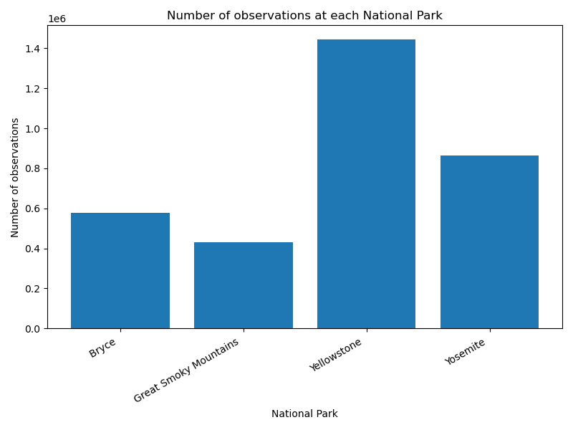
Sightings
Over the 7 day period there were over 3,300,000 sightings of flora and fauna across the 4 national parks
Yellowstone National Park had the most sightings followed by Yosemite, Bryce and Great Smoky Mountain

Slide 4
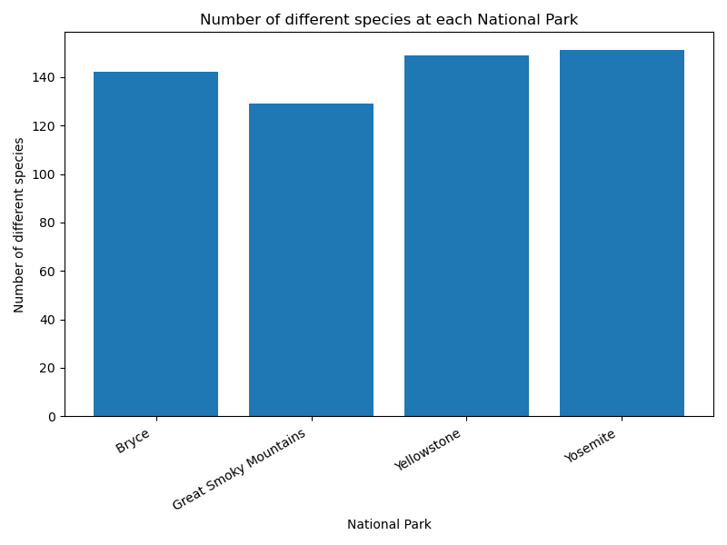
Species
Over the 7 day period 5541 different species of flora and fauna were observed across the 4 national parks
Yellowstone and Yosemite national parks had a similar number of different species whereas Great Smokey Mountain had noticeably less

Slide 5
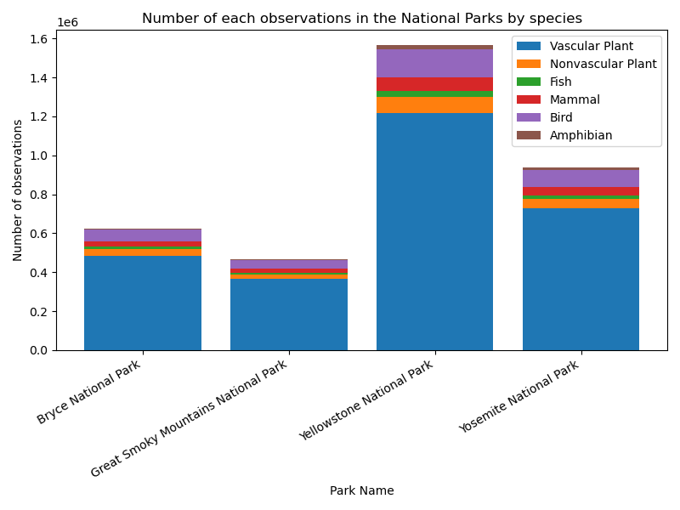
Sightings by species
The majority of species observed across the parks are vascular plants followed by birds.
The proportions of each type of species is consistent across the four parks

Slide 6
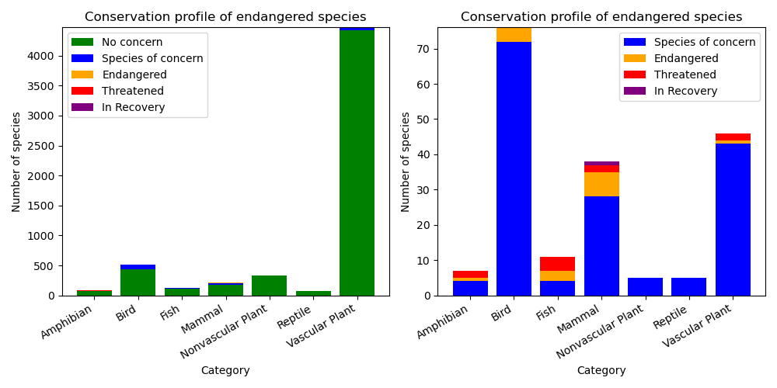
Conservation profile
The vast majority of the flora and fauna observed are not a conservational cause for concern
Birds, mammals and vascular plants have the greatest number of species of concern with mammals also having the most endangered species

Slide 7
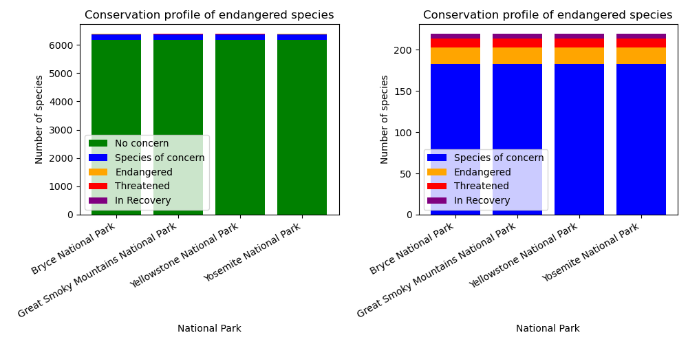
Conservation profile
Each of the parks display a very similar conservation profile with the majority of species (~97%) not being a cause for concern

Slide 8
Conclusions
During a 7-day observational period there have been 3,300,000 sightings of 5541 different flora and fauna across the four US national parks studied
Yellowstone National Park had the most sightings followed by Yosemite, Bryce and Great Smoky Mountain
The majority of species observed are vascular plants followed by birds. This was consistent across each of the parks
The vast majority of the flora and fauna observed (~97%) are not a conservational cause for concern with each with each of the parks displaying a similar conservation status profile
Birds, mammals and vascular plants have the greatest number of species of concern with mammals also having the most endangered species

