Slide 1
What makes a top Olympian?
Data analysis by
Catherine Kelly

Slide 2
Background
The modern Olympics see athletes competing in a wide range of sports. Visually there are numerous differences between athletes such as slight jumpers and powerful weightlifters but what makes Olympians?
This project will aim to investigate various factors that contribute to Olympians and medal winners such as:
Age
Height
Weight
BMI
Hosting the Olympics
Population of country
GDP of country

Slide 3
Background
This work will focus on 5 sports:
Eventing – male athletes only
Men's 100 m
Men's marathon
Men's shot put
Men's high jump

Slide 4
Background
Data was obtained from the following sources:
Olympic and GDP data: Kaggle.com
Population: https://www.jetpunk.com/data/population/countries-by-population/
Data was analysed using Python.
The data was reduced to 2004 to 2016. This was because of a large amount of missing data prior to 2004 and also the pandemic in 2020 affecting data collection and Olympians ability to take part.
The data was also reduced to male athletes only due to the large differences in male and female biometrics impacting on the variability.

Slide 5
Olympians’ biometrics
The following table highlights the biometrics of the competitors
There is a lot a variation between athletes
The youngest and oldest Olympians competed in Diving and Dressage
The shortest and tallest competitors were in Weightlifting and Judo
The lightest and heaviest Olympians competed in Diving and Judo
The lowest BMI and highest BMI Olympians competed in Archery and Judo
Biometric | Mean | Std | Min | Max
Age | 26.7 | 5.6 | 14 | 71
Height | 178.8 | 9.6 | 140 | 210
Weight | 76.0 | 15.9 | 42 | 214
BMI | 23.6 | 3.6 | 14.9 | 63.9

Slide 6
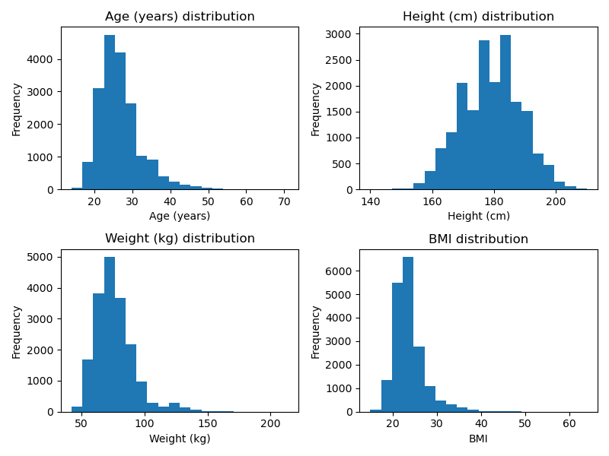
Olympians’ biometrics

Slide 7
Eventing
Biometric | Eventing |  | Olympians |  | p_value
 | Mean | std | Mean | Std
Age | 36.6 | 8.3 | 26.6 | 5.5 | <0.00
Height | 178.8 | 7.1 | 178.8 | 9.6 | 0.98
Weight | 72.1 | 6.6 | 76.1 | 15.9 | <0.00
BMI | 22.5 | 1.5 | 23.7 | 3.7 | <0.00
The following table highlights the biometrics of the competitors

Slide 8
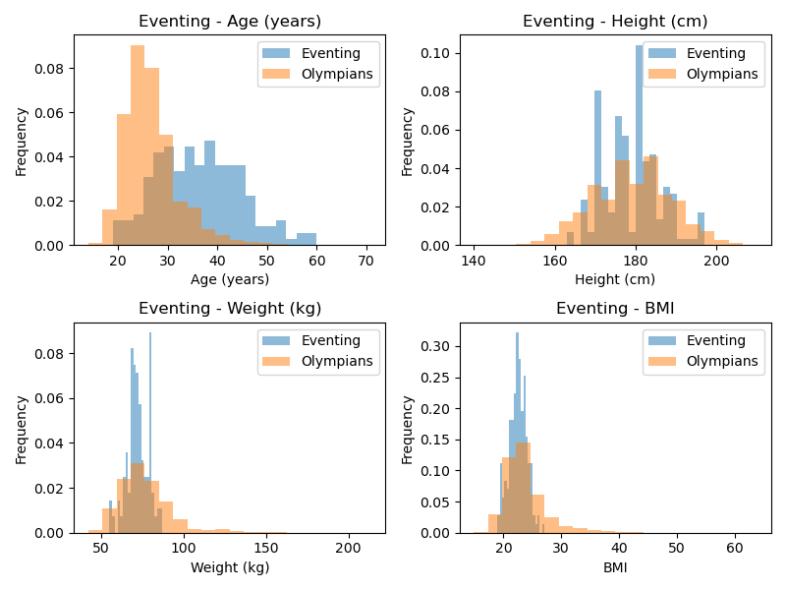
Eventing

Slide 9
Men’s 100 m
Biometric | Men’s 100 m |  | Olympians |  | p_value
 | Mean | std | Mean | Std
Age | 25.4 | 4.2 | 26.7 | 5.6 | <0.00
Height | 177.5 | 7.5 | 178.8 | 9.6 | <0.00
Weight | 75.2 | 8.9 | 76.0 | 15.9 | 0.11
BMI | 23.8 | 2.3 | 23.6 | 3.6 | 0.12
The following table highlights the biometrics of the competitors

Slide 10
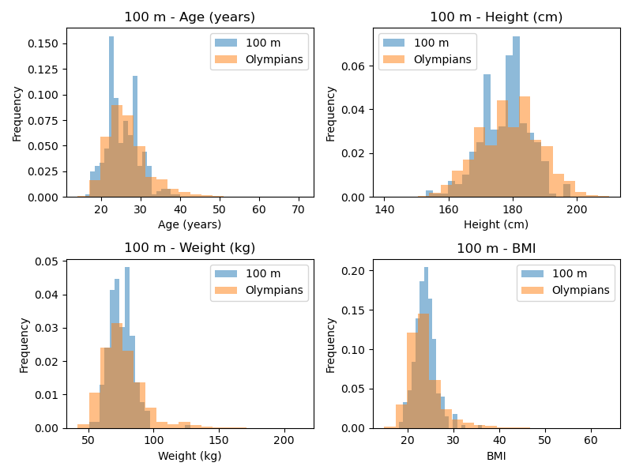
Men’s 100 m

Slide 11
Men’s marathon
Biometric | Men’s marathon |  | Olympians |  | p_value
 | Mean | std | Mean | Std
Age | 30.8 | 4.6 | 26.7 | 5.6 | <0.00
Height | 172.9 | 7.1 | 178.8 | 9.6 | <0.00
Weight | 60.0 | 5.9 | 76.0 | 15.9 | <0.00
BMI | 20.0 | 1.5 | 23.6 | 3.6 | <0.00
The following table highlights the biometrics of the competitors

Slide 12
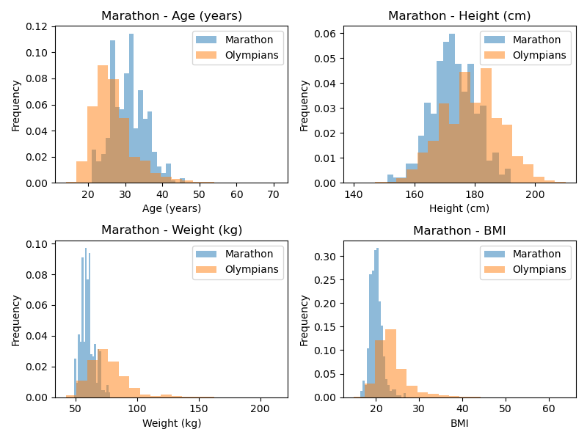
Men’s marathon

Slide 13
Men’s shot put
Biometric | Men’s shot put |  | Olympians |  | p_value
 | Mean | std | Mean | Std
Age | 27.6 | 3.9 | 26.7 | 5.6 | <0.00
Height | 191.7 | 6.5 | 178.8 | 9.6 | <0.00
Weight | 127.0 | 14.3 | 76.0 | 15.9 | <0.00
BMI | 34.6 | 4.0 | 23.6 | 3.6 | <0.00
The following table highlights the biometrics of the competitors

Slide 14
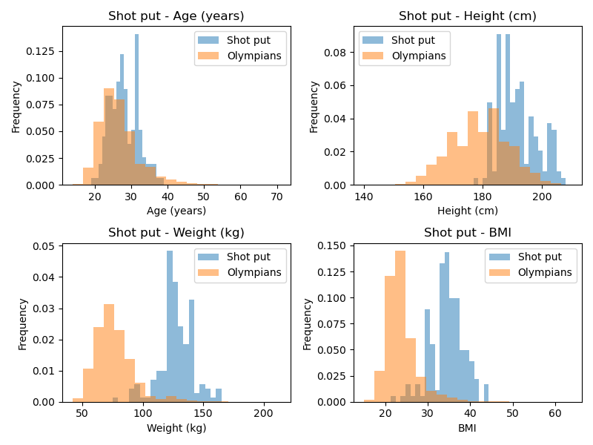
Men’s shot put

Slide 15
Men’s high jump
Biometric | Men’s high jump |  | Olympians |  | p_value
 | Mean | std | Mean | Std
Age (years) | 25.6 | 3.6 | 26.7 | 5.6 | <0.00
Height (cm) | 192.3 | 5.8 | 178.8 | 9.2 | <0.00
Weight (kg) | 76.6 | 6.4 | 76.0 | 15.9 | 0.30
BMI | 20.7 | 1.5 | 23.6 | 3.6 | <0.00
The following table highlights the biometrics of the competitors

Slide 16
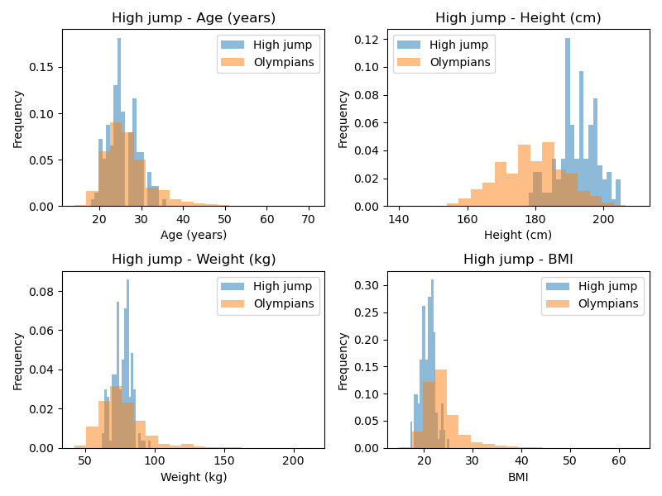
Men’s high jump

Slide 17
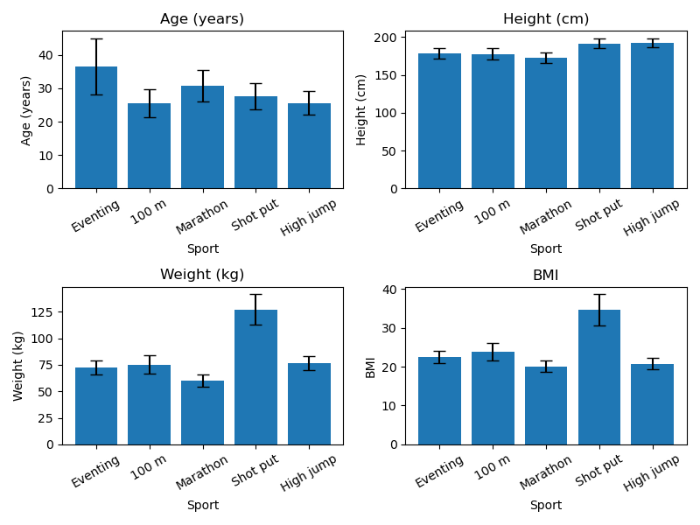
Comparison across selected sports

Slide 18
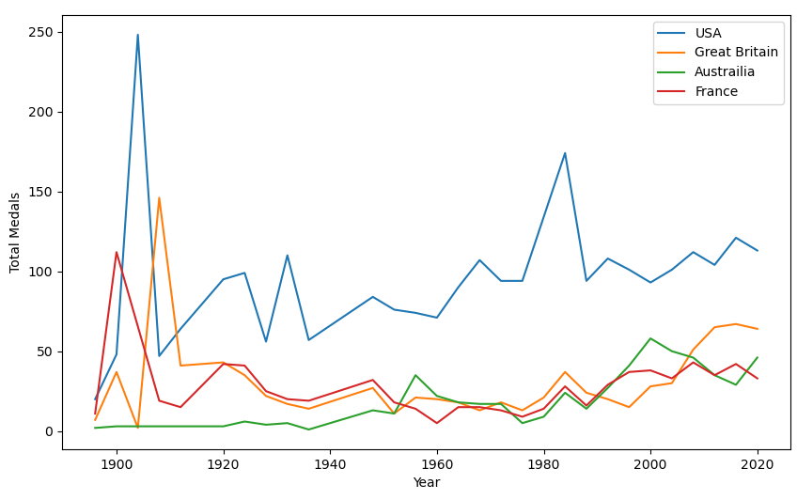
Effect of hosting country – Total medals
St Louis, USA
LA, USA
London, GB
Paris, France
LA, USA
Mexico City, USA
Atlanta, USA
Sydney, Australia
London UK
Paris, France
London, GB
Melbourne, Australia

Slide 19
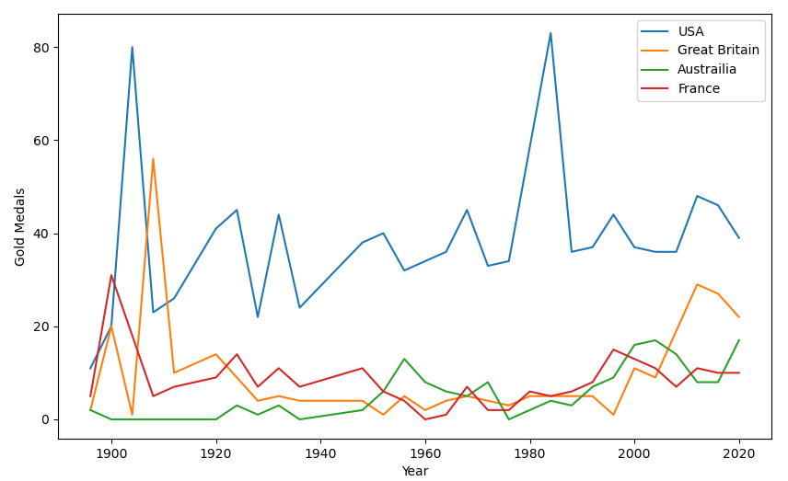
Effect of hosting country – Gold medals
St Louis, USA
LA, USA
London, GB
LA, USA
Mexico City, USA
Atlanta, USA
Paris, France
London UK
Sydney, Australia
Paris, France
Melbourne, Australia
London, GB

Slide 20
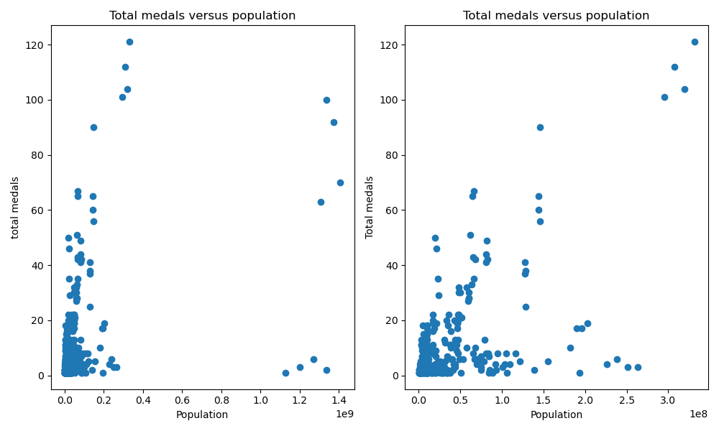
Does population affect total medals?
Pearson correlation = 0.41
Pearson correlation = 0.59

Slide 21
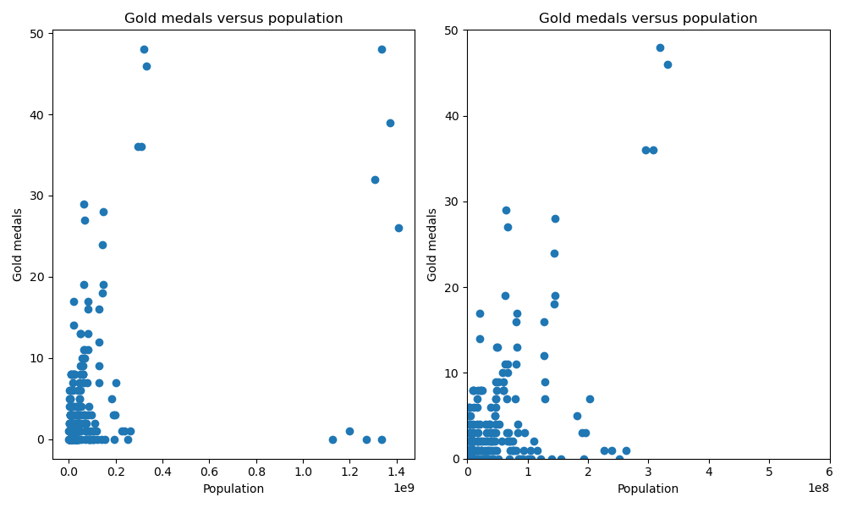
Does population affect gold medals?
Pearson correlation = 0.46
Pearson correlation = 0.58

Slide 22
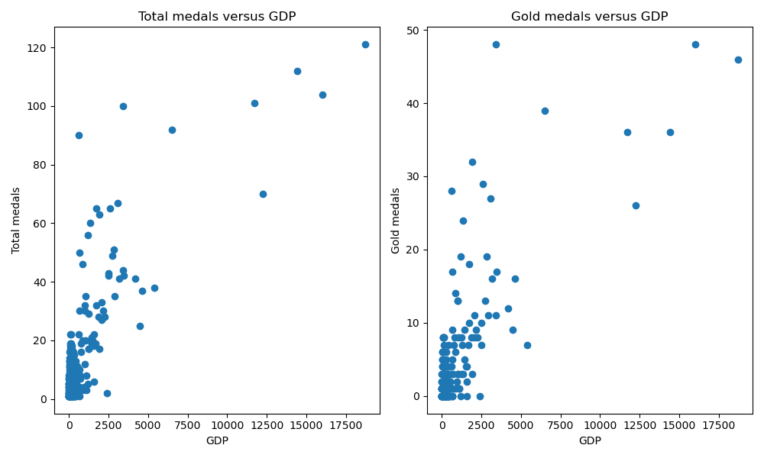
Does GDP affect total and gold medals?
Pearson correlation = 0.80
Pearson correlation = 0.79

