Slide 1
What makes a top Olympian?
Data analysis by
Catherine Kelly

Slide 2
Background
The modern Olympics sees athletes competing in a wide range of sports
Visually, there are numerous differences between athletes such as slight jumpers and powerful weightlifters but what makes Olympians?
This project aims to investigate various factors that contribute to Olympians and medal winners such as:
Age
Height
Weight
BMI
Hosting the Olympics
Population of country
GDP of country

Slide 3
Background
This work will focus on 5 sports:
Eventing – male athletes only
Men's 100 m
Men's marathon
Men's shot put
Men's high jump

Slide 4
Background
Data was obtained from the following sources:
Olympic and GDP data: Kaggle.com
Population: https://www.jetpunk.com/data/population/countries-by-population/
Data was analysed using Python.
The data was reduced to between 2004 and 2016 as there is a large amount of missing data prior to 2004. In addition, the COVID pandemic in 2020 affected data collection
The data was also reduced to male athletes only due to the large differences in male and female biometrics creating greater variability

Slide 5
Olympians’ biometrics
The following table highlights the biometrics stats of the competitors
There is a lot a variation between athletes
The youngest and oldest Olympians competed in Diving and Dressage
The shortest and tallest competitors were in Weightlifting and Judo
The lightest and heaviest Olympians competed in Diving and Judo
The lowest BMI and highest BMI Olympians competed in Archery and Judo
Biometric | Mean | Std | Min | Max
Age | 26.7 | 5.6 | 14 | 71
Height | 178.8 | 9.6 | 140 | 210
Weight | 76.0 | 15.9 | 42 | 214
BMI | 23.6 | 3.6 | 14.9 | 63.9

Slide 6
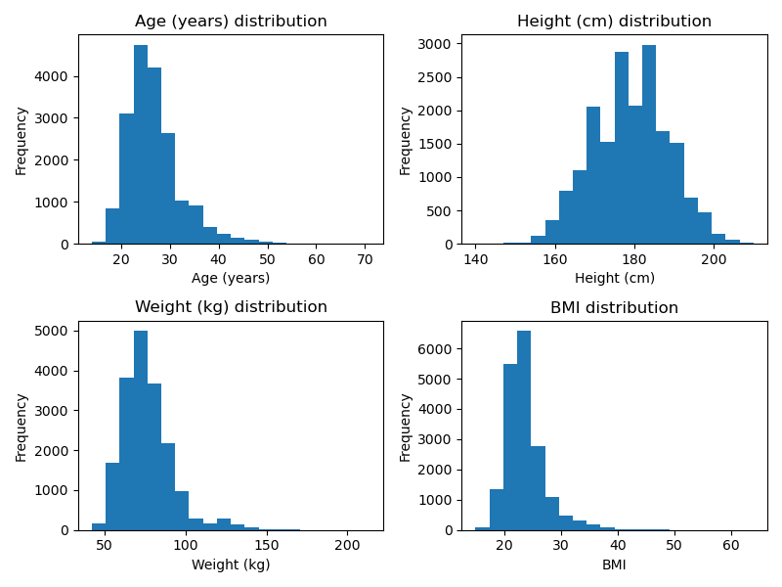
Olympians’ biometrics - distribution

Slide 7
Eventing
Biometric | Eventing |  | Olympians |  | p_value
 | Mean | std | Mean | Std
Age | 36.6 | 8.3 | 26.6 | 5.5 | <0.00
Height | 178.8 | 7.1 | 178.8 | 9.6 | 0.98
Weight | 72.1 | 6.6 | 76.1 | 15.9 | <0.00
BMI | 22.5 | 1.5 | 23.7 | 3.7 | <0.00
Statistical analysis showed that the competitors in eventing were older and lighter than the average Olympian with a lower BMI
This is likely due to eventing requiring a wide depth of knowledge, that comes with age and experience, rather than speed or strength

Slide 8
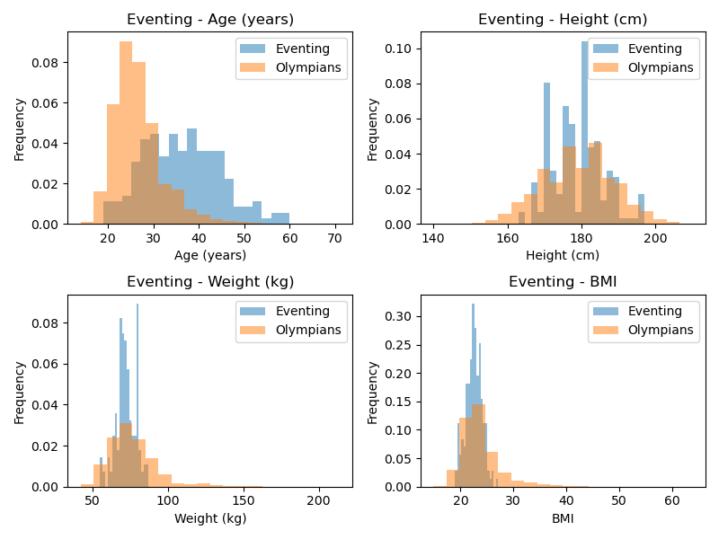
Eventing

Slide 9
Men’s 100 m
Biometric | Men’s 100 m |  | Olympians |  | p_value
 | Mean | std | Mean | Std
Age | 25.4 | 4.2 | 26.7 | 5.6 | <0.00
Height | 177.5 | 7.5 | 178.8 | 9.6 | <0.00
Weight | 75.2 | 8.9 | 76.0 | 15.9 | 0.11
BMI | 23.8 | 2.3 | 23.6 | 3.6 | 0.12
Participants in the men’s 100 m were found to be statistically younger and shorter than the average Olympian

Slide 10
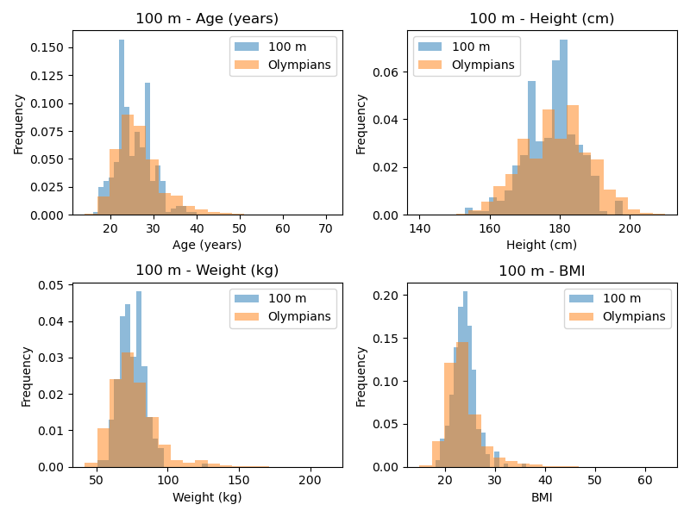
Men’s 100 m

Slide 11
Men’s marathon
Biometric | Men’s marathon |  | Olympians |  | p_value
 | Mean | std | Mean | Std
Age | 30.8 | 4.6 | 26.7 | 5.6 | <0.00
Height | 172.9 | 7.1 | 178.8 | 9.6 | <0.00
Weight | 60.0 | 5.9 | 76.0 | 15.9 | <0.00
BMI | 20.0 | 1.5 | 23.6 | 3.6 | <0.00
Marathon Olympians were older, shorter and lighter than the average Olympian which also led to a lower BMI
This is likely because marathons require endurance rather than power so smaller athletes are at an advantage

Slide 12
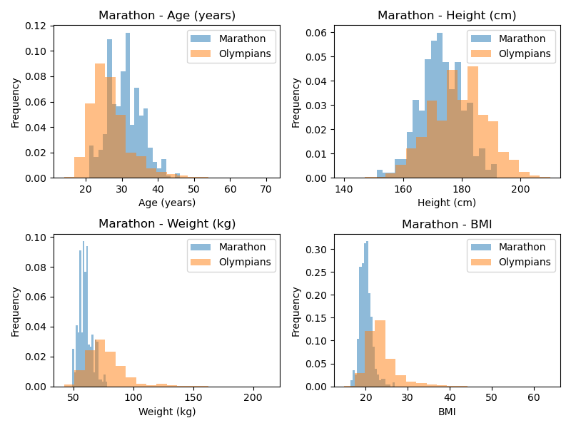
Men’s marathon

Slide 13
Men’s shot put
Biometric | Men’s shot put |  | Olympians |  | p_value
 | Mean | std | Mean | Std
Age | 27.6 | 3.9 | 26.7 | 5.6 | <0.00
Height | 191.7 | 6.5 | 178.8 | 9.6 | <0.00
Weight | 127.0 | 14.3 | 76.0 | 15.9 | <0.00
BMI | 34.6 | 4.0 | 23.6 | 3.6 | <0.00
Shot put athletes were found to be older, taller and heavier than the average Olympian with a higher BMI
This is because shot put requires a lot of strength and power and therefore a more muscular body. In addition, a greater height enables a longer flight time.

Slide 14
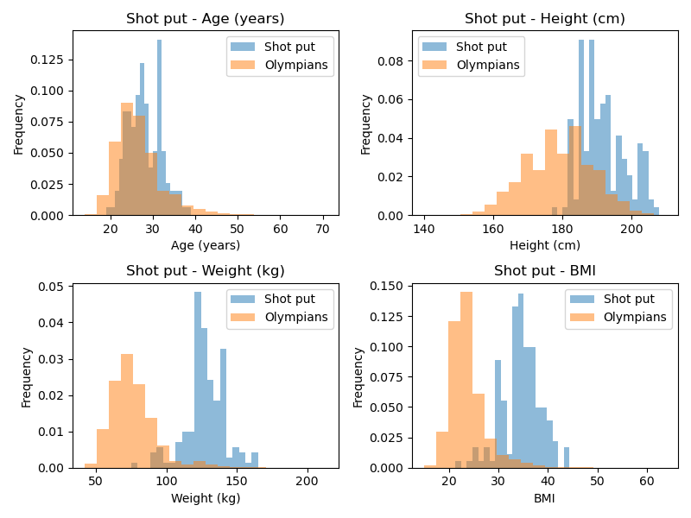
Men’s shot put

Slide 15
Men’s high jump
Biometric | Men’s high jump |  | Olympians |  | p_value
 | Mean | std | Mean | Std
Age (years) | 25.6 | 3.6 | 26.7 | 5.6 | <0.00
Height (cm) | 192.3 | 5.8 | 178.8 | 9.2 | <0.00
Weight (kg) | 76.6 | 6.4 | 76.0 | 15.9 | 0.30
BMI | 20.7 | 1.5 | 23.6 | 3.6 | <0.00
High jumpers are younger, taller and have a lower BMI that the average Olympian
Taller athletes have an advantage in the high jump as their centre of gravity is higher.

Slide 16
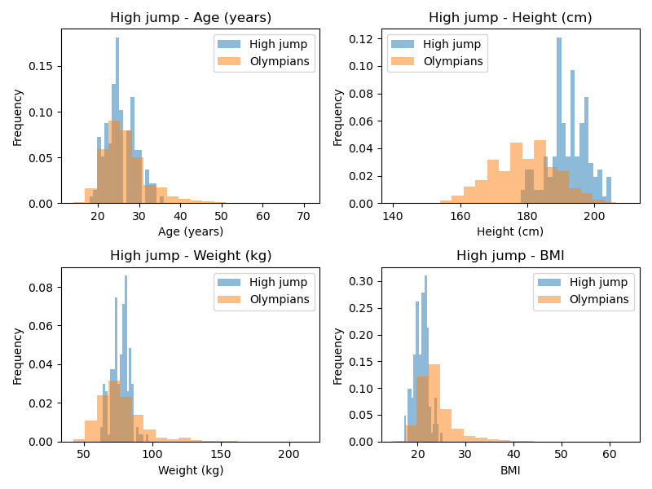
Men’s high jump

Slide 17
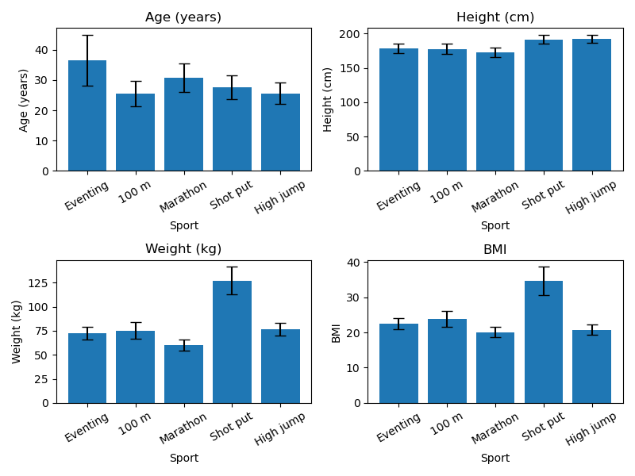
Comparison across selected sports

Slide 18
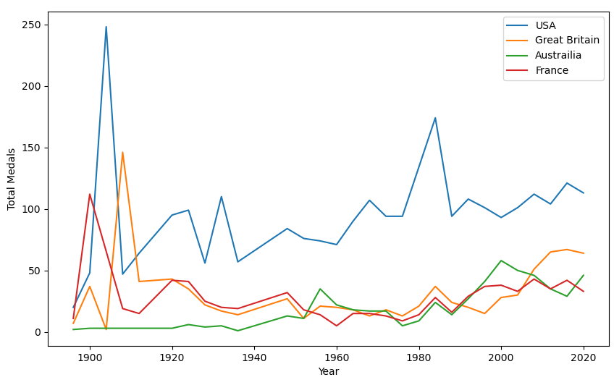
Effect of hosting country – Total medals
A peak in medal count was observed for the hosting country
St Louis, USA
LA, USA
London, GB
Paris, France
LA, USA
Mexico City, USA
Atlanta, USA
Sydney, Australia
London UK
Paris, France
London, GB
Melbourne, Australia

Slide 19
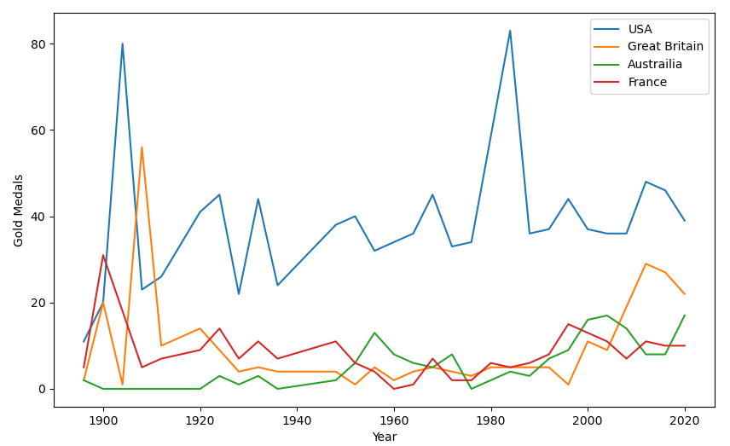
Effect of hosting country – Gold medals
A peak in gold medal count was observed for the hosting country
St Louis, USA
LA, USA
London, GB
LA, USA
Mexico City, USA
Atlanta, USA
Paris, France
London UK
Sydney, Australia
Paris, France
Melbourne, Australia
London, GB

Slide 20
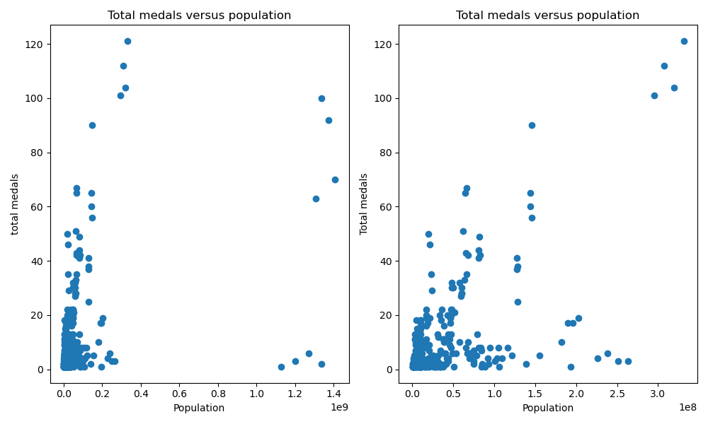
Does population affect total medals?
A positive correlation was found between the total number of medals and population
Outliers are the People’s Republic of China and India
Removal of these improved the correlation
Pearson correlation = 0.41
Pearson correlation = 0.59

Slide 21
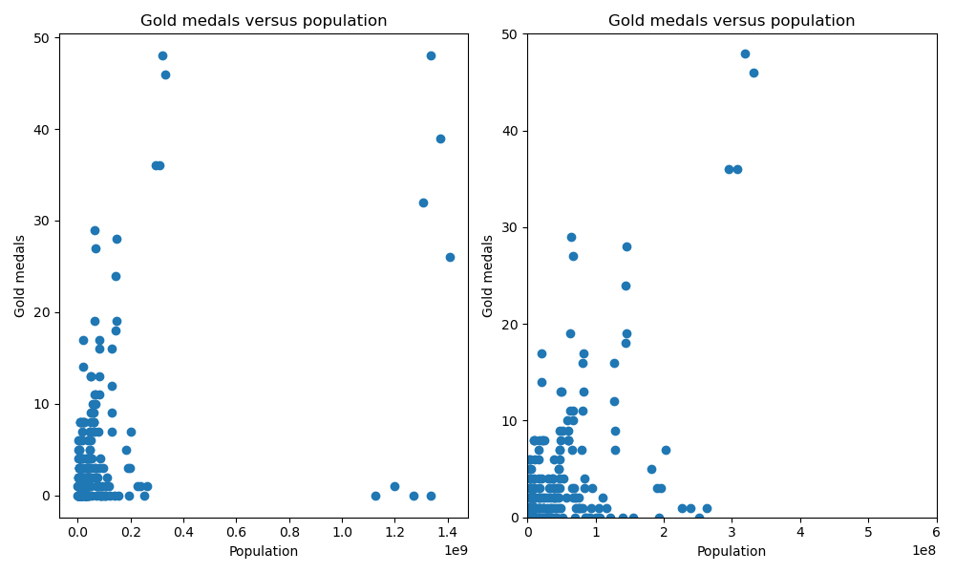
Does population affect gold medals?
A positive correlation was found between the total number of gold medals and population
Outliers are the People’s Republic of China and India
Removal of these improved the correlation
Pearson correlation = 0.46
Pearson correlation = 0.58

Slide 22
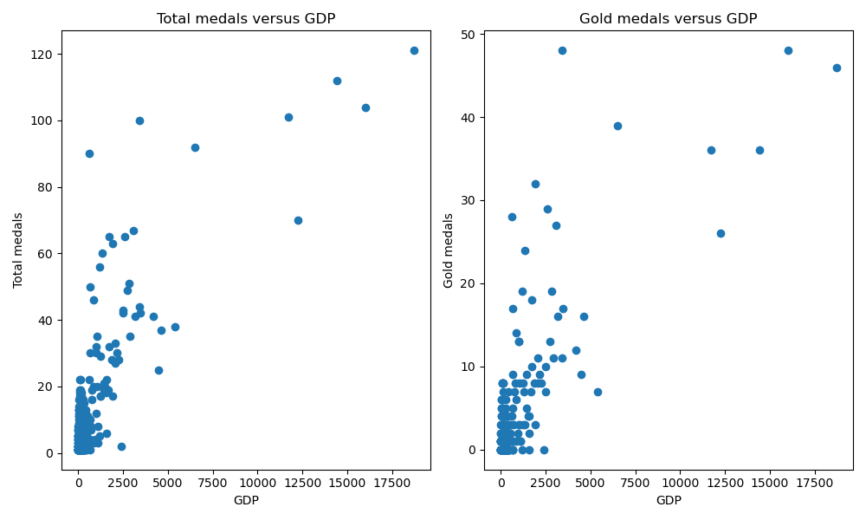
Does GDP affect total and gold medals?
A positive correlation was found between the total number of medals and gold medals and GDP
Pearson correlation = 0.80
Pearson correlation = 0.79

Slide 23
Conclusions
Different sports require different athlete biometrics
The chance of winning a medal is increased if the Olympics is being held in your Country
Countries with larger populations and / or GDP are more successful at winning medals.

