Slide 1
Accuracy Assessment

Slide 2
The Error Matrix
Error matrix for a 5-class classification
Reference Map
No. Pixels Classified as
Class
No. Pixels
Crops
Forest
Wetland
Water
Urban
Crops
120
100
9
3
--
8
Forest
150
15
105
7
3
20
Wetland
80
5
6
60
5
4
Water
90
--
1
2
84
3
Urban
60
1
2
1
1
55
Total
500
121
123
73
93
90
Overall Accuracy = (100 + 105 + 60 + 84 + 55) / 500 = 404 / 500 = 81%

Slide 3
The Error Matrix
The starting point for a series of descriptive and statistical techniques to evaluate accuracy
An N x N matrix where N = number of classes
Compares classified (or interpreted) data to reference data classes
Row totals = number of pixels in the reference data
Column totals = number of pixels assigned to each class
Diagonal elements show agreement between reference data and the classification (i.e., correct classification)
Rows include errors of omission
Columns include errors of commission

Slide 4
Terminology
Type I error (applying the wrong label)
False positive
Commission error
Reduced user’s accuracy
Reduced “Precision”
Type II error (failing to apply the correct label)
False negative
Omission error
Reduced producer’s accuracy
Reduced “Recall”

Slide 5
Commission and Omission Errors

Slide 6
Producer’s and User’s Accuracies
User’s accuracy considers commission errors
Producer’s accuracy considers omission errors

Slide 7
Kappa Statistic
Over the past 15 years the Kappa statistic has become a standard part of evaluating classification accuracy
Based on agreement between the classification and reference data (the diagonal) and chance agreement (the row and column totals or marginals)
In other words, Kappa is a measure of agreement adjusted for chance agreement
Observed Accuracy - Expected Accuracy
1 – Expected Accuracy
Kappa =

Slide 8
Calculation of Expected Agreement by Chance
Row Marginals
Column Marginals
Products of Row x Column Marginals

Slide 9
Calculation of Kappa
“Observed” correct = the overall accuracy
Expected agreement by chance
Kappa Statistic
= 404 / 500 = 0.81
= sum of diagonal / grand total
= 52,580 / 250,000
= 0.21
= Observed - Expected / 1 - Expected
= (0.81 - 0.21) / (1 - 0.21)
= 0.69 / 0.79
= 0.76
= 76% better than chance agreement

Slide 10
Kappa Summary
Although it is now commonly used, newer thinking suggests that adjusting for chance agreement is unnecessary for evaluating accuracy
The map is the map and each pixel is either correctly or incorrectly classified
In reality there is no way to know which pixels were correctly classified by chance (as opposed to “skill”)
In other words, Kappa may be more a theoretical measure than a practical one.

Slide 11
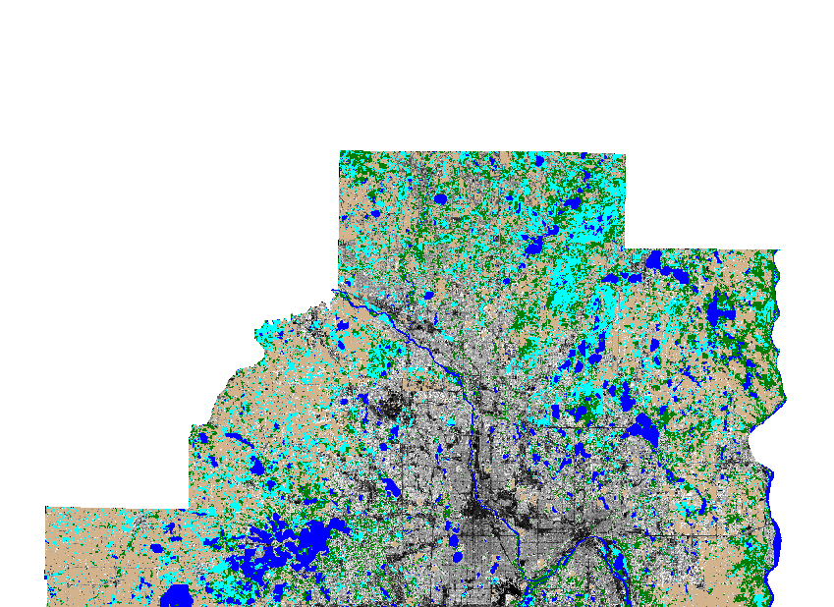
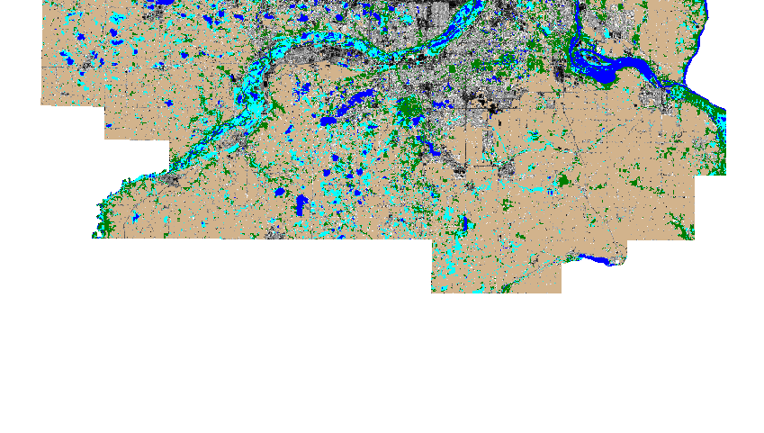
Cultivated
Forest
Landsat Classification of
Twin Cities Metro Area
Land Cover
Shrub & Herbaceous
Water
Urban – % Impervious
0
100
Now, how accurate is this classification?
Miles
0
4.5
9
18
27
36

Slide 12
Error Matrix and Classification Accuracy for Landsat Classification of Twin Cities Metro Area
Ref. Class | No. Pixels Classified as |  |  |  |  | Total | Prod. Acc. (%)
 | Urban | Cult. | Forest | Shrub & Herb. | Water
Urban | 1250 | 46 | 5 | 0 | 2 | 1303 | 95.9
Cult. | 23 | 1717 | 20 | 0 | 0 | 1760 | 97.6
Forest | 3 | 7 | 496 | 0 | 1 | 507 | 97.8
Shrub & Herb. | 3 | 77 | 33 | 522 | 5 | 640 | 81.6
Water | 0 | 0 | 1 | 0 | 263 | 264 | 99.6
Total | 1279 | 1847 | 555 | 522 | 271 | 4474
User Acc. (%) | 97.7 | 93.0 | 89.4 | 100.0 | 97.0 |  | 94.9
Overall accuracy = 94.9%
Kappa statistic = 93

Slide 13
Concluding Thoughts….
Accuracy assessment is critical to inventory, mapping and monitoring projects
No project should be considered complete without an evaluation of its accuracy
The same techniques can be applied equally well to aerial photography and photo interpretation
Must be well planned and statistically valid
Should be reported as an error matrix and associated statistics
It’s expensive -- so budget for it

