Slide 1


Welcome to 2017 Ocean Optics Class SMS 598: Calibration and Validation for Ocean Color Remote Sensing, 10 July – August 4th 2017
Instructors: Emmanuel Boss – UMaine
Curt Mobley – Sequoia Scientific Collin Roesler – Bowdoin College Ken Voss – U. Miami
Jeremy Werdell, Ivona Cetinic – NASA Goddard
TA: Nils Haentjens– UMaine
+Help from: Jordan Snyder, Ali Chase, Jim Loftin – UMaine
John Hedley – Numerical Optics Ltd.
Sean Bailey – NASA Goddard
http://misclab.umeoce.maine.edu/OceanOpticsClass2017/

Slide 2
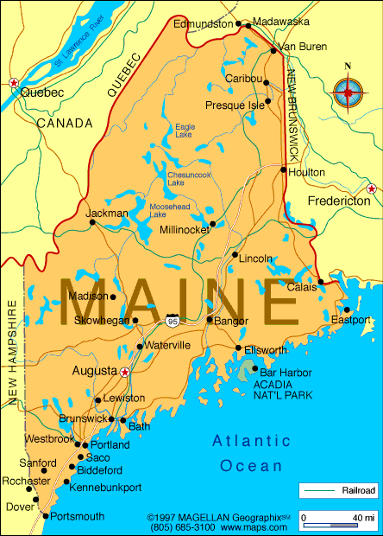
Welcome to Maine
Maine facts:
Population (2016): 1.33 million
Coastline: 5300 miles
Area: 35,387 miles² + 4,523 miles² of inland waters.
Seasons: Tourist, Foliage, Ski, & Mud (some further subdivide it according to prevaling pests).
Welcome to Maine

Slide 3
History of the Ocean Optics class
1985, 1987, 1989, 1995, 1998, 2001, 2004, 2007, 2011, 2013, 2015 and now 2017. This is 12th class in 32 years.
Mary Jane Perry and Ken Carder started the course in 1985, Friday Harbor Lab;
Collin Roesler was student in 1987, TAed in 1989, joined as an instructor in 1995.
Curt Mobley joined as an instructor in 1995.
Emmanuel Boss was student 1995, joined as an instructor in 1998.
Ivona Cetinic was a student in 2004, joined as an instructor in 2013.
Jeremy Werdell & Ken Voss joined as instructors in 2011.
O(190) graduates, including Paula Bontempi at NASA
Many graduates are leaders in their fields: Ray Najjar, Dennis McGillicuddy, Joaquim Goes and Heidi Sosik, to name a few.

Slide 4
History of the Ocean Optics class
1985, 1987, 1989, 1995, 1998, 2001, 2004, 2007, 2011, 2013, 2015 and now 2017. This is 12th class in 32 years.
Evolution and highlights:
1985: 1 spectrophotometer, 1 PAR light sensor, a version 1 in situ spectral transmissometer (2 meters long), a Turner benchtop fluorometer
1987: 1 Mac II computer with floppy drive, a borrowed Flow Cytometer
1989: ONR-sponsored symposium and book
1995: Hydrolight modeling
1998: Hyper-spectral overflights. Special Ocean Sciences session.
2001: Moved from Friday Harbor Lab (U Washington) to DMC, U Maine.
2007: Ocean Optics Web book (http://www.oceanopticsbook.info/)

Slide 5
Key to the Class’s Success –
Requirement for team work, each with his/her own focus.
Collaborative environment. Learning community.
Networking. Contribute to advancement of ocean
sciences through ocean optics.
First two weeks: animated lectures in morning; related lab in afternoon covering basic concept (e.g. NPQ), use of instruments and their calibration. Strong emphasis on relating optical signal to biogeochemical properties, critical thinking, calibration, critical analysis of data, hands-on experience.
Cruise experience: collecting data in the field and processing it; learning how to submit documented data to SeaBASS.

Slide 6
Logistics: safety, internet, meals, linen, Maine activities, etcetera Tim Miller – lab administrator Linda Healy – events coordinator
Course schedule and syllabus
Daily student reporting and summary of previous day’s lab
Saturday morning – more on Student projects

Slide 7
INTRODUCTIONS – work with a fellow student over lunch; introduce that students to the class after lunch NAME of person you are introducing: WHERE she or he comes from (state/country and school or institution): THE PAST – something about the person’s background that resulted in him/her being in this course: THE FUTURE – something about her/his future plans, that he/she hopes the course will help in achieving: THE PRESENT – something that she/he wants to get of this course and how everyone else can contribute to this experience (it might be asking for help in something challenging): THE UNEXPECTED – something that we would never guess about the person’s activities, skills, or interests:

Slide 8
satellite
radiometry
The motivation
In-water
optical
properties;
surrogates
real entity
(cell, POC, etc.)
The optics problem
ecosystem;
carbon cycle;
climate system;
fisheries;
HABs; etc.

Slide 9
Sampling strategy must include appropriate spatial/temporal scales.
Understanding
marine biogeochemical cycles and ecosystems
on regional-to-global scales requires calibrated, validated satellite ocean color data.
Successful satellite cal/val depends on high quality, in-water measurements.
Use measurement – measurement closure and measurements – model closure to reduce uncertainty.

