Slide 1

When do people trust an algorithm?
CONFERENCE NAME · 2026
Ranran Li
Max Planck Institute for the Study of Crime, Security and Law
Three online experiments on explanations and advice-taking

Slide 2
Today
OVERVIEW
01
02
The puzzle
Three experiments
Aversion and appreciation
N = 3,412 online
03
04
What we found
What it means
Reasons raise advice-taking
For design and policy

Slide 3
The puzzle
SECTION 01
Why do people follow some algorithms and ignore others?
01. The puzzle | 02. Three experiments | 03. What we found | 04. What it means

Slide 4
Two findings that don’t fit together
01 · THE PUZZLE
A
AVERSION
B
APPRECIATION
People abandon algorithms after seeing them err
People prefer algorithmic to human advice
After watching a forecasting algorithm make mistakes, people chose it less often, even when it still outperformed a human forecaster.
In estimation and forecasting tasks, people weighted advice more when they thought it came from an algorithm than from a person.
Dietvorst, Simmons & Massey (2015)
Logg, Minson & Moore (2019)

Slide 5
Our predictions
02 · THREE EXPERIMENTS
H1
Advice that explains its reasoning is followed more often.
H2
A confidence score adds to the effect of the reasons.
H3
The effect holds after people see the algorithm err.

Slide 6
How each session ran
02 · THREE EXPERIMENTS
STEP 1
STEP 2
STEP 3
STEP 4
Consent and demographics
Practice trials
Advice task, 24 trials
Debrief
2 min
5 min
15 min
3 min

Slide 7
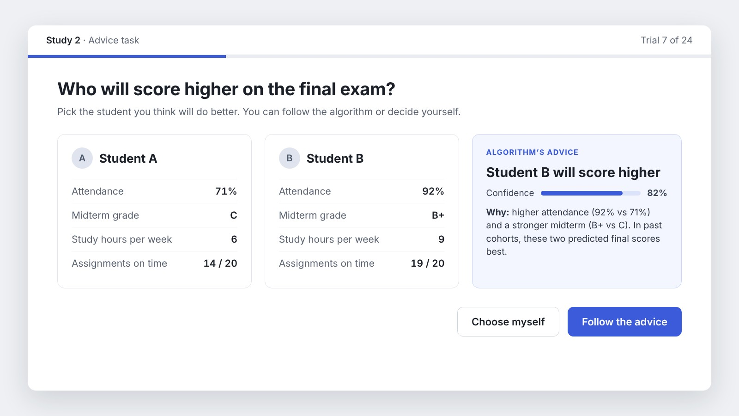
What participants saw
02 · THREE EXPERIMENTS
Figure 2.
The advice screen in the Reasons + confidence condition. On each trial, participants followed the recommendation or chose for themselves.

Slide 8
03 · WHAT WE FOUND
68%
of choices followed the algorithm when it explained its reasoning
Reasons + confidence
68%
No explanation
41%
Study 2, N = 1,204 · sample data

Slide 9
Each layer of explanation raised advice-taking
03 · WHAT WE FOUND
% of trials on which the advice was followed

Slide 10
Mixed-effects logistic regression
03 · WHAT WE FOUND
PREDICTOR | b | SE | p
Reasons (vs none) | 0.94 | 0.12 | < .001
Confidence score | 0.41 | 0.11 | < .001
Reasons × confidence | 0.18 | 0.15 | .23
Error observed | −0.62 | 0.14 | < .001
Random intercepts for participants and items. Sample data.

Slide 11
03 · WHAT WE FOUND
I’d follow it if it told me why.
— Participant 214, open response (sample)

Slide 12
References
FURTHER READING
Burton, J. W., Stein, M.-K., & Jensen, T. B. (2020). A systematic review of algorithm aversion in augmented decision making. Journal of Behavioral Decision Making, 33(2), 220–239.
Castelo, N., Bos, M. W., & Lehmann, D. R. (2019). Task-dependent algorithm aversion. Journal of Marketing Research, 56(5), 809–825.
Dietvorst, B. J., Simmons, J. P., & Massey, C. (2015). Algorithm aversion: People erroneously avoid algorithms after seeing them err. Journal of Experimental Psychology: General, 144(1), 114–126.
Logg, J. M., Minson, J. A., & Moore, D. A. (2019). Algorithm appreciation: People prefer algorithmic to human judgment. Organizational Behavior and Human Decision Processes, 151, 90–103.

Slide 13
Thank you
Questions?
Explore → Create → Build.
r.li@csl.mpg.de
ranranli.net

