Slide 1

When do people trust an algorithm?
CONFERENCE NAME · 2026
Three online experiments on explanations and advice-taking
Speaker Name
Department of Psychology, University Name

Slide 2
Today
01
The puzzle
Aversion and appreciation
02
Three experiments
N = 3,412 online
03
What we found
Reasons raise advice-taking
04
What it means
For design and policy

Slide 3
The puzzle
01
Why do people follow some algorithms and ignore others?

Slide 4
Two findings that don’t fit together
AVERSION
APPRECIATION
People abandon algorithms after seeing them err
People prefer algorithmic to human advice
After watching a forecasting algorithm make mistakes, people chose it less often, even when it still outperformed a human forecaster.
In estimation and forecasting tasks, people weighted advice more when they thought it came from an algorithm than from a person.
Dietvorst, Simmons & Massey (2015)
Logg, Minson & Moore (2019)

Slide 5
Our predictions
H1
Advice that explains its reasoning is followed more often.
H2
A confidence score adds to the effect of the reasons.
H3
The effect holds after people see the algorithm err.

Slide 6
How each session ran
1
2
3
4
Consent and demographics
Practice trials
Advice task, 24 trials
Debrief
2 min
5 min
15 min
3 min

Slide 7
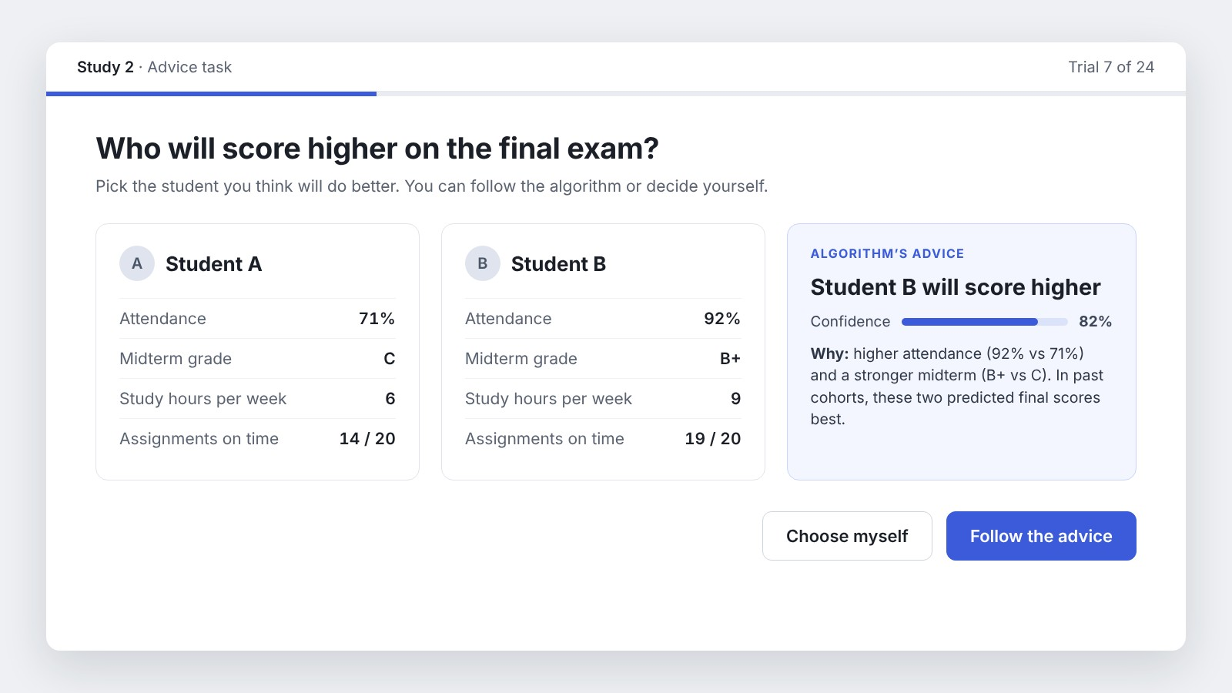
What participants saw
Figure 2
The advice screen in the Reasons + confidence condition. On each trial, participants followed the recommendation or chose for themselves.

Slide 8
68%
of choices followed the algorithm when it explained its reasoning
vs 41% with no explanation
Study 2, N = 1,204 · sample data

Slide 9
Each layer of explanation raised advice-taking
% of trials on which the advice was followed

Slide 10
Mixed-effects logistic regression
Predictor | b | SE | p
Reasons (vs none) | 0.94 | 0.12 | < .001
Confidence score | 0.41 | 0.11 | < .001
Reasons × confidence | 0.18 | 0.15 | .23
Error observed | −0.62 | 0.14 | < .001
Random intercepts for participants and items. Sample data.

Slide 11
I’d follow it if it told me why.
Participant 214, open response (sample)

Slide 12
References
Burton, J. W., Stein, M.-K., & Jensen, T. B. (2020). A systematic review of algorithm aversion in augmented decision making. Journal of Behavioral Decision Making, 33(2), 220–239.
Castelo, N., Bos, M. W., & Lehmann, D. R. (2019). Task-dependent algorithm aversion. Journal of Marketing Research, 56(5), 809–825.
Dietvorst, B. J., Simmons, J. P., & Massey, C. (2015). Algorithm aversion: People erroneously avoid algorithms after seeing them err. Journal of Experimental Psychology: General, 144(1), 114–126.
Logg, J. M., Minson, J. A., & Moore, D. A. (2019). Algorithm appreciation: People prefer algorithmic to human judgment. Organizational Behavior and Human Decision Processes, 151, 90–103.

Slide 13
Thank you
Questions?
speaker@university.edu
yourlab.org

