Slide 1
When do people trust an algorithm?
Conference Name · 2026
Three online experiments on explanations and advice-taking
Speaker Name¹
¹ Department of Psychology, University Name
Notes:
Title page. Highlight a word with Format > Font > Highlight (PowerPoint) or the text colour well's highlight option (Keynote).

Slide 2
Contents
1
The puzzle
3
Aversion and appreciation
2
Three experiments
6
N = 3,412 online
3
What we found
8
Reasons raise advice-taking
4
What it means
11
For design and policy

Slide 3
The puzzle
1.
Why do people follow some algorithms and ignore others?

Slide 4
Two findings that don’t fit together
1.1 Algorithm aversion
1.2 Algorithm appreciation
People abandon algorithms after seeing them err. After watching a forecasting algorithm make mistakes, people chose it less often, even when it still outperformed a human forecaster (Dietvorst, Simmons & Massey, 2015).
People prefer algorithmic to human advice. In estimation and forecasting tasks, people weighted advice more when they thought it came from an algorithm than from a person (Logg, Minson & Moore, 2019).

Slide 5
Hypotheses
H1.
Advice that explains its reasoning is followed more often.
H2.
A confidence score adds to the effect of the reasons.
H3.
The effect holds after people see the algorithm err.

Slide 6
Procedure
1
2
3
4
0
5
10
15
20
25
Minutes from start
1
Consent and demographics
2
Practice trials
3
Advice task, 24 trials
4
Debrief
2 min
5 min
15 min
3 min
Fig. 1 | Session procedure. Each session ran online and took about 25 minutes.

Slide 7
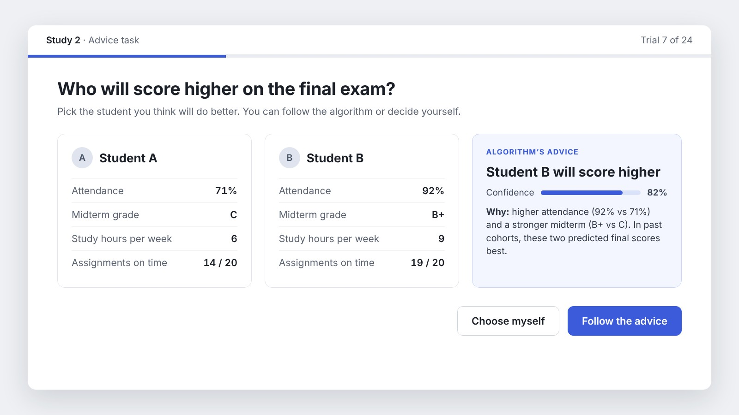
What participants saw
Fig. 2 | The advice screen.
The advice screen in the Reasons + confidence condition. On each trial, participants followed the recommendation or chose for themselves.

Slide 8
68%
of choices followed the algorithm when it explained its reasoning
vs 41% with no explanation
Study 2, N = 1,204; sample data.

Slide 9
Each layer of explanation raised advice-taking
% of trials
Fig. 3 | Advice-taking by condition. Percentage of trials on which participants followed the advice. Sample data.

Slide 10
Mixed-Effects Logistic Regression Predicting Advice-Taking
Table 1
Predictor | b | SE | p
Reasons (vs none) | 0.94 | 0.12 | < .001
Confidence score | 0.41 | 0.11 | < .001
Reasons × confidence | 0.18 | 0.15 | .23
Error observed | −0.62 | 0.14 | < .001
Note. Random intercepts for participants and items. Sample data.

Slide 11
“
I’d follow it if it told me why.
— Participant 214, open response (sample)

Slide 12
References
Burton, J. W., Stein, M.-K., & Jensen, T. B. (2020). A systematic review of algorithm aversion in augmented decision making. Journal of Behavioral Decision Making, 33(2), 220–239.
Castelo, N., Bos, M. W., & Lehmann, D. R. (2019). Task-dependent algorithm aversion. Journal of Marketing Research, 56(5), 809–825.
Dietvorst, B. J., Simmons, J. P., & Massey, C. (2015). Algorithm aversion: People erroneously avoid algorithms after seeing them err. Journal of Experimental Psychology: General, 144(1), 114–126.
Logg, J. M., Minson, J. A., & Moore, D. A. (2019). Algorithm appreciation: People prefer algorithmic to human judgment. Organizational Behavior and Human Decision Processes, 151, 90–103.

Slide 13
Thank you.
Questions?
Author note
Correspondence concerning this talk should be addressed to Speaker Name, Department of Psychology, University Name. Email: speaker@university.edu

