Slide 1



Module 6: Final Project
Exploring Content Trends and User Preferences through Data Analysis of Netflix
Data Mining Applications
Northeastern University
Presentation Slides by Catherine Smereena Dommaty,

Slide 2

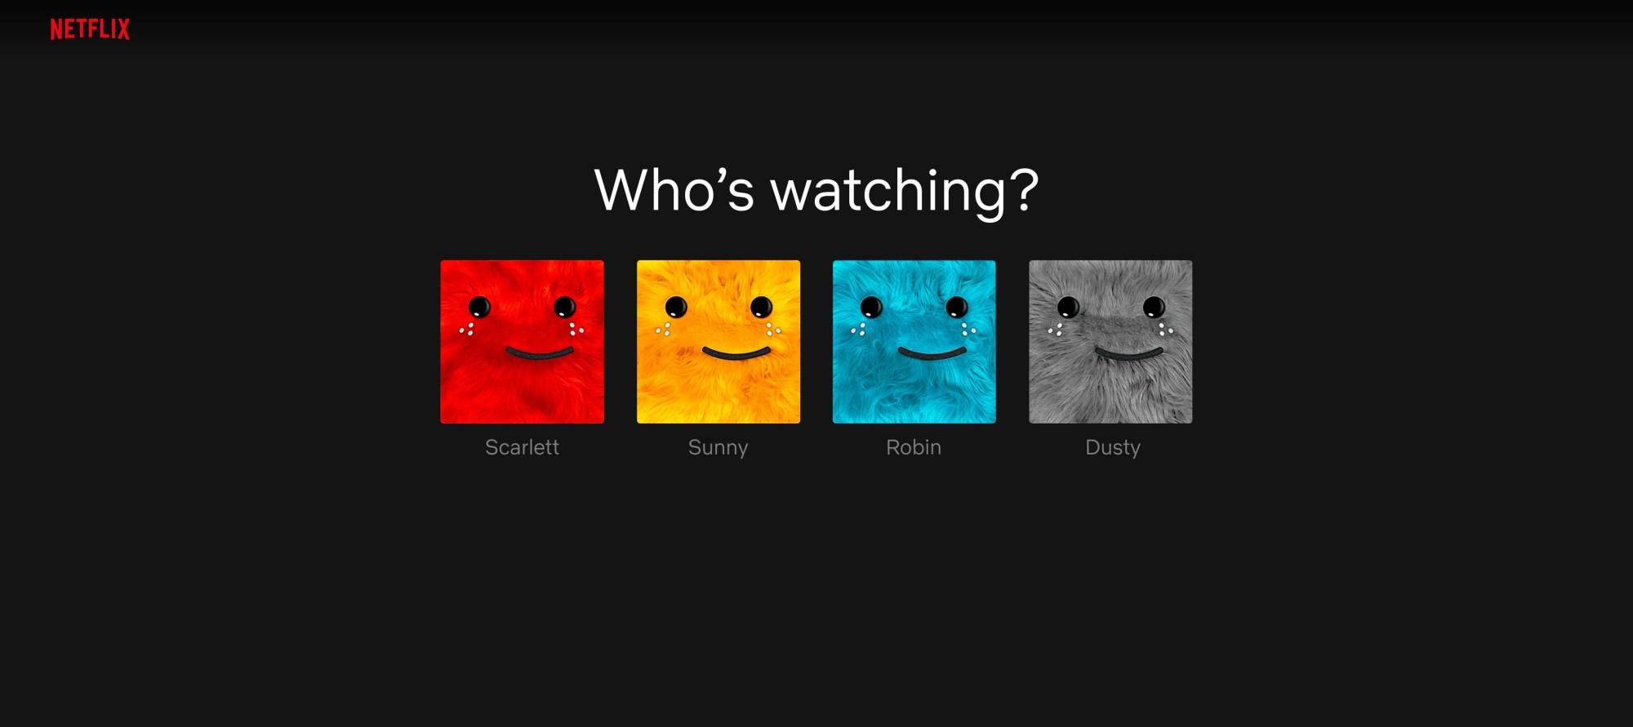
Introduction
Data Overview: I analyzed a dataset sourced from Kaggle, containing 8,807 entries with 12 variables detailing Netflix's film and television content. Variables include director, release year, rating, runtime, genre, and synopsis.
Strategic Objective: Our primary aim is to leverage viewer preferences and recent data to enhance content selection, recommendation systems, and platform features. This initiative is crucial for attracting and retaining subscribers, thus fostering sustained growth for Netflix.
Approach: Through exploratory data analysis and various data mining techniques, we aim to derive actionable insights. This process is poised to elevate user satisfaction, bolster engagement, and solidify Netflix's market position in the streaming industry.

Slide 3
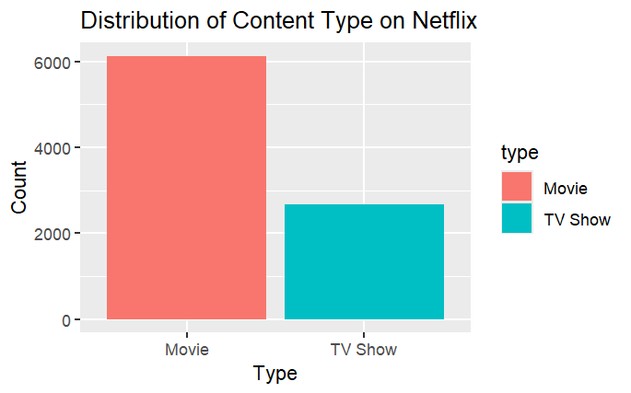

Business questions
Content Strategy & Viewer Retention: What content mix (movies vs. television series) is optimal for attracting and retaining subscribers, considering trends in viewer preferences over time?
Recommendation System Enhancement: How can Netflix improve its recommendation system by incorporating preferred genres, content ratings, and viewing patterns?
Content Acquisition & Success Forecasting: How can recent data aid in identifying profitable genres or formats and predict the success of upcoming content?
Platform Growth & User Experience: How can Netflix sustain growth by utilizing data insights to attract new subscribers and enhance user experience for improved customer loyalty?

Slide 4
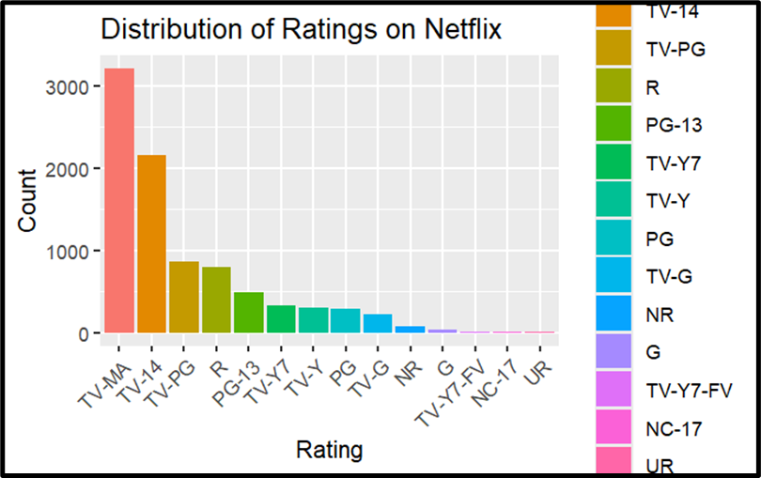
EDA and Dataset Insights:
Dataset preprocessing revealed structure and managed missing values, while initial exploration highlighted unusual zero-minute runtimes.
Content Composition and Ratings:
Netflix primarily showcases movies, with common ratings like TV-MA, TV-14, and TV-PG, and typical runtimes. Adjustments were made to bar plots based on popularity.
Trends and Director Impact:
Post-2010, Netflix experienced a surge in releases, notably influenced by certain directors. Dominance of international movies, dramas, and comedies informs content acquisition and user preferences.
Rating Distribution and Recommendations:
Netflix's rating distribution targets adult audiences, shaping recommendation algorithms. Customized content suggestions enhance user experience and align with audience preferences.
.
Exploratory Data Analysis

Slide 5
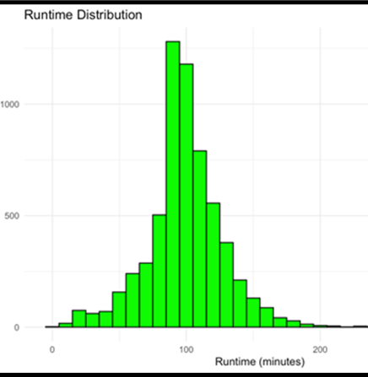
Key Findings & Insights
Content Preferences and Ratings Distribution:
Dataset indicates a higher proportion of movies over television shows on Netflix, guiding investment decisions. Understanding rating distribution aids in demographic targeting and content classification for recommendation engines.
Temporal Trends and Content Growth:
Surge in Netflix releases post-2010 signifies platform growth and increased content investment. Analysis of release years informs ongoing catalog updates and content enhancement strategies.
Director Impact and Genre Preferences:
Identification of top directors informs content acquisition strategies. Genre analysis enhances user preferences and content categorization, enabling tailored offerings. Further study on interrelations between features such as runtime distribution, ratings, and director-genre preferences can provide deeper insights into user preferences.

Slide 6
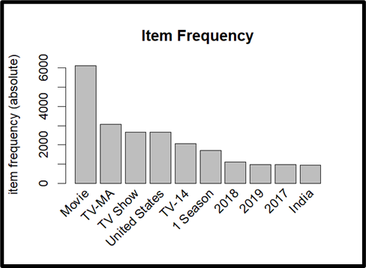
Data mining techniques: Association mining
Association Mining for Recommendations:
Utilizing techniques like 'apriori' and 'eclat' functions for association rule mining reveals customer selection patterns crucial for recommendation systems.
Initial Analysis Insights:
Initial summary of the Netflix dataset identifies 'Other' as the most frequent item, followed by 'Movie,' 'TV-MA,' and 'TV-Show.'
Association Rule Discoveries:
Correlations between 'Movie' and attributes like release dates, ratings, and locations, along with associations between television content and show duration, provide insights into recommendation system mechanisms.
Eclat Function Validation:
Implementation of the 'eclat' function affirms support metrics validity, with 'Movies' dominating followed by 'TV-MA' and television shows, validating recommendation system insights.

Slide 7
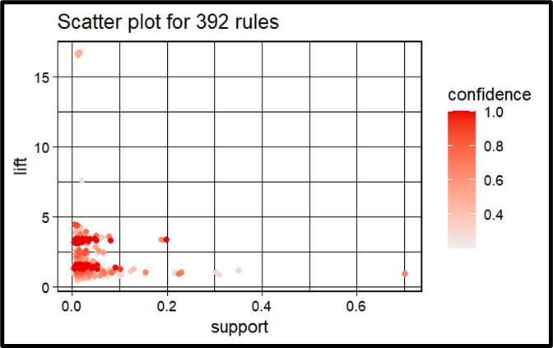
DATA MINING TECHNIQUES: ASSOCIATION MINING (cont.)
Association Mining Parameters:
'Apriori' function adjustments reveal correlations between TV content and genre/duration, and movies and runtime, with high-confidence associations despite low support values.
Rule Optimization:
Parameters refinement eliminates redundant subset rules, enhancing analysis precision and focusing on significant associations.
Viewer Behavior Insights:
Analysis indicates 'TV-MA' viewers engage with recent US-based content, unveiling specific audience preferences and viewing habits.
Visualization and Frequency Analysis:
Data visualizations illustrate correlations between content types based on support, lift, and confidence values, emphasizing prevalent movies and TV shows, alongside ratings, release years, and production locations, with a preference for recent and US-based content, and notable presence of Indian content on Netflix.

Slide 8

Data mining techniques: clustering
Clustering Analysis for Insight Generation:
Utilizing clustering analysis, we categorize Netflix data to unveil latent structures and patterns, complementing conventional exploratory data analysis (EDA) methods. This approach enhances understanding of recurring themes, genres, or viewer preferences, crucial for targeted marketing, content recommendation, and development decisions.
Integration of EDA and Clustering:
Our analysis combines EDA with clustering methodologies, leveraging features like release year and duration to identify patterns and categorize content, aiding in strategy formulation and platform expansion.
Methodologies and Business Implications:
Employing techniques like k-means and hierarchical clustering alongside the Elbow, Silhouette, and Gap Statistic Methods, we determine optimal cluster numbers and reveal meaningful content categories and trends, informing strategic decisions for enhancing user experience and platform performance.

Slide 9
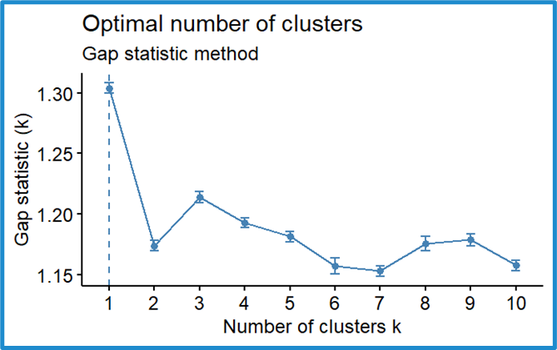
Data mining techniques: clustering (cont.)
Determining Statistical Significance with Gap Statistic: The gap statistic compares the within-cluster sum of squares (WSS) of observed data to reference datasets generated randomly, aiding in determining the statistical significance of clustering structure.
Visualizing Gap Statistic for Cluster Determination: Visualization of the gap statistic involves plotting the number of clusters (k) on the x-axis with corresponding gap statistics computed for each value of k, indicating stronger evidence for distinct clusters with larger gap statistics.
Importance of Gap Statistic in Cluster Analysis: Utilizing the gap statistic helps identify the optimal number of clusters, providing valuable insights into the dataset's underlying structure for more accurate clustering analysis.

Slide 10
Interpretations – Association Mining
Association Mining Insights:
Analysis reveals frequently viewed content, mainly recent US movies and adult TV programming, with high confidence values. Subgroup analysis indicates variety in less frequently viewed content preferences.
Utilizing Less Viewed Rules:
Less viewed rules with high confidence values can attract new subscribers and inform content acquisition decisions, enhancing forecasting of programming relevance and popularity.
Addressing Blank Sides in Rules:
Removal of subsets and further analysis using training and testing sets can address blank sides in rules and itemsets, improving accuracy of insights from association mining.
Business Implications and Recommendations:
Findings aid in balancing content to retain current subscribers and attract new users, strengthening recommendation systems by considering most frequent rules, thus enhancing viewer satisfaction and engagement.

Slide 11

Interpretations - Clustering
Utilizing Clustering for Audience Segmentation:
Clustering analysis identifies distinct clusters in the data, potentially representing different genres or audience preferences, enabling customized marketing campaigns and content suggestions for target segments. Incorporating viewer ratings and external genre classifications can enhance clustering accuracy and insights.
Objectives and Strategies for Analysis:
Clustering techniques aim to refine content strategy, improve recommendation systems, guide content acquisition decisions, and facilitate platform growth. By integrating additional features like genres, ratings, and temporal analysis, alongside techniques such as collaborative filtering and predictive modeling, we aim to deepen our understanding of user preferences and behaviors, driving user engagement and platform success.

Slide 12


Recommendations
Recommendation Systems Enhancement:
Integrating word tagging broadens content diversity, while regular parameter fine-tuning emphasizes trending content to attract and adapt to evolving preferences.
Content Promotion Strategy:
Promoting trending and popular content caters to diverse user interests, leveraging association mining metrics to identify high-confidence content for new audiences.
Addressing Business Inquiries:
Algorithm fine-tuning and data statistics inform tailored recommendation systems, while continued analysis of past data mining results guides future growth strategies.
Recommendation for Further Analysis:
Further data mining analysis can provide deeper insights into user behaviors and viewing habits, optimizing platform strategies for sustained growth and enhanced user experience.

Slide 13
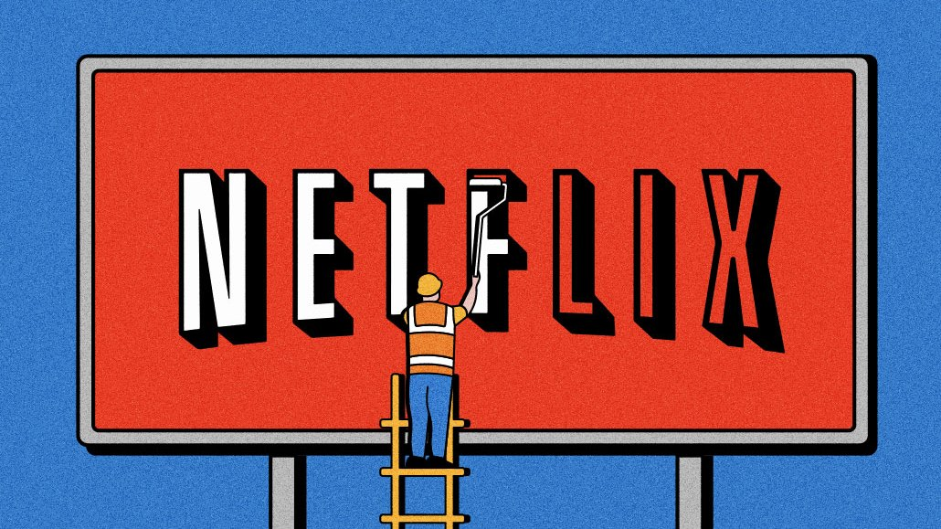
CONCLUSION
Uncovering Valuable Insights:
Analysis revealed insights crucial for decision-making, including content classification, user segmentation, and recommendation system enhancement, empowering stakeholders to improve user satisfaction, attract new subscribers, and expand the business.
Opportunities for Further Exploration:
Further exploration of clustering algorithms and association rule mining techniques, customized to specific business inquiries, holds potential for discovering additional insights and fine-tuning advancement strategies.

