Slide 1

Employee Attrition
Trends, Analysis & Prediction
Catherine Ticzon

Slide 2
Job Specific Trends

Slide 3


Mean Monthly Income
Job Role | Mean Monthly Income
Healthcare Representation | 7,535.34
Human Resources | 3,284.63
Laboratory Technician | 3,221.86
Manager | 17,197.15
Manufacturing Director | 7,505.22
Research Director | 15,749.90
Research Scientist | 3,259.33
Sales Executive | 6,891.78
Sales Representative | 2,6552.83
Notes:
We see Sales Representatives have the lowest mean monthly income and Managers & Research Directors have the two highest mean monthly incomes

Slide 4
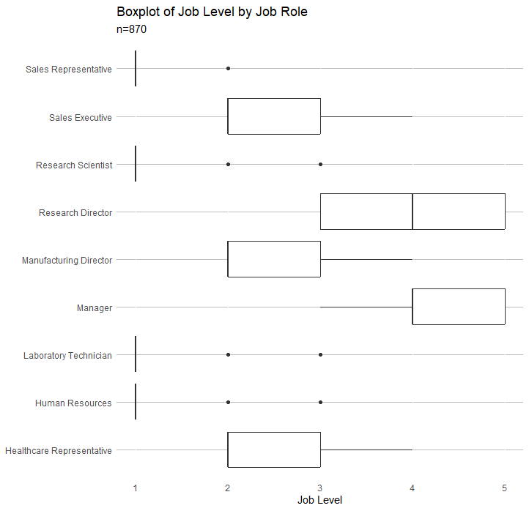
Job Level
Notes:
Boxplot to show the distribution of Job Levels by Job Role
Sales Reps, Research scientists, lab techs, and HR roles have median Job Level 1 with a couple outliers. Based on the boxplots, it is safe to say that the majority of employees in these roles probably have a job level=1/

Slide 5
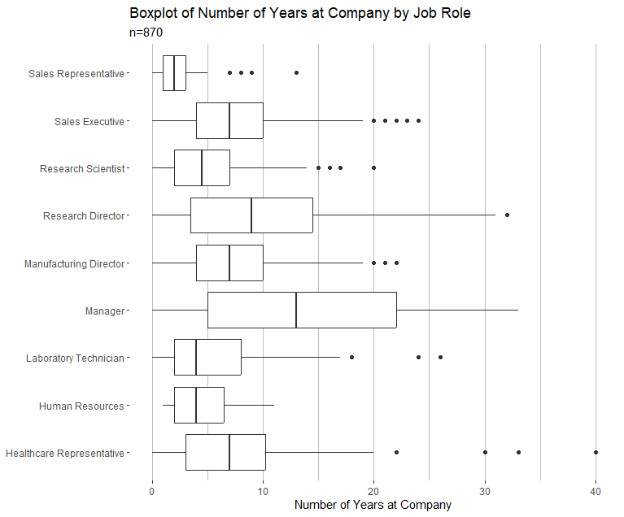
Number of Years at Company
Notes:
Boxplot to show the distribution of the # of years at the company by Job Role
Distribution of Sales Reps’ # of years at the company is SMALLER and LESS THAN all the other roles
Research Directors and Managers have the two highest medians

Slide 6
Attrition

Slide 7
Attrition
n=870
84%
16%
No
Yes
Notes:
In the sample of 870 employees….
No 730 (83.9%)
Yes 140 (16.1%)

Slide 8
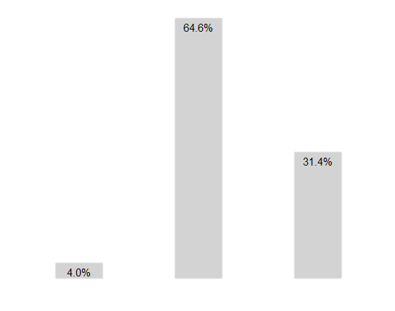
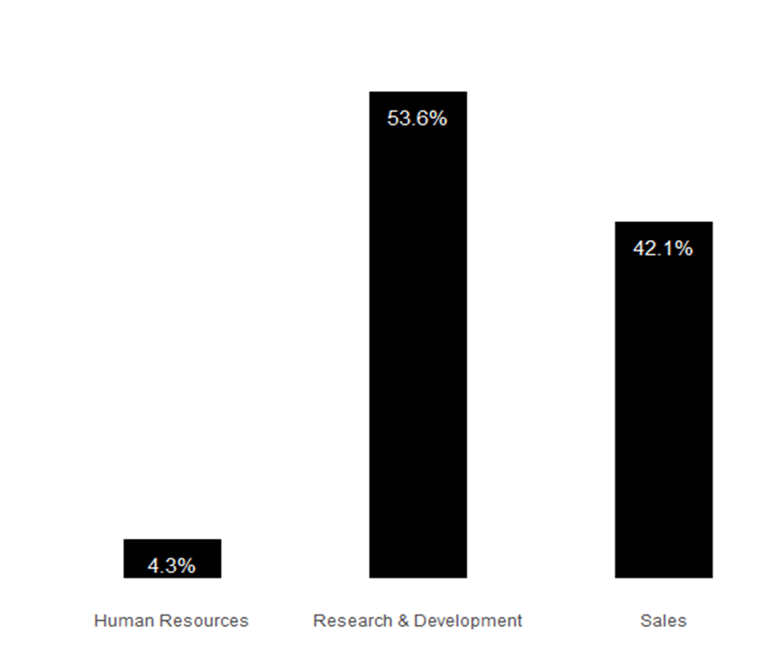
Attrition by Department
Attrition
Entire Sample
Notes:
A little over half of attrition cases were in R&D, then Sales, and a small percentage of HR
Compared to the Entire Sample, however, we see that Sales has a disproportionately higher rate of attrition when compared to the percentage they make up in the Entire Sample

Slide 9
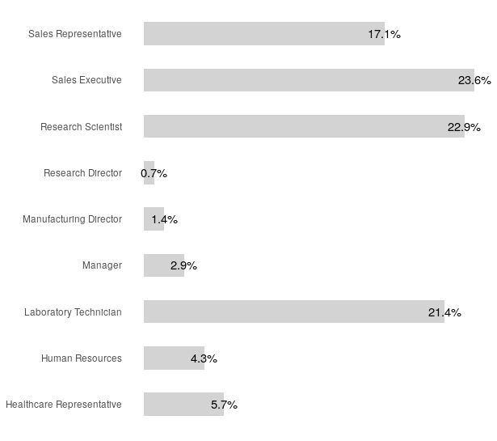
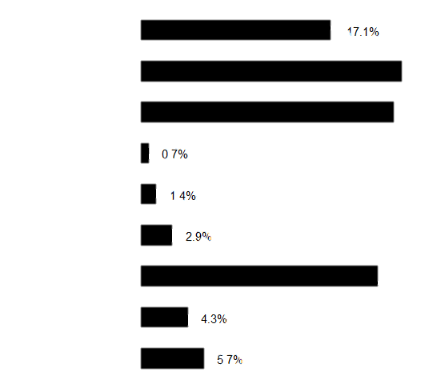
Attrition
by Job Role
23.6%
22.9%
21.4%
Notes:
Sales Execs, Research Scientists and Lab Techs each all make up around 20% of attrition cases

Slide 10
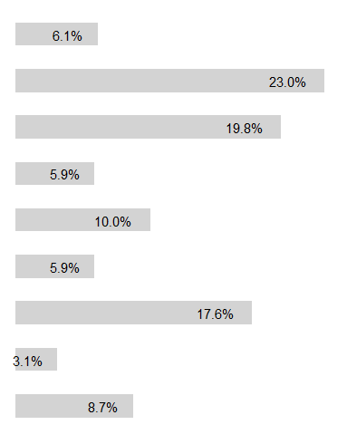
Attrition
by Job Role
23.6%
22.9%
Attrition
21.4%
Entire Sample
Notes:
Sales Execs, Research Scientists and Lab Techs each all make up around 20% of attrition cases
When we compare this to the proportion they make up of the entire sample, it isn’t too alarming

Slide 11
Attrition
by Job Role
23.6%
22.9%
Attrition
21.4%
Entire Sample
Notes:
Sales Execs, Research Scientists and Lab Techs each all make up around 20% of attrition cases
When we compare this to the proportion they make up of the entire sample, it isn’t too alarming
However, we see that Sales Reps disproportionately make up a larger percentage of attrition cases than they do in the entire sample
Percentage of attrition is almost 3x more than the proportion they make up of the Entire Sample
On the other hand, we see that Research Directors and Manufacturing Directors have proportionately much lower rates of attrition compared to their makeup of the entire sasmple

Slide 12
Top 3 Factors Contributing to Turnover

Slide 13
Top 3 Factors Contributing to Turnover
Job Level
Job Role
Environment Satisfaction
Notes:
The plots I will show in the following slides support this claim

Slide 14
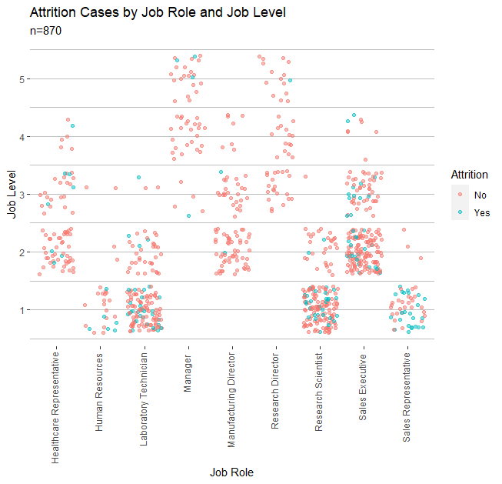
Job Role & Job Level
Notes:
Job roles on x axis and job level on Y
Attrition is denoted by color; Red is No Attrition, Blue is Attrition
Looking at Sales Reps with Job Level 1 – we see there is almost a 50/50 split of attrition, or maybe even more cases of attrition than non-attrition

Slide 15
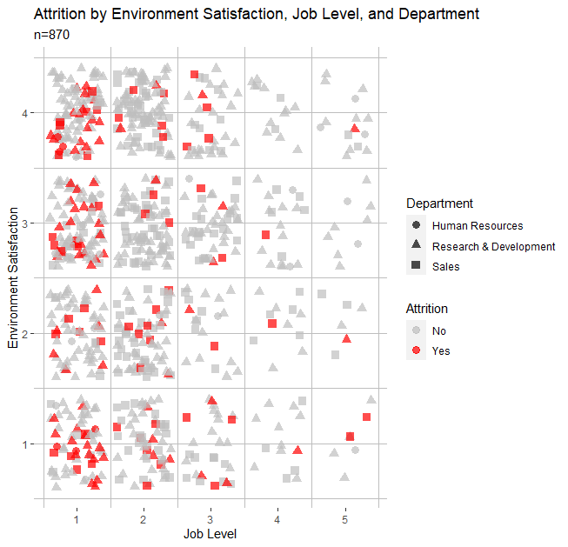
Job Level, Environment Satisfaction, & Department
Notes:
Environment Satisfaction on Y-axis and Job Level on X-Axis
Department is denoted by different shapes
Attrition is indicated by Grey for No and Red for Yes
Visually, we see a lot of Attrition cases in Research and Development and Sales departments; not so much in HR, but remember HR only makes up 4% of the sample
We see a lot more red points where Job Level is lower, particularly where is it 1.

Slide 16
Job Level, Environment Satisfaction, & Department
Notes:
Environment Satisfaction on Y-axis and Job Level on X-Axis
Department is denoted by different shapes
Attrition is indicated by Grey for No and Red for Yes
Visually, we see a lot of Attrition cases in Research and Development and Sales departments; not so much in HR, but remember HR only makes up 4% of the sample
We see a lot more red points where Job Level is lower, particularly where is it 1.
Looking specifically where Environment Satisfaction and Job Level are both 1, visually, it looks like there’s almost a 50/50 mix of Yes and No attrition cases

Slide 17
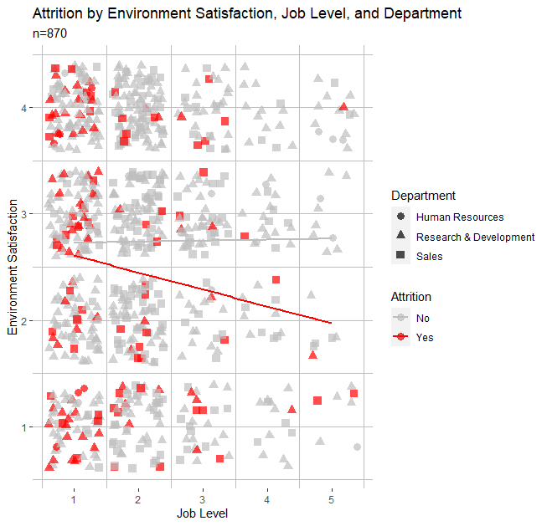
Job Level, Environment Satisfaction, & Department
Notes:
Show the linear regression overlayed on these variables, by Attrition
Red negative slope is for Attrited cases
Grey slope is No – highlighted in yellow since it might be hard to see – we see a very slight positive slope here

Slide 18
Predicting Attrition
Modeling with knn

Slide 19
Predicting Attrition with knn
train7 <- train_attr %>% select(YearsInCurrentRole, YearsSinceLastPromotion, Age, JobLevel, Attrition)
test7 <- test_attr %>% select(YearsInCurrentRole, YearsSinceLastPromotion, Age, JobLevel, Attrition)
knn_model7 = knn(train7[,c(1,4)], test7[,c(1,4)], train7$Attrition, k=5, prob=TRUE)
confusionMatrix(table(knn_model7, test7$Attrition))
probs7 = ifelse(knn_model7 == "1", attributes(knn_model7)$prob, 1- attributes(knn_model7)$prob)
NewClass7 = ifelse(probs7 > .17, "1", "0")
table(NewClass7, test7[,5])
CM7= confusionMatrix(table(NewClass7, test7[,5]), mode = "everything")
setcomp7 <- attrition_comp %>%
select(YearsInCurrentRole, YearsSinceLastPromotion, Age, JobLevel)
knn_comp7 = knn(train7[,c(1,3)], comp7[,c(1,3)], train7$Attrition, k=5, prob=TRUE)
summary(knn_comp7)
}
Create and evaluate knn model with dataset where attrition is known
Using variables:
Years in Current Role
Years since Last Promotion
Age
Job Level
}
Apply model to data set where attrition is unknown
Notes:
First I want to create and evaluation a knn model with a dataset where attrition is known.
You can see I have a training and test set with a 70/30 split
I use the variables years in current role, years since last promotion, age and job level
And k=5
When I evaluate this model with a confusion matrix, I see that it has the specificity and sensitivity desired, so I can now apply it to my dataset where attrition is unknown.
By applying the knn model to the data set where attrition is unknown, I am able to predict the attrition of the employees

Slide 20
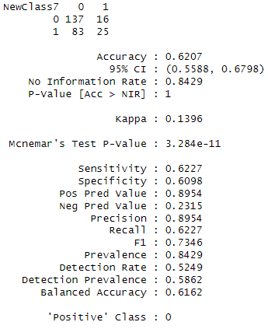
Predicting Attrition with knn
Notes:
Before summarizing the predicted attrition, I want to briefly discuss the evaluation of this knn model.
You can see with the confusion matrix at the top that the model correctly classified 137/230 of the Non-attrition cases; and 25/41 of the attrition cases.
This gives uss the sensitivity of around 62% and a specificity of around 61%

Slide 21
Predicting Attrition with knn
n=300
290
10
No
Yes
Notes:
In the sample where attrition is unknown, there are 300 cases
The model predicted that 290 employees will stay at the company and 10 will leave
So in percentages, around 97% of employees will stay and 3% will leave.

Slide 22
Thank You!
Questions or Comments?
Catherine Ticzon
cticzon@smu.edu

Slide 23
Case Study Links
Presentation video: https://youtu.be/lbArHBZwrpE
GitHub repository: https://github.com/catherineticzon/CaseStudy2DDS.git
GitHub webpage: https://catherineticzon.github.io/

