Slide 1
a fast multi-threaded, master-worker web-server: Proof of concept in go
Robert Carney, Donald Hamnett, Nicholas vann
Cs5600: Computer systems
Northeastern university
Fall 2018

Slide 2
Why GO?
Makes concurrency simple
“go routines” (lightweight threads)
Inter-thread communication via channels

Slide 3

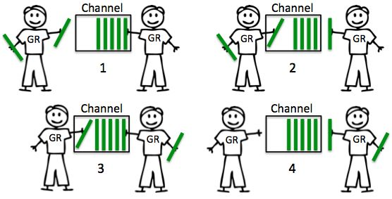
Channels
Source: http://elliot.land/post/goroutines-and-channels-a-real-ly-simple-server-in-go

Slide 4
Implementation
master
reverse
proxy
worker
worker
worker

Slide 5
Master
Reading Configuration
Spawning Workers
Load Balancing
Health-checking
Graceful Shutdown

Slide 6
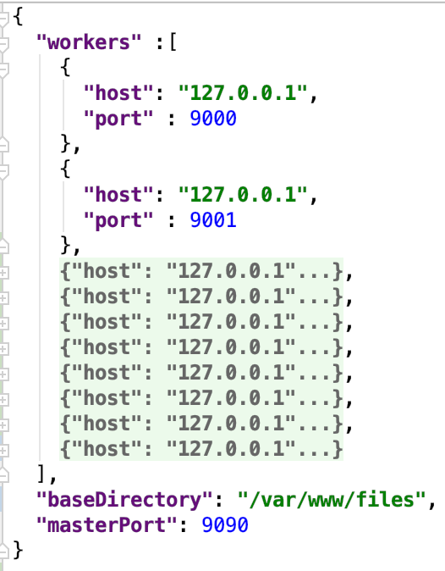
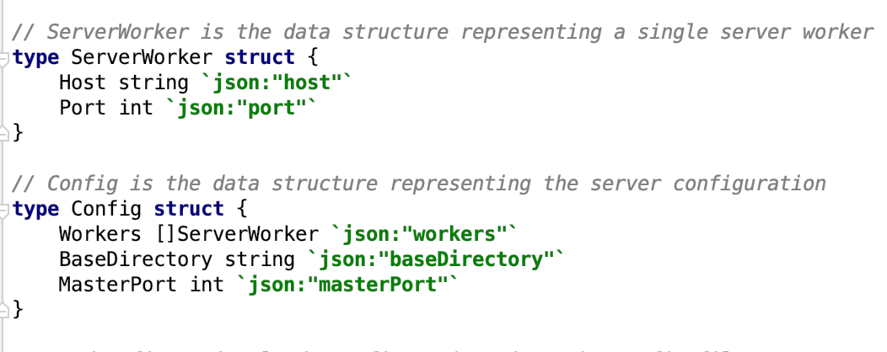
configuration
Easily Extensible JSON

Slide 7
Workers
Listen for file requests
Serve requested files
Caching
Respond to health-checks

Slide 8
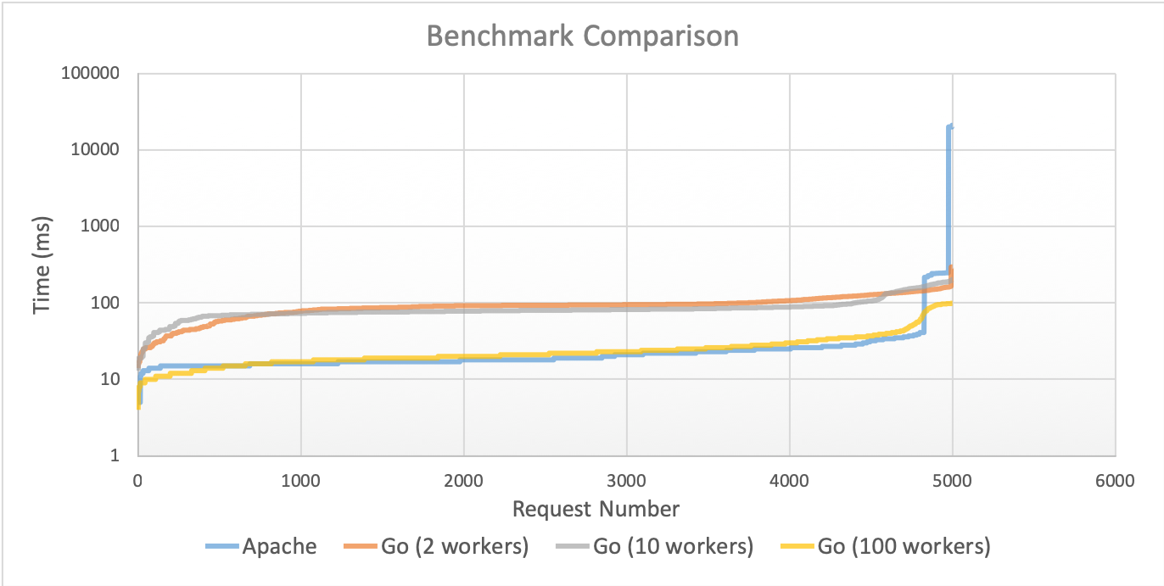

Benchmarking

Slide 9
Future improvements
Extend to a distributed protocol to work on multiple machines
Add further options for configurations to give users more control

Slide 10
Questions?
Feel free to check it out on GitHub!
https://github.com/robcarney/gows

