Slide 1
Patient Analysis: Cost of Care Prediction
Cathey Wang
07/02/2018

Slide 2
Breakdown of Task
Available Data:
Bill_id & Bill_amount: costs related to each hospitalization event
Clinical_data: weight, height, medical history, medications, symptoms
Demographics: gender, age, race, residence
Join charts to connect a patient’s information to total cost:
3000 patients, 3400 visits, 13600 bills
For each visit, find patient info in demographics, find all corresponding bills in bill_id & bill_amount, sum the costs
Regression Task:
X: all information found in clinical_data & demographics, added BMI
Y: total cost

Slide 3
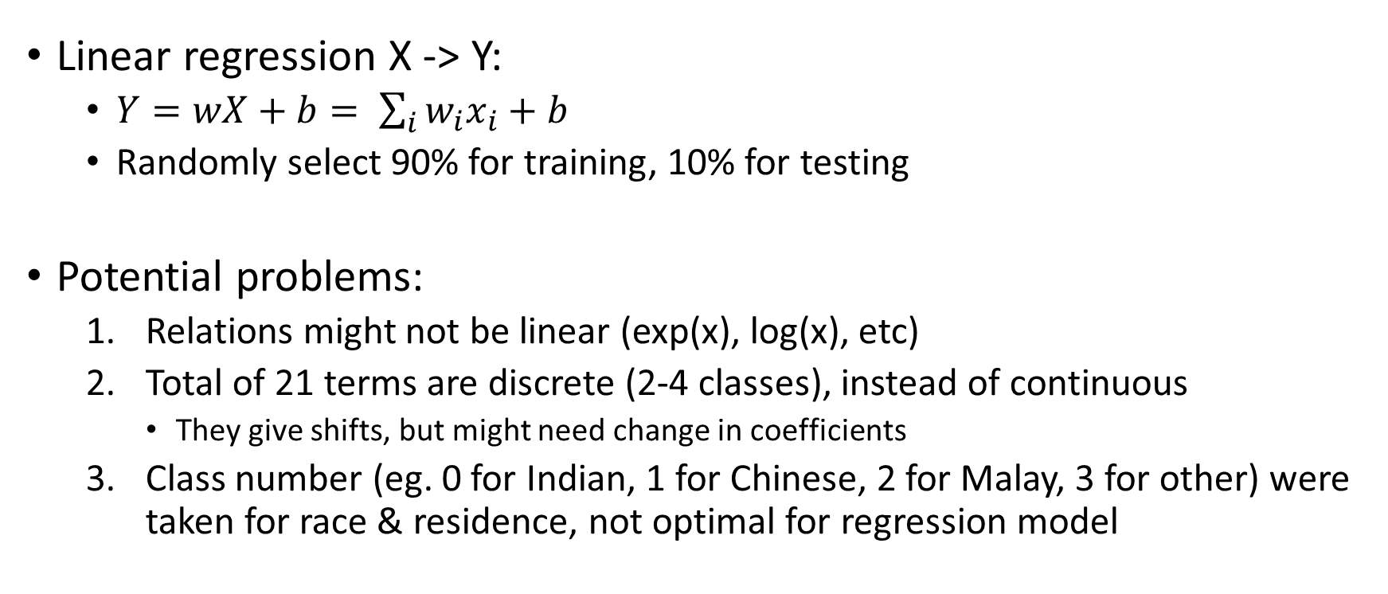
Exploratory Model
Linear regression X -> Y:
$Y=wX+b= \sum_{i}{w_{i}x_{i}}+b$
Randomly select 90% for training, 10% for testing
Potential problems:
Relations might not be linear (exp(x), log(x), etc)
Total of 21 terms are discrete (2-4 classes), instead of continuous
They give shifts, but might need change in coefficients
Class number (eg. 0 for Indian, 1 for Chinese, 2 for Malay, 3 for other) were taken for race & residence, not optimal for regression model

Slide 4
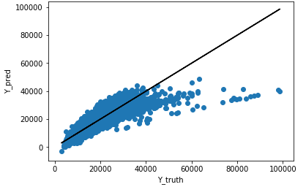
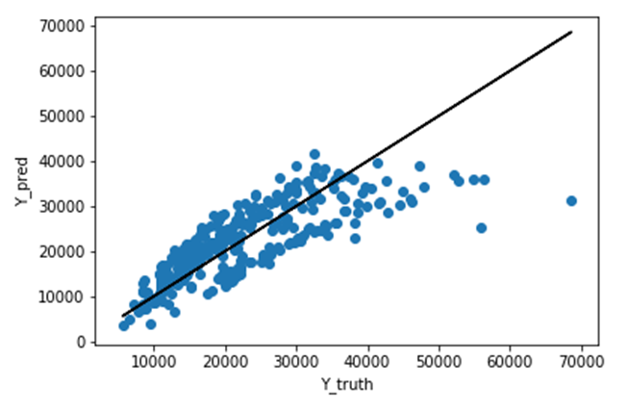
Exploratory Model Results
 | Training | Testing
MSE | 42545627.88 | 33848380.08
R2 | 0.59 | 0.63
This shows linear relationship isn’t optimal.

Slide 5
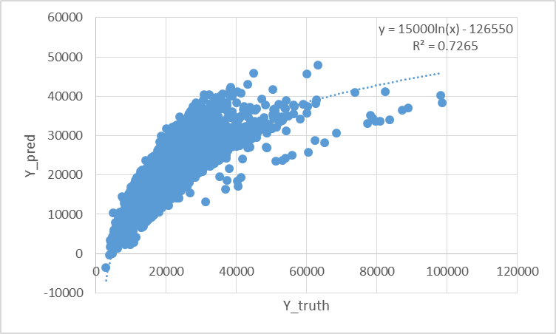
Improvements to 1st Model
Use one-hot vectors instead of class numbers for race & relations
[1, 0, 0, 0] - Indian, [0, 1, 0, 0] - Chinese, [0, 0, 1, 0] - Malay, [0, 0, 0, 1] – other
Map X to log(Y), then compare exp(WX+b) with truth

Slide 6
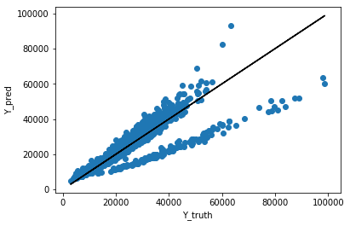
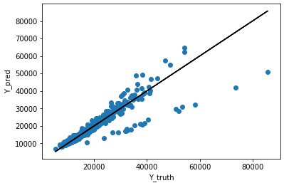
Improved Model Results
 | Training | Testing
MSE | 42545627.88 | 33848380.08
R2 | 0.59 | 0.63
Linear regression to log(cost) works much better
Coefficients seem to diverge. There should be a binary class that needs to be trained separately

Slide 7
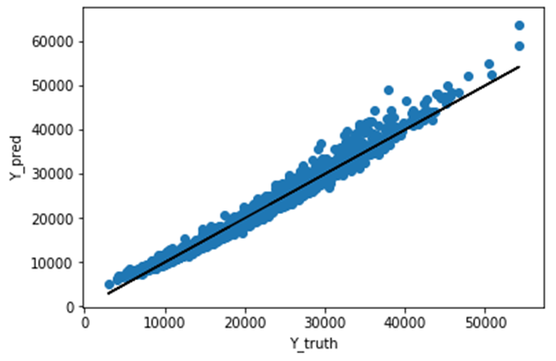
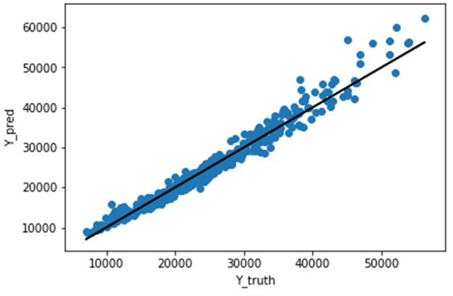
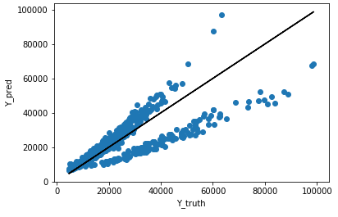
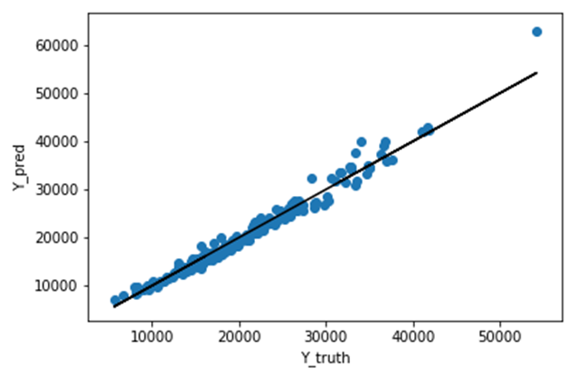
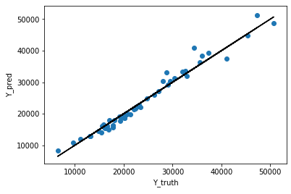
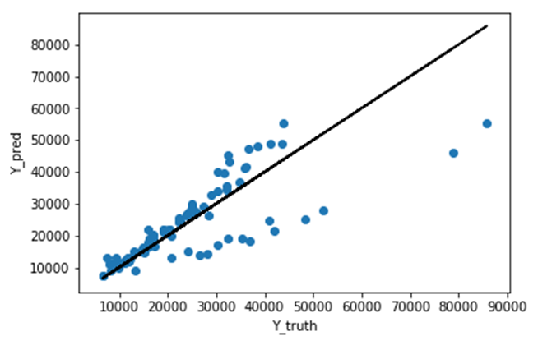
Residence was the only separating term
 | Singaporean | PR | Foreigner
Train
Test
Train R2 | 0.97 | 0.97 | 0.58
Test R2 | 0.97 | 0.97 | 0.61

Slide 8
Discussions
The cost of care for Singaporeans & PR can be predicted accurately.
No other terms in X (gender, clinical data, etc) provided similar separating power, even with foreigners alone.
Why are foreigners special? Maybe some foreigners choose insufficient treatment due to insurance/welfare? These information (income, EP/SP, insurance) might be able to provide more insights.
Explore additional terms in future development
Length of stay = date of discharge – date of admission
For revisiting patients: total previous visit count & cost

Slide 9
Additional Idea: Neural Network
If use MSE for loss function, deep learning is possible for regression
Multiple layers may add needed non-linearity to the model
Difficulties:
What non-linear activation function to use?
ReLU ≈ linear activation, as most outputs > 0, making multiple layers obsolete (W₁W₂…W_{n}X is essentially just WX)
Tanh, sigmoid are downwards concave, based on 1st model, need upward concave
keras.backend.exp(): This is essentially the model we just developed with 1 layer
Initialization method matters. Exploding gradients is likely if not chosen carefully.
Features are still important. If features don’t have separating power, different models won’t be able to do much.

