Slide 1

Midbootcamp Project: How much will you pay your next house?
Federica Riva – Cathalijn Vos
13.05.2022 - Barcelona

Slide 2

Outline
Objectives
Methodology
Results & Conclusions

Slide 3
Objectives
BI tools
Explore the characteristics of the houses using some business intelligence tools.
Build a model that will predict the price of a house based on features provided in the dataset.
Understanding which factors are responsible for higher property value - $650K and above.
Model
High-value property

Slide 4


Methodology: objective 1

Slide 5
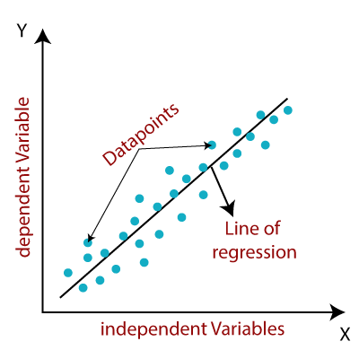
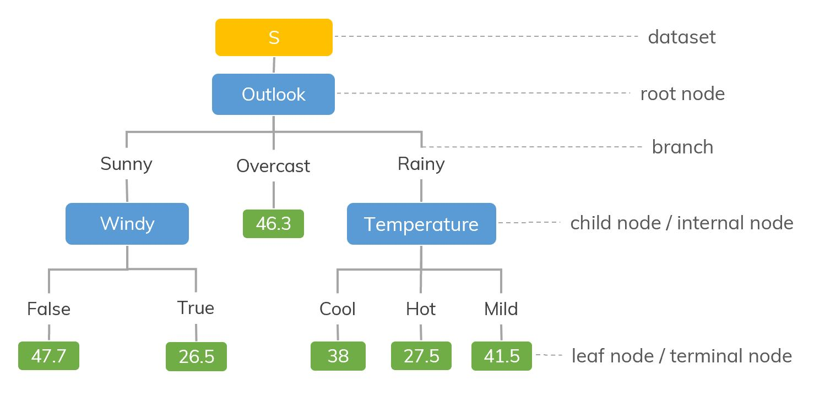
Methodology: objective 2
Two types of model:
Linear regression model
Decision tree regression model

Slide 6
Linear regression model
Baseline model
4 model iterations
Final model
Data cleaning
Features engineering
Features selection
Ouliers analysis

Slide 7
Best model for Linear regression approach
Variables included in the model
Numerical | Categorical (dummies)
Number of bedrooms (scale) Number of bathrooms Sqft of the living area Number of floors Grade Age of the house Distance from the area with the most pricey houses on average | Waterfront Renovated View Condition Basement

Slide 8
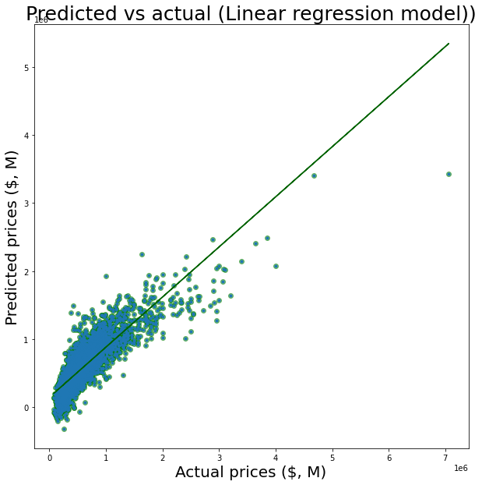
Best model for Linear regression approach
Metrics | Baseline model | Best model
r2 |  | 0.7338
MAE |  | 121.454,3186
MSE |  | 35.003.441.781,8334
RMSE |  | 187.092,0677

Slide 9
Decision tree regression model
Baseline model
Database from best linear regression model
Final model
Max Depth selection
Overfitting check

Slide 10
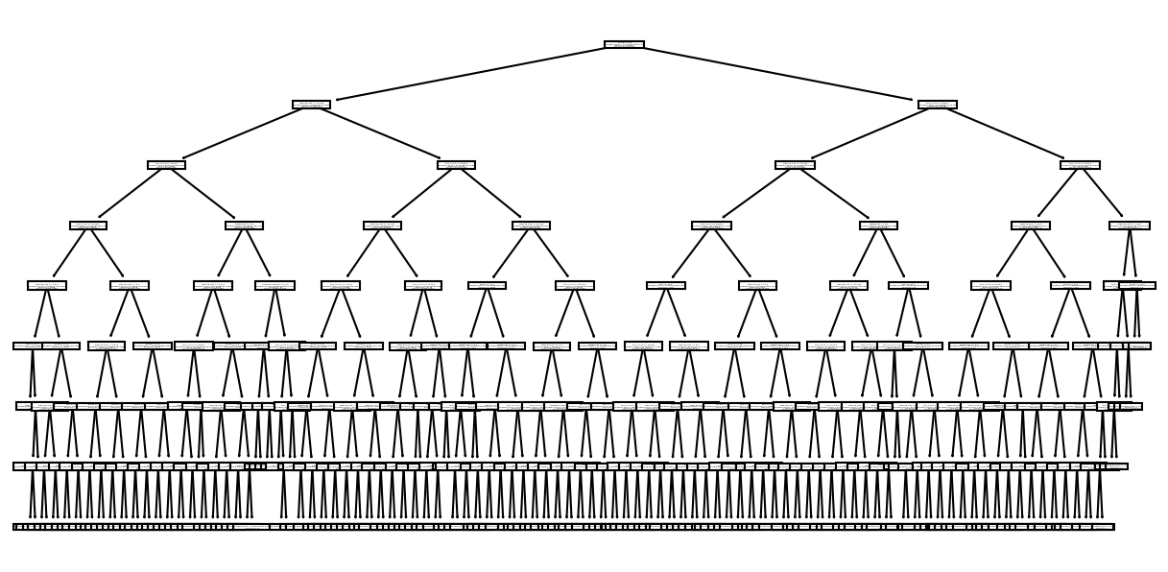
Decision tree regression model
Metrics | Baseline model | Best model
r2 |  | 0.7338
MAE |  | 121.454,3186
MSE |  | 35.003.441.781,8334
RMSE |  | 187.092,0677

Slide 11
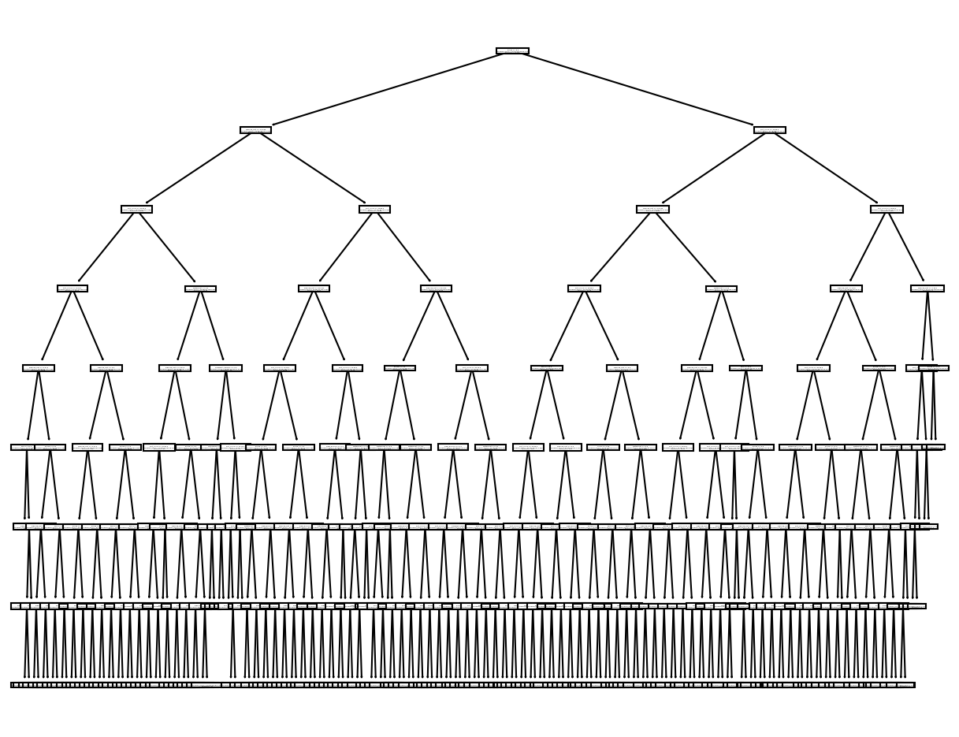
Decision tree regression model
Metrics | Baseline model | Best model
r2 |  | 0.7338
MAE |  | 121.454,3186
MSE |  | 35.003.441.781,8334
RMSE |  | 187.092,0677

Slide 12
Conclusions:
According to our analysis, the decision tree regression model is the better choice to predict house prices given the current database.
Our model can predict the actual prices with an accuracy of 80% and a mean absolute error of les tan $100k
Our analysis also suggests that sqft_lot, sqft_lot15, sqft_living15 are not important factors in predicting the house prices

Slide 13
Future steps
Implement in the ML models the observations coming from the visual inspection (Tableau) to identify the most predictive features.

Slide 14
Thanks for your attention!

