Slide 1
.ts
.html
property
property
Show the value {{property}}
Ele/selector to it attribute
Bind the property value –[]
One way binding
String interpolation

Slide 2
app
post
storedPosts:post[]
Push the record into storedPosts
using eventbinding
Property binding
Accept the post from user
Use eventemitter
postlist
postcreate
@input() Array of posts
Display each post postelement using postlistitem
@input post
Display one post
postlistitem

Slide 3
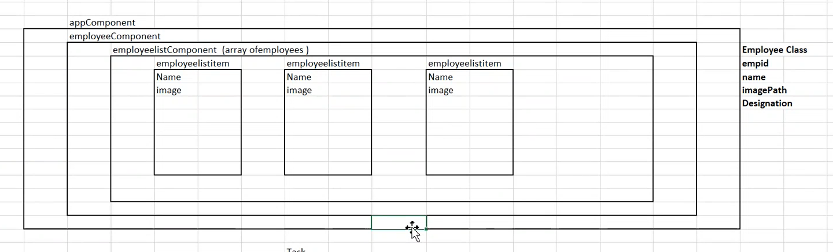

Slide 4
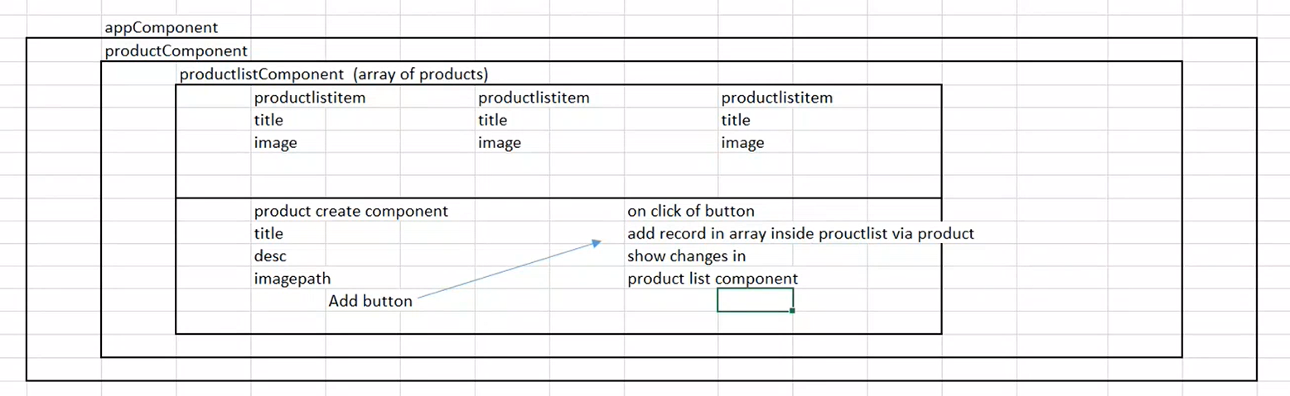
20220523 44:11

Slide 5
app
post service
posts:Post[]
post
DI of postservice to fetch data
postlist
postcreate
array of posts
Display each post using postlistitem
DI of postservice to add data
postlistitem
Display one post

Slide 6
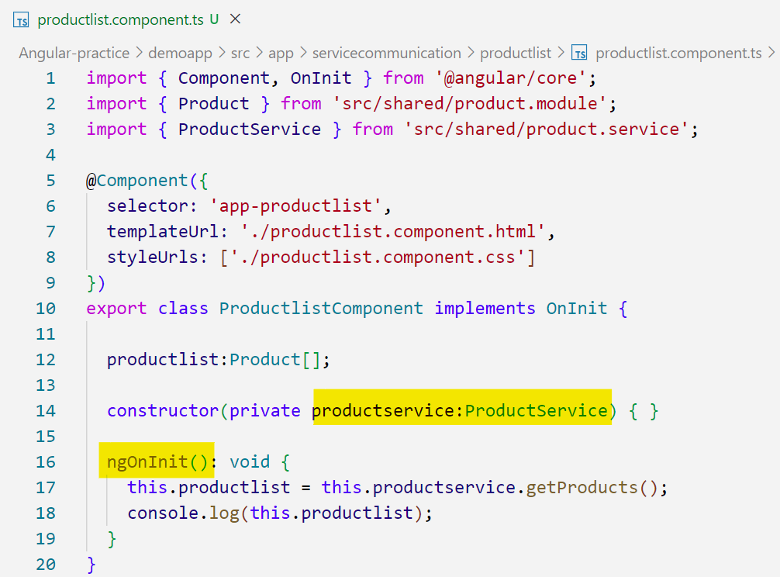
ProductService can be used as a property in the Productlist component
ngOnInit
one of the product lifecycle
You can initialize data here. We are not constructing in the constructor.

Slide 7
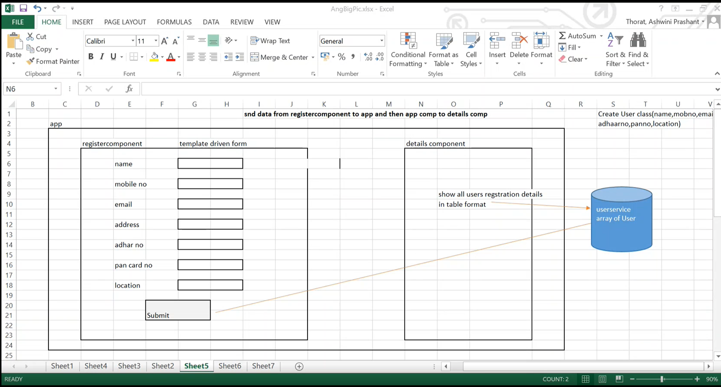

Slide 8
