Slide 1
Maze navigation based on auditory cues
Cathy Oun
Jeffery alcock
June 2nd 2015

Slide 2
Motivation
Virtual Reality
“An artificial world that consists of images and sounds created by a computer and that is affected by the actions of a person who is experiencing it.” – Merriam-Webster Dictionary
Replace reliance on visual feedback with audio feedback to indicate direction
Entertainment

Slide 3
Surround Sound
Surround sound gives a sense of direction to an observer listening to an audio source
Can be achieved with stereo hardware (i.e. ear buds) by a compilation of basic filtering effects
Delay
Volume Manipulation
Frequency Filtering

Slide 4
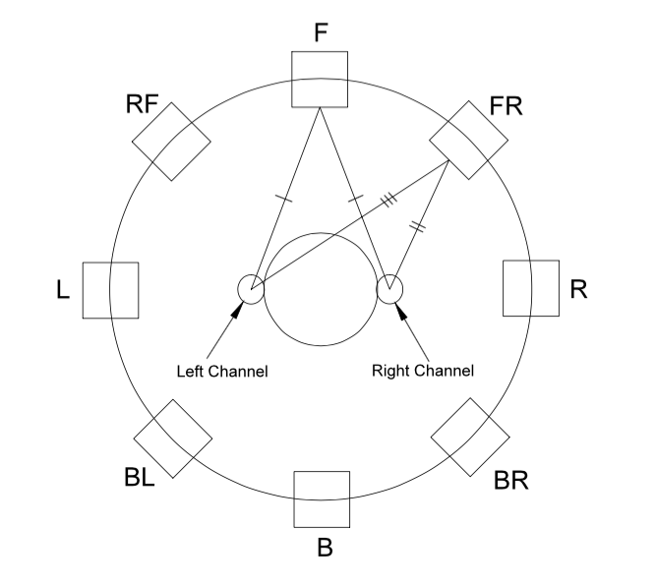
Surround Sound Technical Details
We chose to quantize the granularity of the surround sound to 8 different regions surrounding the user
Delay:
The distance from a source to each ear can vary by direction based on simple geometry.

Slide 5
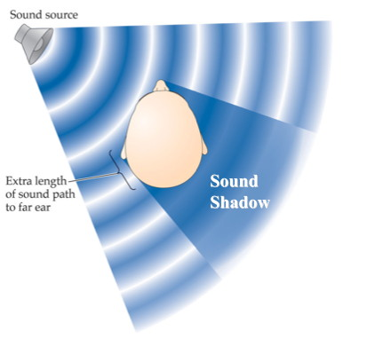
Surround Sound Technical Details (2)
Volume Manipulation:
Sound Shadow – refers to the absorption of sound by an object in its path.
Interaural Intensity Difference – describes the differences in the sound perceived by both ears. These differences allow the human brain to localize sound and determine origin information.
tl;dr make the far ear quieter
[1]

Slide 6
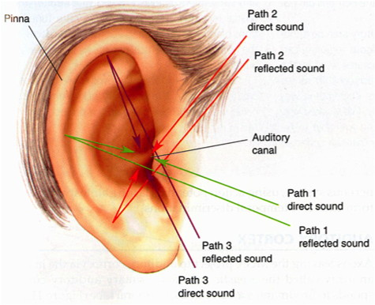
Surround Sound Technical Details (3)
Frequency Filtering:
Human ears are oriented in order to hear in front of them. The outer structure of the ear (the Pinna) allows sound to bounce off in various ways to orient the listener.
We chose to model this as an exaggerated head shadow effect. When a sound source is behind the listener, we low pass filter the sound to emulate the loss of information caused by the Pinna.
[1]

Slide 7
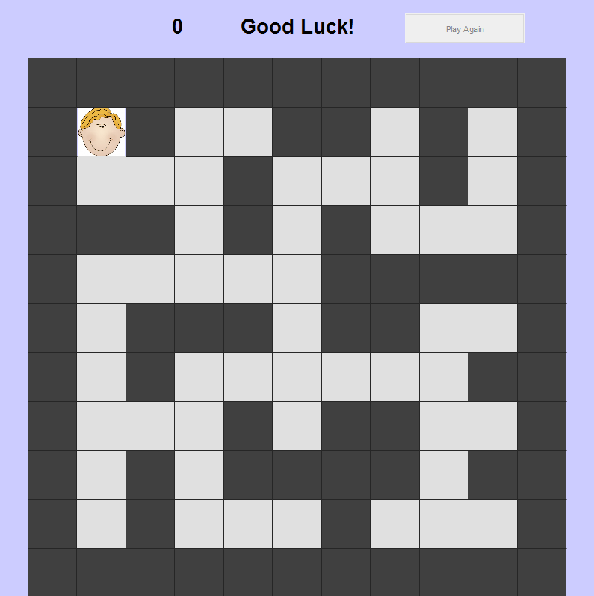
Application: A Maze Solving Game!
User Feedback Message
Move Counter
Play Again Button
User Position/Direction
Path
Hidden Sound Source
Wall

Slide 8
Maze User Controls
Game Objective: Navigate to the hidden sound source using the auditory cues presented.
Ear buds are used to observe various audio signals
Static ambient jungle noise
Dynamic trumpet fanfare (emitted from the destination)
Keyboard used to move the user
Four arrow keys move the user along the maze path
W, A, S, D change the direction the user is facing
W = face up, A = face left, S = face down, D = face right
Finishing the Game: A celebratory sound is played, a win message is displayed, and the Play Again button is enabled to reset the game.

Slide 9

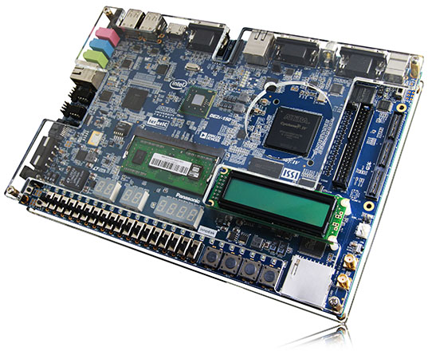
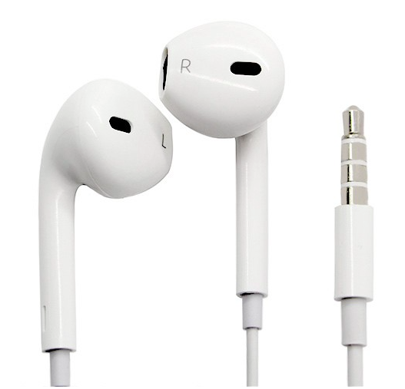
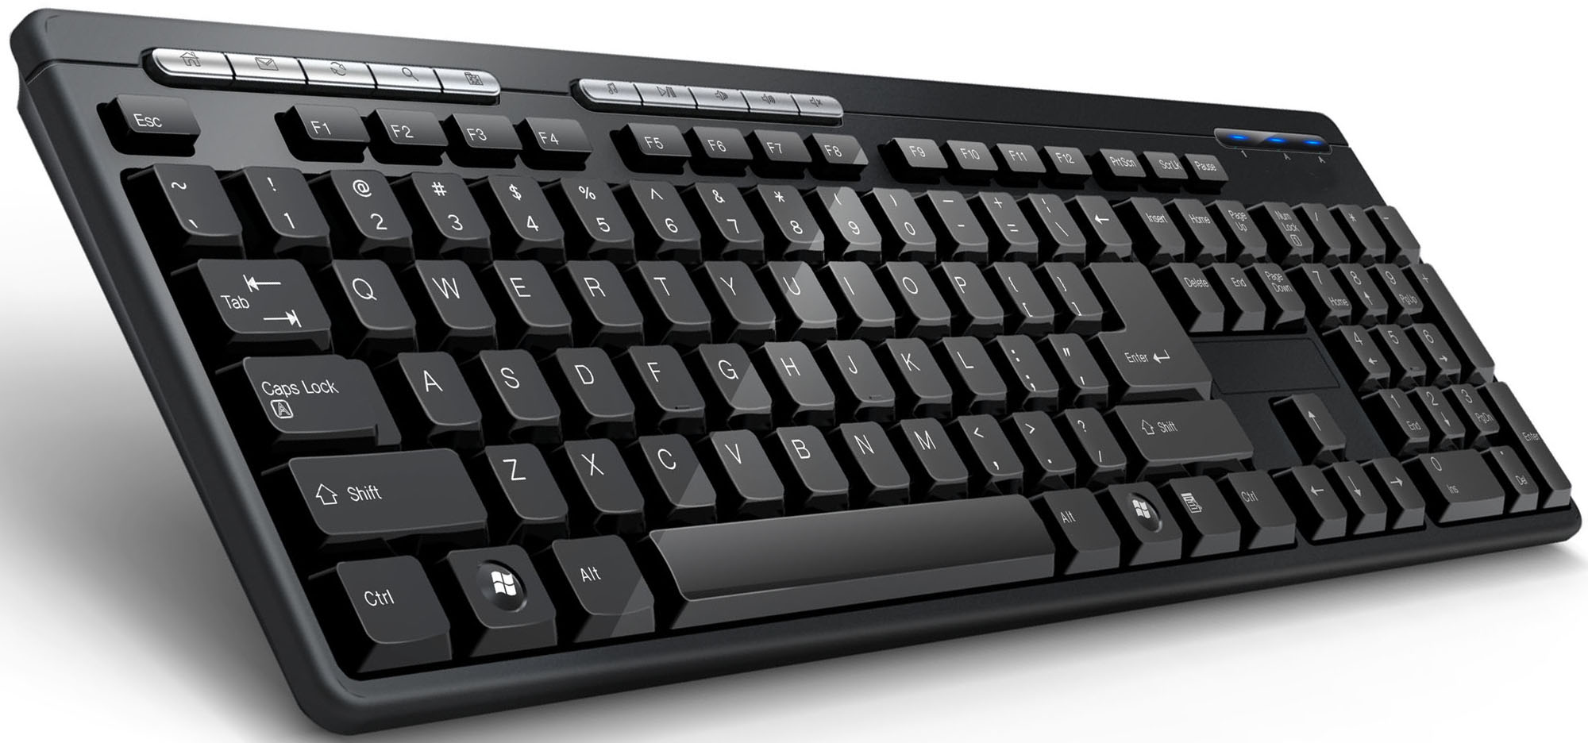
Block Diagram
User keyboard input
Bundled
sound
parameters
Back-End
Data Management
Sound Playing
GUI Creation Update
Audio Processing
Delay
Intensity manipulation
filtering
Ear buds

Slide 10
MATLAB Code
Back-end: data management
currentRow, currentCol
destinationRow, destinationCol
distance, direction, lowPassIndex
Open SerialChannel to send data to C
Music: import and play sounds
Load sound files, create audioplayer object to loop sound
Play sounds through separate channels so C can process them individually
GUI: display maze and user feedback
Custom GUI (figure, uipanel, cell array of axes)

Slide 11
MATLAB Flow Diagram
mazeMain
creatGUI
key_pressed_fcn
updateSoundModule
updateGUI
initializeGUI
reset_maze_fcn
uart
Send to C
if(gameOver)

Slide 12
Sending Data from MATLAB to C
The following parameters are packaged together as a string and sent via UART to Eclipse
distance
0 – 9, 0 representing very close to the sound source, and 9 representing very far away from the sound source
lowPassIndex
0 – 9, representing various degrees of filtering
0-2, 3-5, 6-9 are all processed as different low pass filters with an increasingly small cutoff for more extreme low pass filtering
direction
0 – 7, representing the 8 possible directions of the sound source

Slide 13
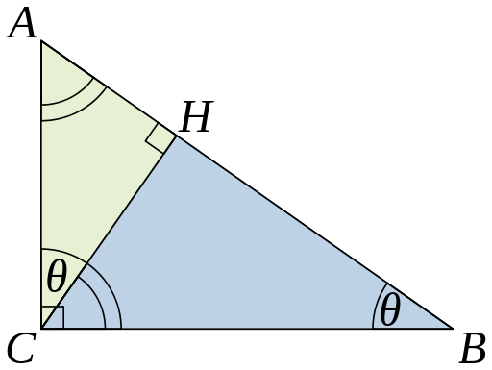
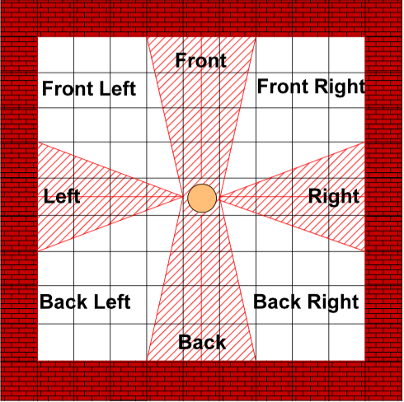
Algorithms
Distance & Intensity: Pythagorean theorem
Sqrt((destX-currX)^2 + (destY-currY)^2)
Inverse-square law: 1/(distance^2)
Low Pass Index:
Currently modeled the same as
distance
Future work should incorporate
shortest path
Direction: 8 different regions
Calculate the slopes of each region
Set the boundaries (in our case, between 0.25 and 4)
[4]

Slide 14
C Code
Receives bundled parameters from MATLAB using the UART connection
uart_byte_recv(void)
Stores the characters in the rx_buffer
Every time new data is received, the buffer is sent to the sound_module(distance, lowPassIndex, direction)
The sound_module changes the leftChannelData, rightChannelData by applying delay, intensity manipulation, and frequency filtering

Slide 15
References
[1] Brian Shannan, “Audiology-A Curriculum for Excellence”, 25 Nov 2010. Web. 30 May 2015. http://www.ssc.education.ed.ac.uk/courses/deaf/dnov10i.html
[2] Youtube Audio Library. Web. 30 May 2015. https://www.youtube.com/audiolibrary/music
[3] MathWorks-Instrument Control Toolbox. Web. 30 May 2015. http://www.mathworks.com/products/instrument/supported/serial.html [4] Pythagorean theorem. Web. 30 May 2015.
http://en.wikipedia.org/wiki/Pythagorean_theorem
[5] Inverse-square Law, Wikipedia. Web. 30 May 2015 http://en.wikipedia.org/wiki/Inverse-square_law
[6] Conor O’Sullivan “A Formulation of Holophonic Display”, 5 July 2012. Web. 30 May 2015. https://www.academia.edu/2931477/A_Formulation_of_Holophonic_Display

Slide 16
Thank you

