Slide 1
Go for 2048!
Lyu, Zimeng G, M002
Zeng, Xiangde UG
Zhang, Qinzhe G, M002
Zhang, Tianyu G, M002

Slide 2
Introduction: Game 2048
1

Slide 3
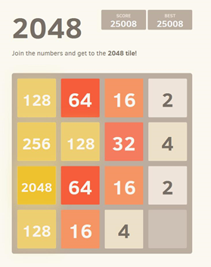
Introduction
2048 is a single-player puzzle game which requires player to slide tiles on a grid to reach the number 2048.
Notes:
（2048是啥）Four directions of movements: up, down, left, right.
When you slide tiles, all the conjuncted ones would combine to a new tile. And a randomly created tile with number “2” or “4” would appear.
Finally, player will either reach the number 2048 (win), or make the grid unable to slide anymore (lose).

Slide 4
Introduction
Our project is to design an AI such that the computer can automatically slide the tiles to reach the goal state (One of the tile’s number is 2048).
Notes:
(AI要干嘛）Using feasible heuristic function, the AI can judge the current state of the grid and find an optimal solution to reach the final goal.

Slide 5
Motivation?
Win 2048!

Slide 6
Implementation
2

Slide 7
Code Structure
Get current state
Game Part
https://github.com/bulenkov/2048
Robote
AI Part
https://github.com/qinzhez/SUCourseProject2048
Evaluate and give instruction
Notes:
Game Part：
We found a Github repository of game 2048
AI Part：
We implemented heuristic functions to calculate scores of each state, then use a strategy to evaluate those scores and make a choice: moving direction

Slide 8
AI Structure
first
second
third
last
Heuristic Function
Search strategy
Return direction
Calculate the score sum
Notes:
Heuristic Function：Design heuristic function.and calculate the score of each heuristic function for different moving directions
Calculate the score sum：Calculate the heuristic score sum of different moving directions(4 directions: up down, left, right)
Search strategy ：Using search strategy to choose a best direction Search strategy: Greedy/MiniMax
Return direction：Return the best direction to game and make a move

Slide 9
Heuristic Functions
3

Slide 10
What heuristic functions do we want?
Get large number
Combine the same numbers
The largest numbers at the corner
The AI can form a geometric sequence

Slide 11
How to deal with heuristic functions?
1. Choose the score from four directions
2. Align scores
3. Assign weights to scores
Notes:
1. Each heuristic function has a score, we would add all the score to a sum. After comparing the sum of four directions(up, down, left, right), choose the best direction.
2. So in case different heuristic functions would neutralize each other, so we define the score of each heuristic function to be positive, and our goal is to make the sum as high as possible(we don’t have infinite score)
3. Then we would run test program on heuristic functions and get a rough range of each one. Then assign weight on heuristic functions basing on their importance and range.

Slide 12
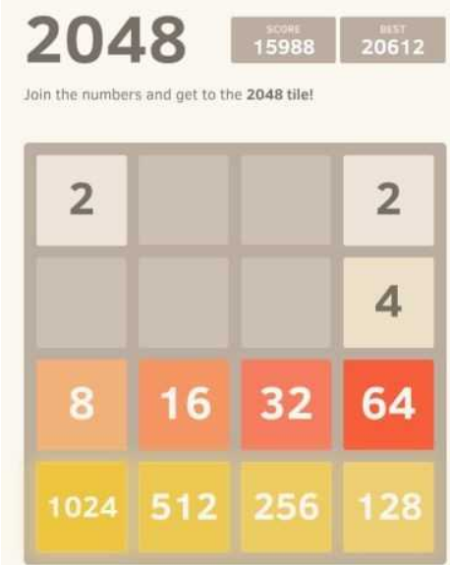
0.Geometric sequence
Notes:
This is the first model we want our AI to achieve, it forms a geometric sequence with common ratio of 2. We had this heuristic function at first, to make the AI form a geometric sequence with common ratio of two.
But this is to ideal to achieve, actually it never makes a sequence like this.
It makes no contribution to the program, sometimes gives disturbance when it reaches large number like 512.
So we give it up

Slide 13
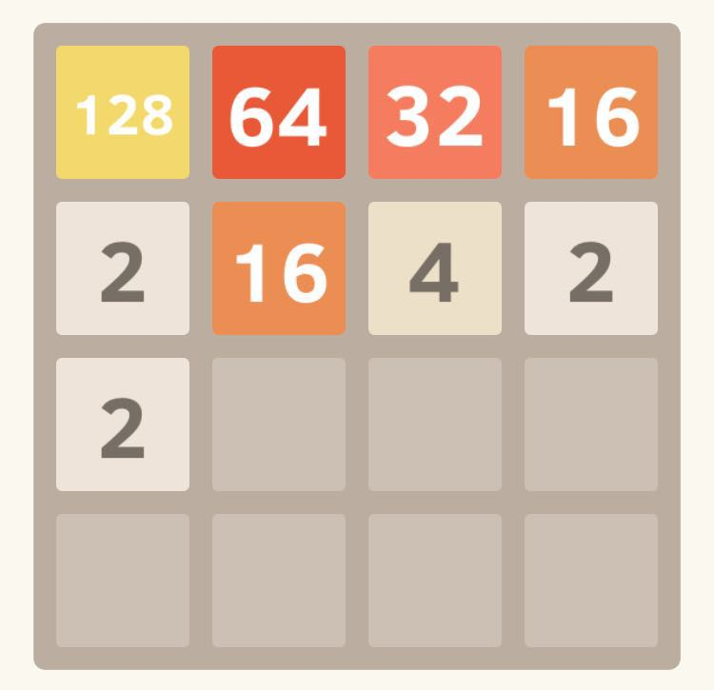
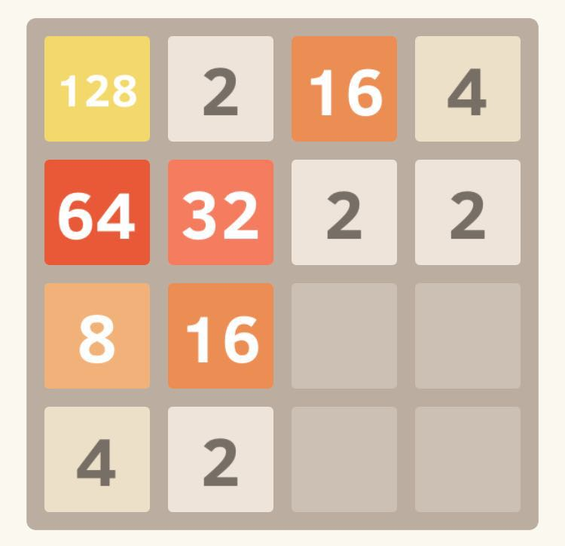
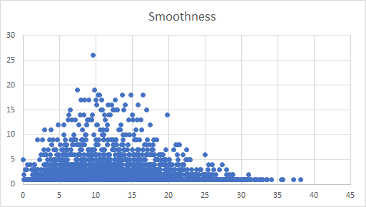
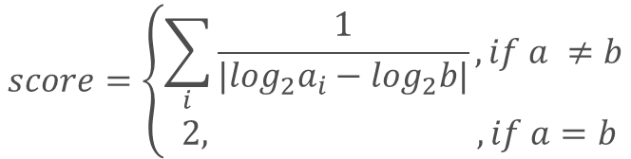
1.Smooth numbers in each row/column
Border: score=score*2
ai
b
Two directions: Down, right
Notes:
Left : what we want the AI to achieve, right: what it would look like without this heuristic function
Smooth number: doesn’t need to be geometric sequence, but it has the trend of getting bigger or smaller at each direction
ai: represents each tile of this game, b represents any of the tile that next to ai
The score is the Reciprocal value of the absolute value of logai-logb
Test: 10000

Slide 14
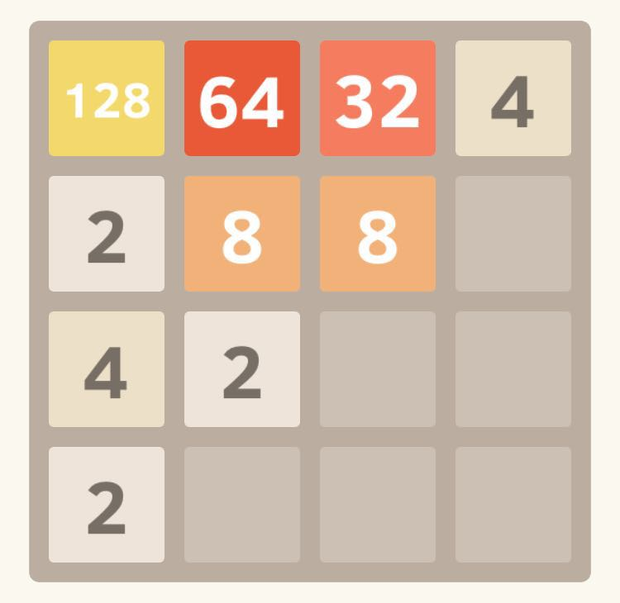
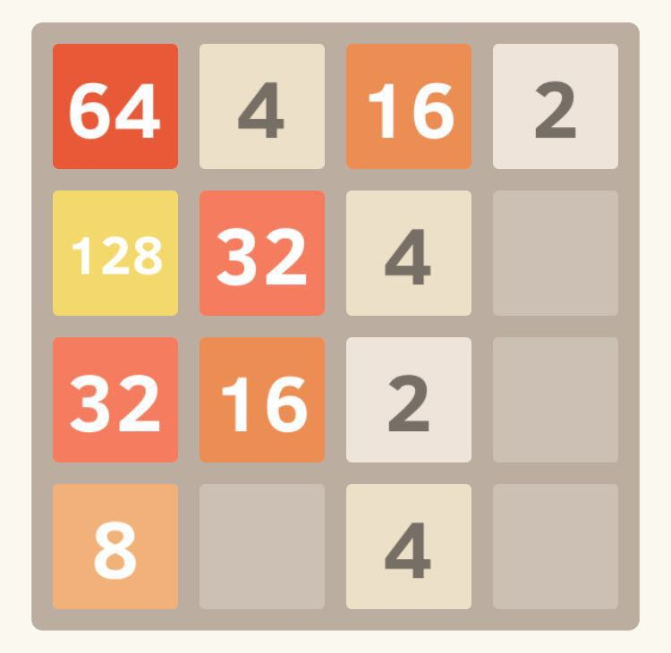
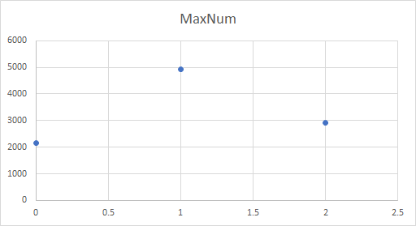
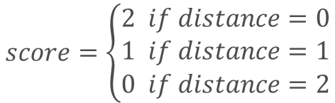
2.The largest number stay close to cortex
Manhattan distance
Notes:
We want the largest number to stay at one corner because if it stays at the center, the value of the tiles would be radial and this would take a lot of space.
Works well at beginning, but the largest number tends to move among different cortexes when reach to 512+ and die

Slide 15
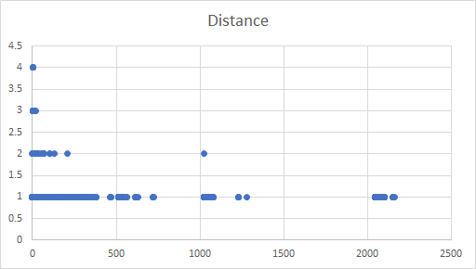
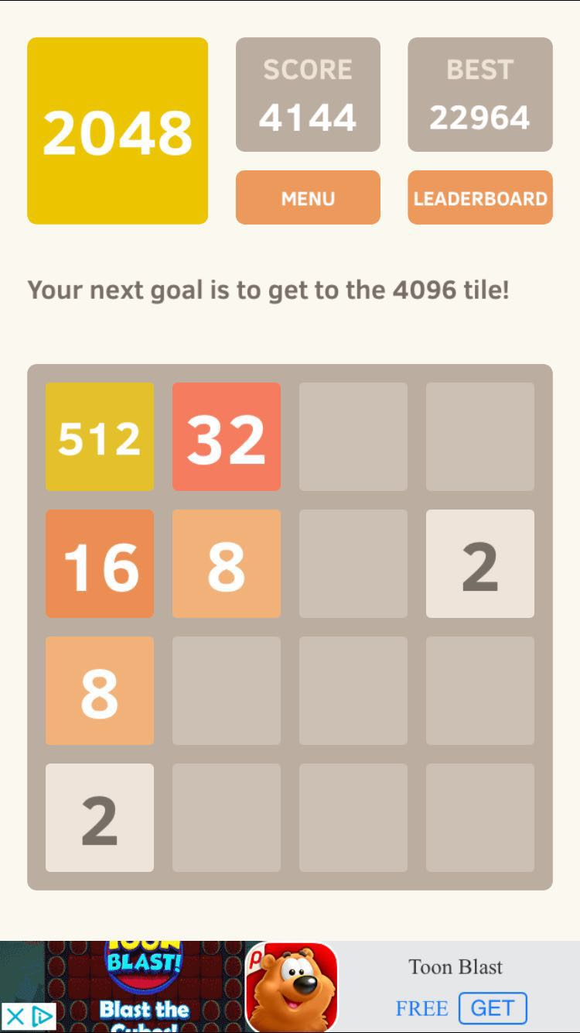
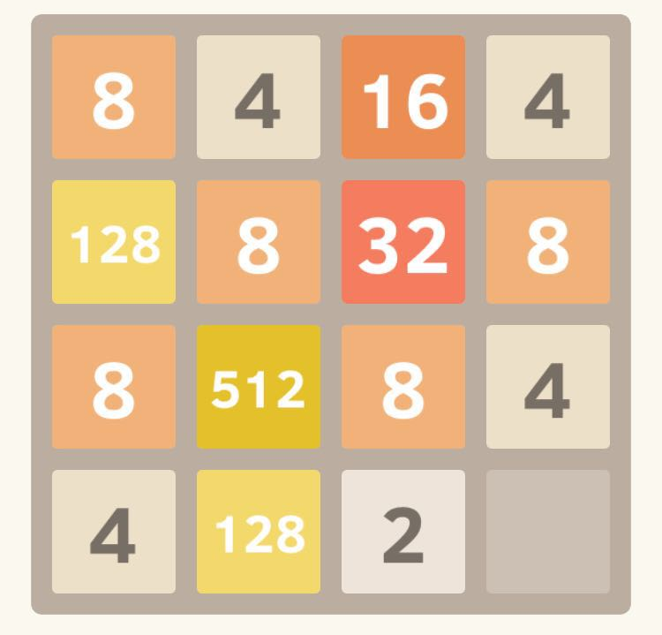
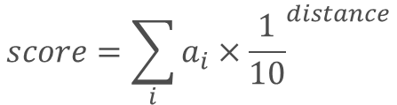
3.Let the largest number stay at one corner

Slide 16
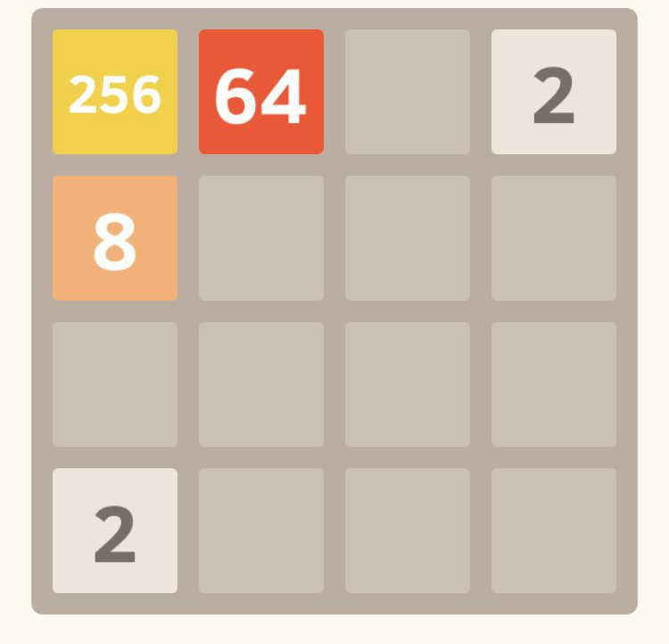
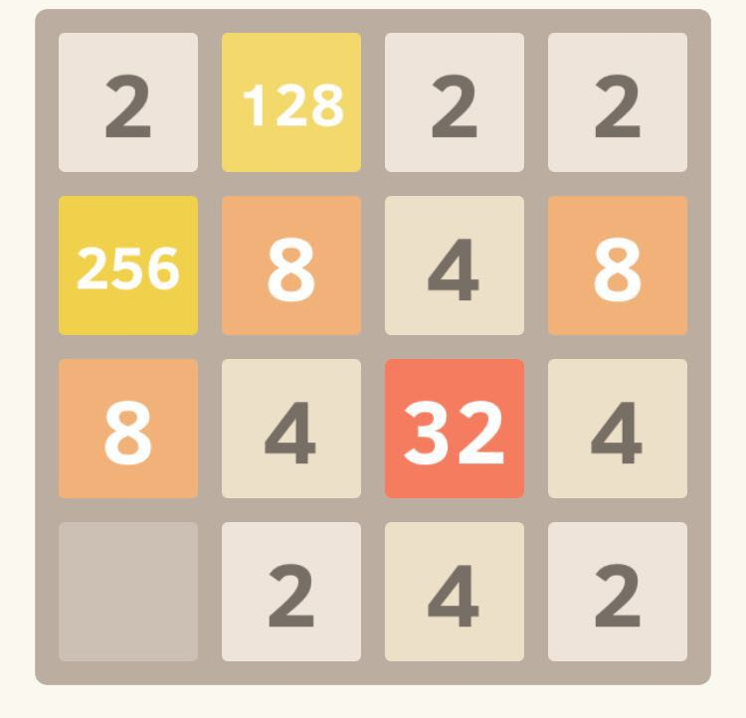
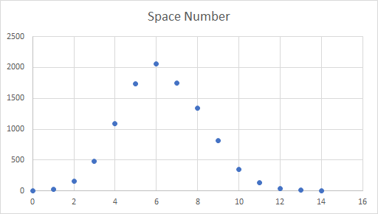

4.Have as many blanks as possible

Slide 17
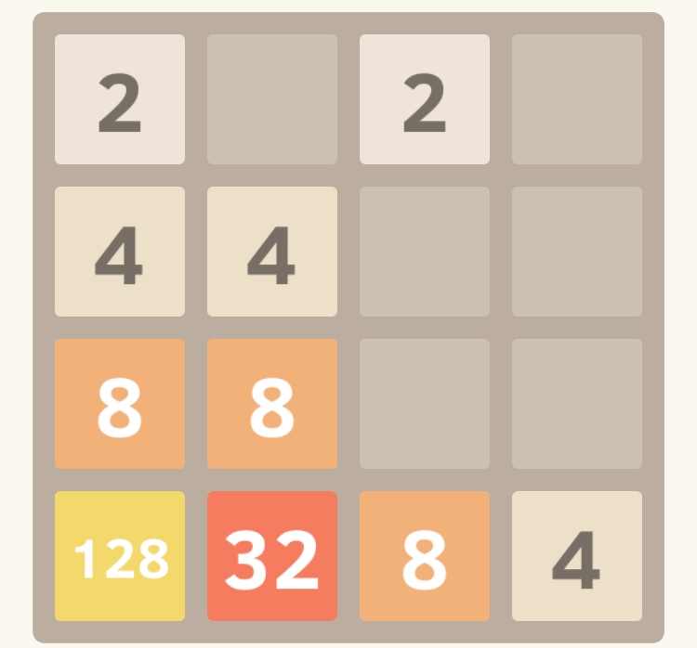
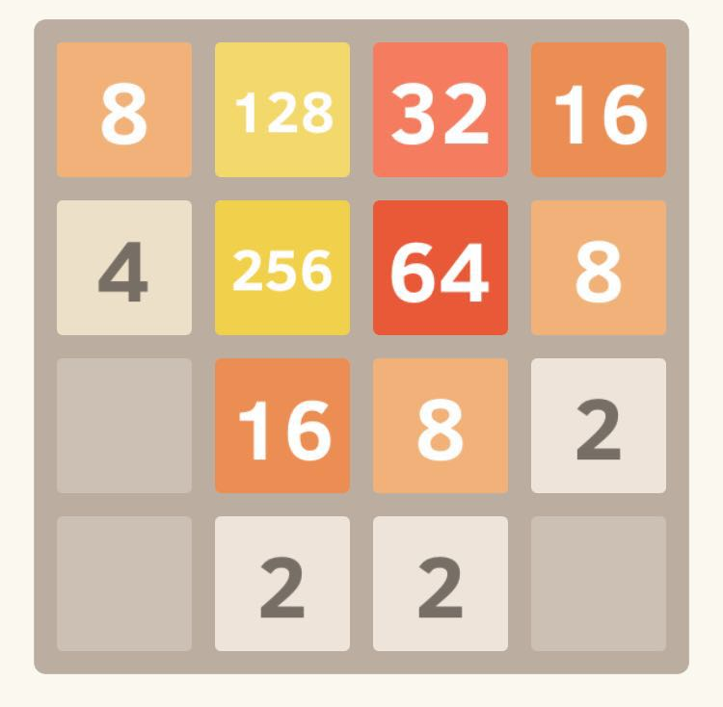
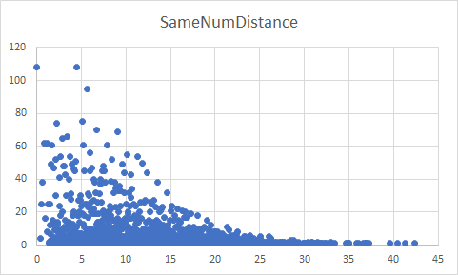
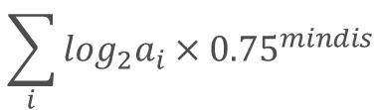
5.The same numbers’ distance is 1

Slide 18
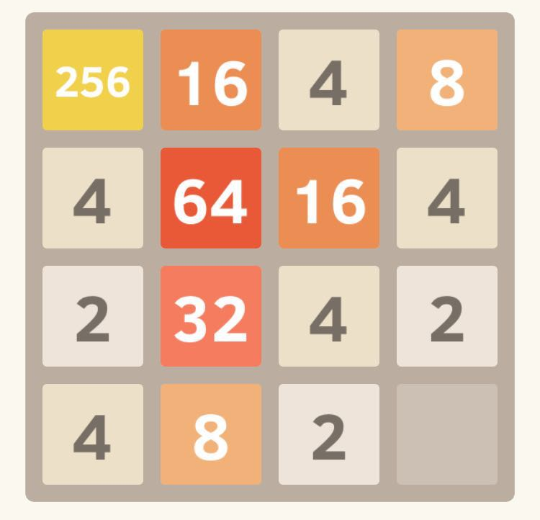
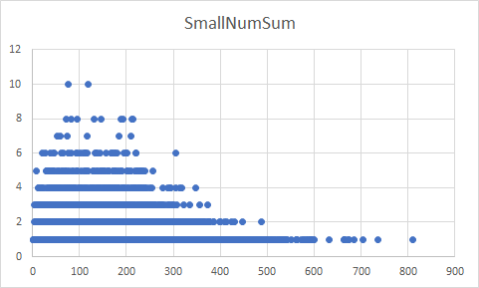

6. Have less small numbers
Notes:
It is obvious that it’s easier to win if there are less small numbers.
How this function work: calculate the sum of the cube of logarithm divided by the number of tiles
Value larger score higher
对数： Logarithm

Slide 19
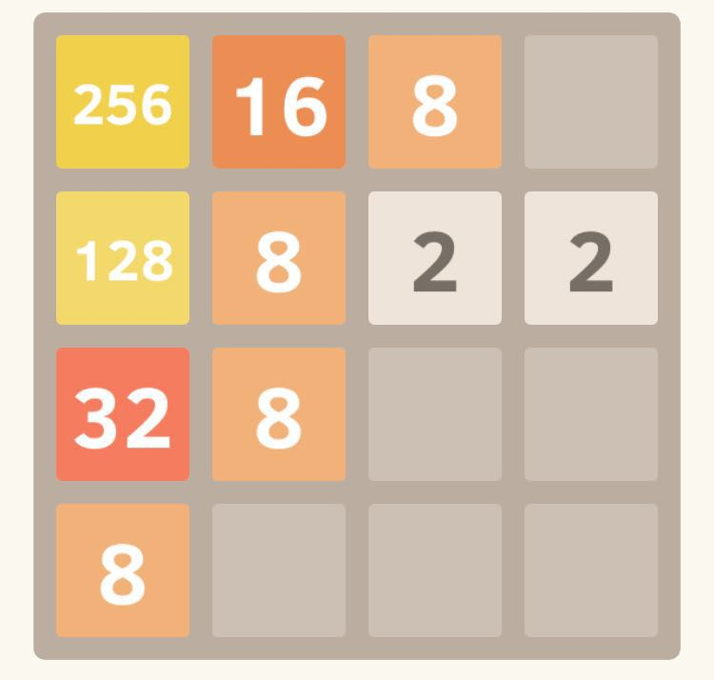
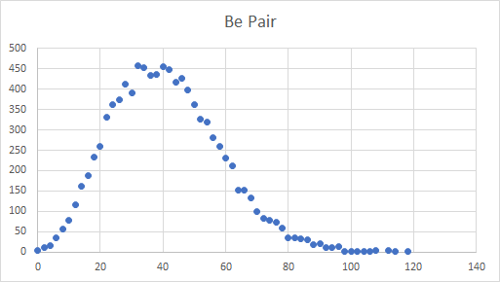
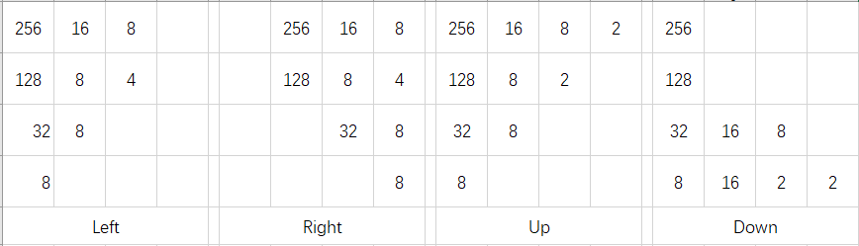

7.Have more pairs of same number
Notes:
Left: 1, right: 1 up: 1 down: 2
Merge → pair of same number
Many pairs of 2 or 4 is not good
To get 2048 needs pairs of large number
Pairs of large number get high score

Slide 20
After getting all the heuristic functions?
Notes:
1. Get the current state (as 4x4 matrix)
2. Calculate the next state of four moving directions
3. Calculate the sum of heuristic scores of four directions
4. Using search strategy to choose next moving direction

Slide 21
Search Strategy
4

Slide 22
Greedy Search
A greedy algorithm is an algorithmic paradigm that follows the problem solving heuristic of making the locally optimal choice at each stage with the hope of finding a global optimum. ------------Wikipedia
Notes:
In our project, we just choose the sum heuristic function score of each direction and choose the largest score’s direction as our next move.

Slide 23
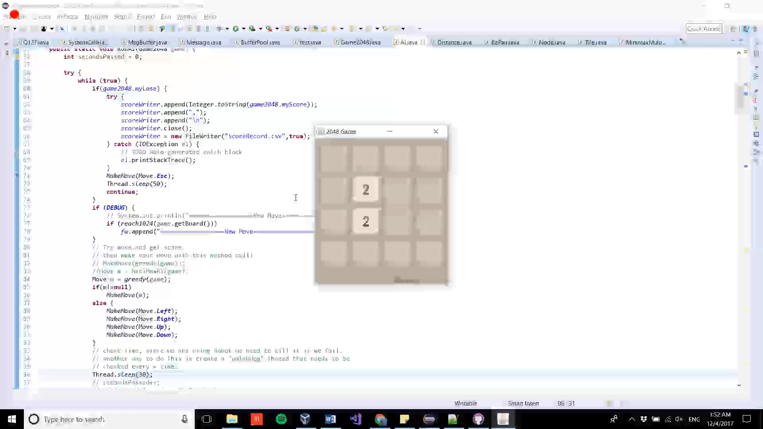
Greedy Search Example
Notes:
The best result for Greedy Search is 1024(ten twenty four)

Slide 24
Minimax Search
Minimax is a decision rule used in decision theory, game theory, statistics and philosophy for minimizing the possible loss for a worst case (maximum loss) scenario. When dealing with gains, it is referred to as "maximin"—to maximize the minimum gain. ------------Wikipedia

Slide 25
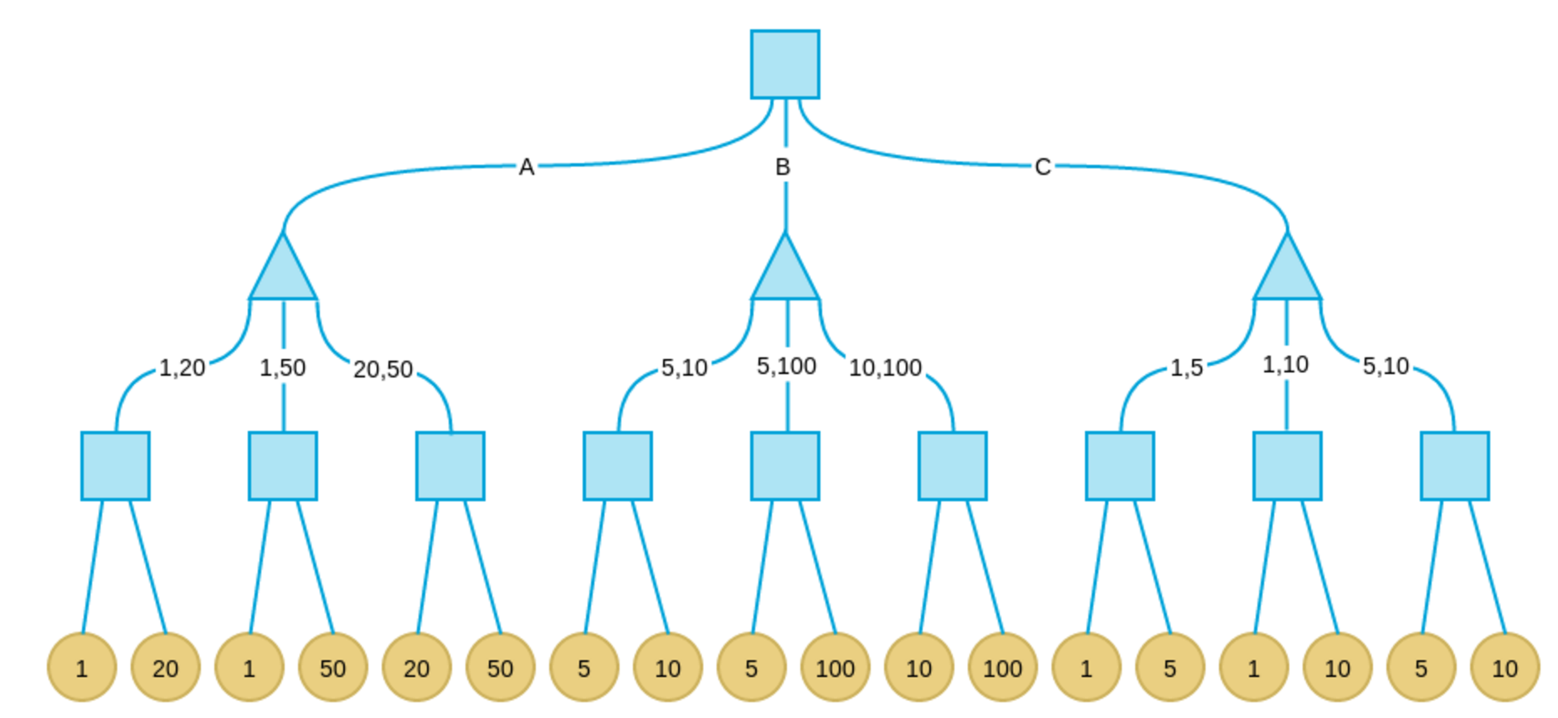
Minimax Search
Notes:
We know that Minimax Algorithm is commonly used for 2-player gaming.
Player: Move the tiles to reach 2048
Competitor (Computer): Place a random tile to make the board unmovable.

Slide 26
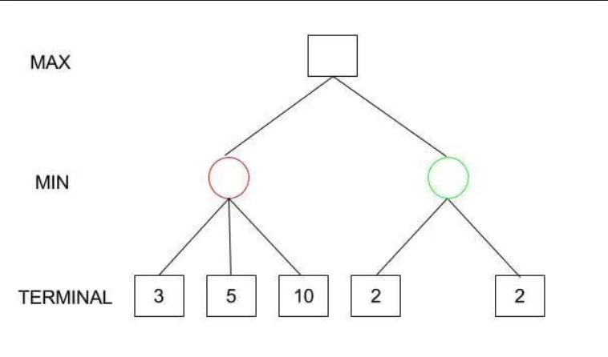
Minimax Implementation
Player: Predict 4 possible result if we move.
Computer: Predict possible outcome of random new tile
Max: Find the child node with maximum scores
Min: Find the child node with minimum scores
Score: Based on the weighted heuristic functions
Minimax Tree depth: 3
Method: Multi-threading & Tree structure
Notes:
1.Get the current state of board
2.Generate the Minimax Tree with depth 3
3. Start from the root, travel through the tree to get the leaf nodes. Find the Max/Min value of each layers.
4.Find the Root’s best child with maximum point, and move to that direction.

Slide 27
About Depth
AI run pretty slowly when the depth is above 5.
The performances with depth 3,4,5 vary greatly
Depth 3 performs best.

Slide 28
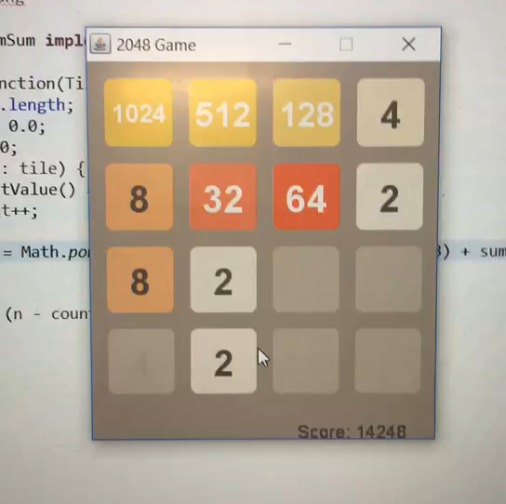
Minimax Search Example

Slide 29
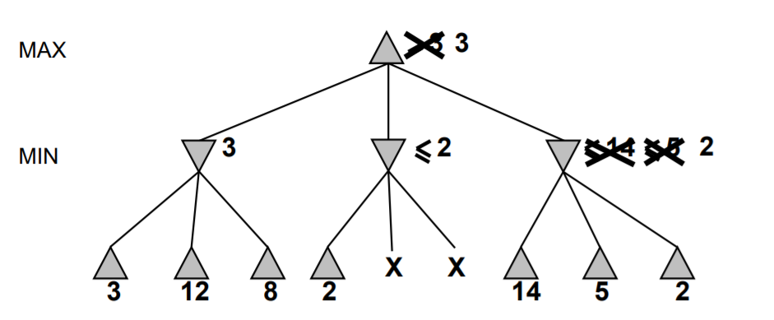
Future construction
Implementing Alpha–beta pruning.

Slide 30
Reference
AI game (java): https://github.com/bulenkov/2048
Heuristic: https://stackoverflow.com/questions/22342854/what-is-the-optimal-algorithm-for-the-game-2048
Minimax blog: http://blog.codinglabs.org/articles/2048-ai-analysis.html
Alpha-beta pruning: m.blog.csdn.net/baixiaozhe/article/details/51872495

Slide 31
Thanks!
😉
Any questions?
Our github repository:
https://github.com/qinzhez/SUCourseProject2048

