Slide 1

Reliability and Reproducibility in Neurorehabilitation Research Data Analysis Pipelines
James Finley, PhD
Assistant Professor
University of Southern California
@jamesmfinley @FinleyLabUSC

Slide 2
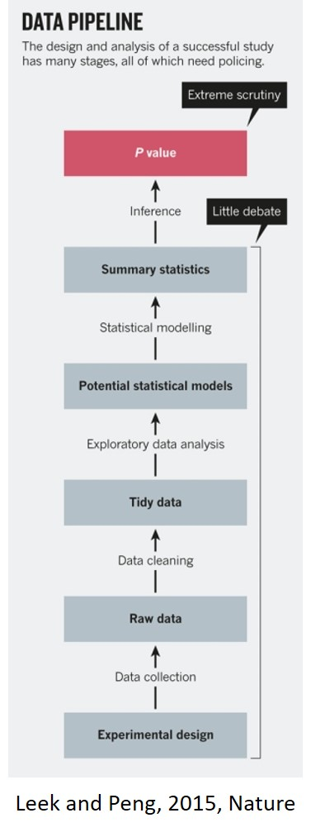
What is a data analysis pipeline?
Includes everything from data collection to statistical inference
Properly documenting and (hopefully) automating this pipeline is critical for reproducible research
Today’s objectives
Use simulations to create a dataset for a virtual experiment
Make deliberate choices about filenames and organization
Learn how to import and organize data using structures
Compute summary statistics and generate a publication quality figure

Slide 3
A pipeline for analyzing single-subject data
Import raw data
Perform manual or automated quality control
Are measurements within an expected range, can noise be filtered, can errors be fixed?
Perform necessary pre-processing steps
Segment long trials, compute secondary variables of interest, filter data
Perform manual or automated quality control
Compute summary measures
Perform manual or automated quality control
Save the results

Slide 4
A pipeline for combining data from multiple participants
Load each participant's data
Store data in a single matrix or structure
Perform manual or automated quality control
Compute summary measures
Perform statistical analyses
Generate summary figures

Slide 5
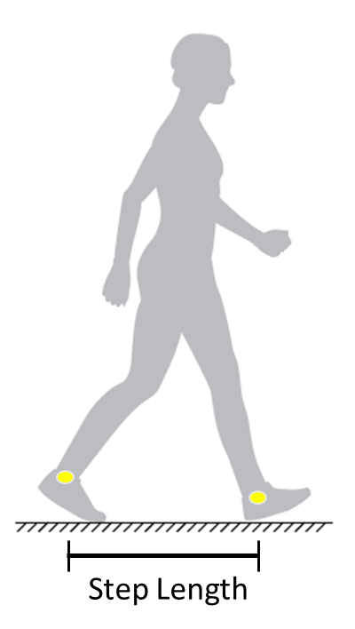
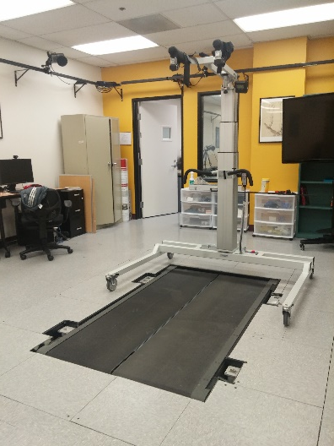
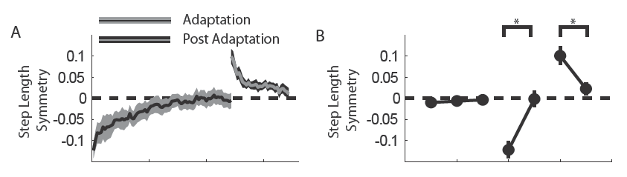
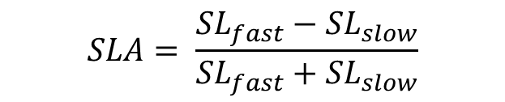
Exploring adaptation to a sustained asymmetric perturbation using a dual-belt treadmill
$$SLA= \frac{{SL}_{fast}−{SL}_{slow}}{{SL}_{fast}+{SL}_{slow}}$$
Step Length
Asymmetry
Dietz et al., 1994, Exp Brain Res
Reisman et al., 2005, J Neurophys
Finley et al., 2013, J Physiol
Notes:
Why split-belt adaptation?
Useful tool to understand how intralimb and interlimb coordination
In the absence of damage to the cerebellum, most population adapt in a similar manner
Understanding the adaptation process may provide insight into the costs of asymmetry in pathological populations
Repeated adaptation in people post-stroke can lead to long-term reductions in asymmetry for a subset of individuals

Slide 6
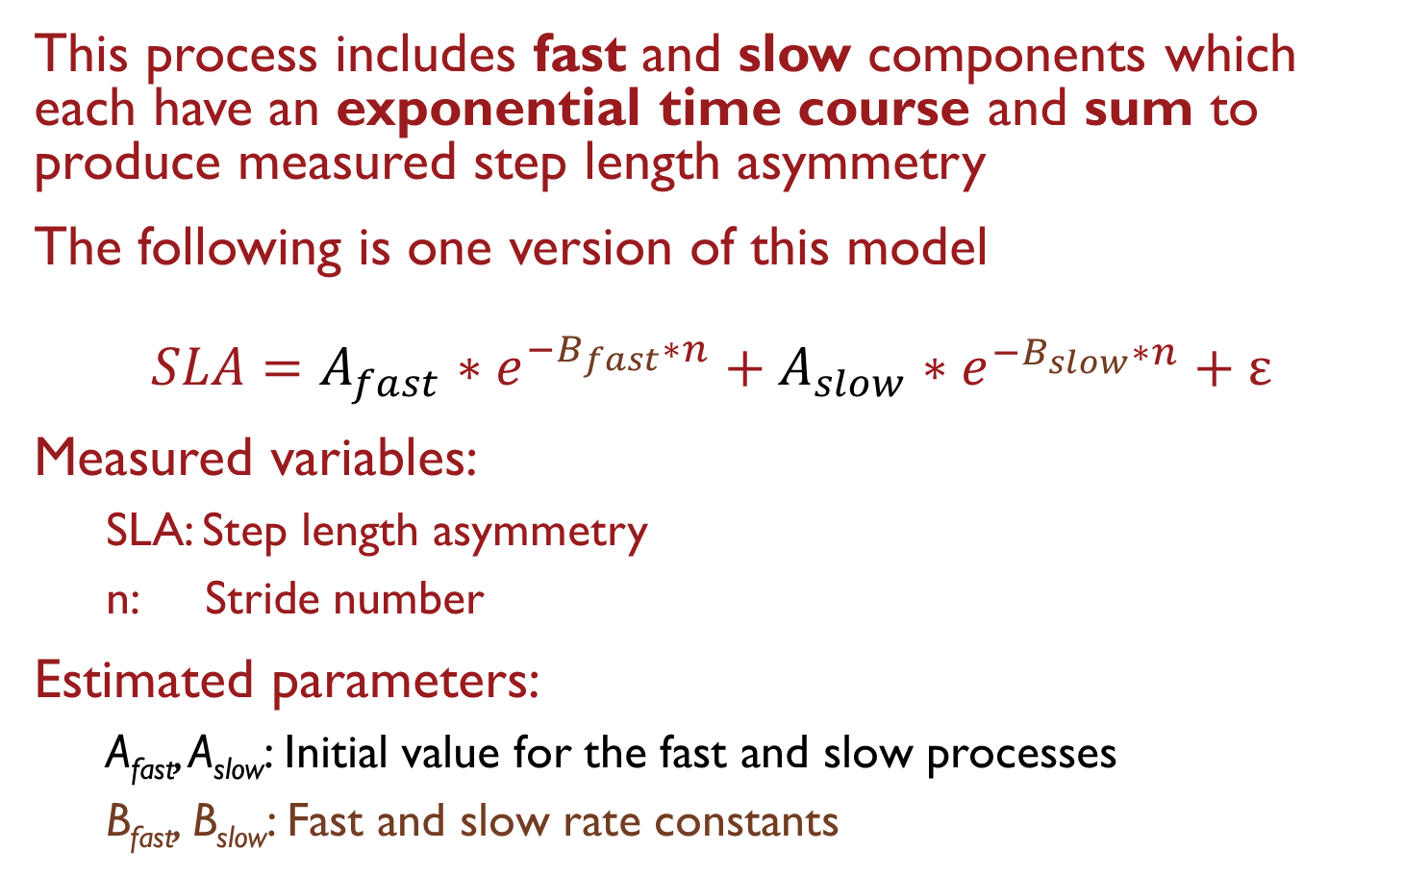
Adaptation is commonly modeled as a dual-rate learning process
This process includes fast and slow components which each have an exponential time course and sum to produce measured step length asymmetry
The following is one version of this model
$$SLA=A_{fast}∗e^{−B_{fast}∗n}+A_{slow}∗e^{−B_{slow}∗n}+ε$$
Measured variables:
SLA: Step length asymmetry
n: Stride number
Estimated parameters:
A_{fast}, A_{slow}: Initial value for the fast and slow processes
B_{fast}, B_{slow}: Fast and slow rate constants
Mawase et al., 2013, J Neurophys.

Slide 7
Our virtual data collection session
Assume that step length asymmetry data are generated from a dual-rate process
Specify a sample size
Set reasonable values of each parameter for each hypothetical participant
Add some participant-specific noise to represent stride-to-stride fluctuations
Save our raw data in a set of .csv files

Slide 8
Our analysis procedure
Import data from .csv files into Matlab
Perform visual quality control
Estimate model parameters from the data
Determine if estimates match ground truth
Generate a publication-quality summary figure

