Slide 5
evidence

Slide 6
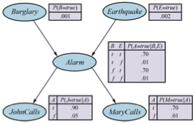

Slide 7
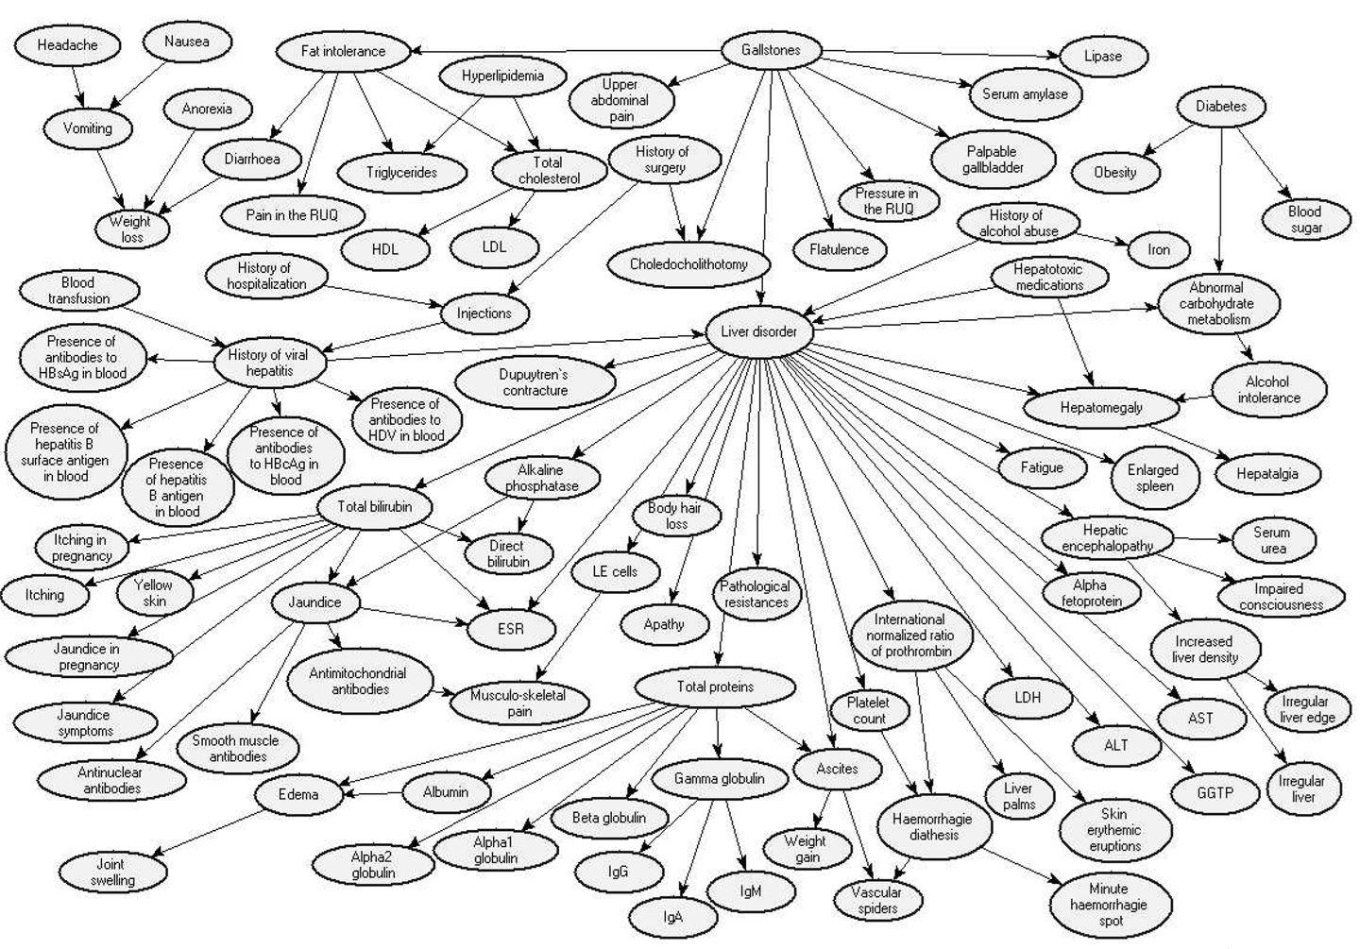
The example below is taken from the publication “A Bayesian Network Model for Diagnosis of Liver Disorders” – Agnieszka Onisko, M.S., Marek J. Druzdzel, Ph.D., and Hanna Wasyluk, M.D.,Ph.D.- September 1999.

Slide 8
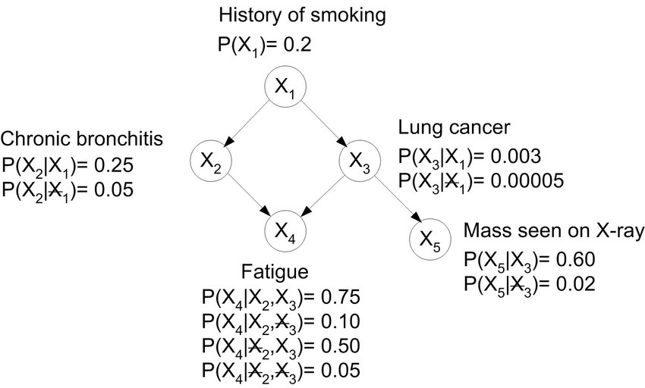

Slide 9
