Slide 1
URBAN EXPANSION VS.
ECONOMIC ACTIVITY
Satellite-only economic analogue retrieval
across 30 U.S. metros, 2013-2023.
AC209B / CS1090B Final Project Group 12
github.com/cathyliu0510/209b_Final_Project
Minh Tran, Cathy Liu, Jenny Zhu, Maddy Jin

Slide 2
PROBLEM + APPROACH
2 / 14
RETRIEVAL USES SIGNAL THAT REGRESSION MISSES
DIRECT REGRESSION
ANALOGUE RETRIEVAL
Image → GDP value
Image → similar city-years
85% of GDP variance is between cities, driven by size and geography.
Pooled satellite vs. GDP correlation is near zero: r ≈ 0.01.
A single regression must compress city differences and noisy yearly changes into one prediction.
Train so the image space carries economic meaning.
At test time: an image alone retrieves the most economically similar city-years from history.
Their GDP becomes the estimate. No economic data needed at inference.
->
Fails on small panel, noisy cross-city signal
Robust, interpretable, satellite-only at test

Slide 3
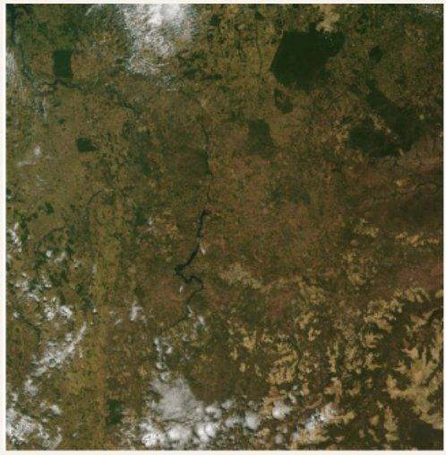
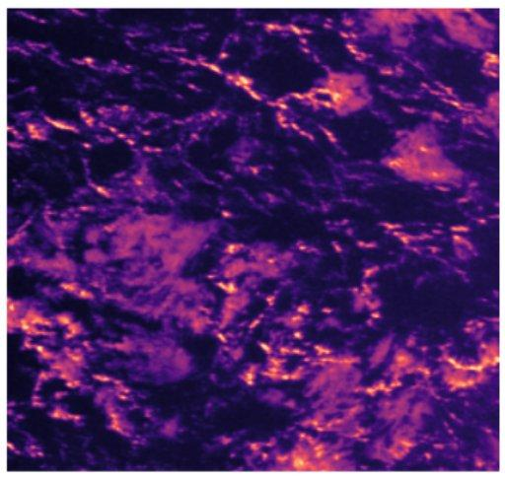
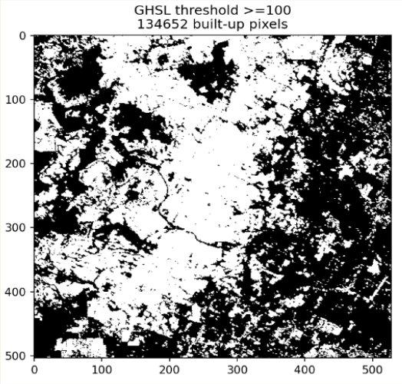
DATA
3 / 14
A 30-METRO PANEL WITH A STRICT TEMPORAL HOLDOUT
30
330
2020
4
U.S. metro areas
city-year observations
excluded (COVID)
data sources
TEMPORAL SPLIT - split by years, not metros, to test generalization to unseen future periods
TRAIN
VAL
EXCLUDED
TEST
2013-2018
2019
2020
2021-23
2020 excluded: COVID created a structural break that sequence models cannot learn across.
MODIS RGB
VIIRS Nightlights
GHSL Built-up Mask
BEA / BLS Panel
Visible urban texture & land use
Economic activity proxy
Urbanization ground truth
GDP - Unemployment
Total Wages
GDP - Employment
Unemployment Rate
Total Wages

Slide 4
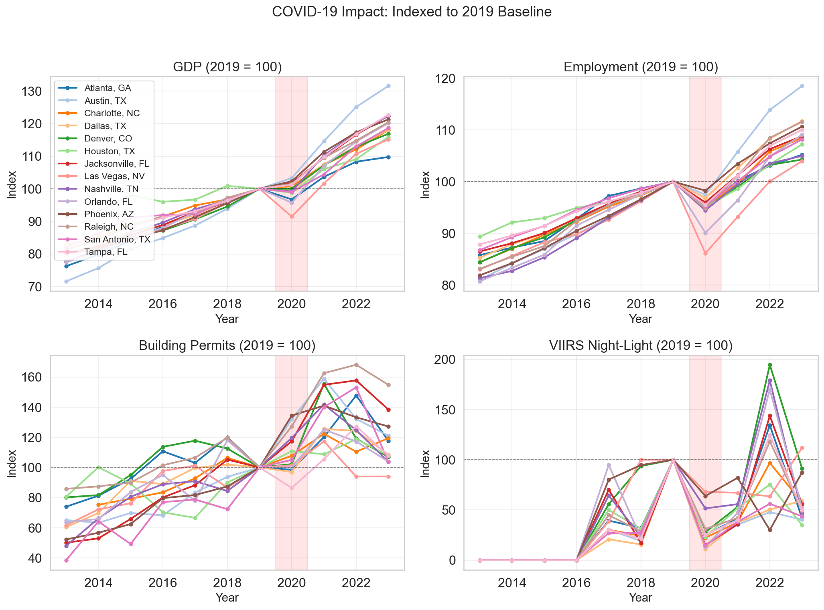
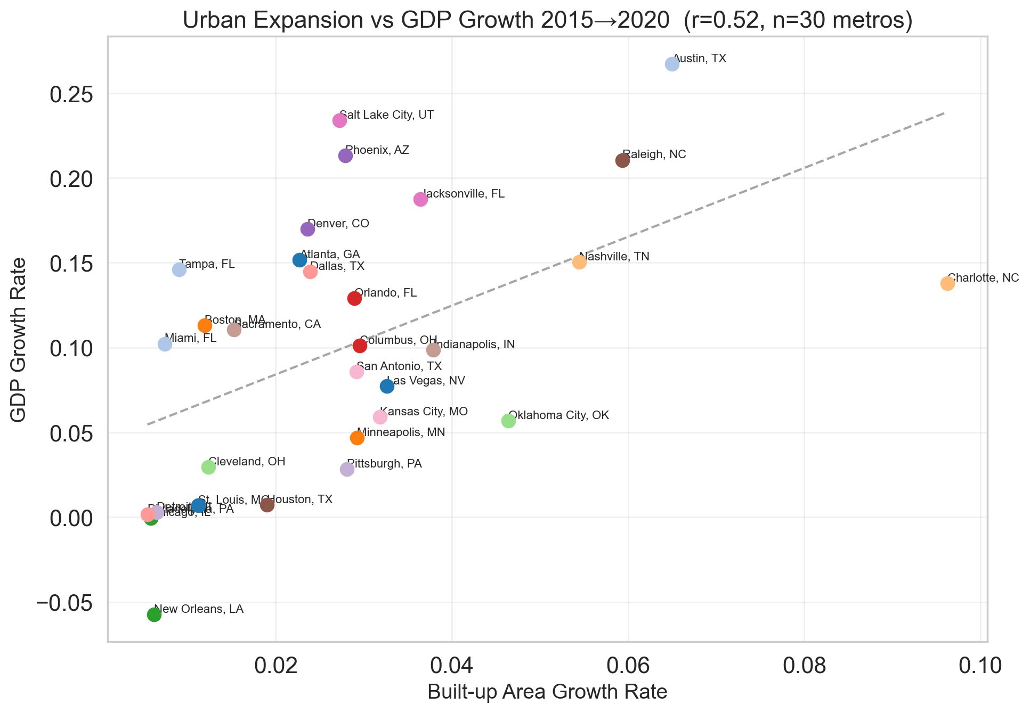
EDA
4 / 14
EDA FINDINGS 1 & 2: COVID BREAK AND CROSS-CITY VARIANCE.
FINDING 1 - COVID 2020 STRUCTURAL BREAK
FINDING 2 - FINDING 2 - EXPANSION TRACKS GDP
2020 is a hard break: unemployment spikes while built-up area stays flat.
Built-up area growth is positively associated with GDP growth before COVID.
Sequence models cannot bridge this discontinuity. Exclude 2020 from all training.
Faster built-up area growth aligns with higher GDP growth (r = 0.52, n = 30).

Slide 5
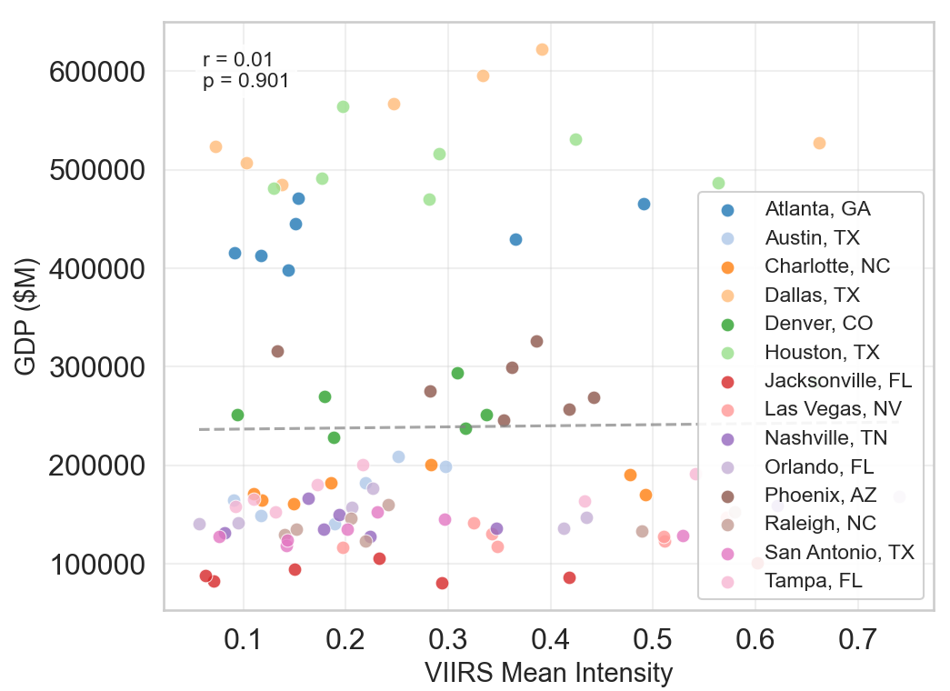
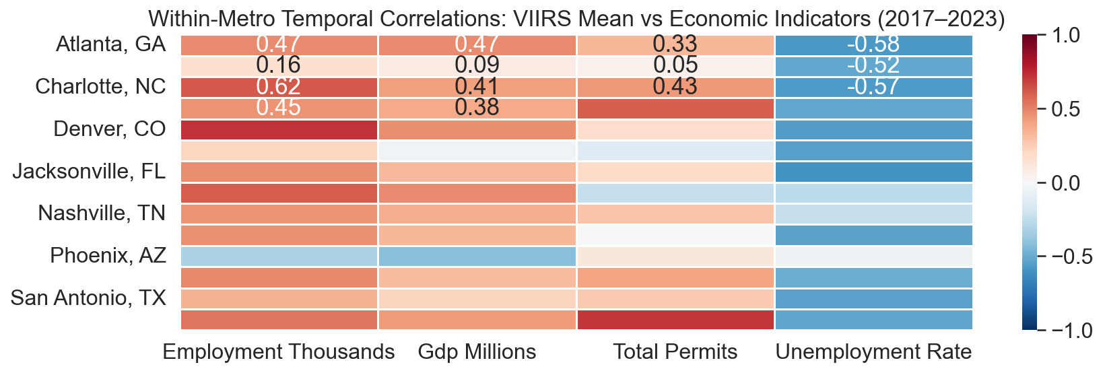
EDA
5 / 14
EDA FINDING 3: EDA FINDING 3: SATELLITE SIGNAL IS WEAK ACROSS CITIES, STRONGER WITHIN CITIES
POOLED ACROSS ALL CITIES
WITHIN EACH METRO (TEMPORAL)
r = 0.01
r = 0.3 to 0.7
Within-metro VIIRS vs. GDP, Employment, Permits, Unemployment
The signal appears within cities over time, not when all cities are pooled.
Pooled regression mixes fixed city differences with real economic change.
We need city-aware representations that separate city identity from temporal change.
VIIRS Mean vs. GDP, pooled across all metros

Slide 6
MODEL PIPELINE
6 / 14
TRAIN WITH BOTH MODALITIES.
AT INFERENCE, SATELLITE IMAGERY ONLY.
TRAIN
Satellite imagery
Finetuned ResNet
Contrastive VAE
Training
latent DB
MODIS + VIIRS
4-channel input
→
→
GHSL supervised
with InfoNCE
contrastive alignment
→
180 city-years
with known GDP
(2013-2018)
16-D shared
latent space
Economic data
MLP Encoder
GDP, employment
unemployment etc.
→
→
economic
INFER
AT INFERENCE - economic branch dropped entirely
Satellite
imagery only
Image-only encoder
k-NN retrieval
GDP estimate
No economic data
at query time
→
project image
→ latent space
→
nearest historical
city-year
→
average of k
neighbors

Slide 7
PHASE 1 - SATELLITE ENCODER
7 / 14
SATELLITE ENCODER: FINE-TUNED RESNET WITH GHSL SUPERVISION.
Fine-tuned
ResNet-18
512-D
embedding
→
GHSL built-up area
regression loss
(BCE + Dice)
→
urbanization encoded from GHSL
Centroid separation improves from 1.217
to 1.418 (+16%)
MODIS RGB 250m satellite
GHSL urbanization mask
used as supervision target
→ projection head
GHSL supervision makes the encoder focus on urbanization structure, not raw image appearance.
GHSL binary mask - urbanization ground truth

Slide 8
PHASE 1 - ECONOMIC ENCODER
8 / 14
ECONOMIC ENCODER: MLP SELECTED OVER GRU AND LSTM.
Economic Data
MLP
Encoder
64-D
embedding
Economic Encoder Comparison
GDP growth
Unemployment rate
Log-wages
MLP
0.056
→
Static per-year
→
GRU
1.081
economic state
per city-year
LSTM
1.192
2021-2023 reconstruction MSE
Lower is better. MLP has the lowest holdout reconstruction error.
Economic input
COVID 2020 breaks GRU/LSTM sequence assumptions
→ projection head
TRAINING DETAILS
Satellite encoder
ResNet-18 BCE+Dice loss LR 3e-4 40 epochs batch 16
Economic encoder
MLP Adam optimizer LR 1e-3 200 epochs (early stopping) MSE loss
Contrastive VAE
InfoNCE t=0.07 KL warmup 0.1 to 1.0 batch 32 16-D latent space

Slide 9
PHASE 1 - CONTRASTIVE VAE
9 / 14
CONTRASTIVE EMBEDDING VAE:
MULTIMODAL ALIGNMENT and MODALITY DROPOUT
Image Embeddings
Multimodal contrastive alignment
Shared Latent Space
Same city-year from both branches = positive pair. All others = negatives. Forces latent space to be economically ordered.
z_img (ResNet-18,, GHSL-finetuned)
Modality dropout
matched - pulled together
Economic branch randomly zeroed during training. VAE learns to reconstruct from satellite alone, enabling satellite-only inference.
Economic Embeddings
unmatched - pushed apart
What the latent space encodes
z_econ (MLP encoder, 3 indicators)
Each 16-D point is a city-year encoding both urbanization structure and economic state. Nearby points are economically similar.

Slide 10
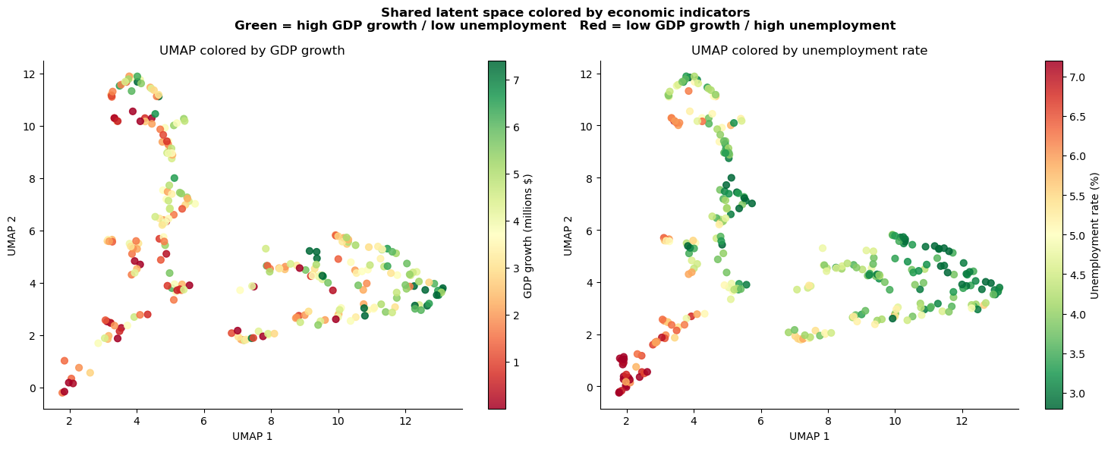
RESULT - LATENT SPACE
10 / 14
THE LATENT SPACE CREATES ECONOMIC NEIGHBORHOODS.
UMAP of 16-D shared latent space - colored by GDP growth (left) and unemployment rate (right).
Economically ordered
Not just geography
Validates retrieval
Color gradient is spatially coherent. Green = high GDP / low unemployment. Red = stagnant.
Cities from different regions mix when economic trajectories align. The space is economic.
If nearby points share economic state, k-NN retrieval finds useful analogues.

Slide 11
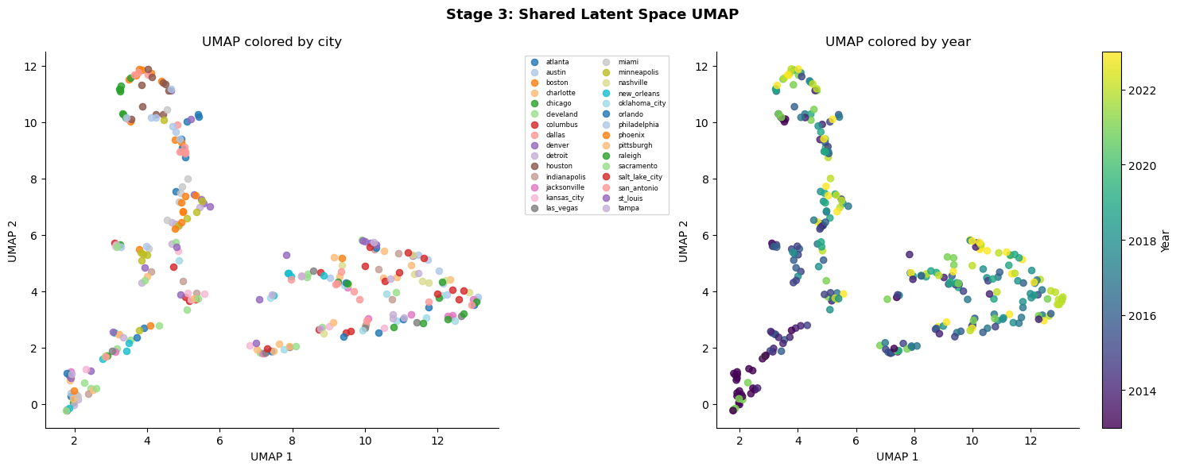
RESULT - LATENT SPACE
11 / 14
CITIES TRACE COHERENT ECONOMIC TRAJECTORIES THROUGH THE LATENT SPACE.
Same UMAP - colored by city (left) and by year (right). Cities cluster across years; year gradient shows temporal ordering is preserved.
The model was never given year labels. Temporal ordering emerges purely from the economic structure learned in the latent space.

Slide 12
PHASE 2 - K-NN RETRIEVAL
12 / 14
PHASE 2: k-NN RETRIEVAL APPLIED AFTER THE LATENT SPACE LEARNED.
1
2
3
4
5
Query Image
Finetuned
ResNet-18
Project onto
latent space
Top-k
Neighbors
GDP Estimate
→
→
→
→
new city
satellite only
same weights
frozen
k chosen by
2019 val MAE
average of
neighbors
Validation-guided model selection - 2019 val MAE used to select k and metric; tested on 2021-2023 holdout
Configuration
Val MAE (2019)
Test MAE (2021-23)
Scaled Euclidean k=8
1.159
2.435
SELECTED
Scaled Manhattan k=8
1.186
2.455
Cosine k=3
1.395
2.488
Cosine k=5
1.320
2.504
Cosine k=1
1.995
2.690

Slide 13
RESULTS
13 / 14
IMAGE-ONLY RETRIEVAL BEATS NAIVE BASELINES
TEST MAE = 2.435
Given only a satellite image, we estimate a city's GDP growth within +/-$2.4B without any economic data.
MAE = 2.435
GDP growth B USD satellite only at test
Train mean
2.558
Learned analogues beat
random guessing
Random retrieval (avg 100)
2.923
The latent space retrieves economically meaningful neighbors, not random city-years.
Previous-year value
2.358
Satellite imagery becomes
economically searchable
Cosine k=5
2.504
Multimodal training gives the image encoder economic signal it could not learn from imagery alone.
Scaled Euclidean k=8 (selected)
2.435
Image-only inference
outperforms naive baselines
2021-2023 test MAE on GDP growth
Satellite-only retrieval beats train-mean and random baselines at test time.
Tested on 2021-2023 holdout using satellite imagery only. Baselines use no imagery.

Slide 14
CONCLUSIONS & NEXT STEPS
14 / 14
FROM SATELLITE IMAGERY TO ECONOMIC INTELLIGENCE.
WHAT WE CAN DO NOW
Given a new city at a new point in time, we can make an informed estimate of its economic state: GDP growth and unemployment, using only satellite imagery.
This matters most where economic data is delayed, sparse, or unavailable: developing regions, fast-growing secondary cities, post-crisis monitoring.
With a larger worldwide retrieval bank, cities in the same economic region cluster together, and satellite images of unknown cities can be placed into that economic neighborhood.
WHAT WE BUILT
NEXT STEPS
Contrastive Embedding VAE: aligns pre-trained satellite and economic embeddings into a shared 16-D economic latent space.
Scale to 1,000+ cities with Sentinel-2 (10m) for richer retrieval and less sample-limited analogues.
GHSL supervision for ResNet: encoder learns urbanization density, not just pixel color (+16% centroid separation).
Test on developing-nation metros where economic data is sparse: the primary target use case.
k-NN retrieval in latent space: interpretable, parameter-free Phase 2 separate from training.
Sliding-window contrastive learning to capture richer temporal economic dynamics.

