Slide 1
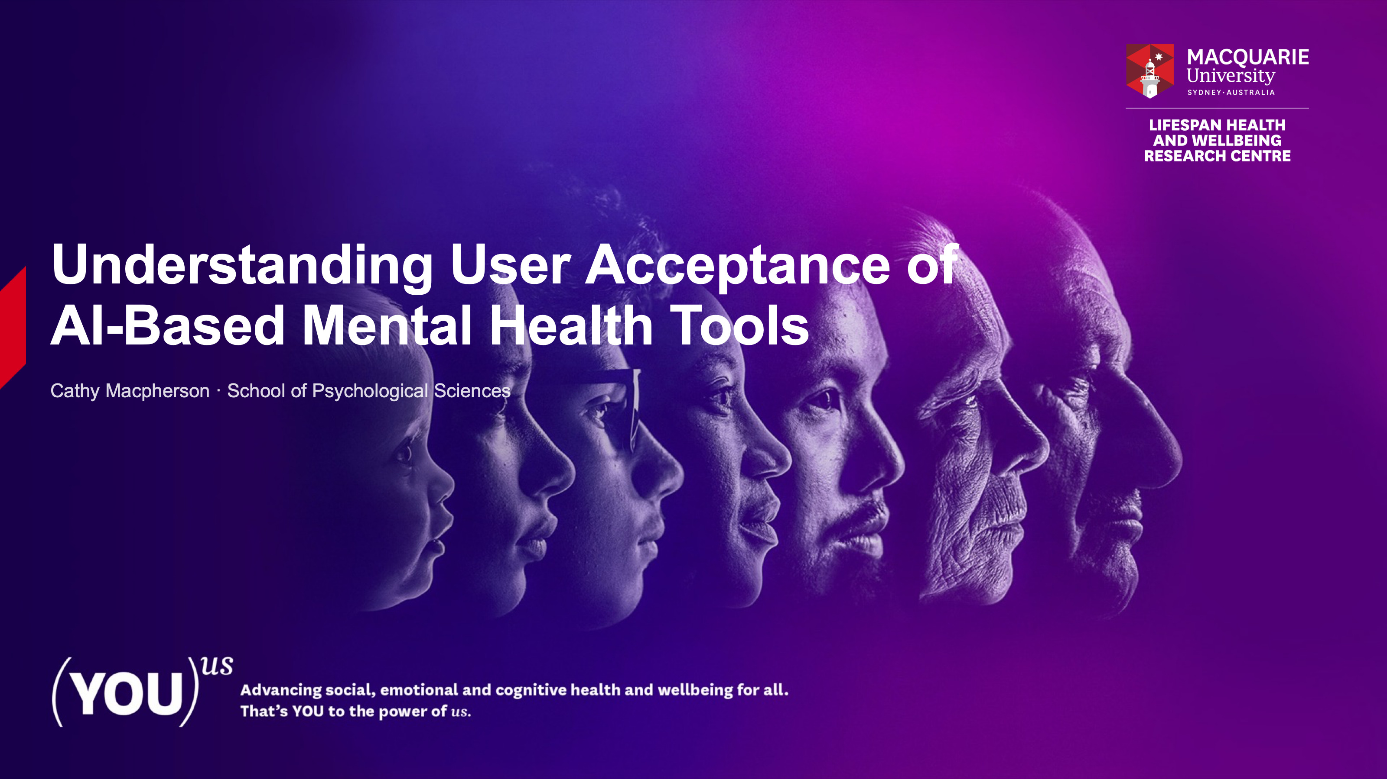

Slide 2
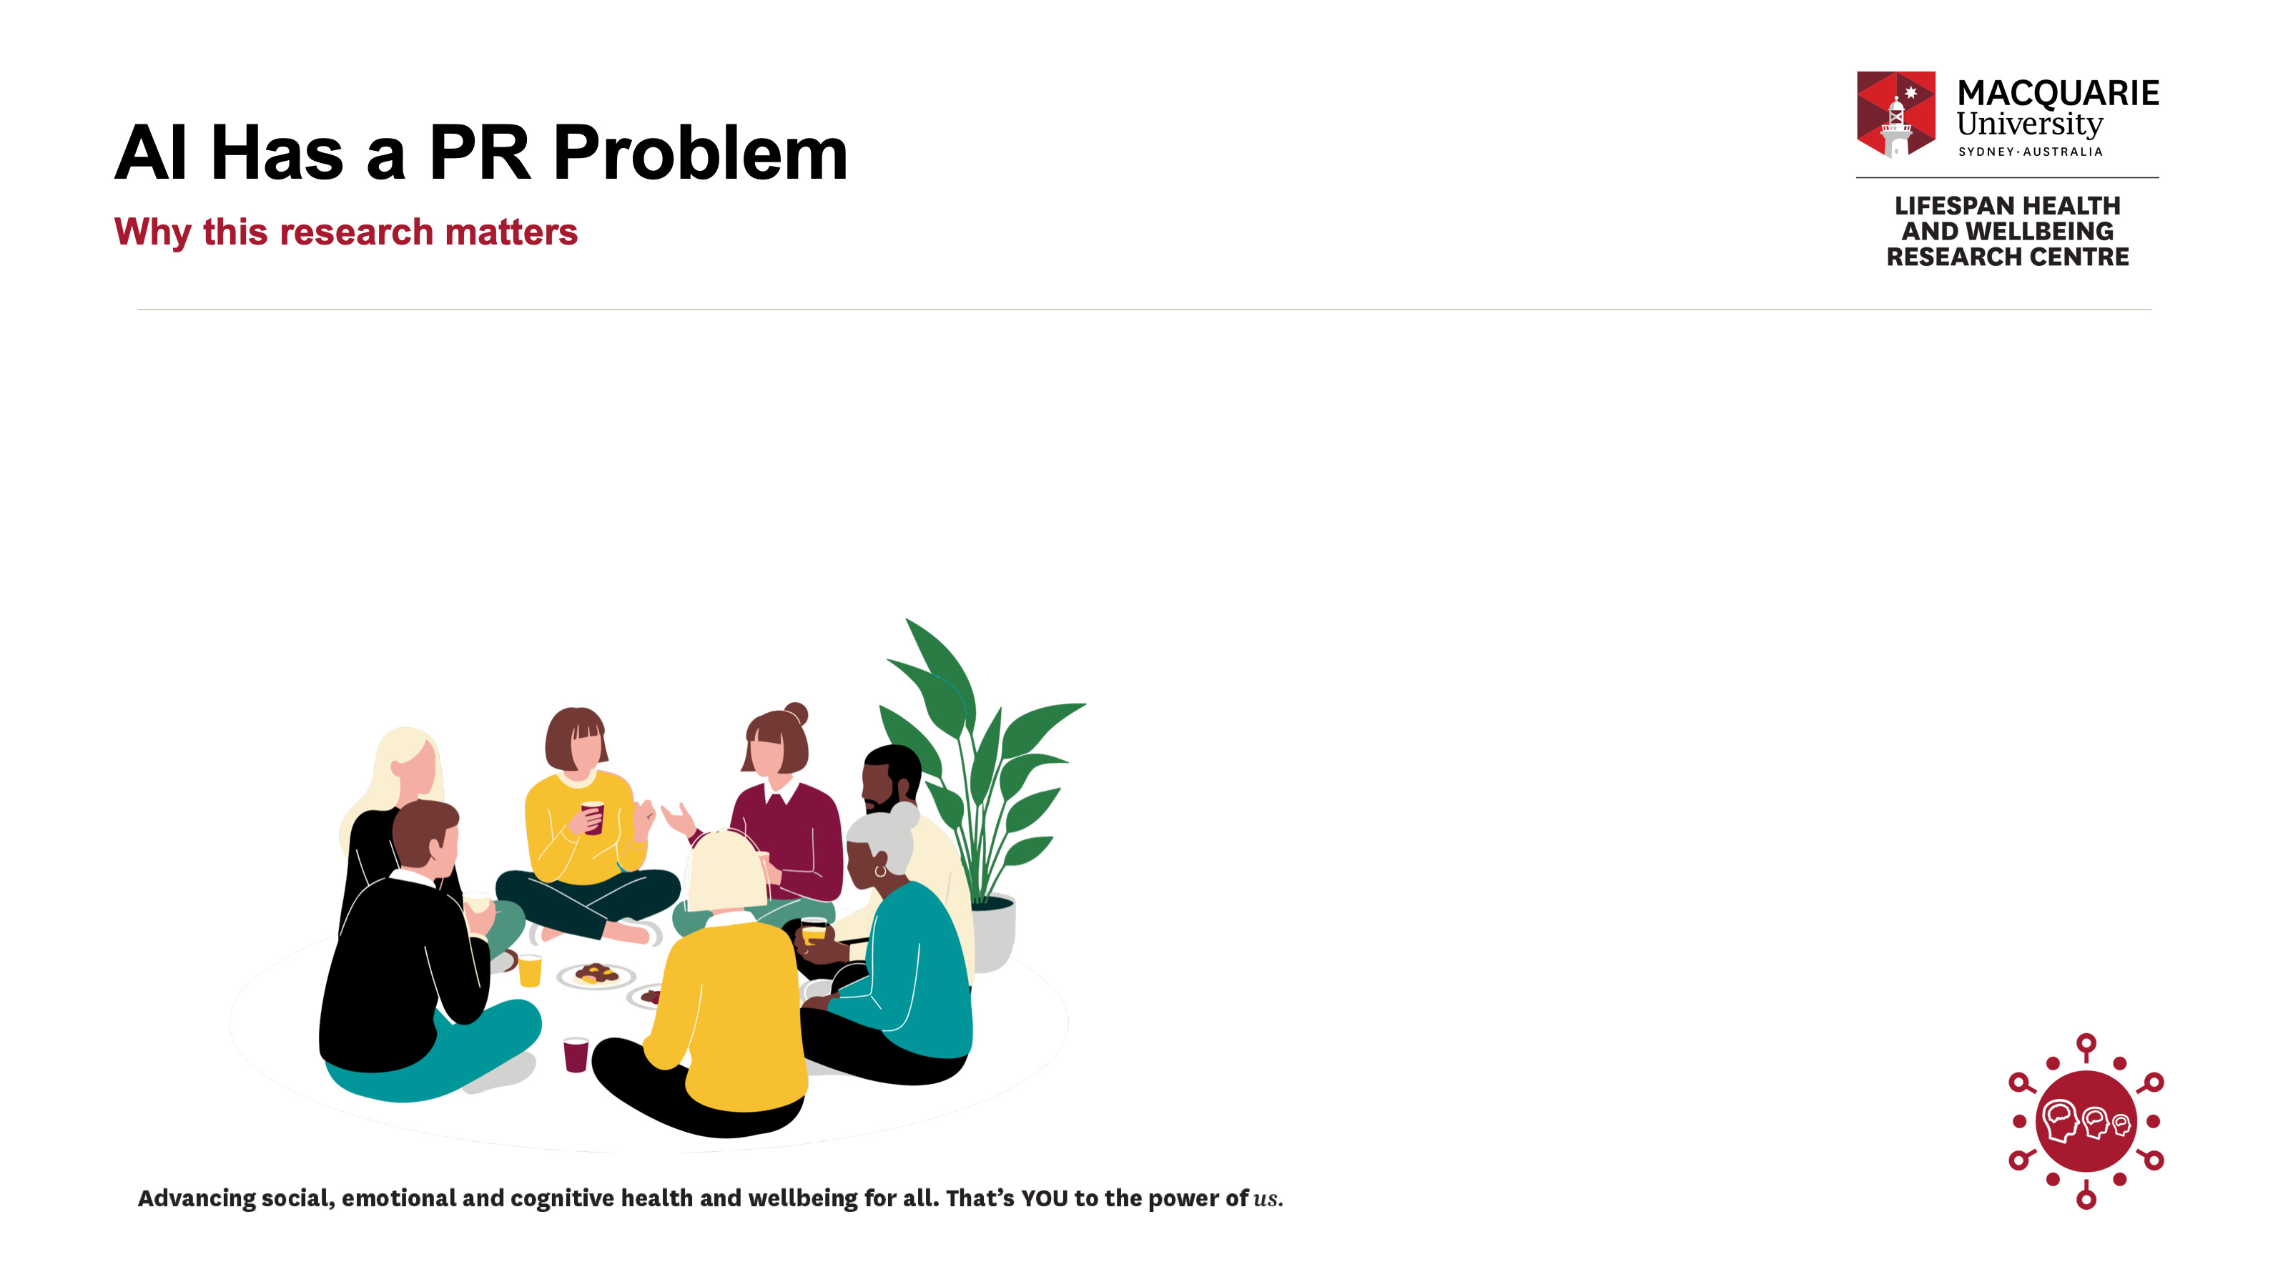
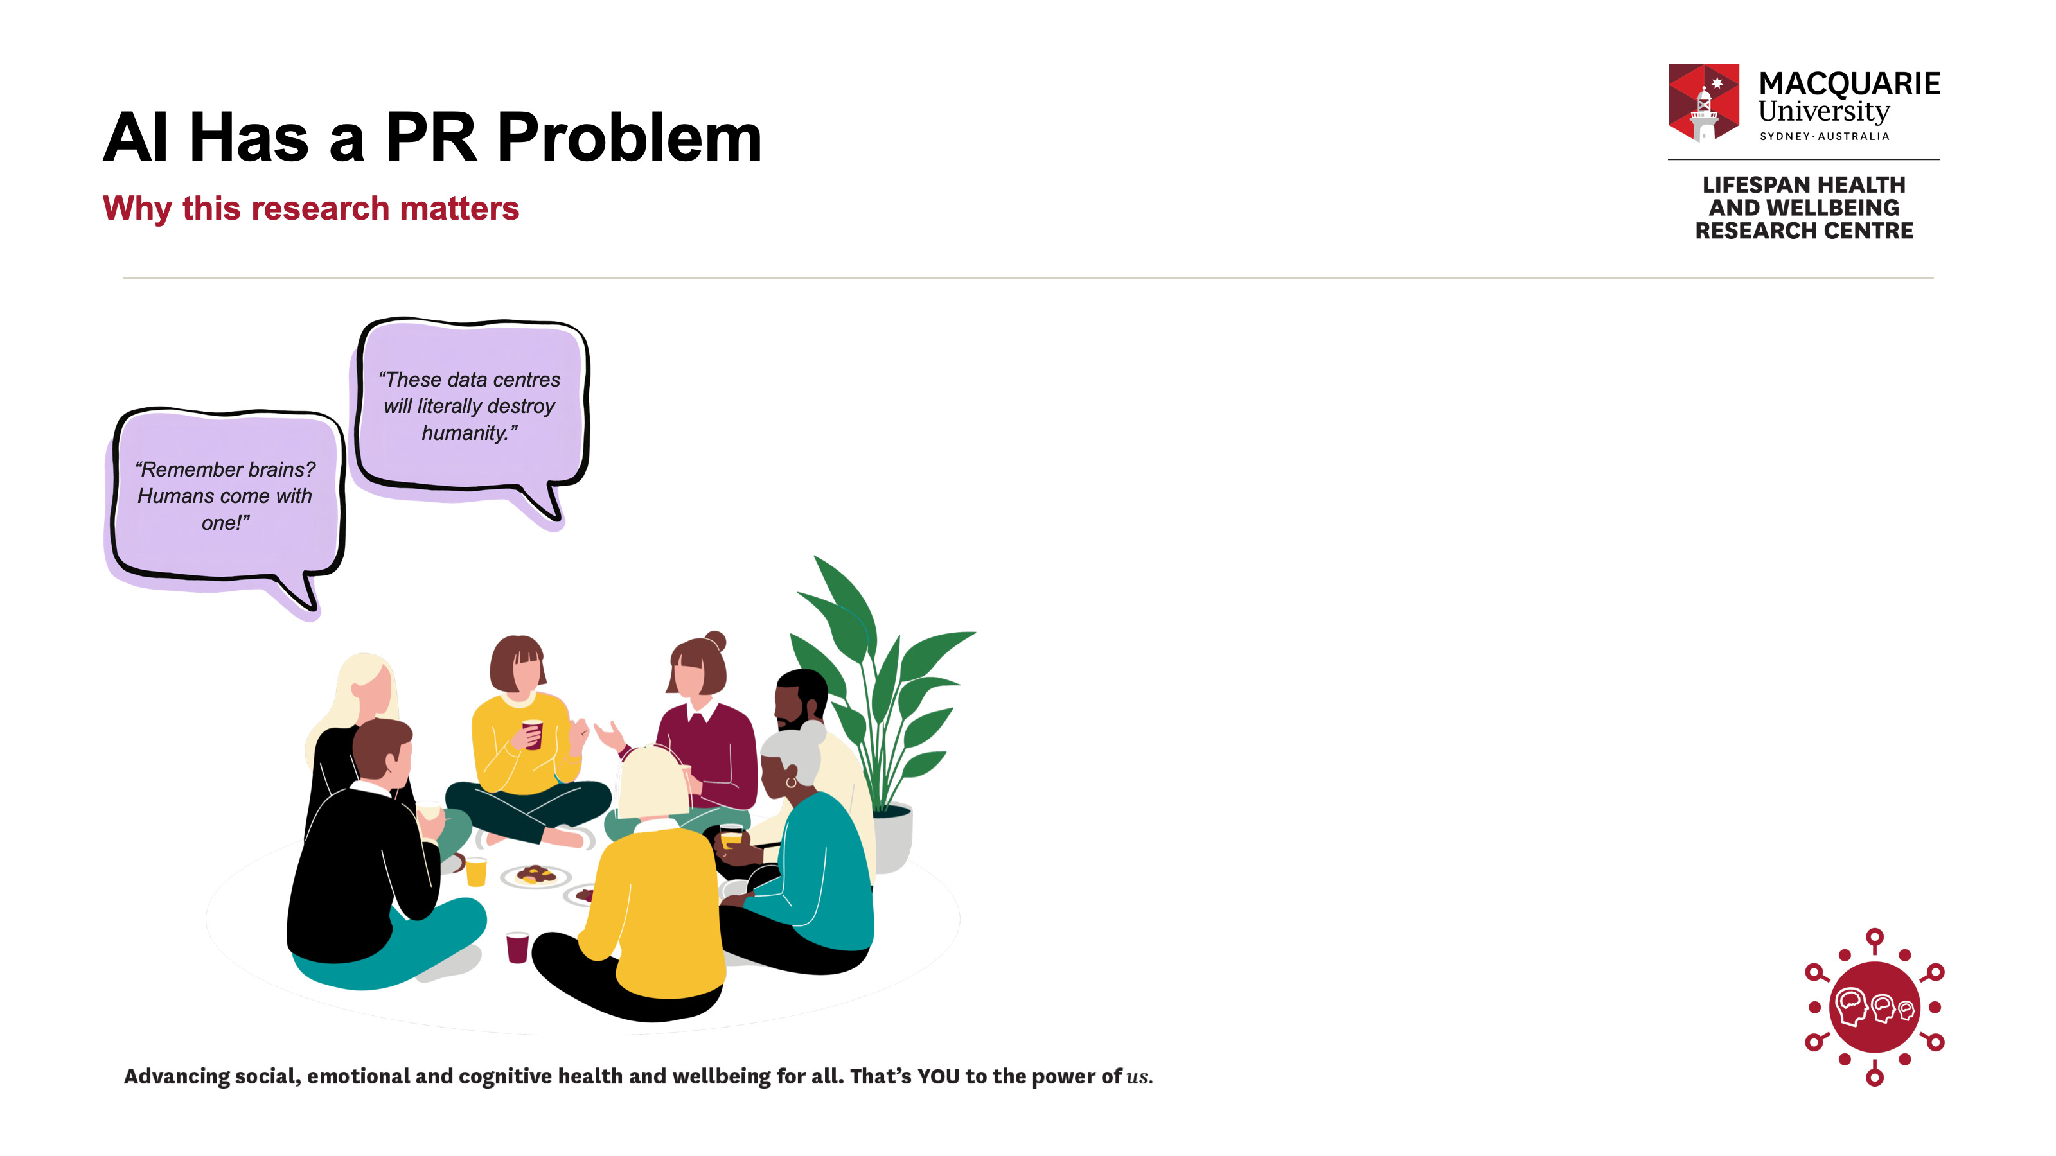
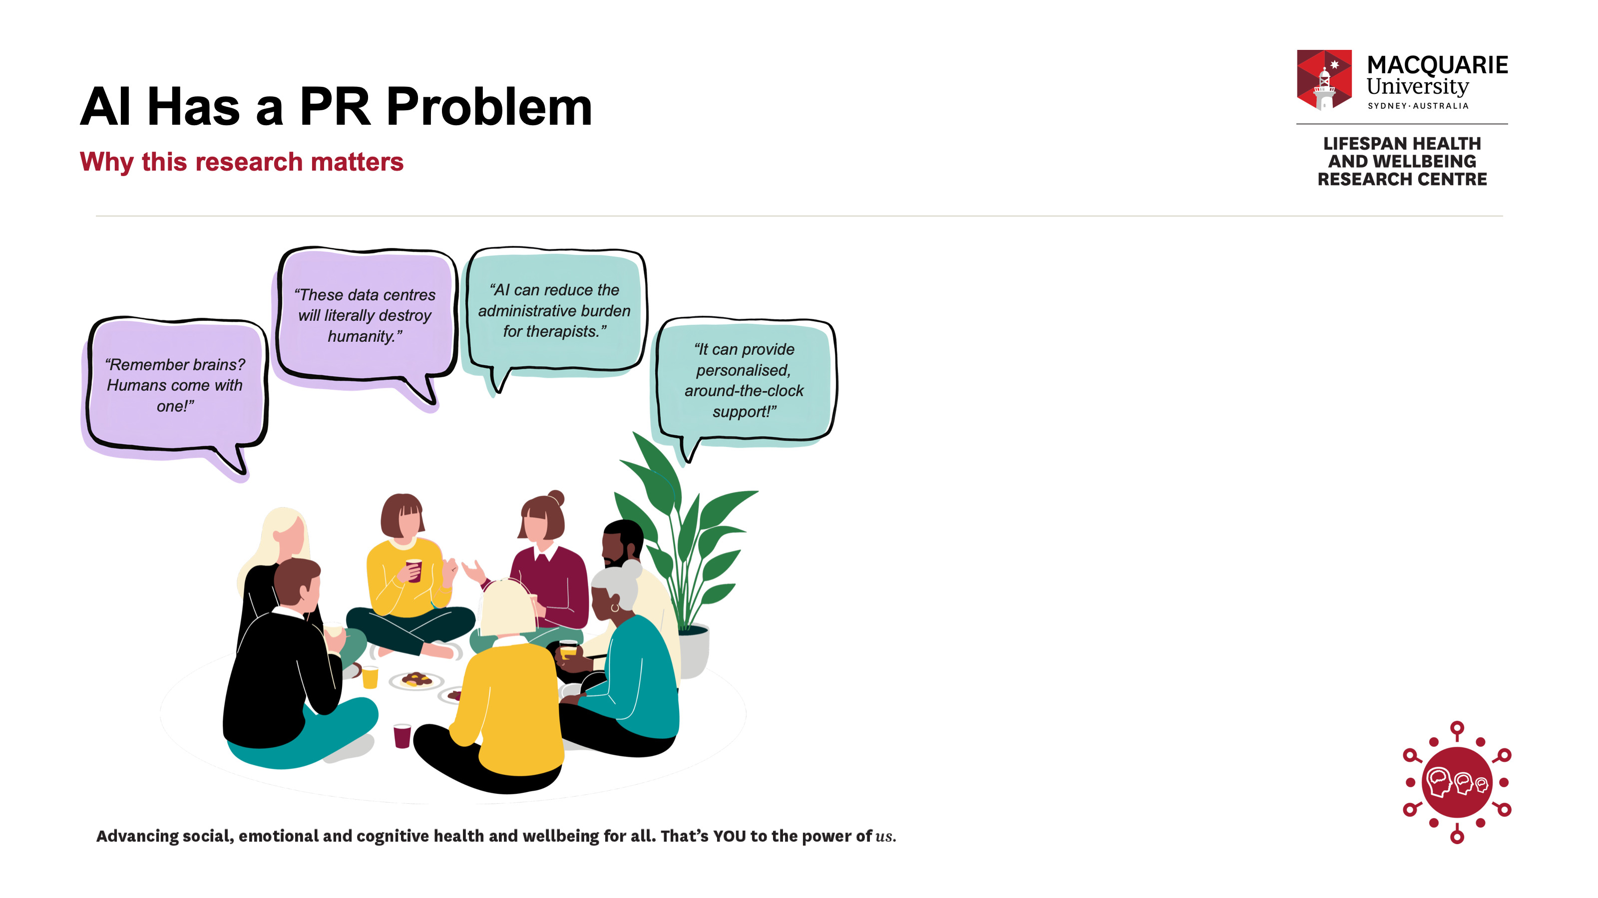
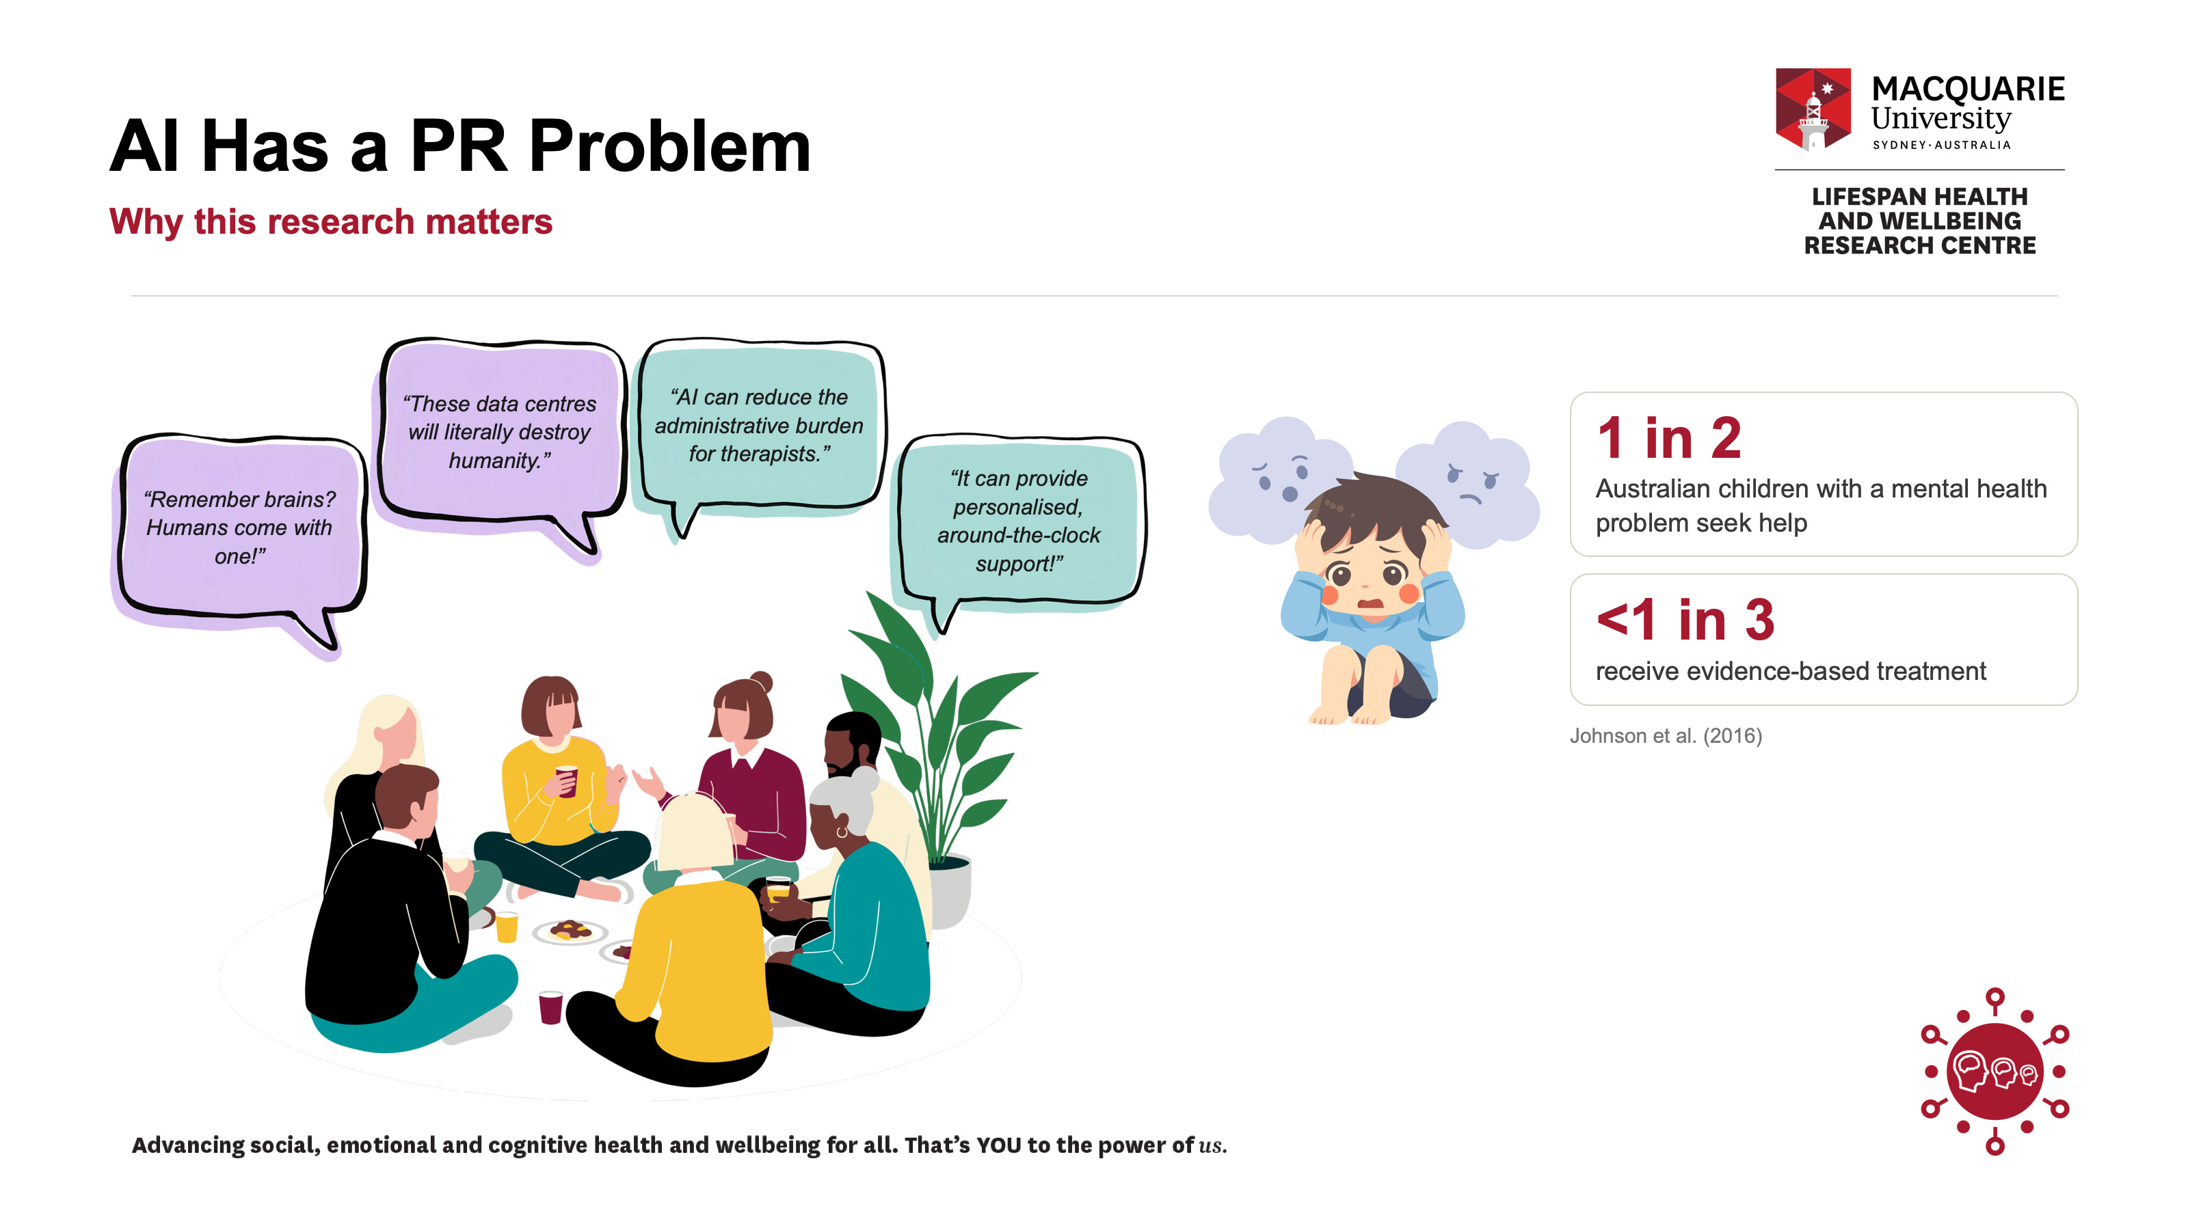

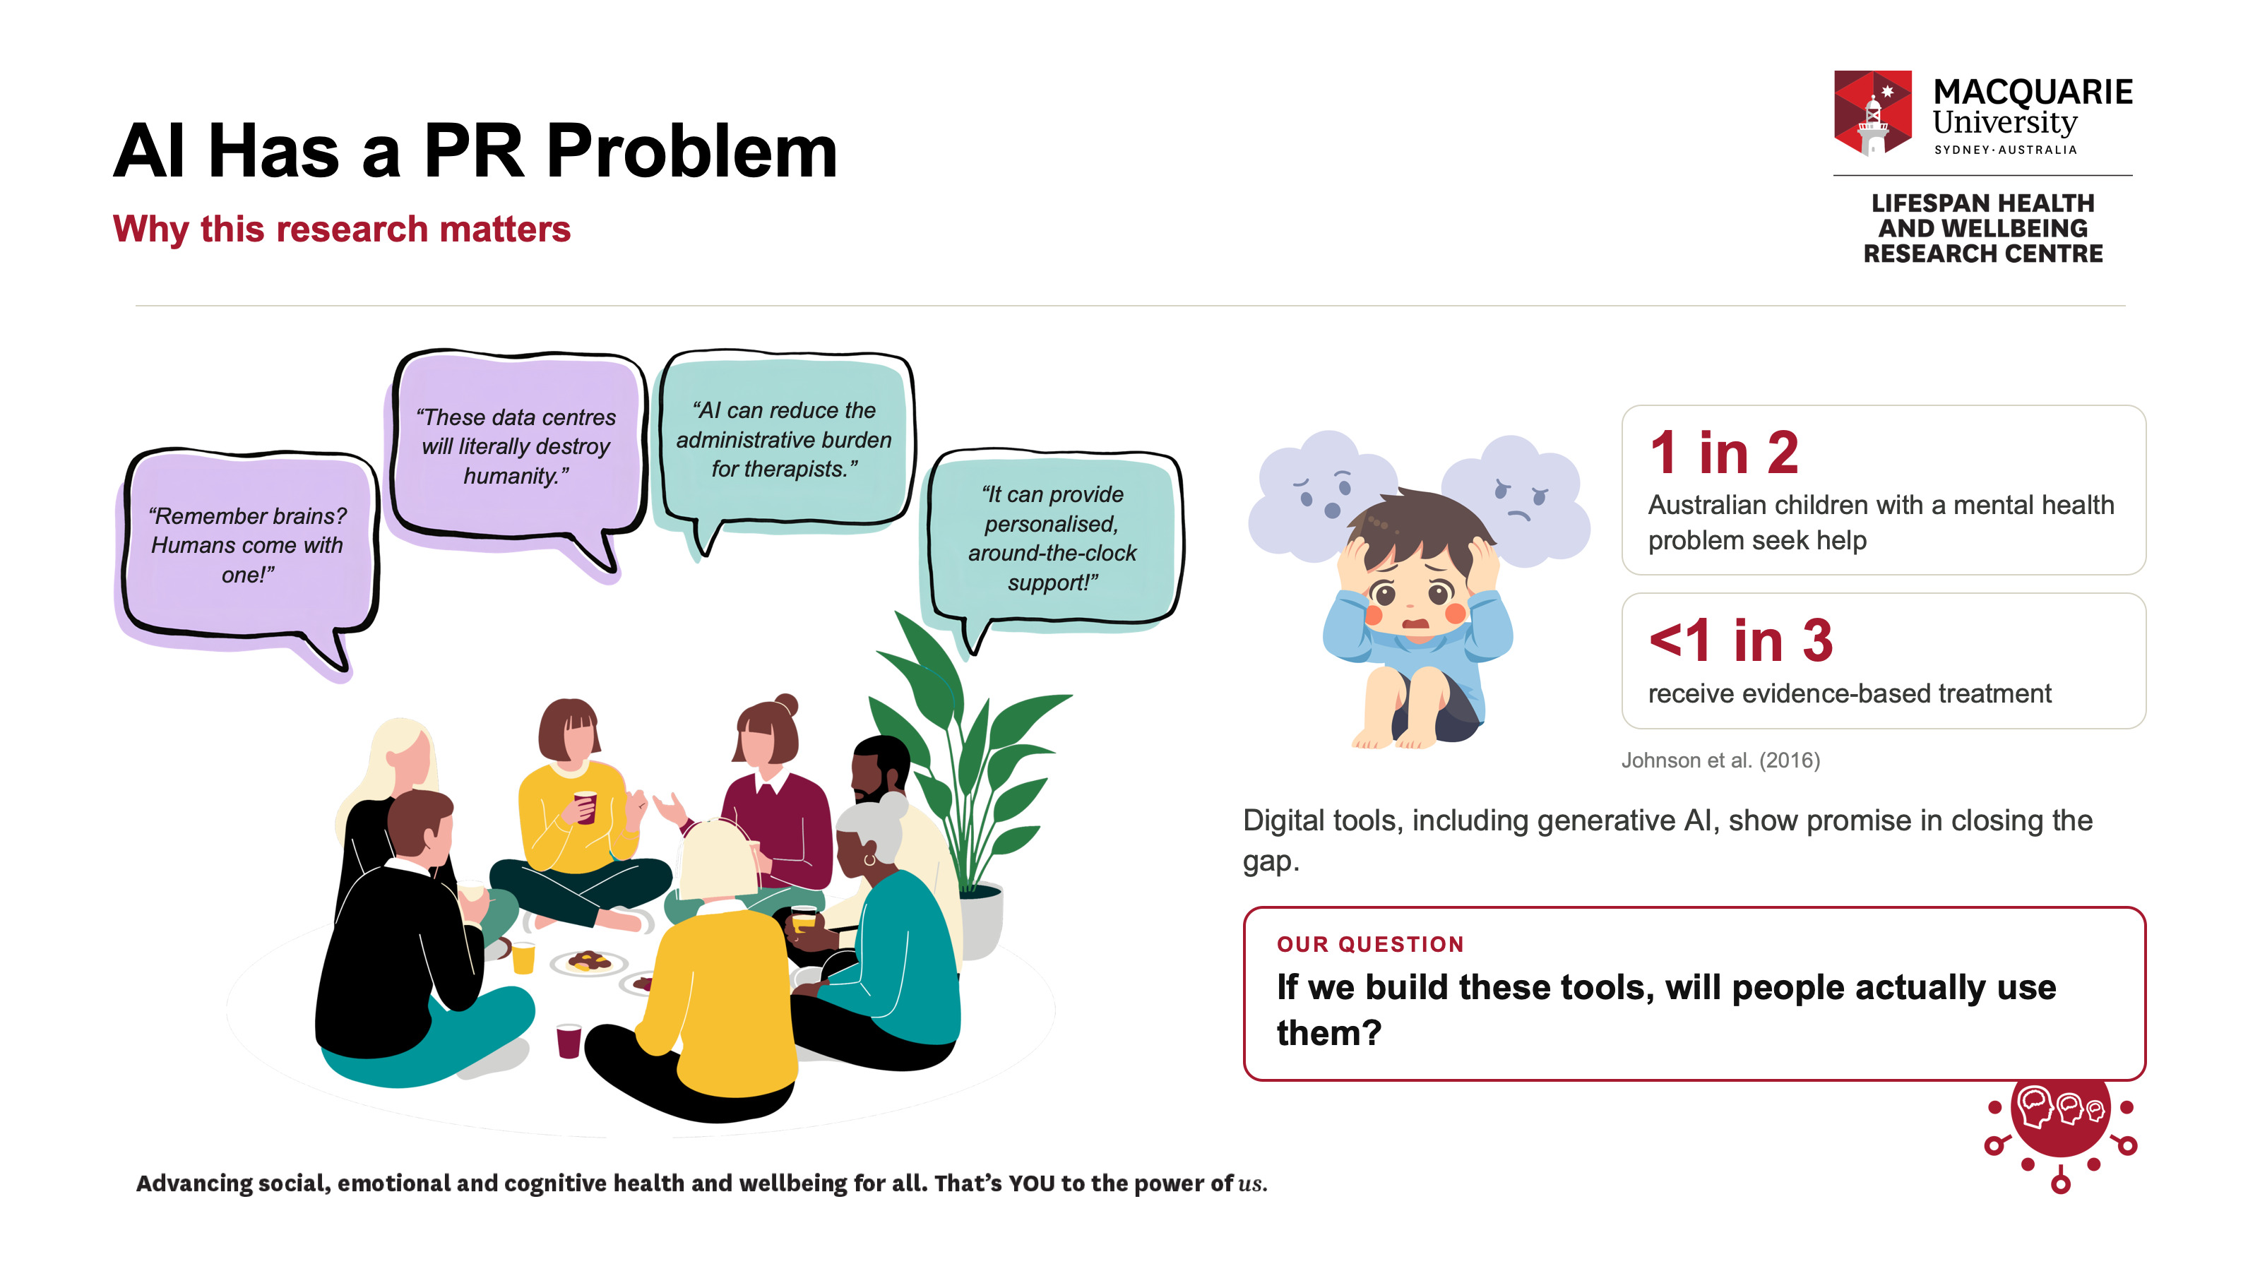
Notes:
Artificial intelligence has a PR problem. Look almost anywhere on social media and you'll see comments like these.
People are worried about AI ruining our ability to think, and data centres taking over.
But look elsewhere and you'll see research highlighting AI's potential to fill real and critical gaps in our healthcare system.
And some of the biggest gaps in care can be found in child mental health settings. In Australia, only around half of children with a mental health problem seek help, and fewer than one in three receive evidence-based treatment.
Digital tools, including those powered by generative AI, show genuine promise in closing the gap between the care kids need and the care they actually get.
Which brings us back to that PR problem. If we build these tools, will people actually use them?

Slide 3
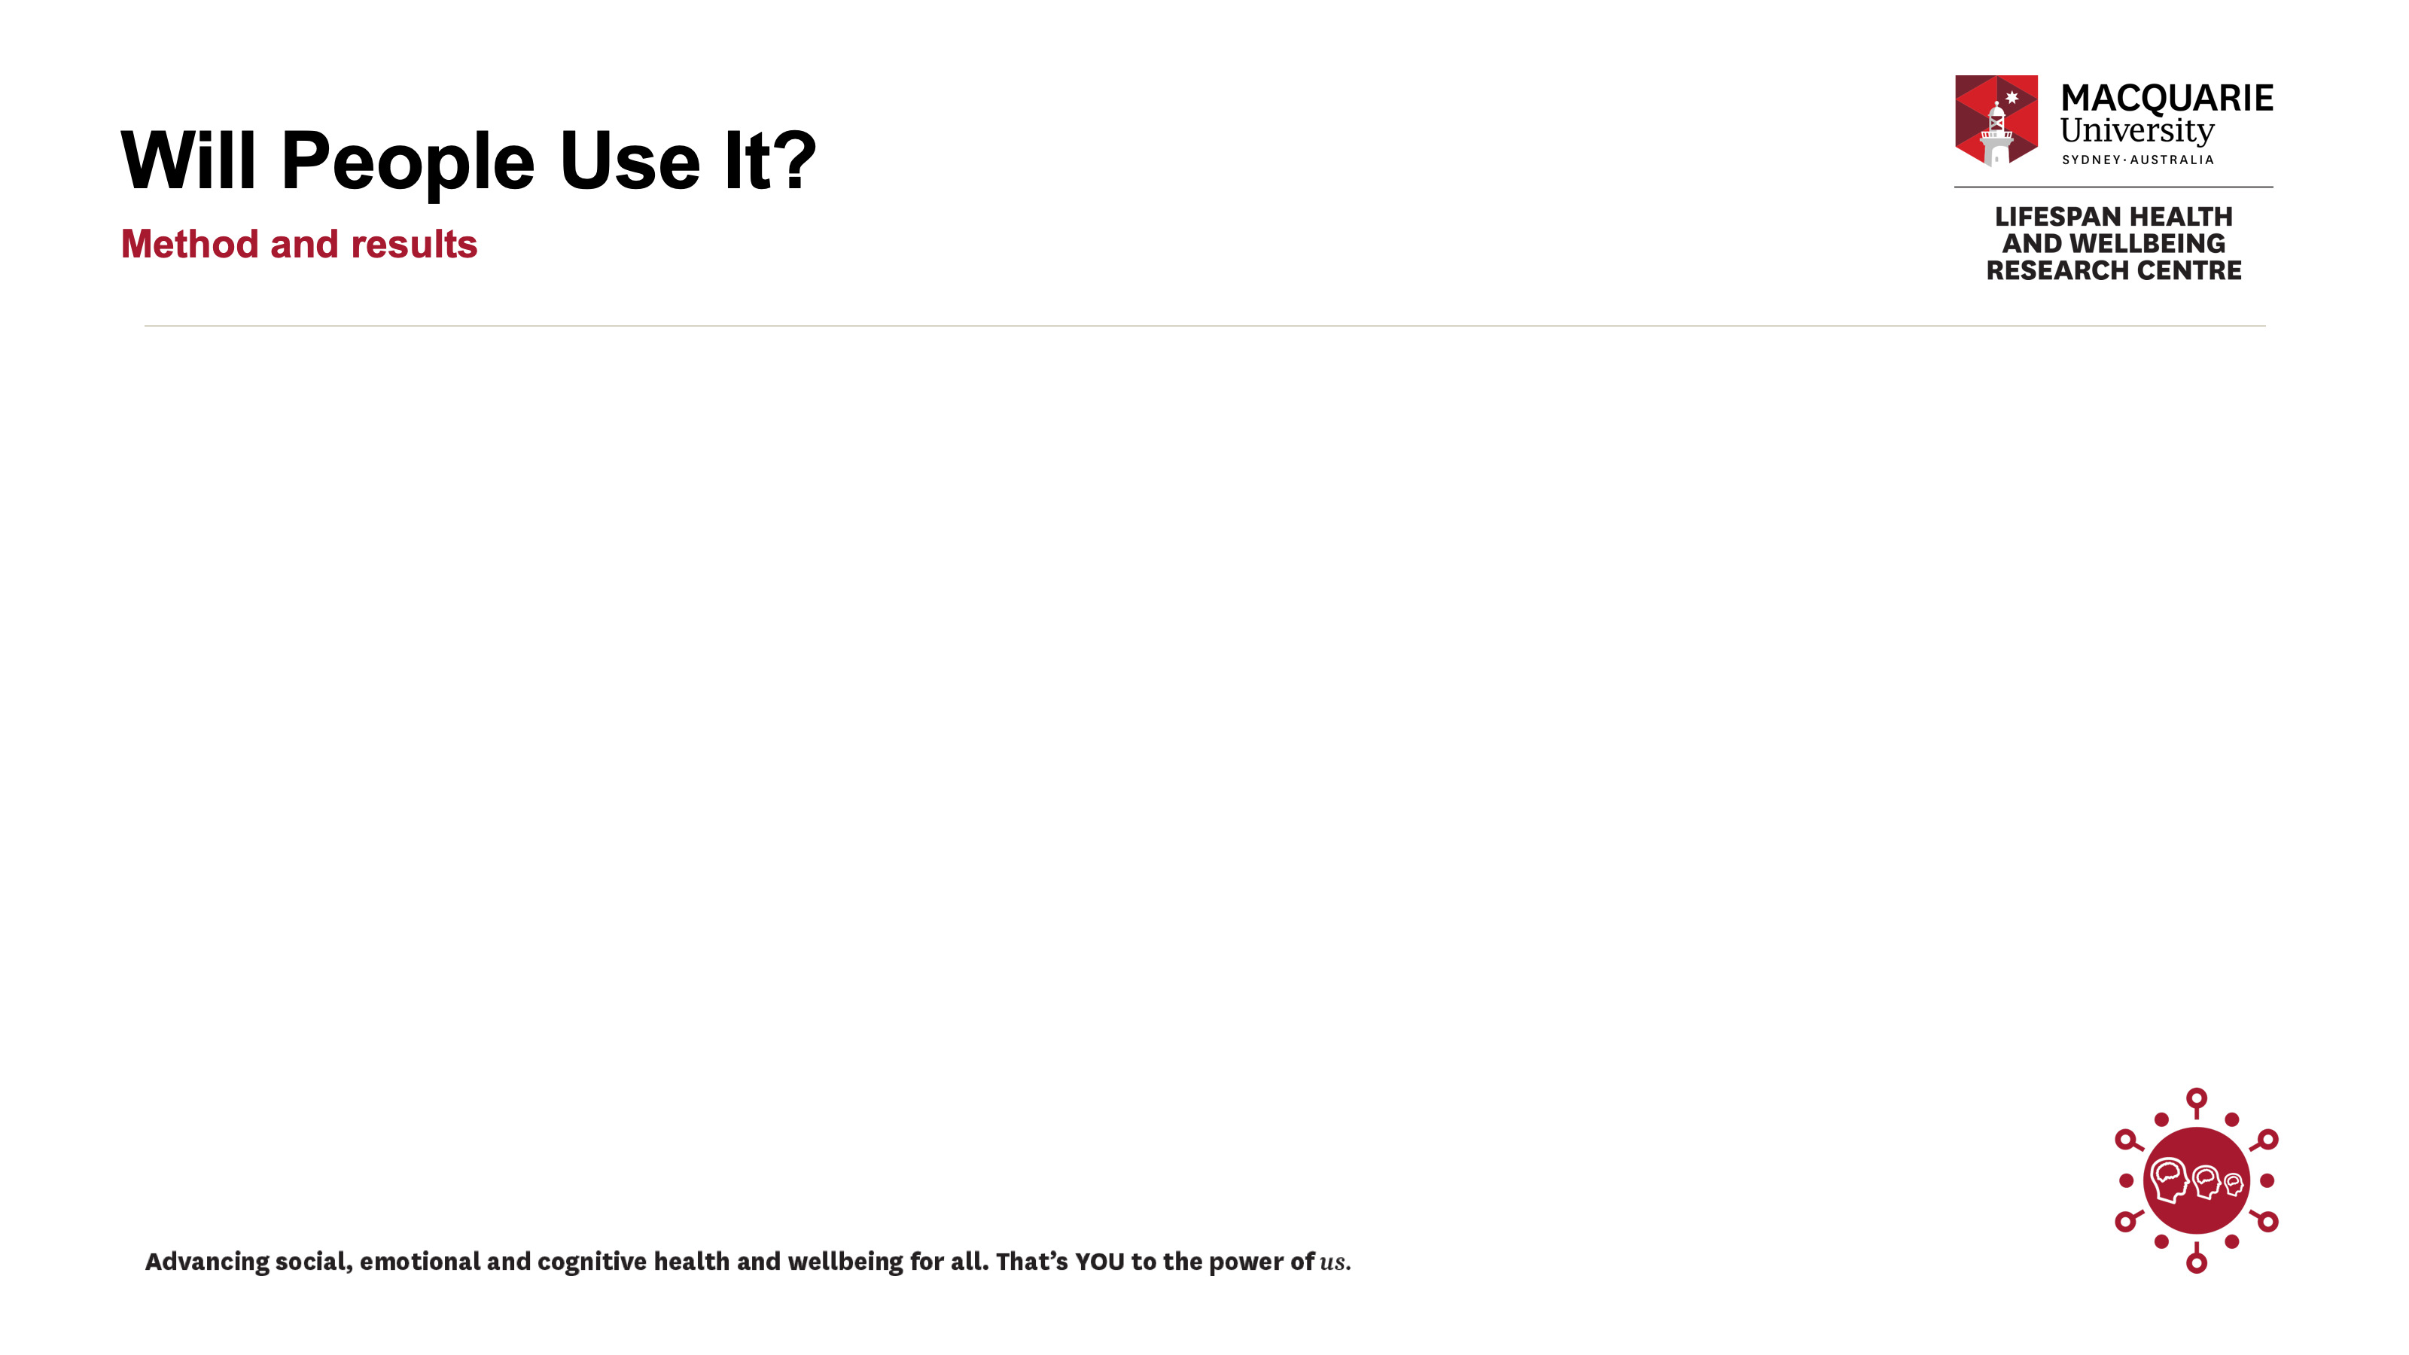
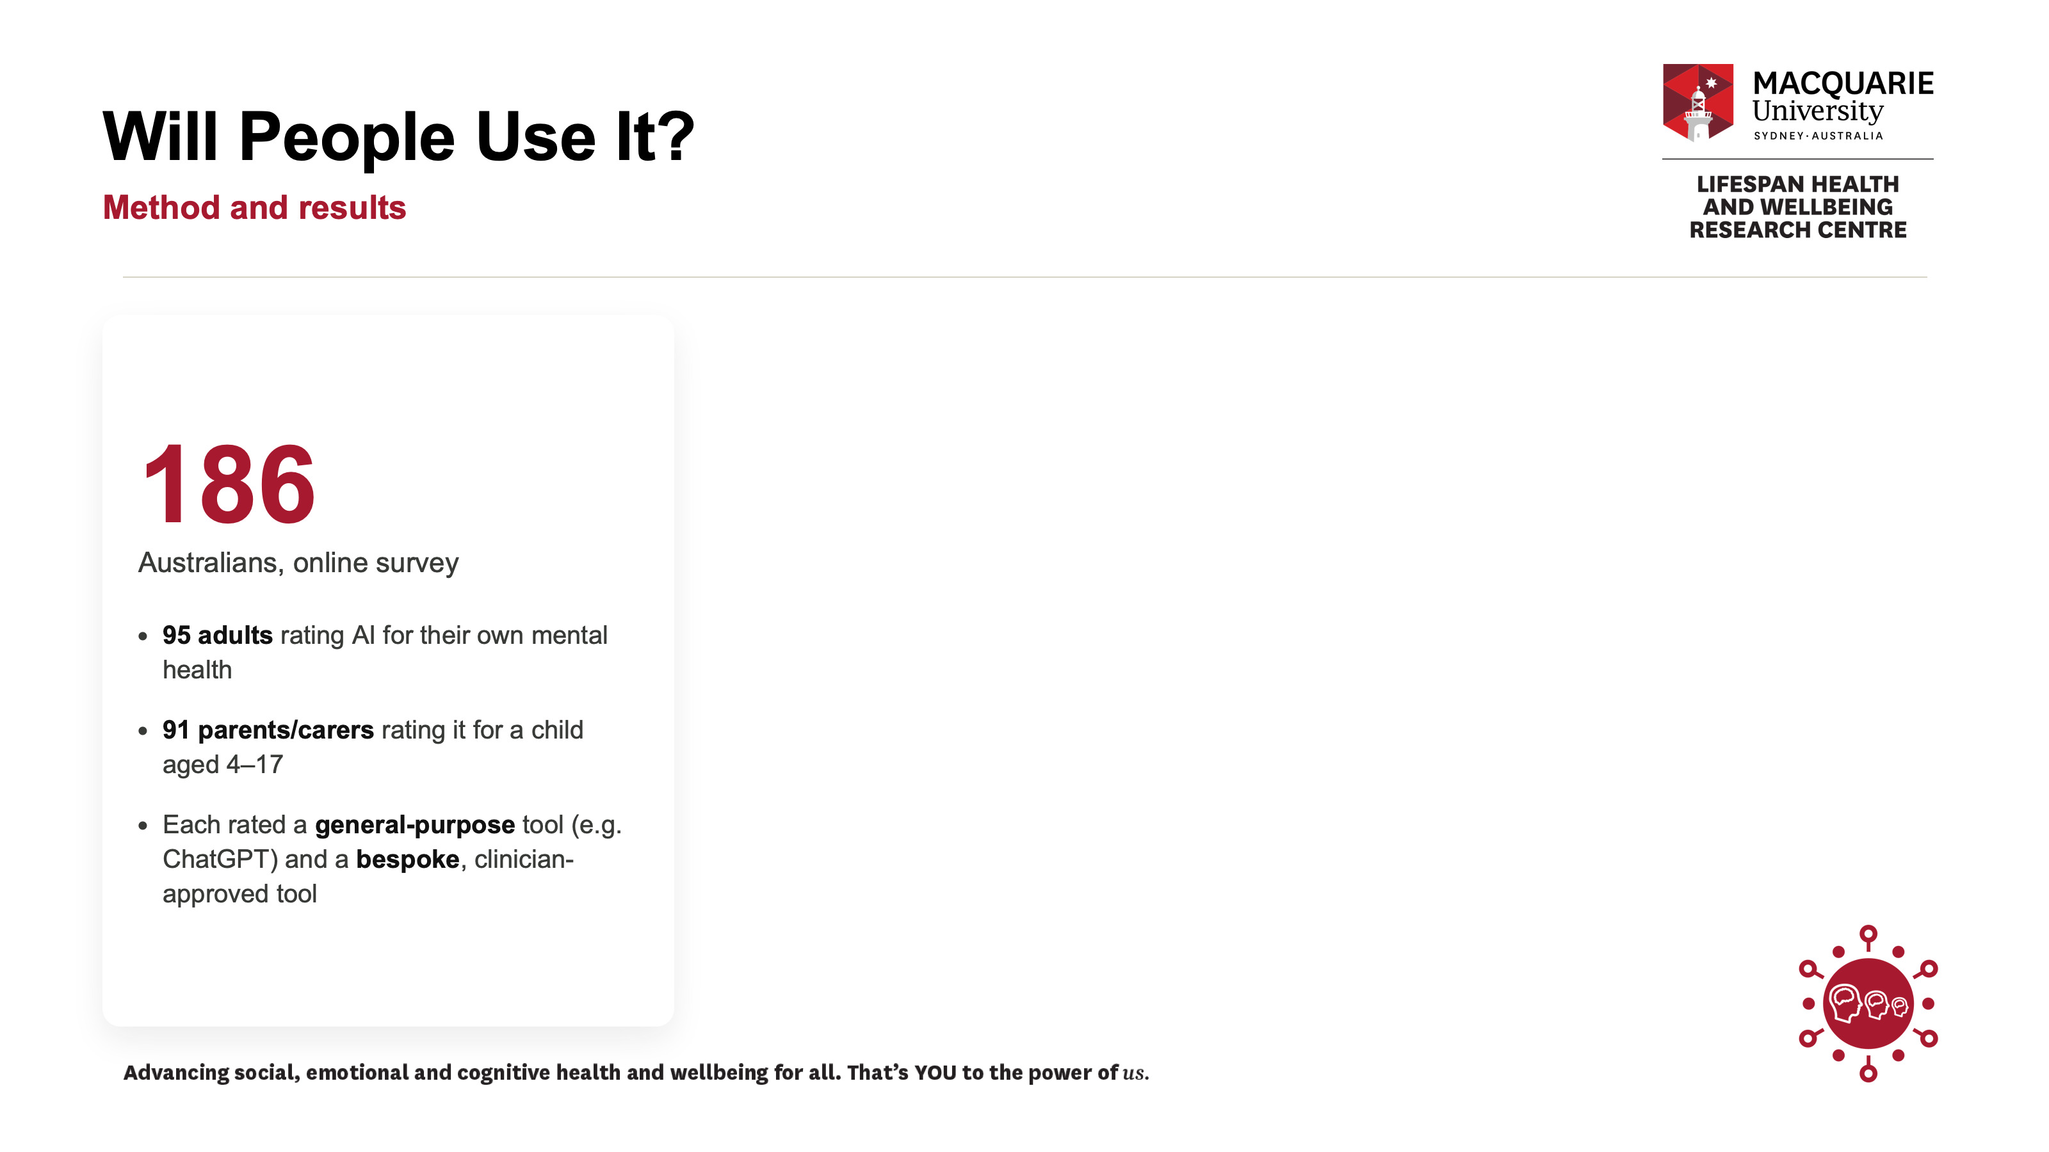
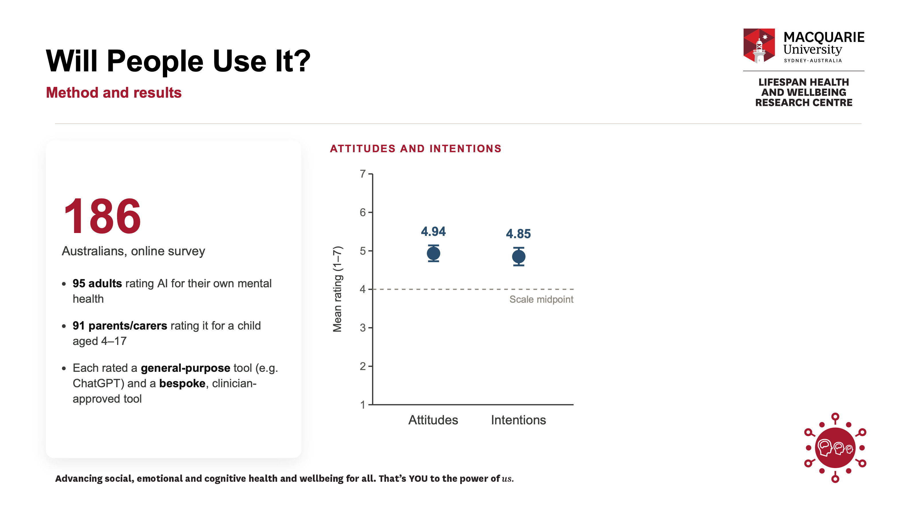
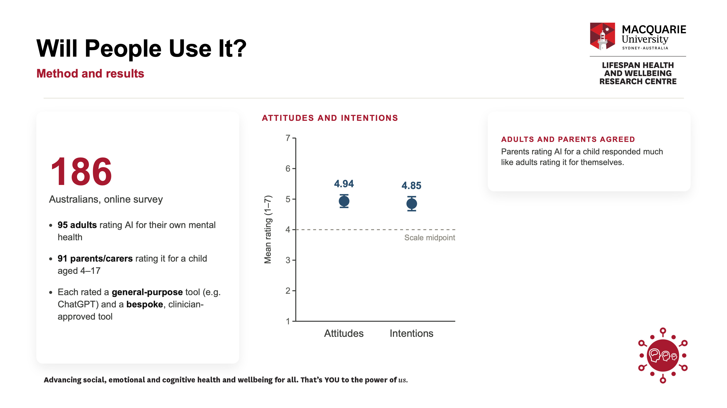
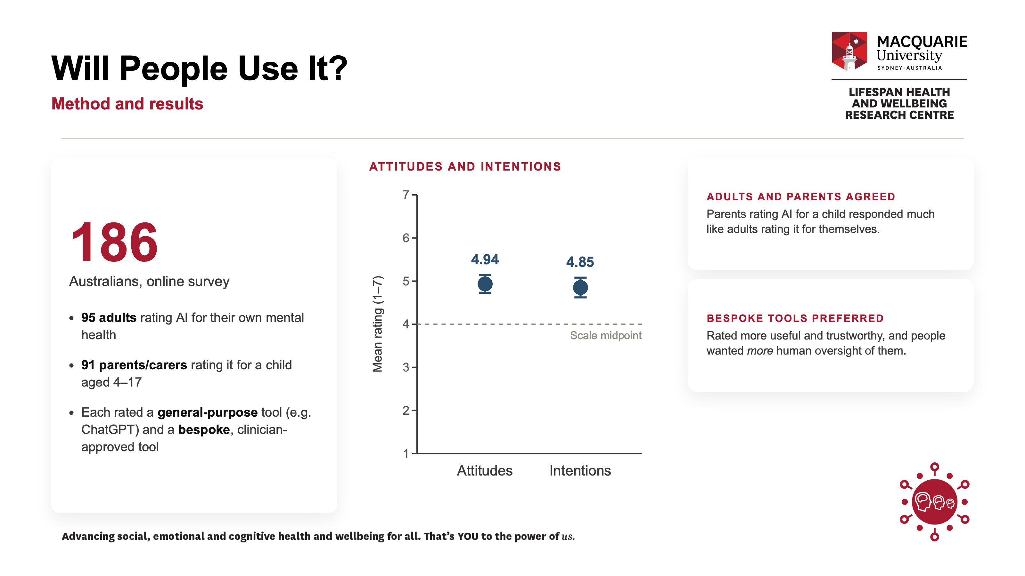
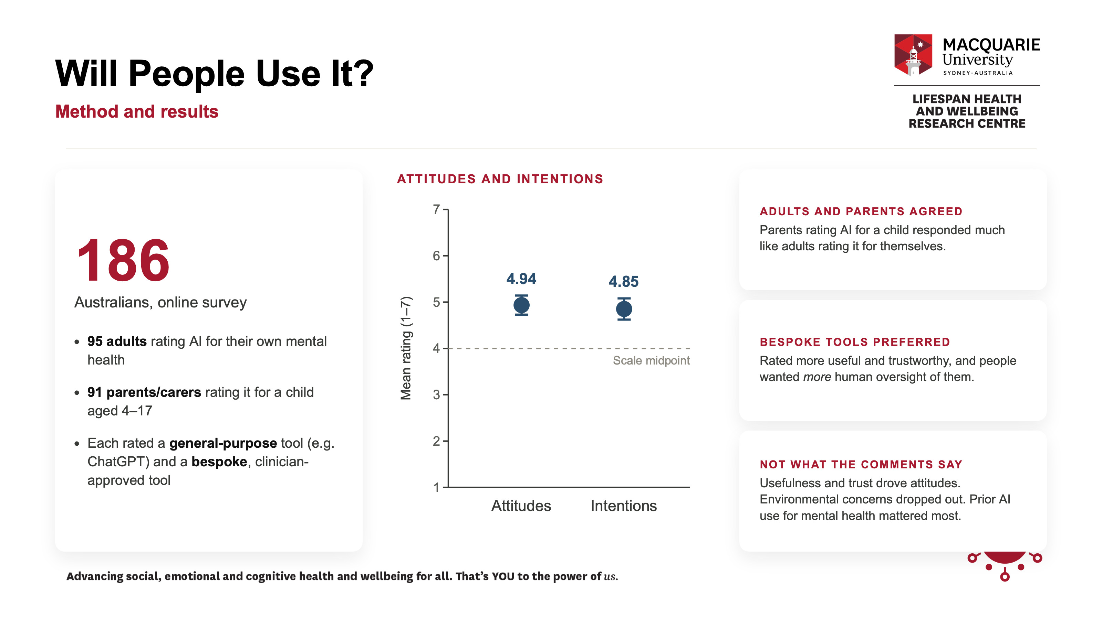
Notes:
We surveyed 186 Australians. Ninety-five were adults reporting on whether they'd use AI for their own mental health, and 91 were parents and carers reporting on a child. Each person rated two types of tool: general-purpose AI like ChatGPT, and bespoke, clinician-approved tools built specifically for mental health.
What we found was that people were actually fairly open — attitudes and intentions to use AI tools sat comfortably above the midpoint of the scale.
Adults and parents responded similarly.
Bespoke tools were rated as more useful and trustworthy, and people wanted more human oversight of them.
And the factors driving attitudes weren't the ones dominating the comments section. Once we accounted for trust and usefulness, environmental concerns no longer predicted anything.
The strongest personal predictor was whether someone had already used AI for mental health.

Slide 4
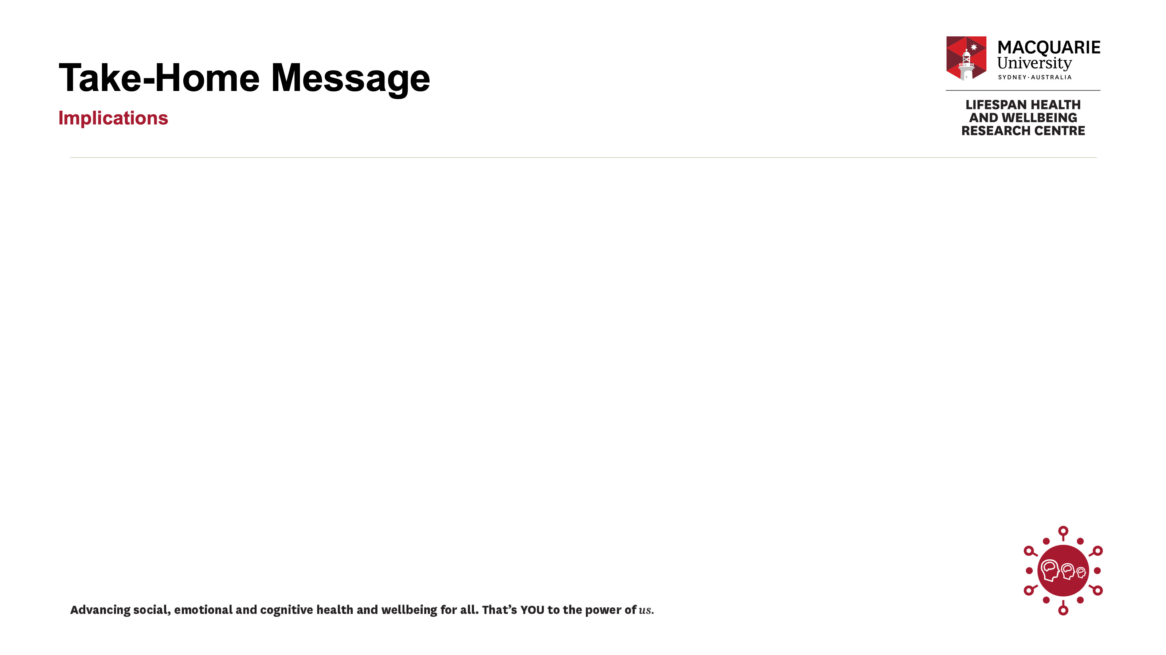
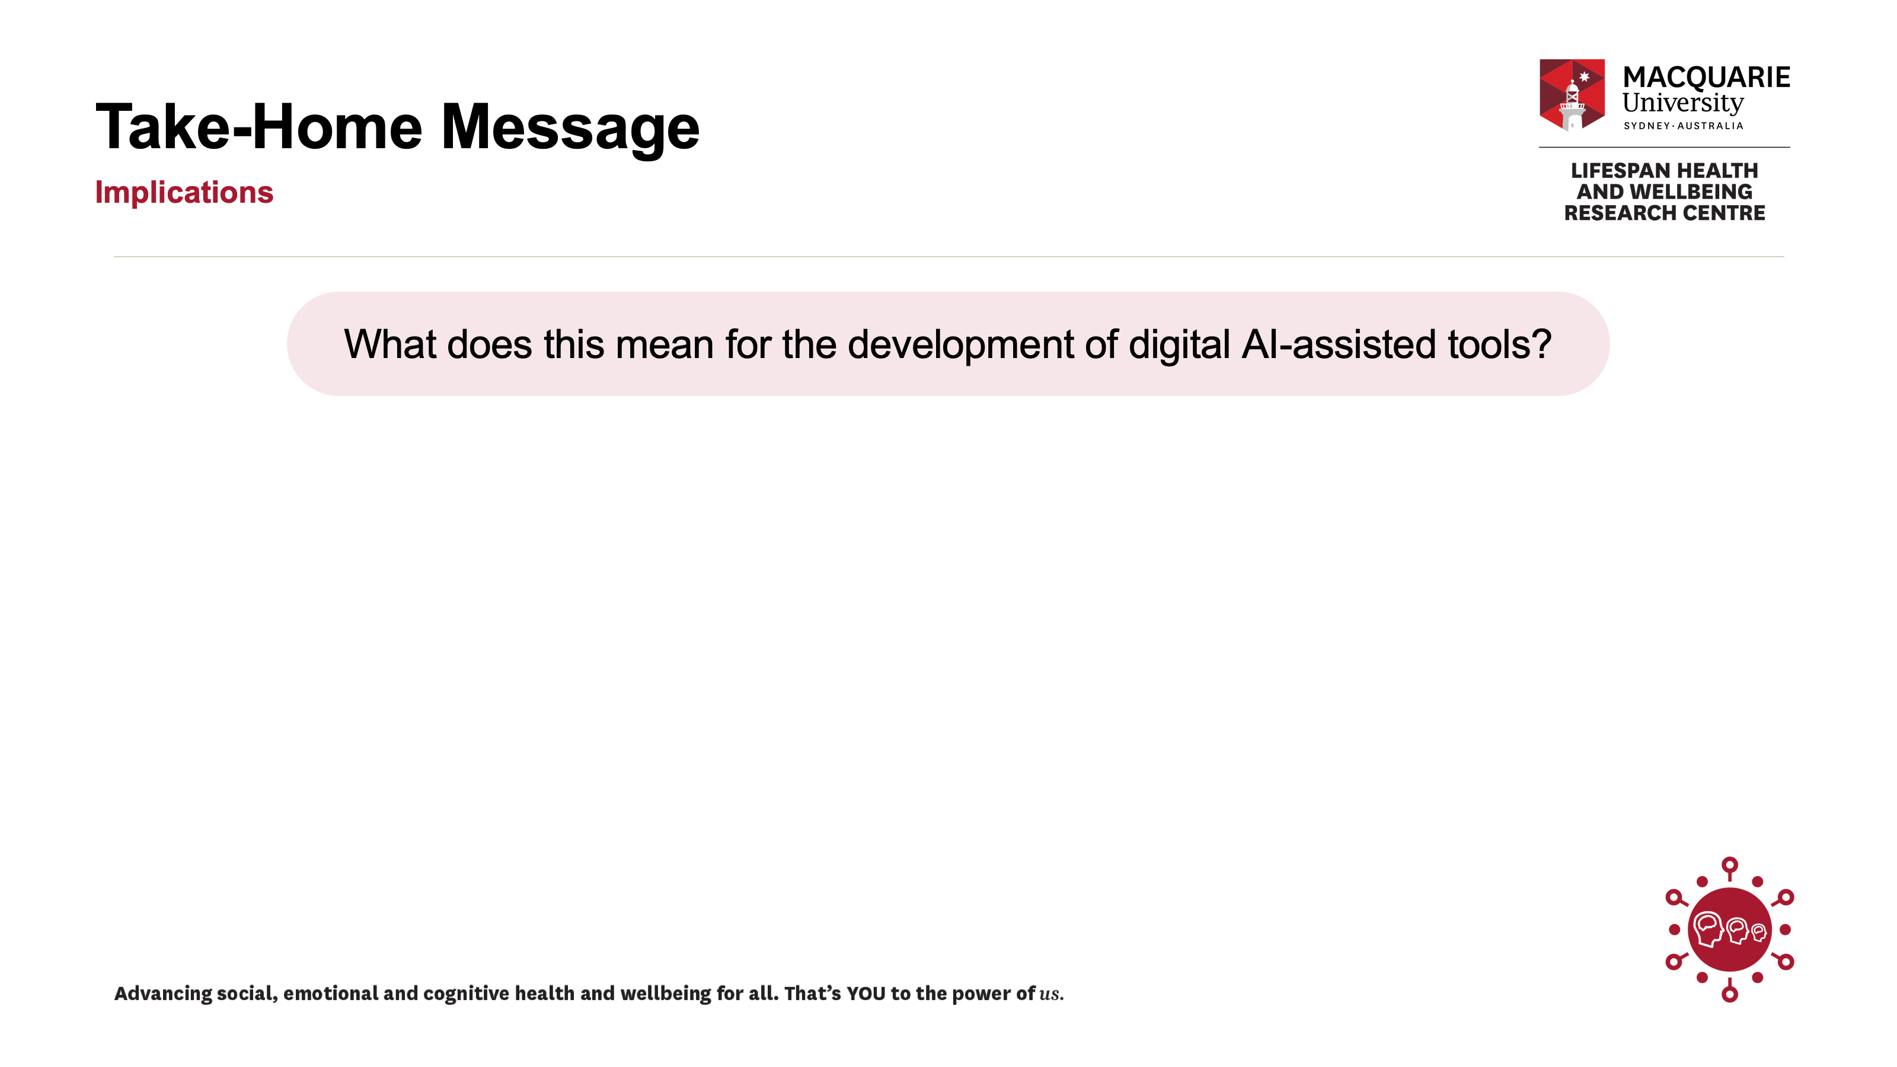
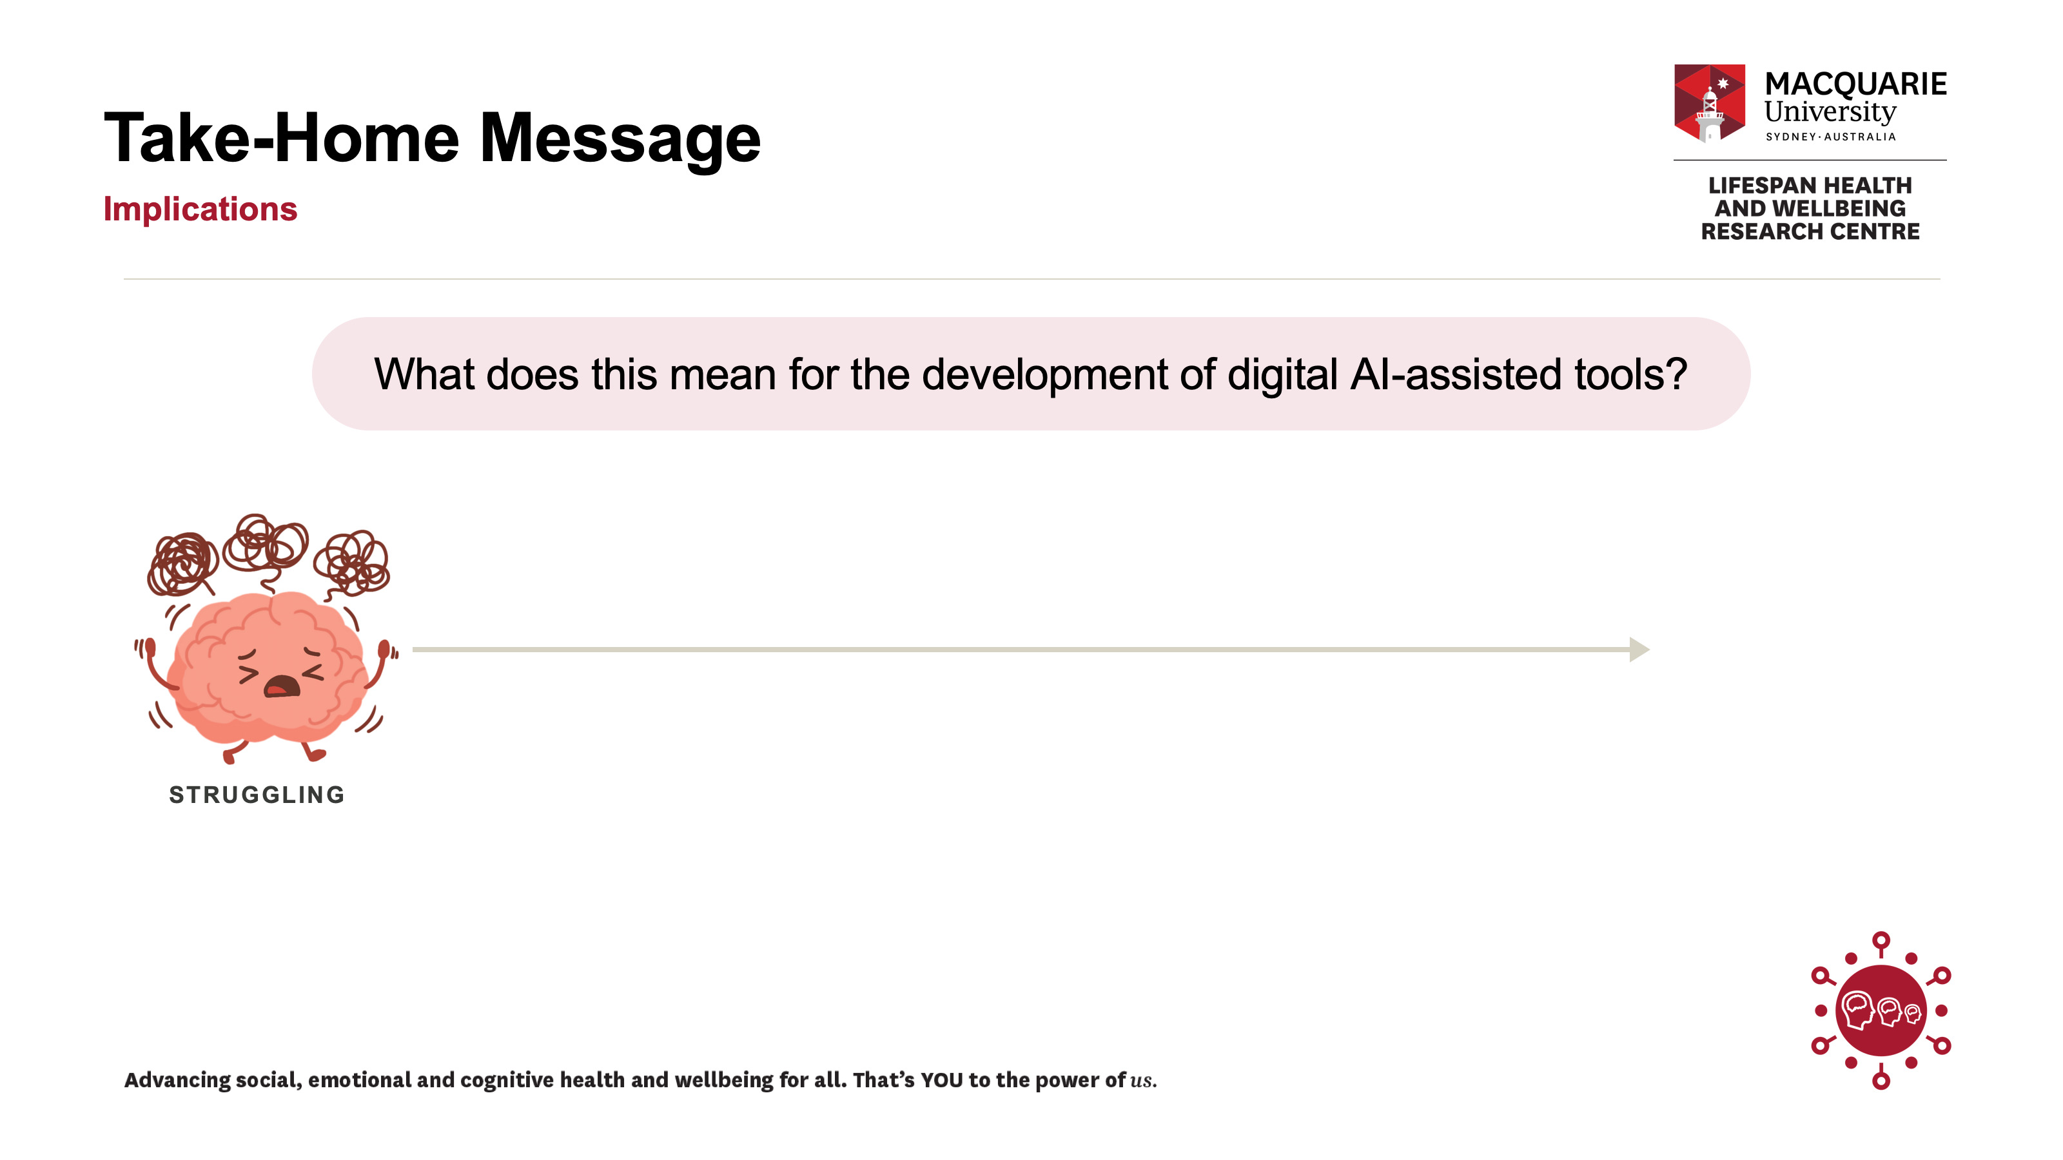
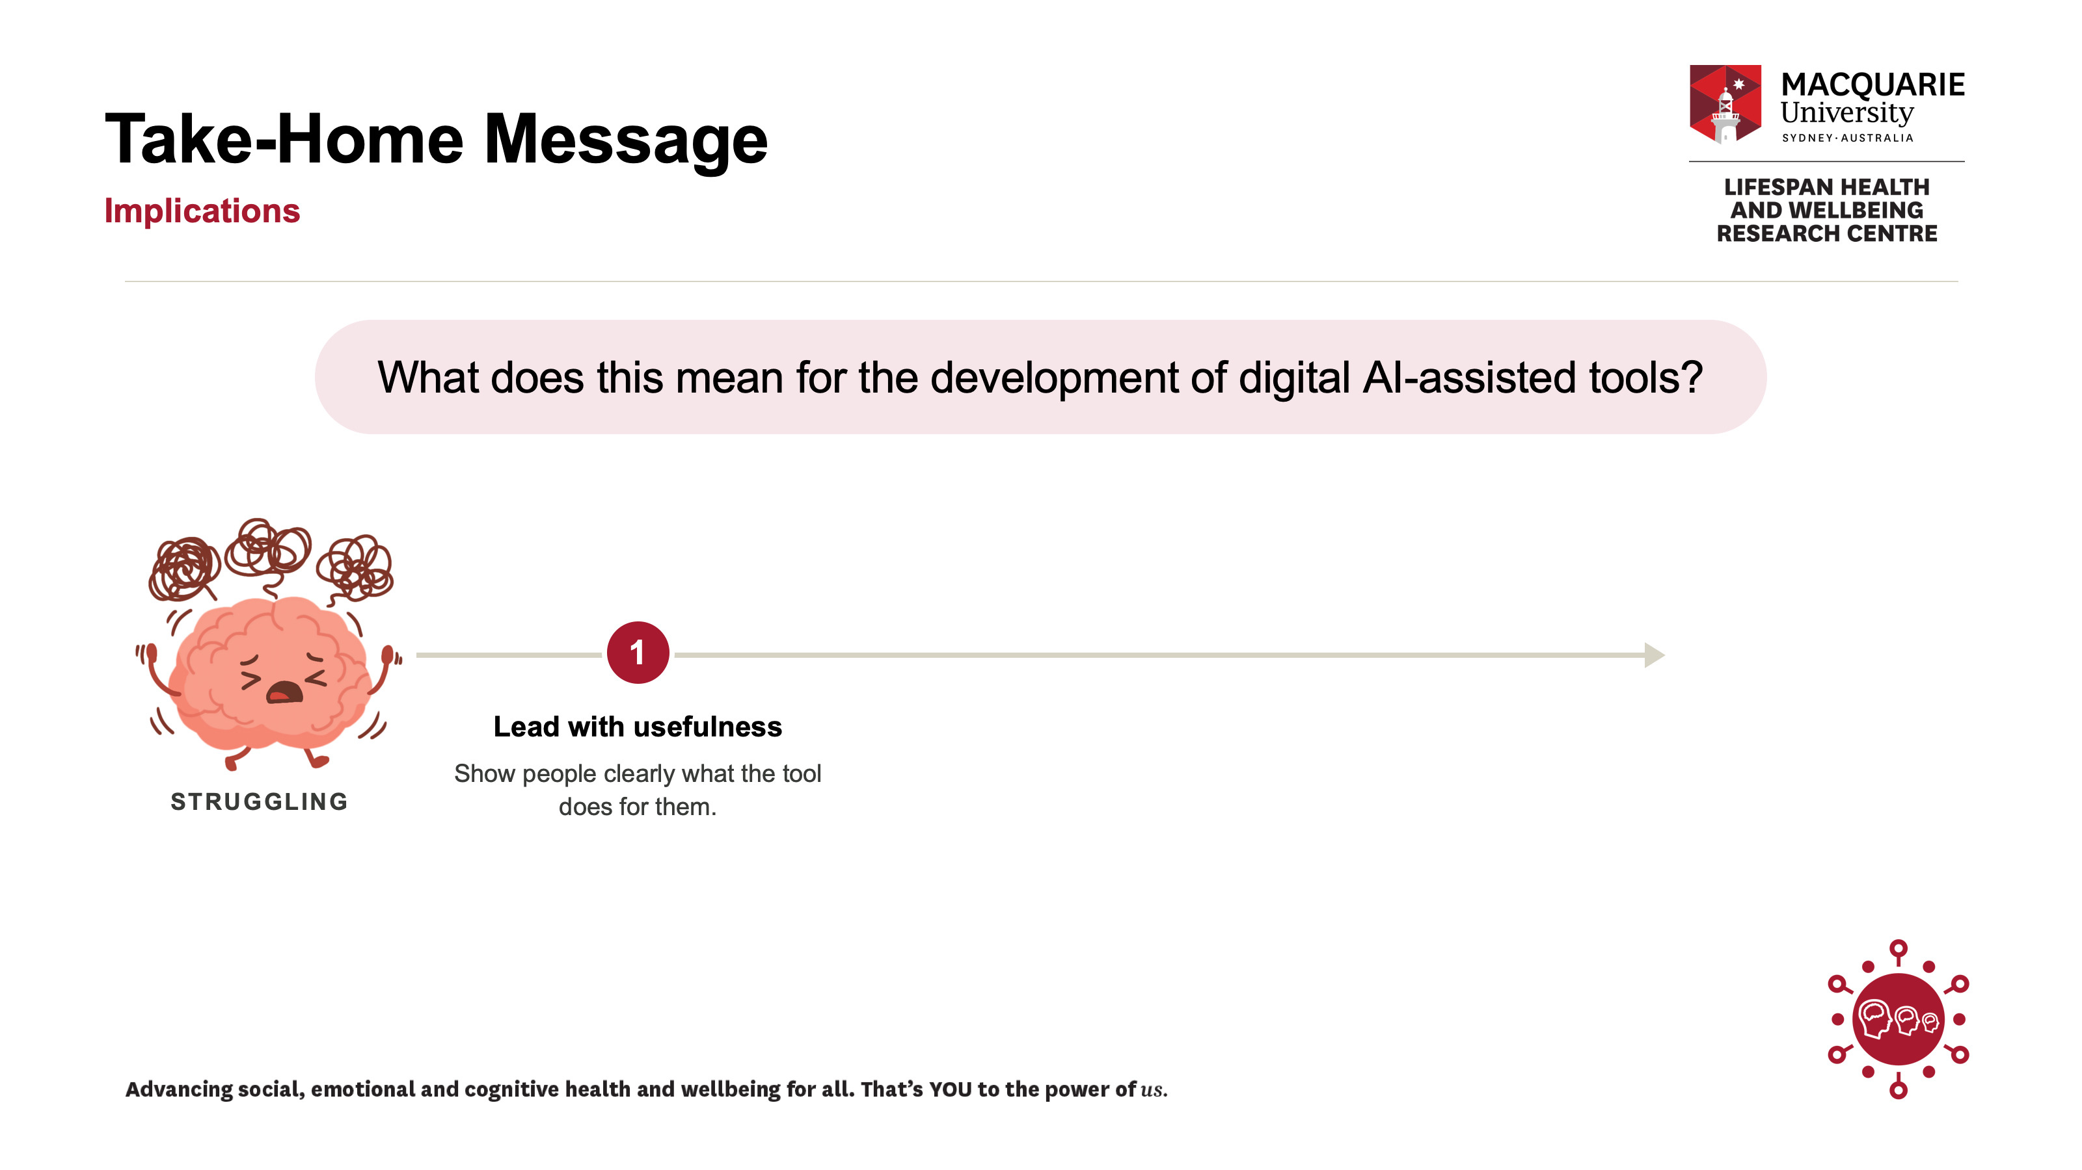
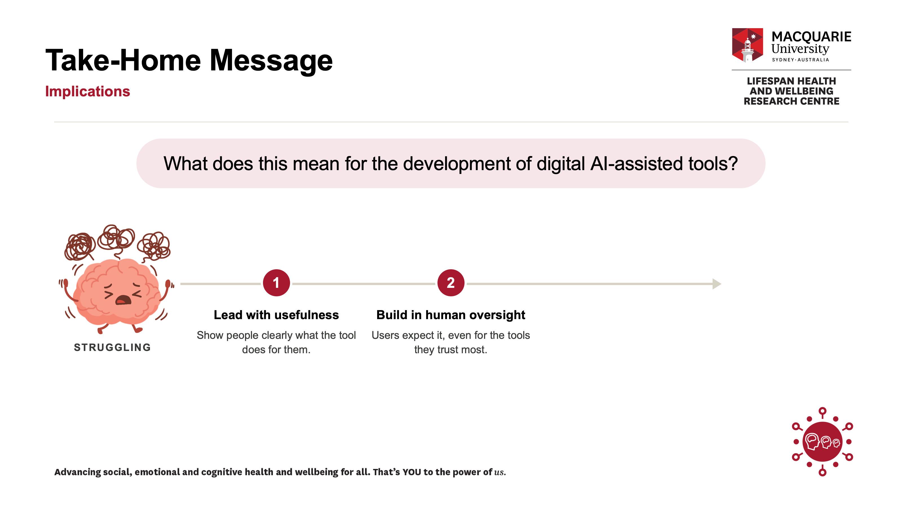
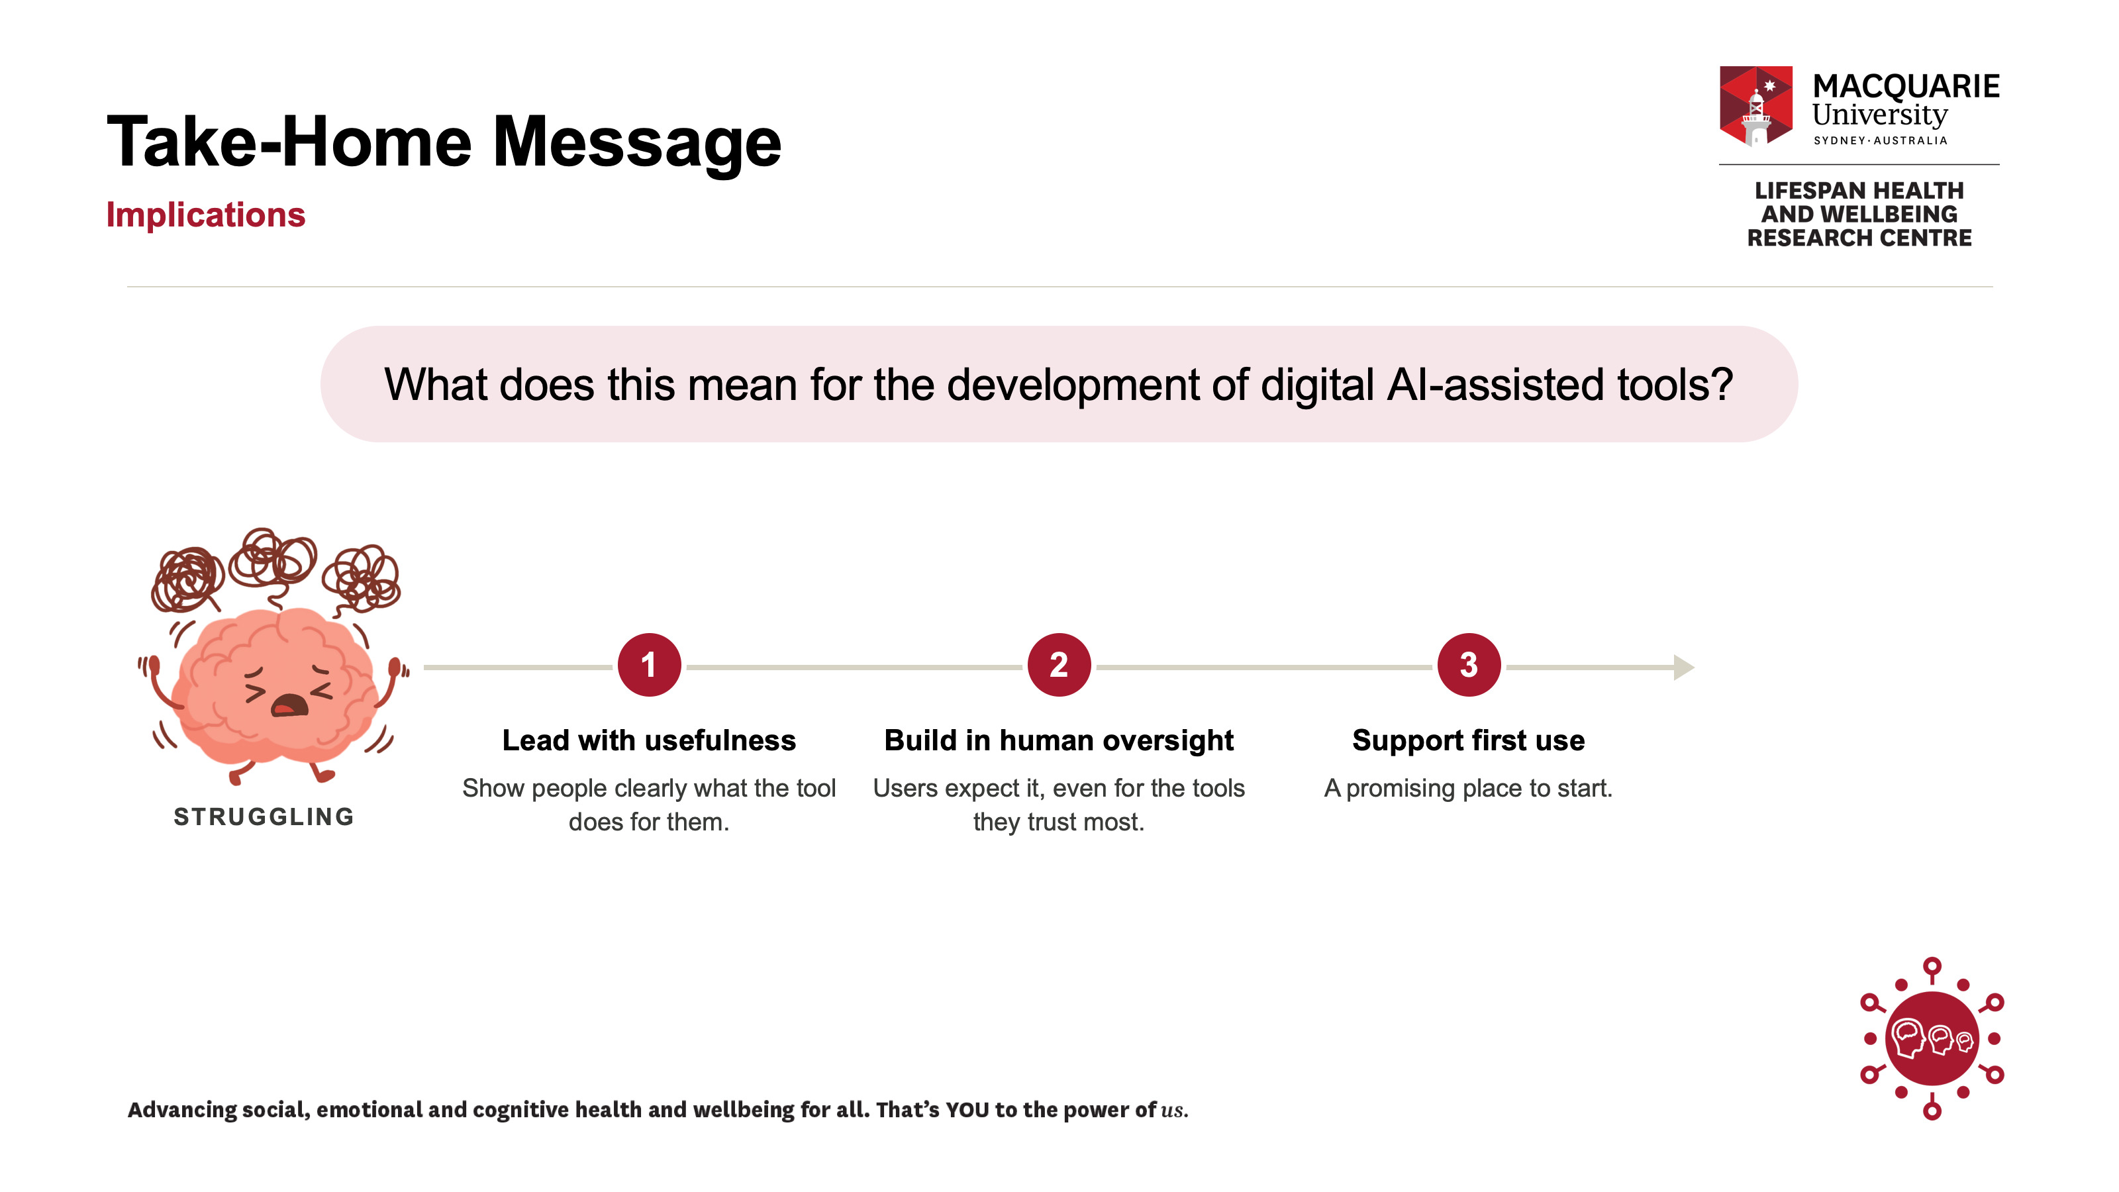
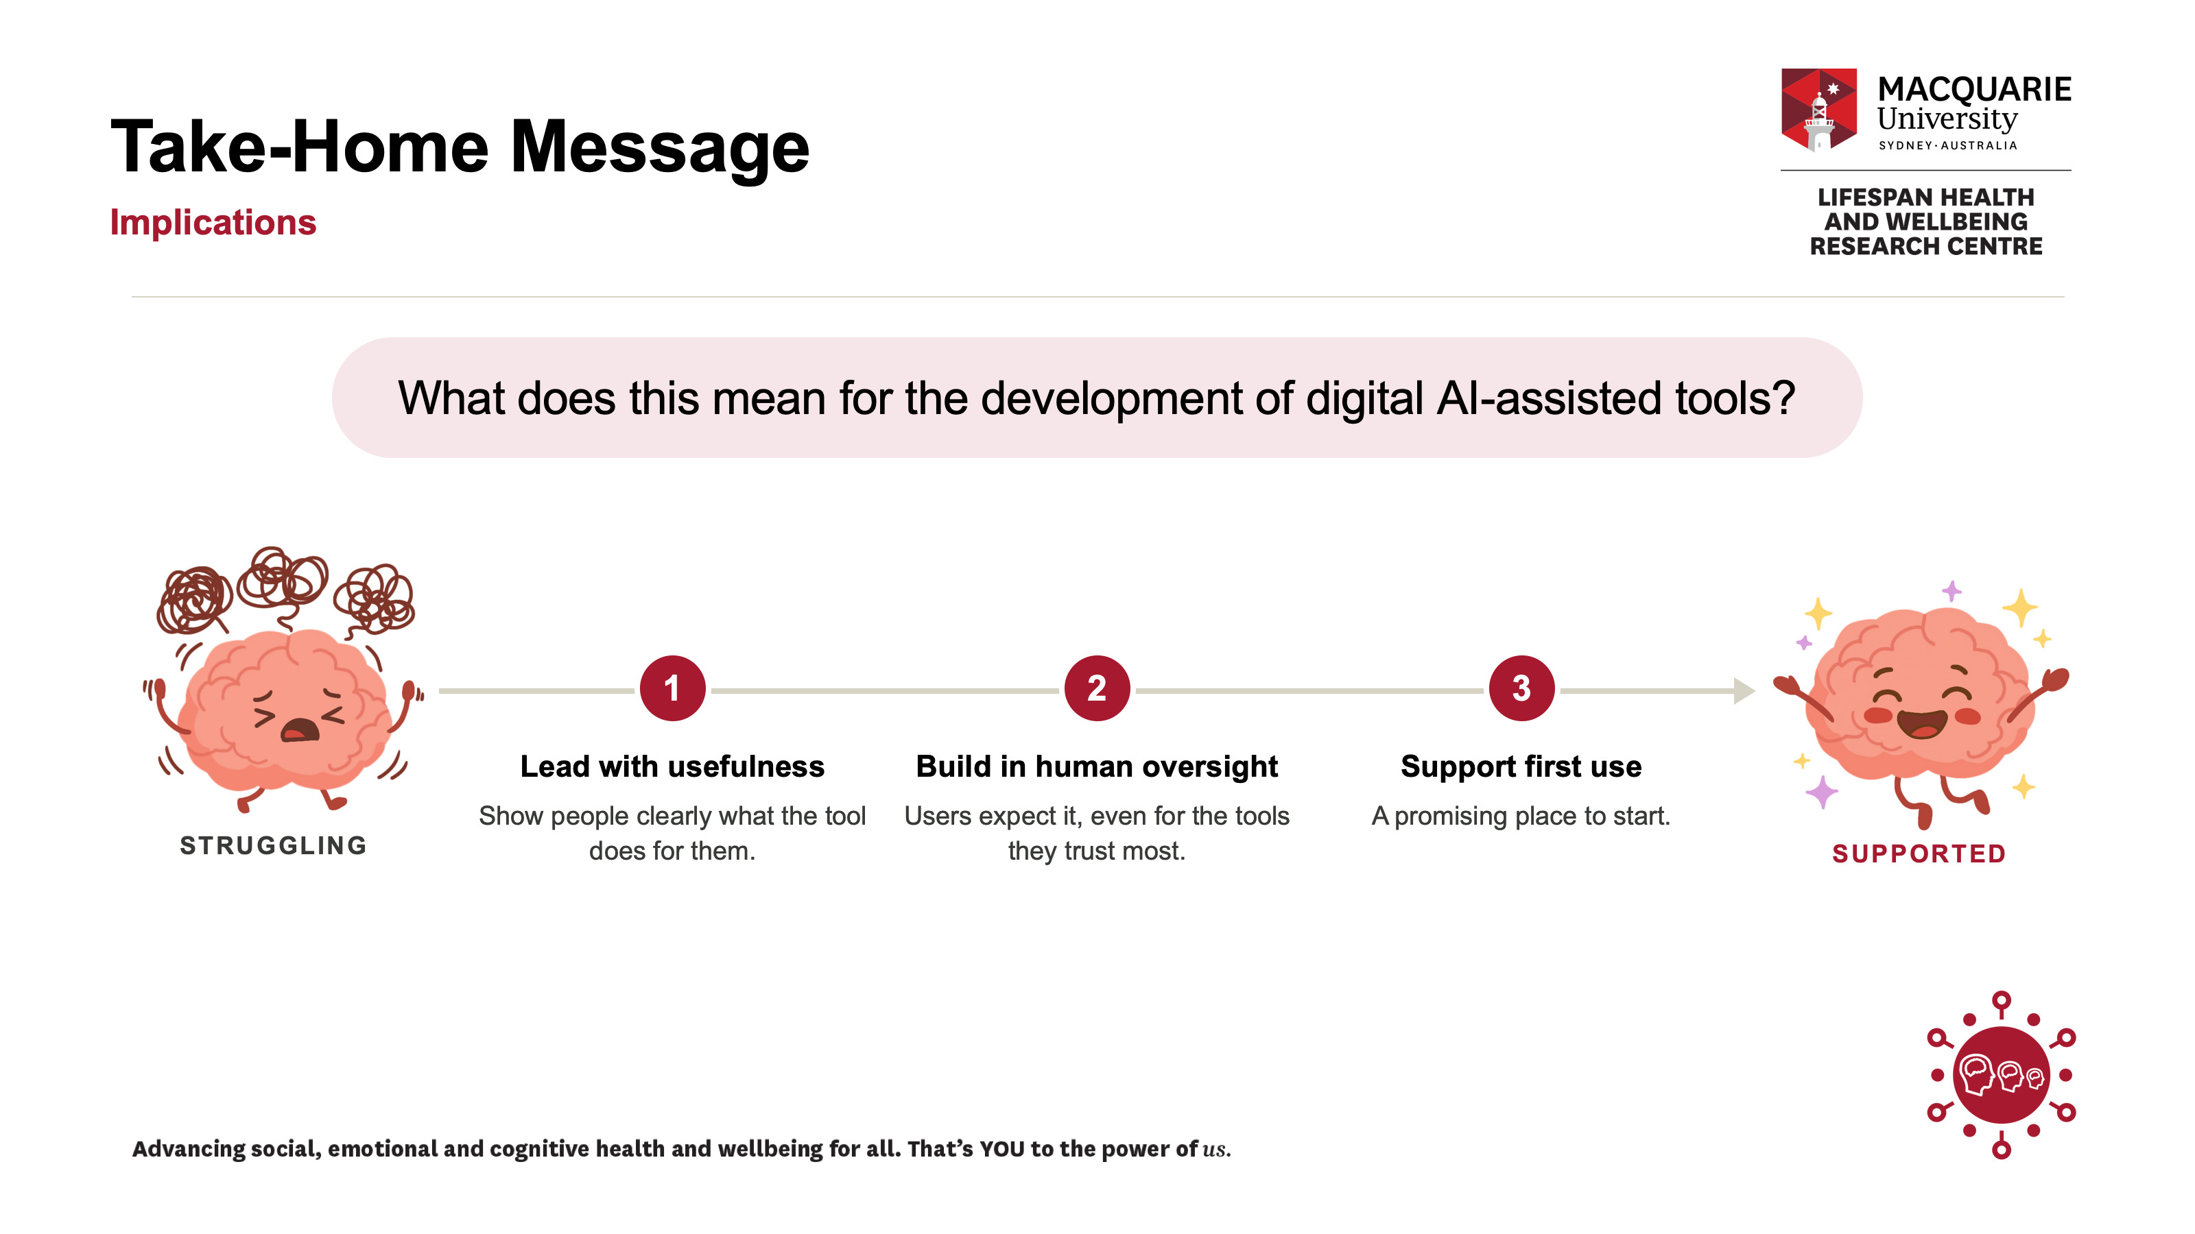
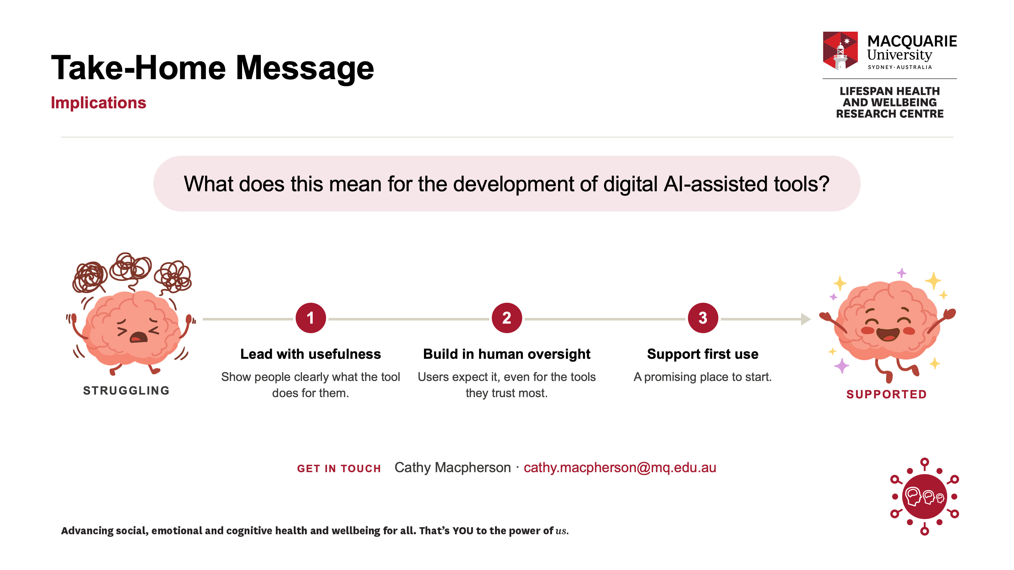
Notes:
So what does this mean for anyone building these tools?
Lead with usefulness, and show people clearly what the tool does for them. Build in human oversight, because users expect it, even for the tools they trust most. And create opportunities for supported first use. We can't yet say whether experience drives acceptance or the reverse, but it's a promising place to start.
AI might have a PR problem. But for the people who'd actually use these tools, the question isn't “is AI good or bad?” It's “will this help me, or my child?”
If we can show them the answer is yes, they're ready to listen.

