Slide 1
Data Mining Techniques Assignment 2
Laurens Hakkesteegt (2577269, lht620), Cathy Tol (2567806, ctl240) & Janine van Wonderen (2573337, jwn203)

Slide 2
Introduction
Travel booking website Expedia
Recommender system for hotel reservations
Based on the data of Expedia
Notes:
On these websites the user can, among other things, make a hotel reservation or buy flight tickets.

Slide 3
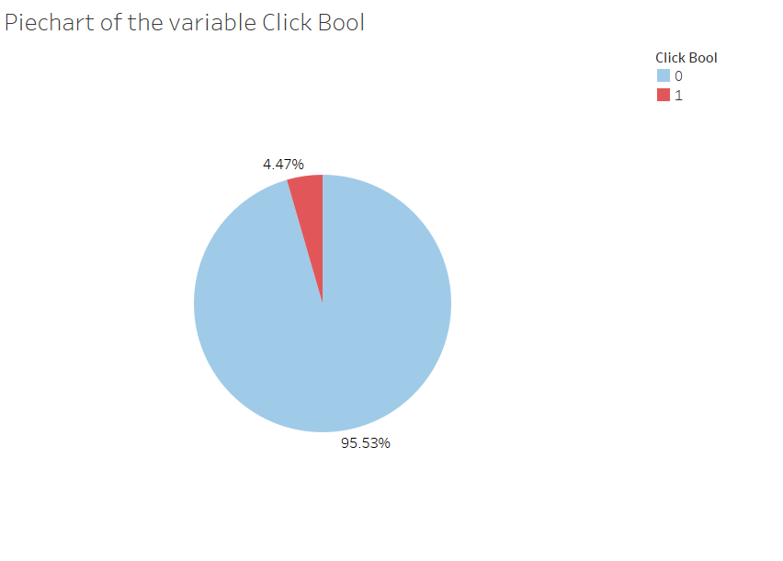
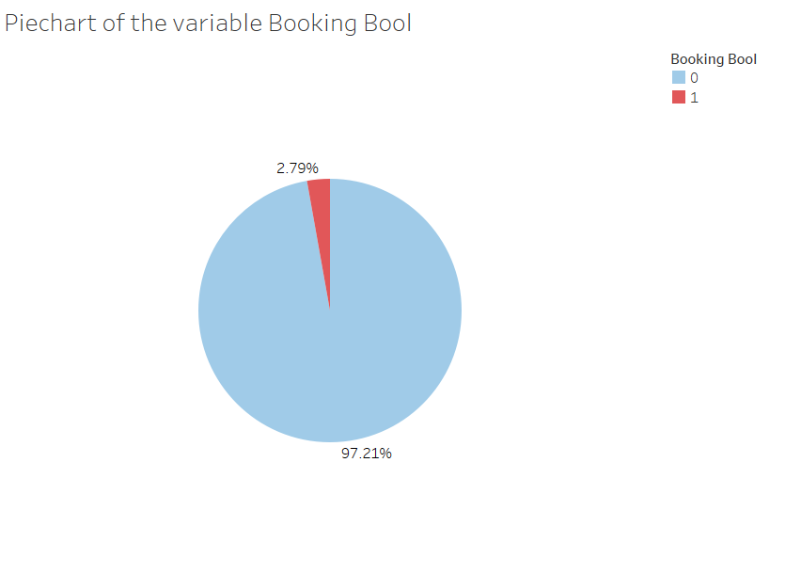
Data analysis

Slide 4
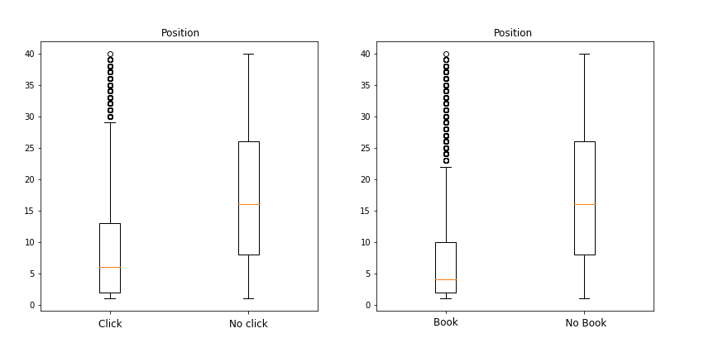
Data analysis
Notes:
On these websites the user can, among other things, make a hotel reservation or buy flight tickets.

Slide 5
New features
Mean of numeric property features
Clustering the mean numeric features
Mean difference in distance per search id
Mean difference in price per search id
Mean number of bookings for a property and property destination combination

Slide 6
XgBoost
‘eXtreme Gradient Boosting’
A parallel implementation of Gradient Boosted Decision Trees (GBDT)
Speed & performance
Notes:
The final model that is used is the XGBoost model which is proven to be a very powerful machine learning model.
XGBoost stands for eXtreme Gradient Boosting. itis a parallel implementation of Gradient Boosted Decision Trees (GBDT) designed for speed and performance.

Slide 7
Gradient Boosted Decision Trees (GBDT)
A technique which applies a framework called gradient boosting that uses regression trees as base learners.
Starts with a naïve prediction and then iteratively fits regression trees on the residuals to obtain a linear combination of predictors.
Notes:
This is a technique which applies a framework called gradient boosting that uses regression trees as base learners.
GBDT starts with a naïve prediction and then iteratively fits regression trees on the residuals to obtain a linear combination of predictors for any regression (or classification) problem.

Slide 8

Final framework used
Value clicking bool
Value booking bool
Sum value
Notes:
The final framework used consists of two XG-Boost models. The first model gets trained to predict the value of clicking bool and the second model gets trained to predict the value of booking bool. Both models are trained on the same dataset. The predicted values of clicking bool and booking bool are summed. The properties are then sorted by that sum in descending order.

Slide 9
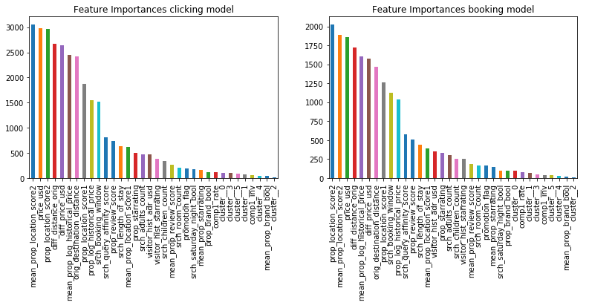
Results

Slide 10

Questions?

