Slide 1
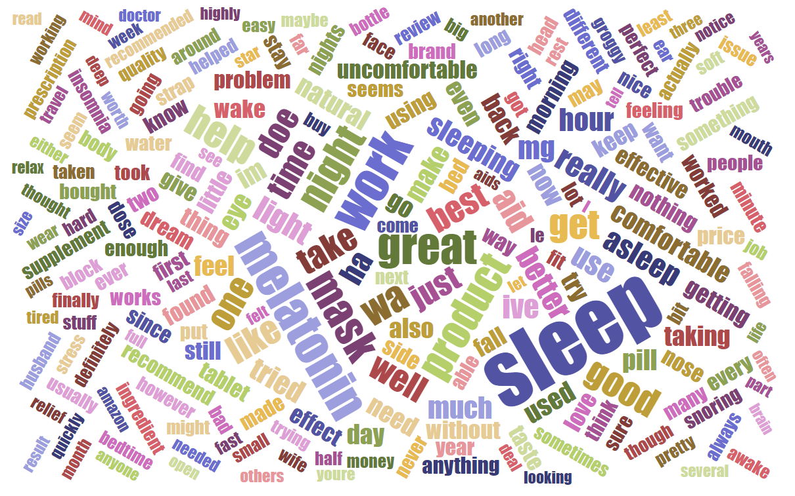
Mining Users’ Opinions from Amazon Reviews by xinyu zhang

Slide 2
Goals
Through mining amazon review text to understand:
When reviewers like or dislikes a certain product, what do they like/dislike about?

Slide 3
Data Collection

Slide 4
Methods and Results
Data cleaning and integration
Exploratory data analysis
Sentiment analysis to identify the positive opinions and negative opinions
Extracting the relevant product features and representative sentences

Slide 5
Methods and Results
Data cleaning and integration
Exploratory data analysis
Sentiment analysis to identify the positive opinions and negative opinions
Extracting the relevant product features and representative sentences

Slide 6
Data cleaning and integration
There are in total 263032 products in Health and personal care department
Product metadata contain: product ID. brief description of the product other products that users who bought this product also bought. the rank of the sale amount of product. categories that a product can belong to. price brands | Review data contains: the reviewers' ID reviewers’ user name the number of people who find the review helpful or not helpful the review text the rating (1 – 5) summary of the review time the review was uploaded product ID
Two datasets are linked by product ID

Slide 7
Data cleaning and integration
Inner join product metadata with review data by column of product ID
Select products under category “Sleep & Snoring”
Select subset of columns for sentiment analysis
Review ID
product ID
Review text
Rating
Summary

Slide 8
Methods and Results
Data cleaning and integration
Exploratory data analysis
Sentiment analysis to identify the positive opinions and negative opinions
Extracting the relevant product features and representative sentences

Slide 9
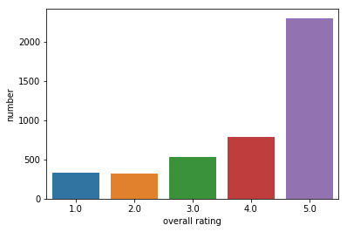
Number of reviews by rating

Slide 10
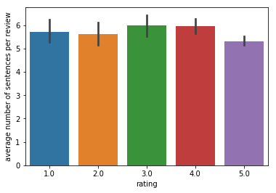
Average number of sentences per review by rating

Slide 11
An example of review text and summary:
review text:
“Ok... so I got this because a friend recommended melatonin to help me sleep at night. The first night I tried it I got a little relaxed, fuzzy sleeping feeling for maybe 5 minutes (I was already a little tired) and then BAM I felt hyper. Every other time I tried it since then? Nada. I might as well be drinking water. As for taste... I love me some straight up spirits, so the alcoholy part didn't bother me. It reminded me a bit of NyQuil meets a bit of, I don't know..some sort of flavored vodka. I'm certainly drank worse things.”
summary sentence:
“Can't decide if I should dump the rest or just keep using it.”
Review text are less focused and cannot be labeled using rating
The summary sentence more straightforwardly reflects the user's opinion than the review text

Slide 12
Methods and Results
Data cleaning and integration
Exploratory data analysis
Sentiment analysis to identify the positive opinions and negative opinions
Extracting the relevant product features and representative sentences

Slide 13
Sentiment analysis
Selecting data for training, validation and testing
Data preprocessing
Test-train split
Classification pipeline
Evaluate tuned classifiers
Custom cutoff probabilities for classification

Slide 14
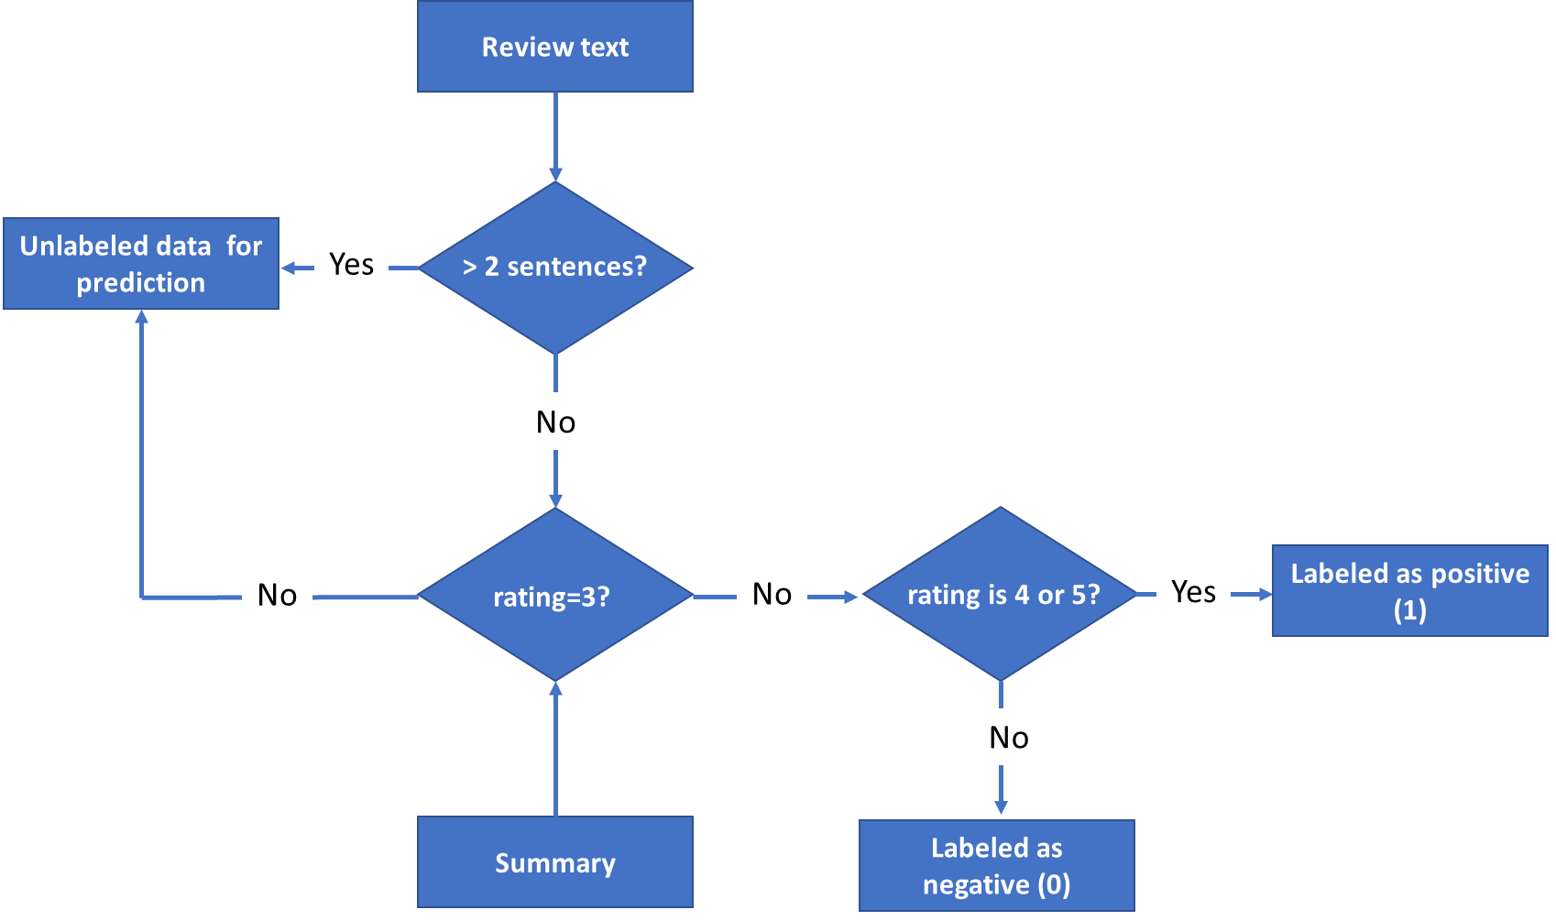
Selecting data for training, validation and testing

Slide 15
Data Preprocessing
All letters changed to lower cases;
Separating "not" as a single word. For example: don't -> do not, won't -> will not.
Spelling correction. For example, amazzzzing -> amazing.
Removing punctuations
Lemmatization
Test-train split
70% for train and cross validation and 30% data for testing

Slide 16
Classification pipeline
Tf-idf → Chi square feature selection → 5-fold cross validation
Stages of pipeline | Hyperparameters to tune | Tuning range
Tfidf | n grams | 1-3: single word, bigrams, and trigrams 1-4: single word to four grams 1-5: single word to five grams
Feature selection | Number of features to keep | 100, 300, all
Classification (5-fold cross validation)
Naïve Bayes | Smooth factor (alpha) | 0.01, 0.1, 1, 10
Random Forest | Number of random trees used to aggregate the predictions
 | Maximum number of features used to grow a tree | 20, log2(N), (N)^0.5 N= total number of features
 | Maximum number of splits in a tree | 8, 10, 40
SVM | Penalty coefficient of the error term | 0.01, 0.1, 1, 10
 | Kernel coefficient (gamma) | 0.01, 0.1, 1, 10
 | Kernel | ‘rbf’, ‘poly’
Gradient Boosting | Number of trees to assemble | 50, 100, 500
 | Max number of features used to grow a tree | 20, log2(N), (N)^0.5 N= total number of features
 | Minimum number of leaves on a tree | 3, 10, 20
 | Minimum number of split | 3, 5, 10

Slide 17
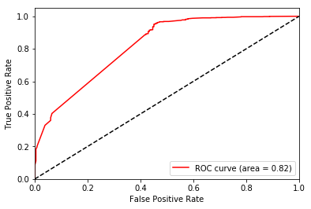

Evaluate tuned classifier
$$ROC Curve$$

Slide 18
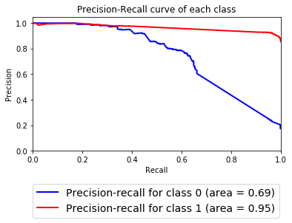
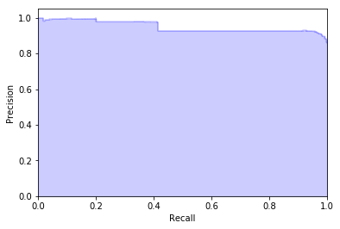

Evaluate tuned classifier
$$Precision−recall curve$$

Slide 19
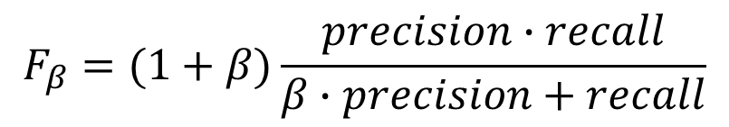
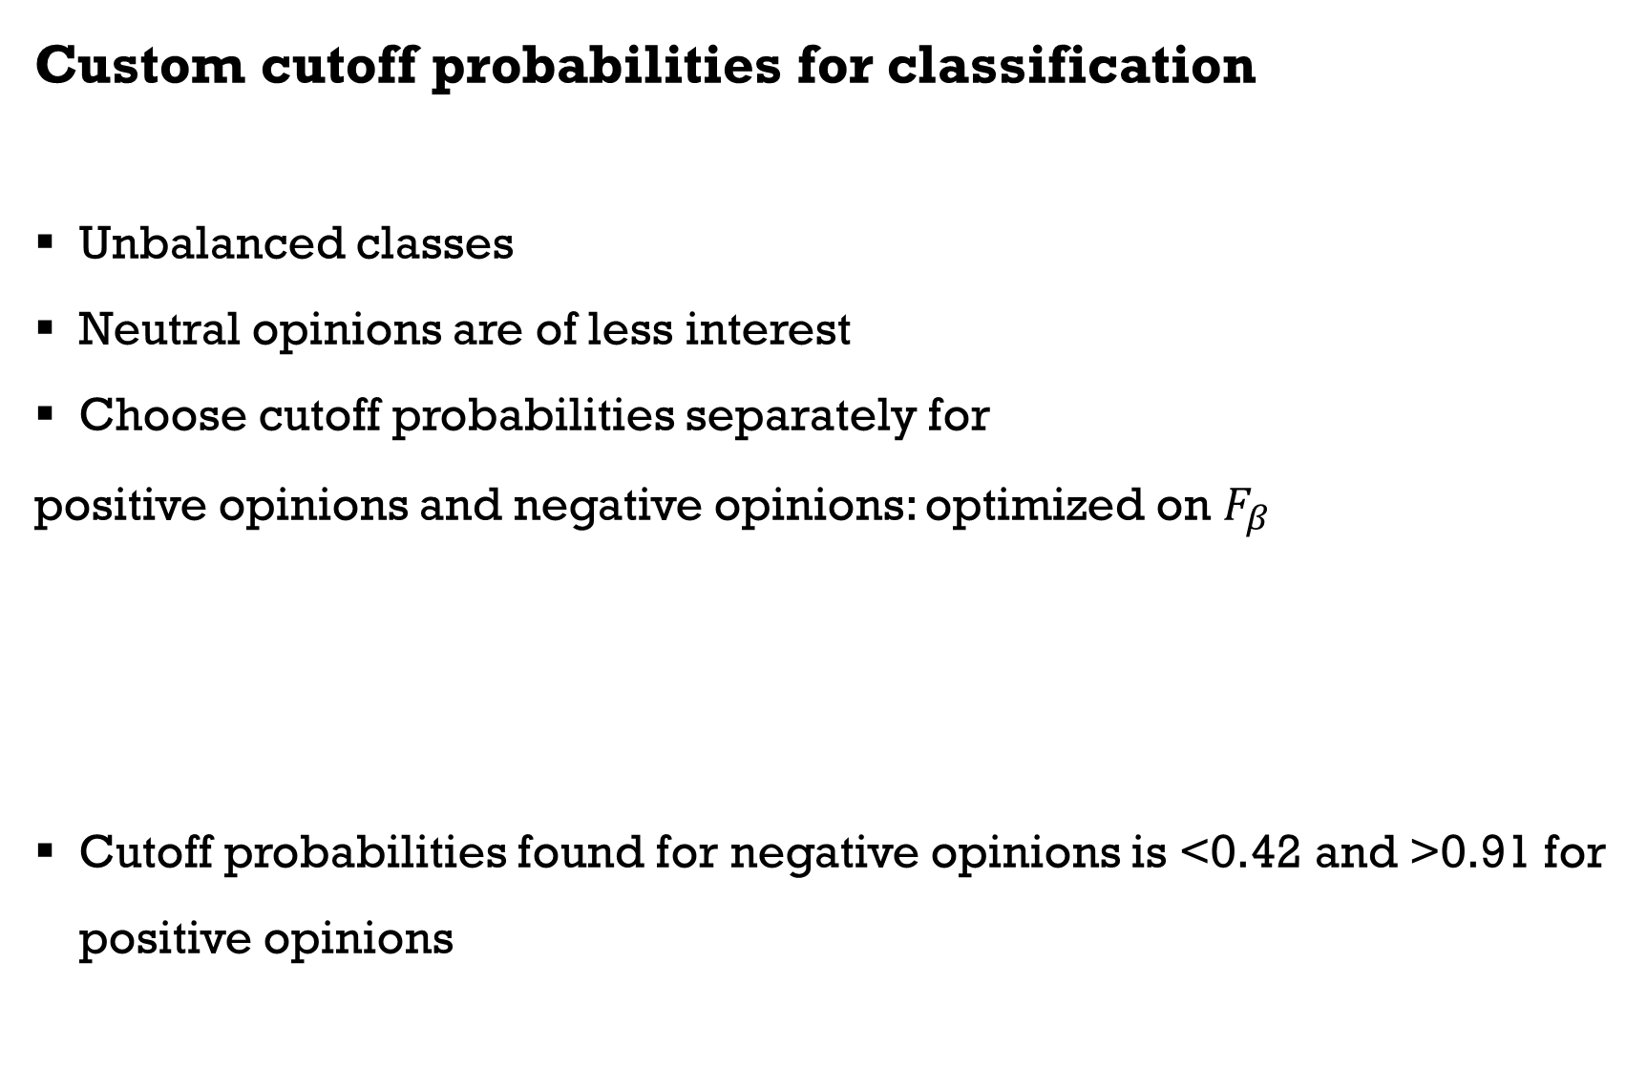
Custom cutoff probabilities for classification
Unbalanced classes
Neutral opinions are of less interest
Choose cutoff probabilities separately for
positive opinions and negative opinions: optimized on $F_{β}$
Cutoff probabilities found for negative opinions is <0.42 and >0.91 for positive opinions
$$F_{β}=(1+β)\frac{precision∙recall}{β∙precision+recall}$$

Slide 20
Methods and Results
Data cleaning and integration
Exploratory data analysis
Sentiment analysis to identify the positive opinions and negative opinions
Extracting the relevant product features and representative sentences

Slide 21
Extracting the relevant product features and representative sentences
Classifying Unlabeled Data
Extracting Meaningful Phrases
Finding the Representative Sentences

Slide 22
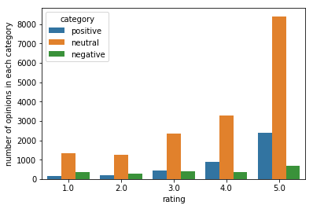
Classifying unlabeled data

Slide 23
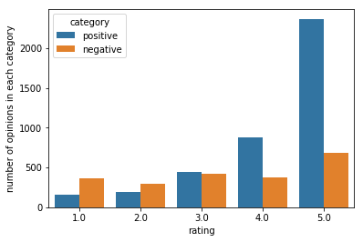
Classifying unlabeled data

Slide 24
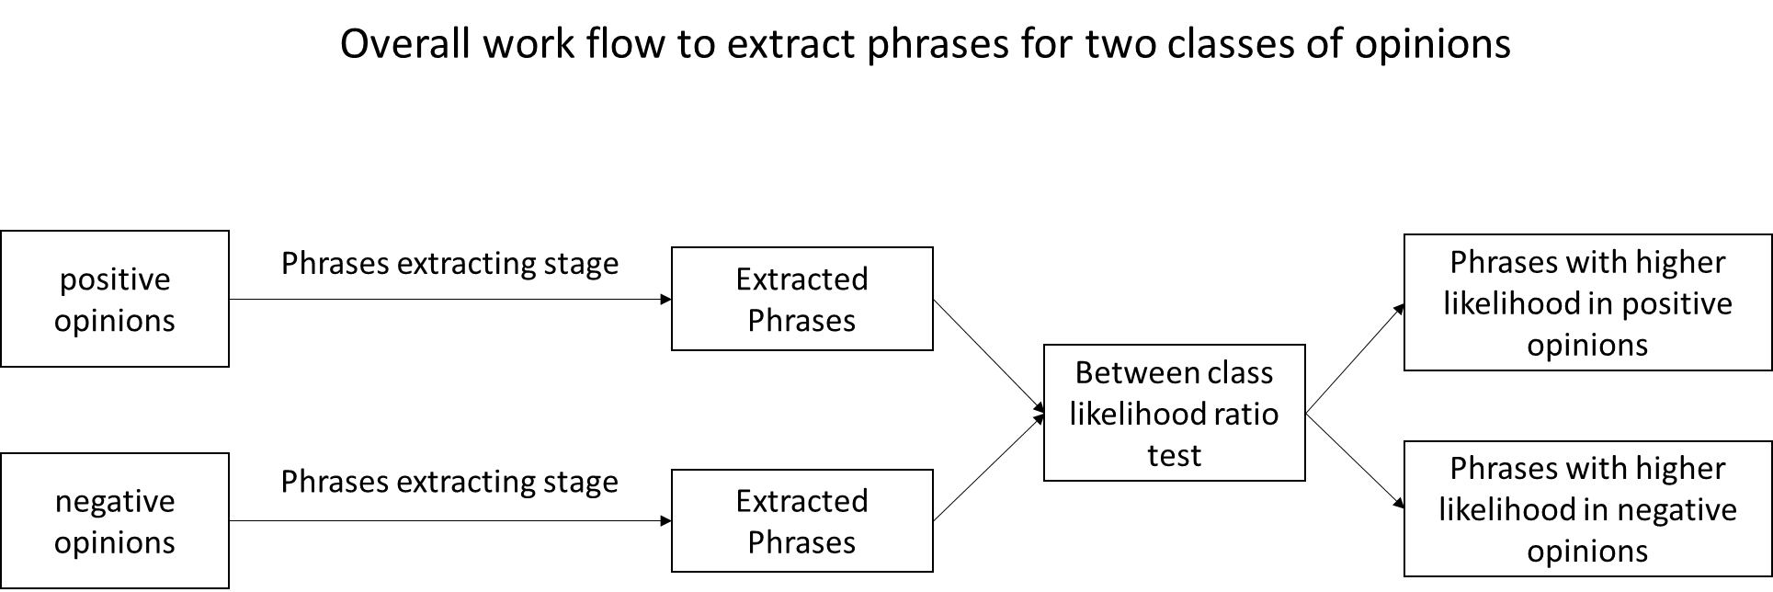
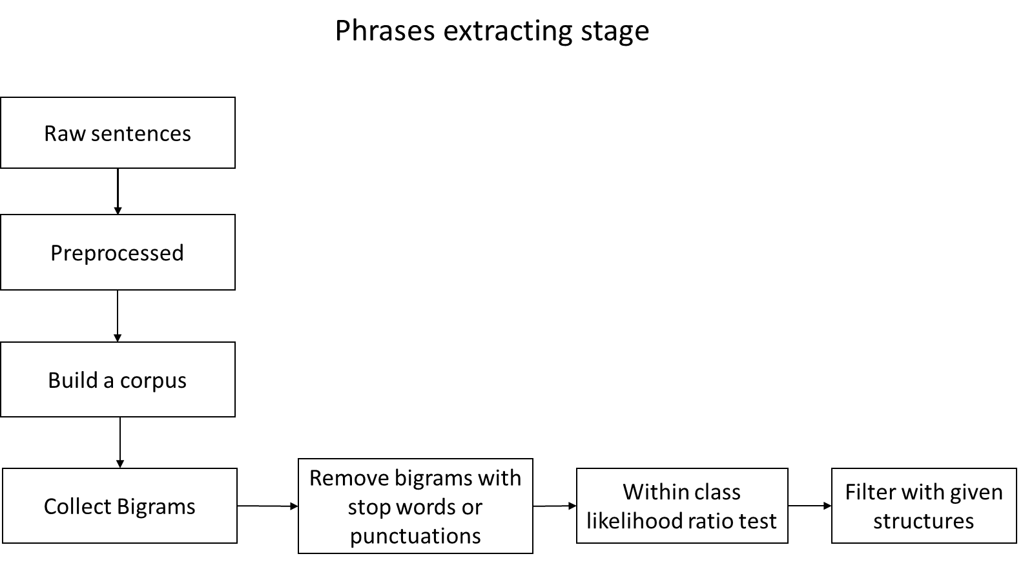
Extracting Meaningful Phrases

Slide 25
$$Top selected phrases for negative opinions$$
$$Top selected phrases for positive opinions$$
Bigrams | Likelihood ratio
not work | inf
not help | 4.594080e+70
anything not | 1.769477e+67
not not | 3.918912e+65
side effects | 2.840317e+56
taste not | 4.025552e+55
night not | 5.350249e+54
find not | 1.617184e+54
strap not | 1.054834e+53
think not | 3.958870e+52
not like | 1.248547e+52
thing not | 9.385651e+49
not know | 5.681983e+48
product not | 5.695425e+47
well not | 2.455697e+47
sleep aid | 2.166788e+45
not sure | 1.087599e+41
not notice | 1.420797e+37
not feel | 1.164237e+33
trying not | 1.318783e+30
not use | 7.833462e+22
simply not | 1.032731e+22
not stay | 1.453739e+21
not recommend | 7.177878e+20
Bigrams | Likelihood ratio
sleep mask | inf
fall asleep | 3.246981e+215
doe not | 7.644850e+160
dream water | 1.111200e+159
work well | 4.158263e+150
great product | 1.323021e+150
work great | 2.313019e+133
good night | 1.596020e+128
ear plug | 5.910845e+121
jet lag | 1.146892e+87
doxylamine succinate | 1.157488e+69
year old | 2.807142e+63
side effect | 1.883415e+62
mg sleep | 3.214381e+61
next day | 4.774278e+60
go sleep | 8.225597e+58
time release | 5.060111e+58
also sleep | 3.014924e+58
eye sleep | 2.554948e+58
much better | 2.036825e+58

Slide 26
Extracting Representative Sentences
Phrases
e.g. doe not
Find preprocessed text
e.g. 'my son doe not wake up at : a. m. anymore! yea! '
Find corresponding raw sentences
e.g. "My son doesn't wake up at 5:30 a.m. anymore! Yea! "

Slide 27
Examples of extracted opinions
Product "Biotab Nutraceuticals Alteril Sleep Aid with L-Tryptophan, Tablets 30 ea"
Positive opinions:
“Works Well for Our 8 Year Old”
Negative opinions:
“I've taken double and triple the recommended dosage and I don't feel a thing, not even a little sleepy. Don't waste your money on this one. “
Product "Dream Zone- Earth Therapeutics Sleep Mask, 1ct"
Positive opinions:
“My son doesn't wake up at 5:30 a.m. anymore! Yea!... “
“works well... “
“When I take two tablets, they seem to work well. I'm able to get to sleep within 1/2 hour, and stay asleep for at least 4; many times, longer.... “
Negative opinions:
“Strap not comfortable...”
“This product in no way made me sleepy, not to say that it won't work for you.... “
“I hate to say this product did not work for me....”
“I'm not sure if it did or did not; I used for about 2-3 months then went back off.... “
“That's okay on an rare basis, but would not work nightly.”

