Slide 1
Geomagnetic data integration
CSA Challenge 2: GO Canada
By Team Beans
Beans: We Eat Em

Slide 2
About Us
We are a group of Waterloo students who saw an opportunity to use the knowledge we’ve accrued through our studies in tandem with existing professional techniques to modernize and advance the management and integration of geomagnetic data. We set out to create a system that would isolate erroneous data consistently and accurately; and present it cogently. The foundation of our code is based on the “Hilbert Huang transform” along with other signal processing techniques.

Slide 3
The challenge
The Canadian Space Agency (CSA) fronted the challenge of identifying outliers in geomagnetic measurements made all across the country by magnetometers
Magnetic measurements are impacted by external phenomena, be it human intervention or astral anomalies
A system is needed to classify non-geomagnetic data, so that it doesn’t interfere with said data’s accuracy

Slide 4
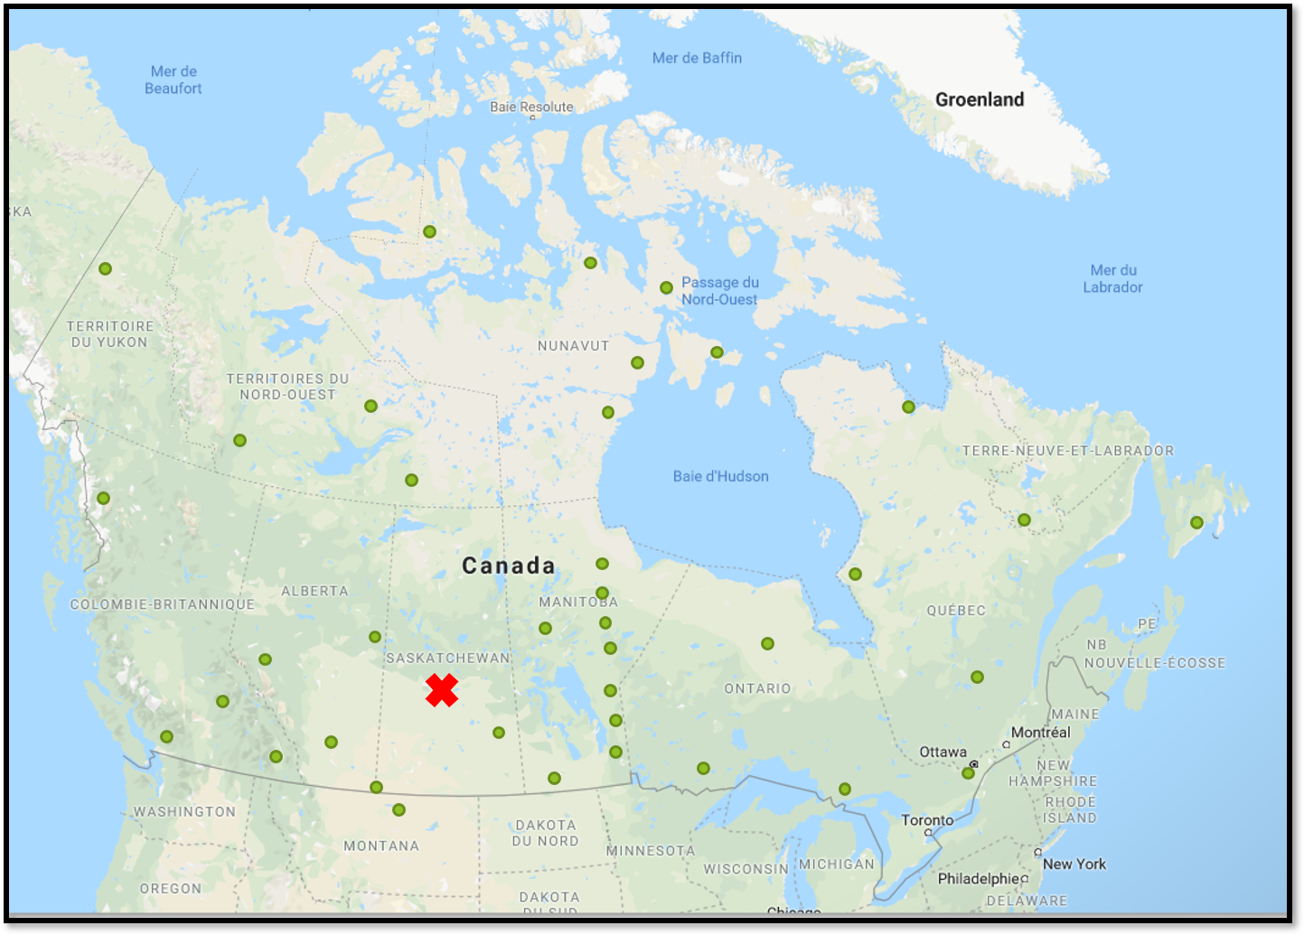
Geomagnetic data
Geomagnetic data is measured in remote locations across Canada
The goal of these devices is to detect solar storms and anomalies
These anomalies can destroy powerlines and interfere with data transfer
In 2003, there was a nation wide power outage caused solely by solar fluctuations

Slide 5
The solution

Slide 6

Hilbert-huang transform
The Hilbert-Huang Transform is an emerging technology in Signal Processing, which decomposes datasets into bite-sized signals which encapsulate information about the time-varying behaviour of the data (phase and frequency)
Used to filter out noise in our dataset so that we can compare locations of peaks and valleys in our dataset through cross-correlation
Signal
HHT
“Intrinsic Mode Functions”

Slide 7
Outlier detection algorithm
Big picture: the algorithm scores pairs (HH-DD, Location) based on whether other locations experience a similar disturbance at the same time. This lets us track down local (rather than global) interferences such as storms, power outages, and other technical difficulties.
Factors in the scoring method:
Correlation function between the two signals (Filtered by a HHT)
Maximum-norm between the moving (STFT) Fourier transform of two signals
Physical distance (along Earth’s surface) between points at which signal is measured

Slide 8
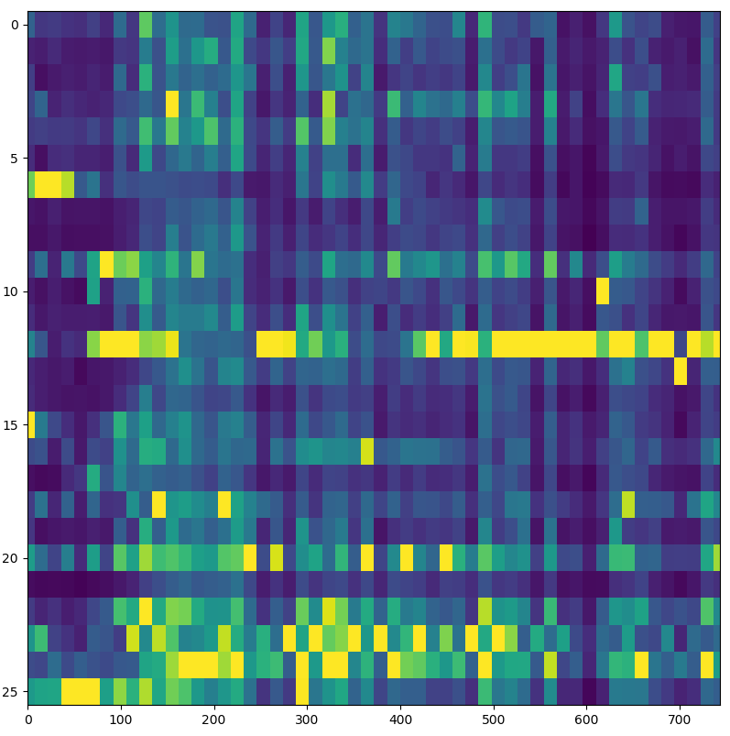
The results
Outlying points in dataset1.txt are shown in yellow. Due to algorithmic limitations, exact time values are not picked out – one may view this as telling you how statistically confident you are in the magnetic field values being correct. The script outputs these values in a csv file.
Column Number
Time (hr)

Slide 9
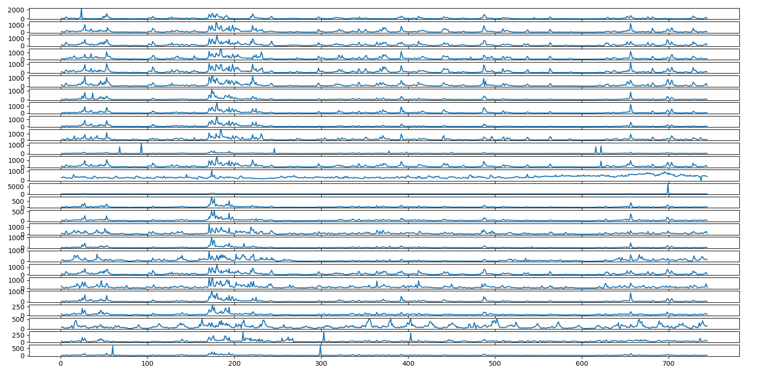
Visualizing some of the results
Column Number
Location
THRF
(col 13)
Periodic Signal Outlier

Slide 10
Interface concept
Text files are uploaded to the interface, containing data sets with potential outliers
These files are ran through our outlier detection algorithm
The final plot is displayed in the window, and the user receives a prompt to open the csv file containing the results.
Market opportunities

Slide 11
Applications
The algorithm we’ve put together is easily tunable, with more fine tuning the results would improve even more
It can be used to reliably detect anomalous data in most sets, regardless of the data type or quantity, most notably non-linear and non-stationary data
The Hilbert-Huang Transform has a lot of potential as an emerging technology in signal processing, which is used by any scientists working with large time-series datasets
This algorithm won’t change the world, but rather, it will make changing the world easier

Slide 12

Thank you for you time !
We can now attempt to answer any questions you might have.
Github: github.com/mastwood/spaceapps-2019

Slide 13

The Math behind our program (Supplementary Slide)
Second IMF of Ω
FFT of Ω

Slide 14
Packages Used in Python
Hilbert-Huang Transform: PyHHT
Short-time Fourier Transform: SciPy
Other: NumPy, MatPlotLib, TkInter, Progress

