Slide 1
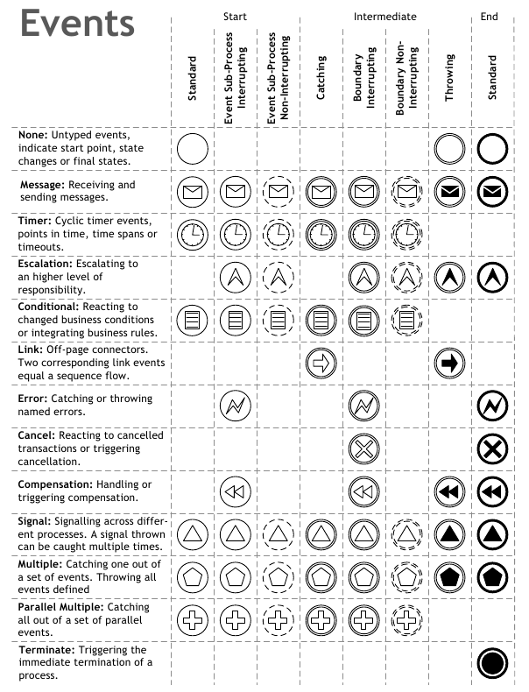
1.0
1.0
1.0
1.0
1.0
1.0
1.0
1.1
1.1
1.0

