Slide 1



Session-02 Introduction to single cell analysis with Seurat
Data QC, Filtering, Cell Clustering

Slide 2
Starting an analysis project

Slide 3
Know the project goals
Experimental design
Library type, sequencing depth, targeted # of cells
Relevant sample metadata
Conditions, timepoints
Celltypes of interest
Niche populations, heterogeneous vs sorted samples

Slide 4
Organizing bioinformatic analysis
Don’t
Use a single analysis script
Make undocumented changes to data via the console or other interactive tools
Become attached to data or functions in your environment
Do
Split your workflow into stages
Save intermediate objects between processing steps
Periodically rerun your scripts from the beginning
**If you're ever afraid of not being able to reproduce an outcome, reassess your workflows**

Slide 5
Tools for reproducible workflows
r projects
Isolate analyses, organize filepaths
renv
Record and manage package versions
Git
Track and revert changes; backup and share code

Slide 6
Cellranger output files
Data may be stored in matrix/tsv formats or HDF5 format
Matrix format
barcodes.tsv.gz features.tsv.gz matrix.mtx.gz
H5 format
sample_feature_bc_matrix.h5
Running `cellranger multi` with other assays (e.g. T or B cell repertoire seq, CITE-seq) may produce other output files

Slide 7
Analysis software
Seurat
R based, probably most popular, many tools built around Seurat's framework
Scanpy
Python based, newer, more amenable to trajectory analyses
SeqGeq
GUI based, similar to FlowJo (flow cytometry tool), paid software

Slide 8

Data processing with Seurat

Slide 9
Goals of processing
Remove empty GEMs, multiplet GEMs, low quality cells
Scale/normalize data
Dimensional reduction

Slide 10
Isolating high-quality cells
Cellranger has built-in filtering to remove empty GEMs
Helps reduce size of initial data, but insufficient for rigorous analysis
Additional, manual filtering performed in Seurat on a per-capture basis
Knowledge of study design and goals informs stringency

Slide 11
QC metrics

Slide 12
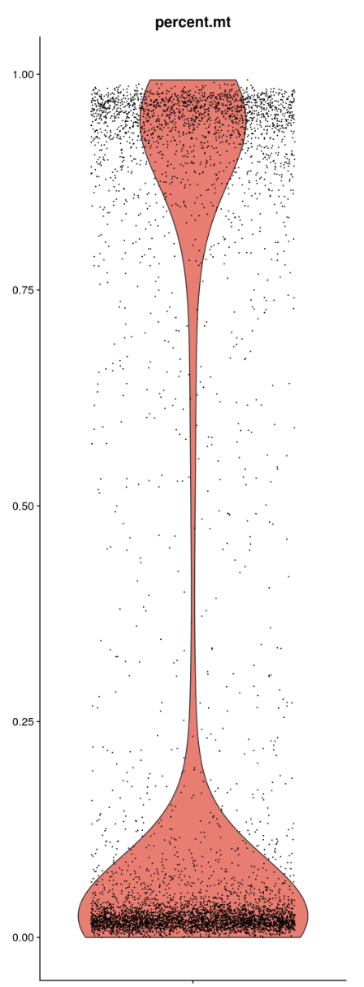
Mitochondrial gene expression
High proportion of MT gene expression indicates unhealthy cells, not a good representation of normal cell state
Some studies expect high MT expression (e.g. tumor biopsies)

Slide 13
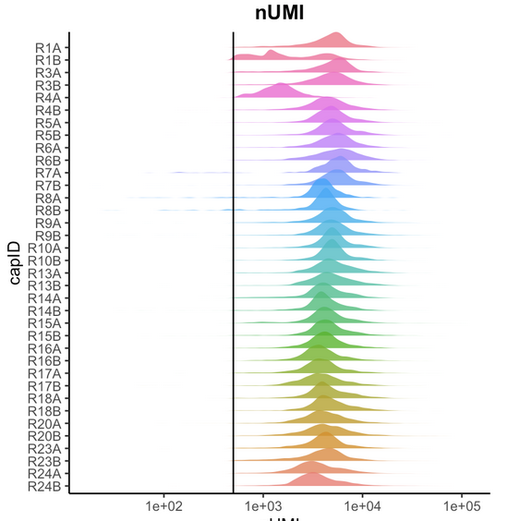
Number of unique reads
Low # of reads may not capture all cell activities
High # of reads may suggest multiple cells in a single GEM (multiplets)

Slide 14
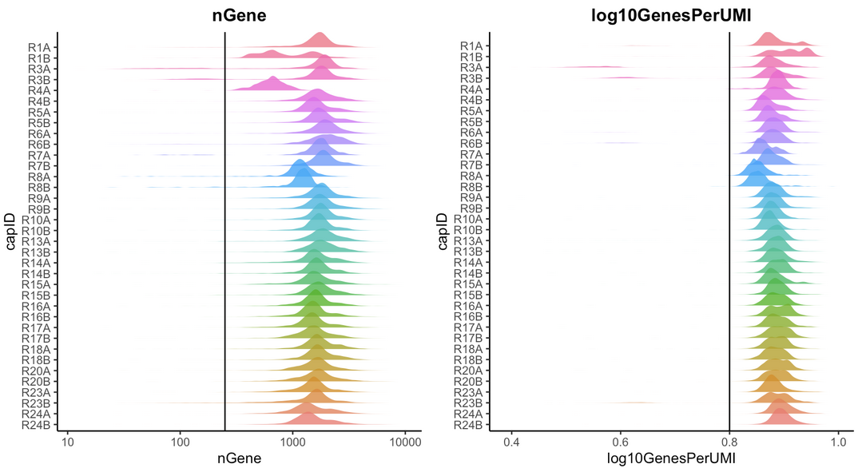
Number of unique genes/features
Cells with many features may need greater sequencing depth
Considered with # of reads as a proxy for cell complexity
A cell with many reads coming from few genes may be technical artifact

Slide 15
Knowledge of organism, tissue, and desired cell-types are key
Quiescent populations may have higher # of unique features
Red blood cells may have majority of reads in a few features
Disease studies may be interested in dying cells
Each capture introduces technical variation
Do you value putative detection of subtle signals, or high-confidence analyses?
You shouldn't just apply general filtering thresholds to every study
Notes:
Examples Neutrophils in lung data removed by stricter QC

Slide 16
Outlier detection approach
A good starting point can be to filter outliers from your data
Median absolute deviation (MAD) outlier detection: exclude values beyond n MADs
Increasing the allowed number of MADs reduces the stringency
A general cutoff used by developers of the scater package is 4 MADs

Slide 17
Doublets

Slide 18
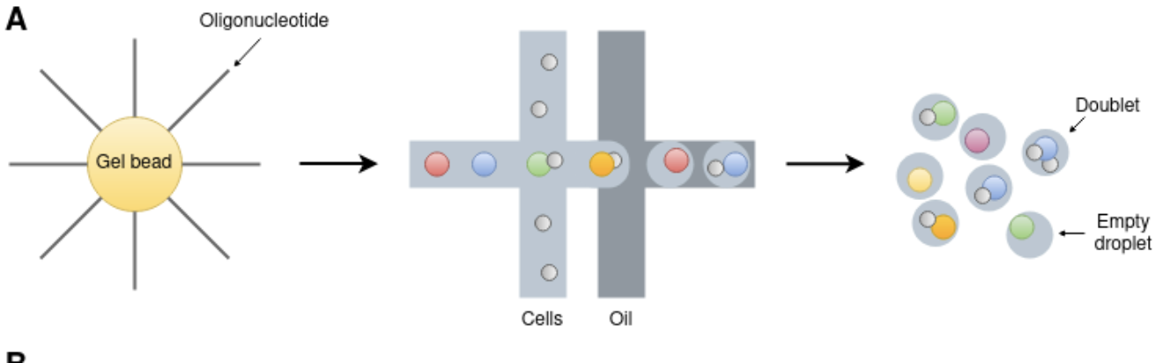
Doublets
Two cells that share the same barcode
Reads cannot be separated
Fig. source

Slide 19
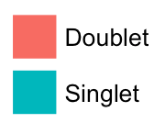
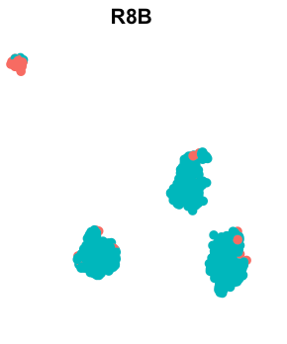
Doublets
Difficult to identify due to biological and technical variability
Imperfect detection algorithms: you should expect to lose some 'real' signal
Check for clustering of doublets and overlay other metadata
Expression of multiple cell-type markers
High gene/UMI counts
Notes:
In b cells, removing cells with 2 heavy chains

Slide 20
Tools for removing doublets
These are outside the `Seurat` ecosystem
DoubletFinder
scDblFinder

Slide 21
Ambient RNA

Slide 22
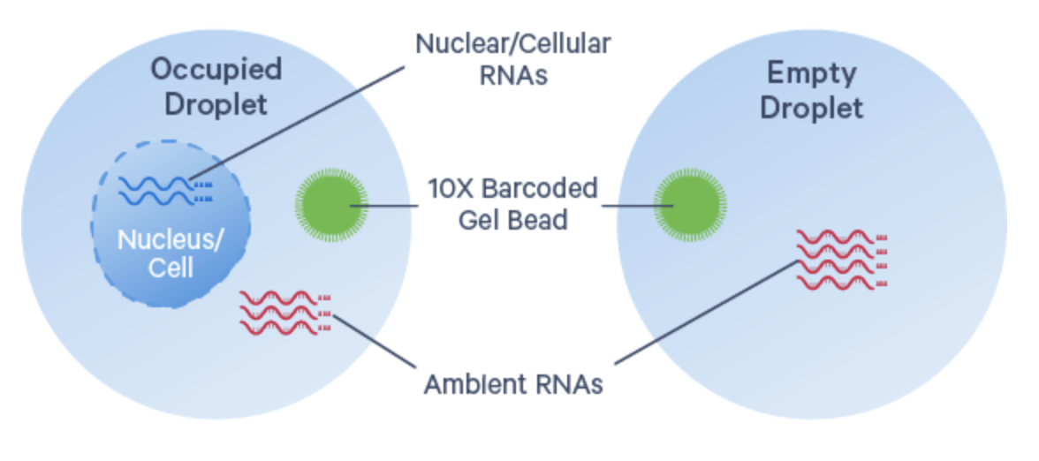
Ambient RNA
Lysed cells release RNA into solution
Ambient RNA fragments get barcoded in GEMs
Falsely attribute
expression to a cell
Introduction to Ambient RNA Correction - 10x genomics

Slide 23
Ambient RNA correction
**We will not be doing correction as part of the workshop**
Different methods require different inputs, preprocessing steps, etc.
Some required data is not usually made available with public datasets
SoupX - popular correction tool
See more tools in the 10x vignette
Introduction to Ambient RNA Correction - 10x genomics

Slide 24
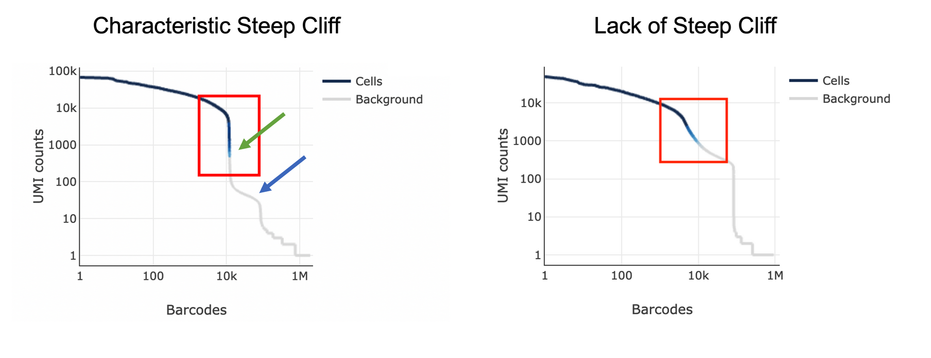
Ambient RNA correction
Correction is a powerful step: transforms your data in unpredictable ways
Consider running tools to assess amount of ambient RNA before deciding to act
Introduction to Ambient RNA Correction - 10x genomics

Slide 25
Normalizing and scaling data

Slide 26
Normalizing and scaling data
Standardize transcript counts as fraction of total cell expression
Log-transform
Scale to mean expression for feature across cells to 0

Slide 27
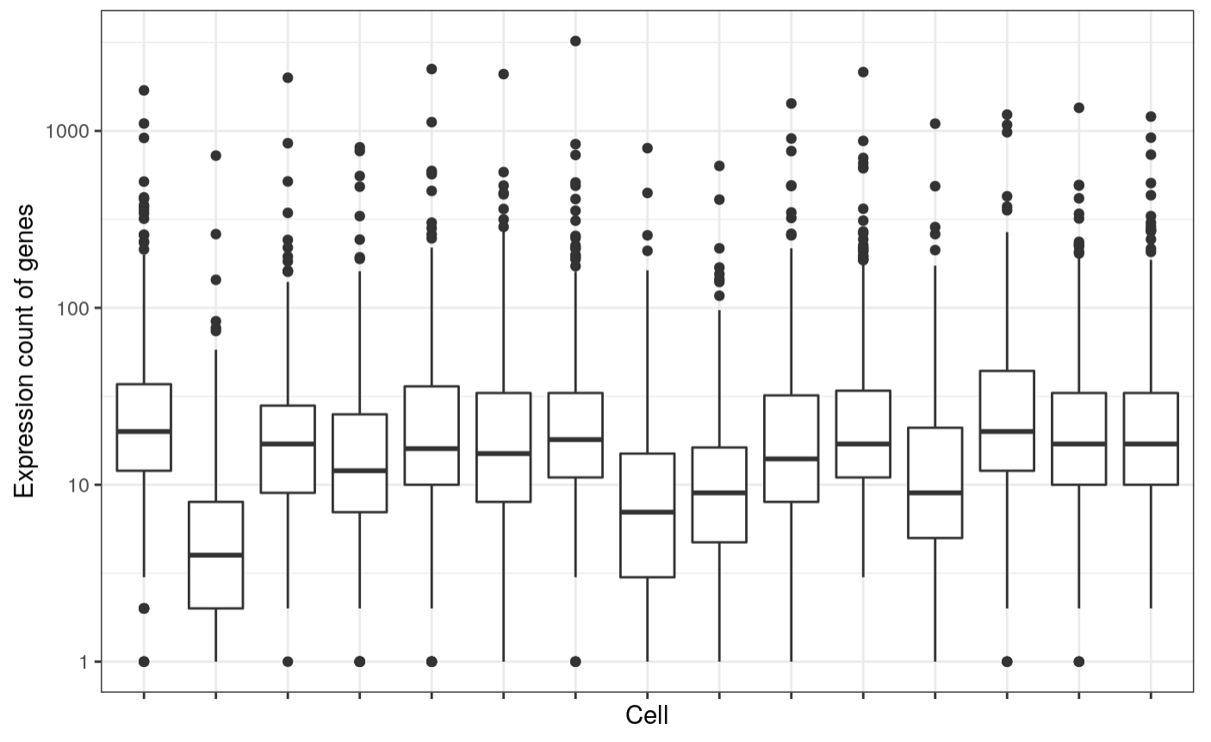
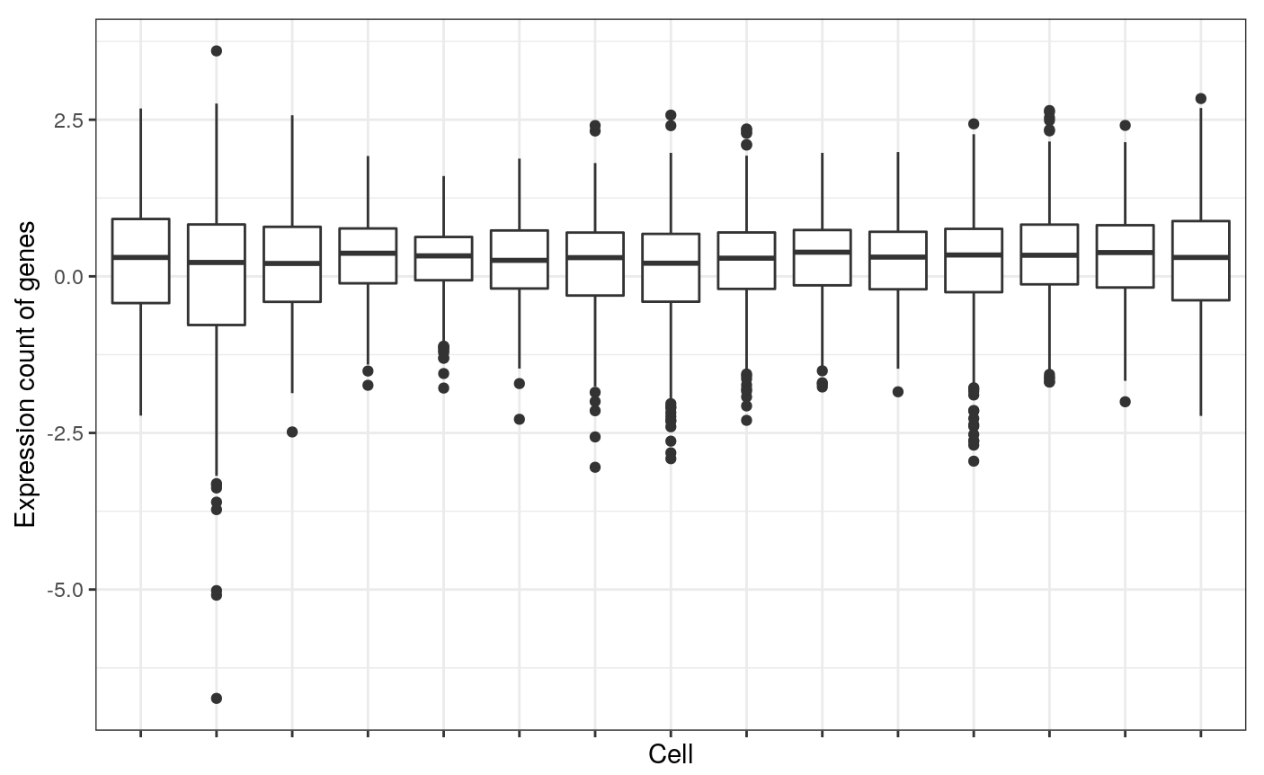
Normalizing and scaling data
Each box / x-axis entry is a cell
Each point is a single gene in that cell
before after
Expression count
Expression count
Note that this plot was made with a subset of genes and cells to reduce render/viewing burden,
hence the non-0 medians

Slide 28
Normalization techniques
Seurat::NormalizeData(): "By default, we employ a global-scaling normalization method that normalizes the feature expression measurements for each cell by the total expression, multiplies this by a scale factor (10,000 by default), and log-transforms the result"
Seurat::SCTransform(): Tailored to the variance and dropout observed in single-cell data, but still somewhat new and up for debate
Some newer Seurat vignettes will use SCTransform, but many other tools and techniques use classic log normalization. We use NormalizeData in the workshop

Slide 29
Cell cycle regression

Slide 30
Cell cycle regression
Cell cycling can produce heterogeneity in similar cells
Can overpower more interesting sources of variance
Seurat provides genes and functions to predict cell-cycle stage
Cell cycle value can be used to regress expression of genes that covary with cell cycle genes

Slide 31
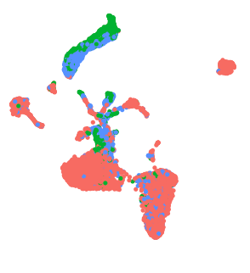
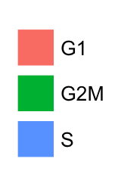
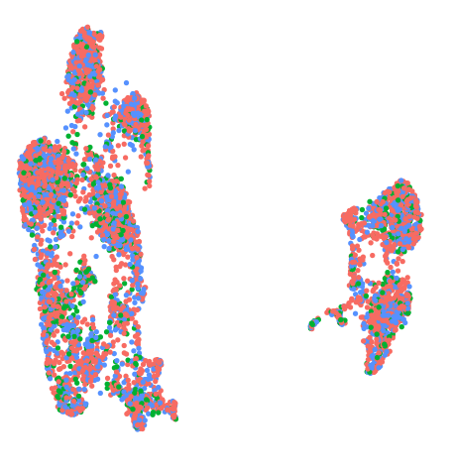
Cell cycle regression
Cell cycle may be relevant to the study
e.g. proliferating stem cells
CC regression transforms the expression of genes in unpredictable ways
See if CC is driving clustering and consider if regression is necessary
See Seurat’s vignette for more info
Special workflows for isolating proliferating cells
Notes:
top is bonemarrow, bottom lymph node

Slide 32

Dimensional reduction

Slide 33
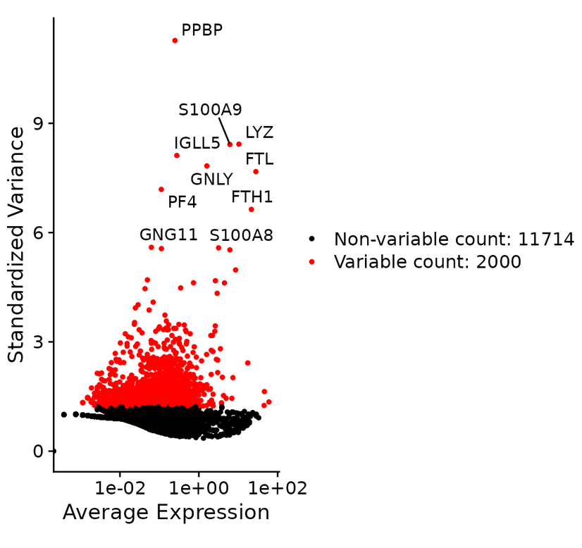
Highly variable features
Datasets include 10,000+ genes, but most
aren't relevant to the study/system
Focus on genes with high variability
Seurat::FindVariableFeatures handles
this in one step

Slide 34
Principle Component Analysis (PCA)
Finding vectors that capture the most variable genes between cells
Highest PCs account for the most variance in the dataset
Additional resources
StatQuest (video)
Harvard Chan Bioinformatics Core vignette

Slide 35
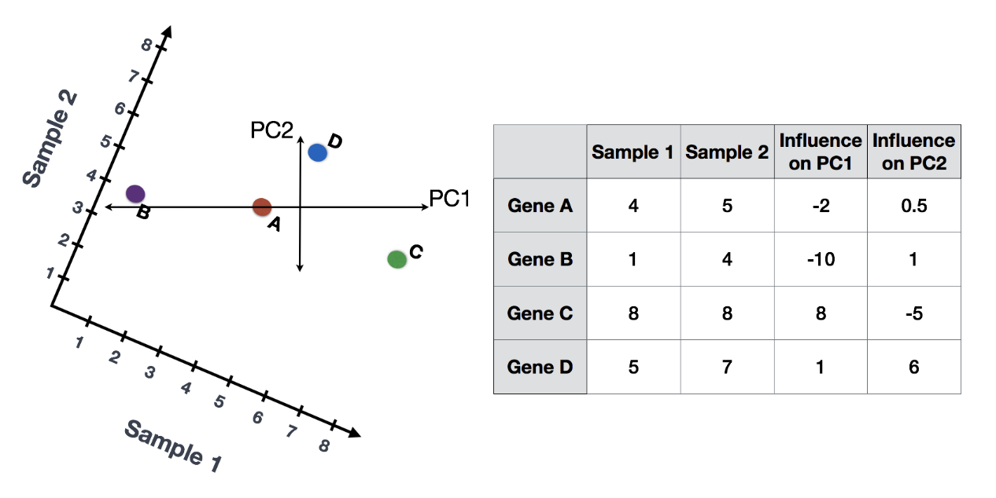
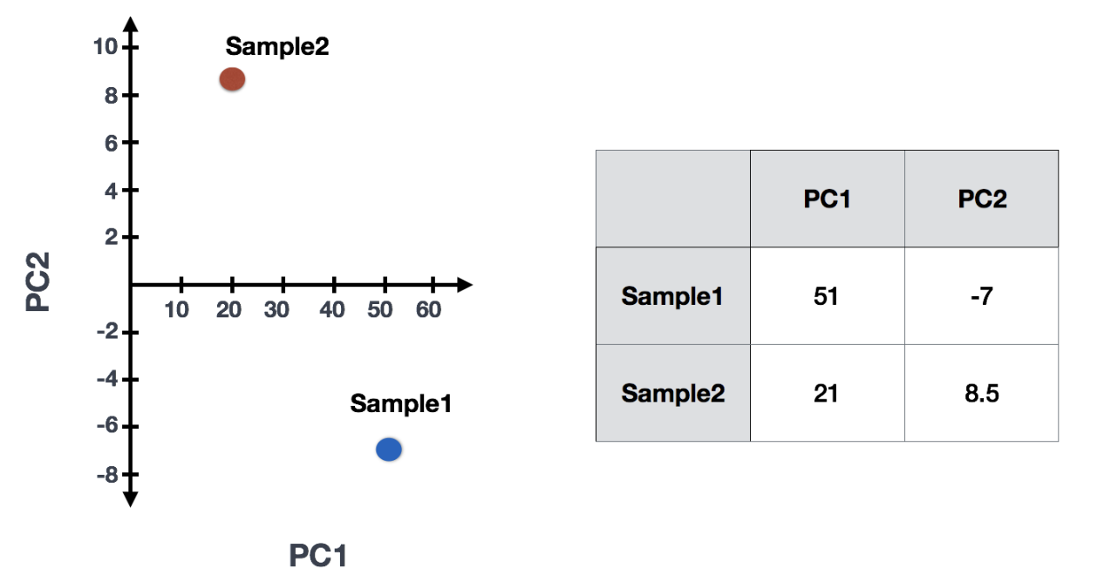
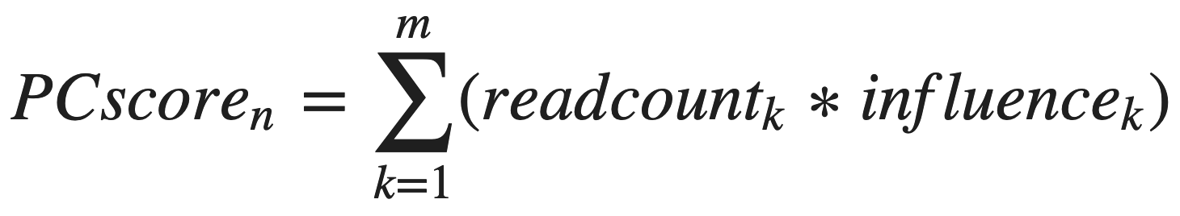
For a given sample with m genes, a score for PC n can be calculated by
Figure source

Slide 36
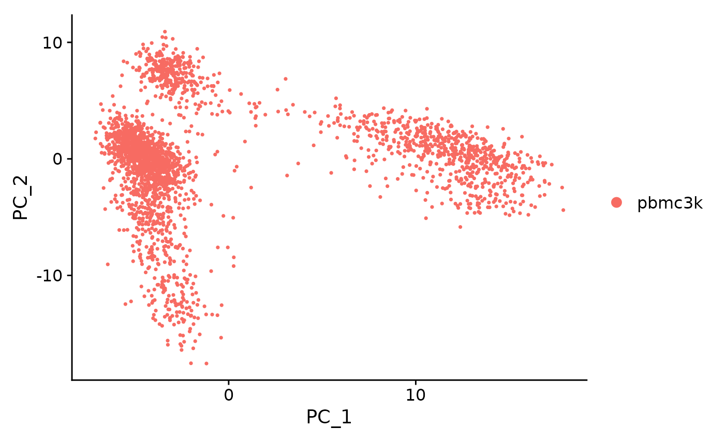
Visualizing data in reduced dimensions
Two PCs are usually insufficient to visually represent cell populations --->
Additional techniques optimize the 2d representation of high-dim data
Take PCs as input rather than genes

Slide 37
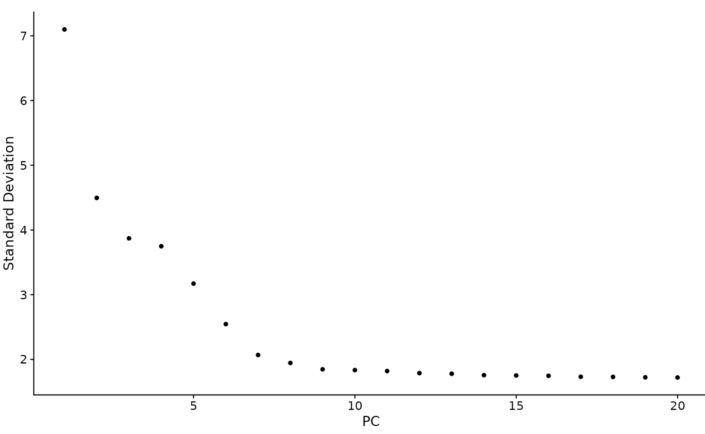
High variance PCs
Jackstraw - Bootstrapping approach to determine significant PCs
More rigorous but computationally intense
ElbowPlot - Quick heuristic to approximate significant PCs
Usually sufficient, downstream tools are robust to PC selection

Slide 38
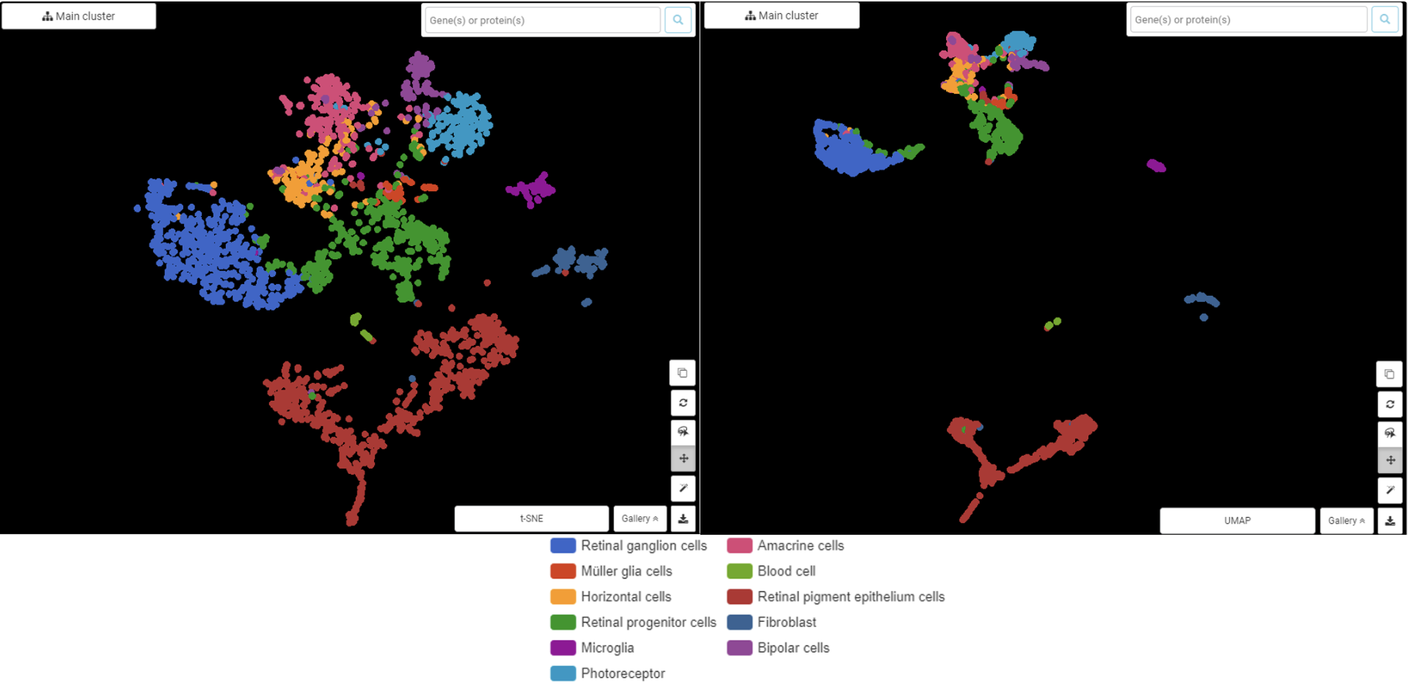
2D visualization algorithms
tSNE - t-distributed stochastic neighbor embedding
Older but still used
UMAP - Uniform Manifold Approximation and Projection for Dimension Reduction
Preserves global structure better than tSNE
Figure source
tSNE
UMAP

Slide 39
Seurat objects

Slide 40
Seurat objects
Assays hold cell + gene/feature level data
Raw counts, normalized counts, etc.
Metadata / colData holds cell level data
Sample info (capture, condition), computed metrics (MT proportion, nFeature)
Reductions hold cell level values for dimensional reductions
PCA, UMAP

Slide 41
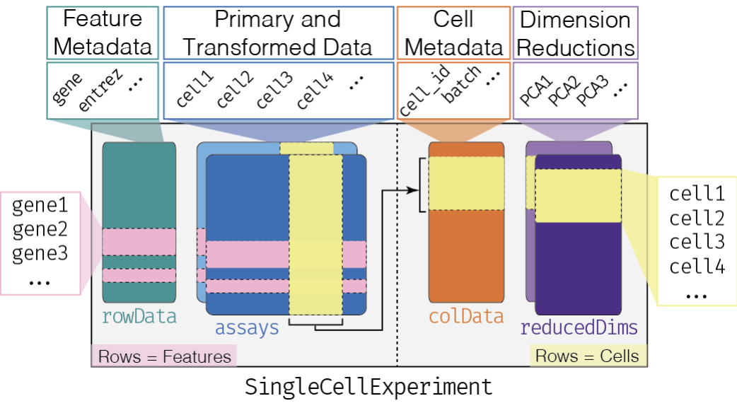

Slide 42
Help with Seurat
Seurat vignettes
Github issues
Biostars forum
Bioconductor forums
Use Rstudio’s built in help documentation viewier via the ‘?’ command:
?Seurat::NormalizeData()

