Slide 1

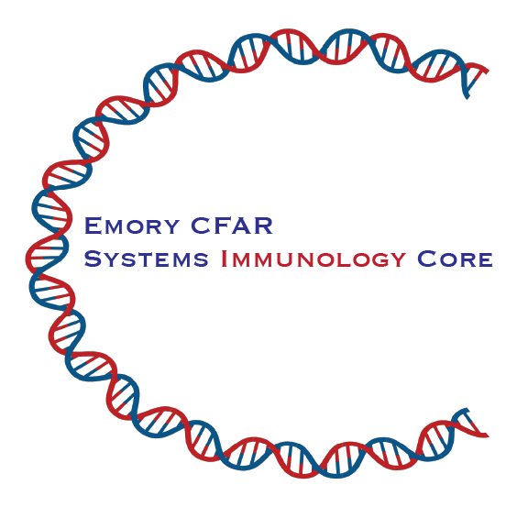

Session-06 Working with Features
10X Feature Barcoding Antibody Capture
Surface Protein expression,Sample Hashing
And More
Greg Tharp, MSc.
Bioinformatics analyst

Slide 2
What have we done so far and what comes next?
Sample prep and sequencing
Lecture 2
Sample prep
Cell capture
Sequencing
Single-sample scRNA-seq
Lecture 3
Lecture 4
UMI count table(s)
Multi-sample scRNA-seq
Lecture 5
Finding markers
Dimensionality reduction
Cell clustering
QC/processing
Cell type annotation
Integration
Differential expression
Functional enrichment

Slide 3
What have we done so far and what comes next?
Sample prep and sequencing
Lecture 2
Sample prep
Cell capture
Sequencing
Single-sample scRNA-seq
Lecture 3
Lecture 4
UMI count table(s)
Multi-sample scRNA-seq
Lecture 5
Finding markers
Dimensionality reduction
Cell clustering
QC/processing
Cell type annotation
Integration
Differential expression
Functional enrichment
Multi-sample/Multi-modal data
Lecture 6
Hash demultiplexing samples
Weighted Nearest Neighbors
Surface protein expression

Slide 4
Overview
Review 10X Feature Barcoding and define scope
Study design considerations
Review Seurat object structure and usage
“Antibody Capture” data handling and assay setup
Feature Barcoding for hashing
Feature Barcoding for surface proteins
Multi-Modal analysis with Weighted Nearest Neighbors
R practical code example

Slide 5
10X Feature Barcoding
Sequence tagging a cell feature
Surface protein expression (Antibody Capture)
Use for Seurat sample hashing
Not 10X sample hashing
id | name | read | pattern | sequence | feature_type
CD4 | CD4 | R2 | 5PNNNNNNNNNN(BC) | GAGGTTAGTGATGGA | Antibody Capture
CD8 | CD8 | R2 | 5PNNNNNNNNNN(BC) | GCGCAACTTGATGAT | Antibody Capture
CD28 | CD28 | R2 | 5PNNNNNNNNNN(BC) | TGAGAACGACCCTAA | Antibody Capture
CD39 | CD39 | R2 | 5PNNNNNNNNNN(BC) | TTACCTGGTATCCGT | Antibody Capture
CD69 | CD69 | R2 | 5PNNNNNNNNNN(BC) | GTCTCTTGGCTTAAA | Antibody Capture
CD95 | CD95 | R2 | 5PNNNNNNNNNN(BC) | CCAGCTCATTAGAGC | Antibody Capture
CD101 | CD101 | R2 | 5PNNNNNNNNNN(BC) | CTACTTCCCTGTCAA | Antibody Capture
CD152 | CTLA-4 | R2 | 5PNNNNNNNNNN(BC) | ATGGTTCACGTAATC | Antibody Capture
CD169 | Siglec-1 | R2 | 5PNNNNNNNNNN(BC) | TACTCAGCGTGTTTG | Antibody Capture
CD279 | PD-1 | R2 | 5PNNNNNNNNNN(BC) | ACAGCGCCGTATTTA | Antibody Capture
CD366 | TIM-3 | R2 | 5PNNNNNNNNNN(BC) | TGTCCTACCCAACTT | Antibody Capture
HLA-DR | HLA-DR | R2 | 5PNNNNNNNNNN(BC) | AATAGCGAGCAAGTA | Antibody Capture
Hash2Human | Hash2 | R2 | 5PNNNNNNNNNN(BC) | TGATGGCCTATTGGG | Antibody Capture
Hash3Human | Hash3 | R2 | 5PNNNNNNNNNN(BC) | TTCCGCCTCTCTTTG | Antibody Capture
Notes:
Another example of feature barcoding is CRISPR perterbations.
10X sample hashing uses feature barcoding but not antibody based.
Discuss cellranger considerations
Single table for all antibodies
Need to demux in Seurat,…

Slide 6
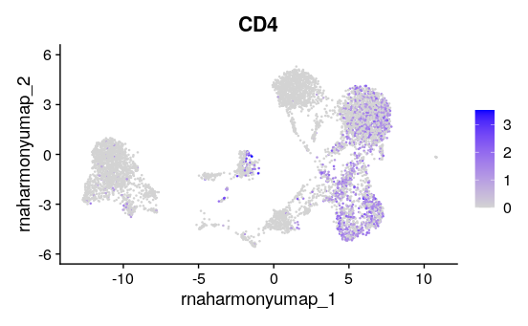
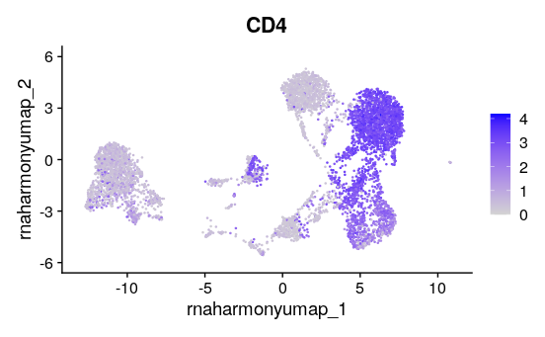
RNA ≠ Surface Protein
RNA
ADT

Slide 7
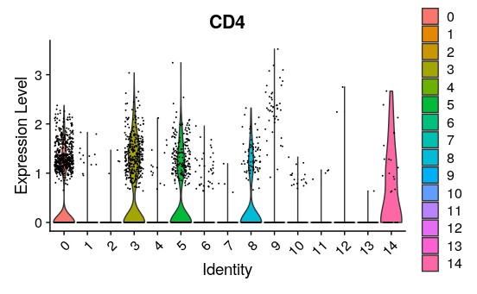
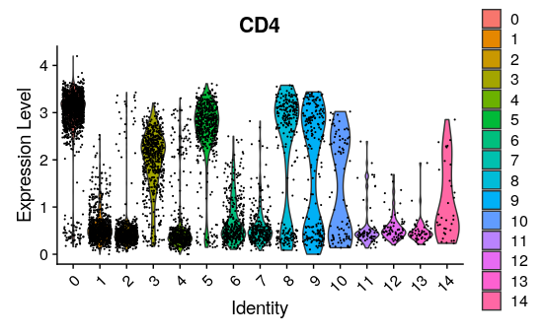
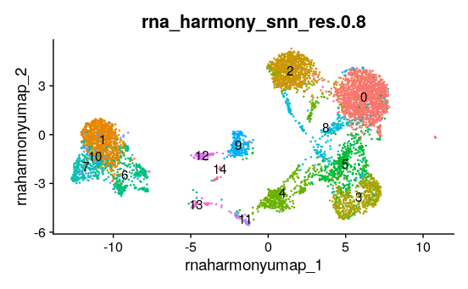
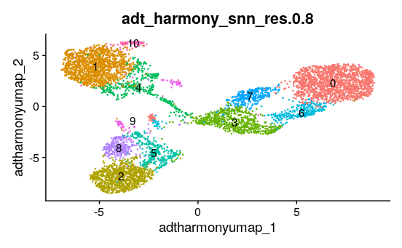
Similar but not the same
RNA
ADT

Slide 8
Study Design Considerations
Cells are not samples, consider pooling from multiple sources with hashing
For rare cell populations consider multiple captures
Use more antibodies than you think, consider a prepared cocktail panel
Run a pilot capture, usually can be first capture of study
Test hashing of sources or sorted populations
Notes:
Differential expression or cell proportion
Pilot for human antibodies with monkey samples
Discuss cell loss

Slide 9
Seurat Object organization
@assays$RNA
obj
@counts
@reductions$pca
@reductions$harmony
@data
@reductions$umap
@scale.data
@meta.data
Notes:
Seruat object maintains information about cells
Assays are counts (raw, normalized, …) of features
Different kinds of features use different assays
Reductions are simplifications of the data to lower dimension
Some reductions are reductions of earlier reductions

Slide 10
Seurat Object organization
@assays$RNA
obj
@counts
@reductions$rna_pca
@reductions$rna_harmony
@data
@reductions$rna_harmony_umap
@scale.data
@reductions$wnn.umap.harmony
@assays$ADT
@reductions$adt_pca
@counts
@reductions$adt_harmony
@data
@reductions$adt_harmony_umap
@scale.data
@meta.data

Slide 11
Antibody Capture Counts
Read10X gives list of count tables
Gene Expression (RNA)
Antibody Capture
Antibody Capture composed of
Surface protein (ADT)
Cell hashing (HTO)
Create Seurat Object with Gene Expression Assay
RNA
Add Antibody Capture Assays
ADT
HTO
id | name | read | pattern | sequence | feature_type
CD4 | CD4 | R2 | 5PNNNNNNNNNN(BC) | GAGGTTAGTGATGGA | Antibody Capture
CD8 | CD8 | R2 | 5PNNNNNNNNNN(BC) | GCGCAACTTGATGAT | Antibody Capture
CD28 | CD28 | R2 | 5PNNNNNNNNNN(BC) | TGAGAACGACCCTAA | Antibody Capture
CD39 | CD39 | R2 | 5PNNNNNNNNNN(BC) | TTACCTGGTATCCGT | Antibody Capture
CD69 | CD69 | R2 | 5PNNNNNNNNNN(BC) | GTCTCTTGGCTTAAA | Antibody Capture
CD95 | CD95 | R2 | 5PNNNNNNNNNN(BC) | CCAGCTCATTAGAGC | Antibody Capture
CD101 | CD101 | R2 | 5PNNNNNNNNNN(BC) | CTACTTCCCTGTCAA | Antibody Capture
CD152 | CTLA-4 | R2 | 5PNNNNNNNNNN(BC) | ATGGTTCACGTAATC | Antibody Capture
CD169 | Siglec-1 | R2 | 5PNNNNNNNNNN(BC) | TACTCAGCGTGTTTG | Antibody Capture
CD279 | PD-1 | R2 | 5PNNNNNNNNNN(BC) | ACAGCGCCGTATTTA | Antibody Capture
CD366 | TIM-3 | R2 | 5PNNNNNNNNNN(BC) | TGTCCTACCCAACTT | Antibody Capture
HLA-DR | HLA-DR | R2 | 5PNNNNNNNNNN(BC) | AATAGCGAGCAAGTA | Antibody Capture
Hash2Human | Hash2 | R2 | 5PNNNNNNNNNN(BC) | TGATGGCCTATTGGG | Antibody Capture
Hash3Human | Hash3 | R2 | 5PNNNNNNNNNN(BC) | TTCCGCCTCTCTTTG | Antibody Capture

Slide 12
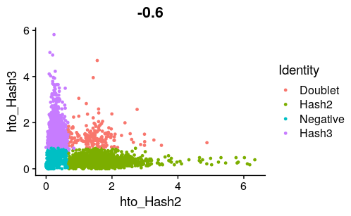
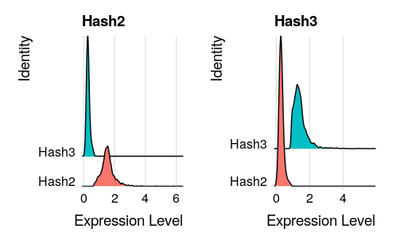
Sample demultiplexing with hash antibodies
Seurat function: HTODemux(obj, assay = “HTO”)

Slide 13
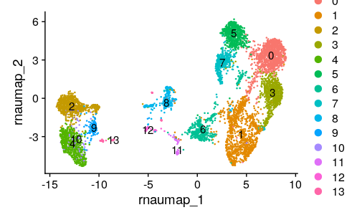
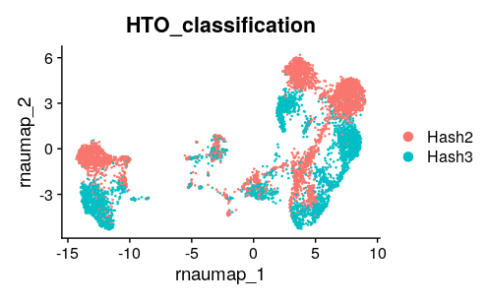
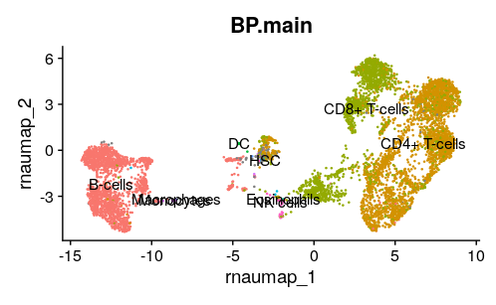
Review RNA clustering and integration
NormalizeData(obj) %>%
ScaleData() %>%
FindVariableFeatures() %>%
RunPCA(npcs = 30, reduction.name = "rna_pca") %>%
FindNeighbors(dims = 1:30, reduction = "rna_pca", graph.name = c("rna_nn","rna_snn")) %>%
FindClusters(resolution = 0.5, graph.name = "rna_snn") %>%
RunUMAP(dims = 1:30, reduction = "rna_pca", reduction.name = "rna_umap")

Slide 14
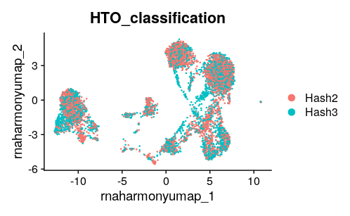
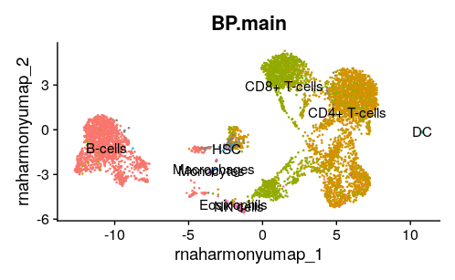
Review RNA clustering and integration
obj <- RunHarmony(obj, group.by.vars = "HTO_classification", reduction = "rna_pca", reduction.save = "rna_harmony")
obj <- FindNeighbors(obj, assay = "RNA", reduction = "rna_harmony", graph.name = c("rna_harmony_nn","rna_harmony_snn"))
obj <- FindClusters(obj, assay = "RNA", graph.name = "rna_harmony_snn", resolution = 0.8)
obj <- RunUMAP(obj, reduction = "rna_harmony", reduction.name = "rna_harmony_umap", dims = 1:30)

Slide 15
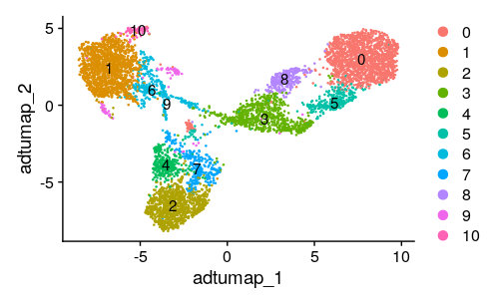
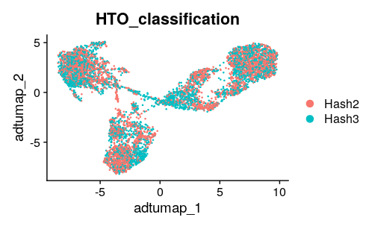
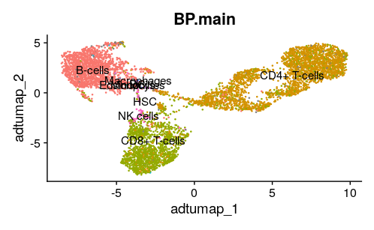
ADT clustering and integration
VariableFeatures(obj, assay = "ADT") <- rownames(obj[["ADT"]])
obj <- NormalizeData(obj, assay = "ADT", normalization.method = "CLR", margin = 2)
obj <- ScaleData(obj, assay = "ADT")
obj <- RunPCA(obj, assay = "ADT", npcs = 12, reduction.name = "adt_pca")
obj <- FindNeighbors(obj, assay = "ADT", reduction = "adt_pca", graph.name = c("adt_nn","adt_snn"))
obj <- FindClusters(obj, assay = "ADT", graph.name = "adt_snn", resolution = 0.8)
obj <- RunUMAP(obj, assay = "ADT", reduction = "adt_pca", dims = 1:11, reduction.name = "adt_umap")

Slide 16
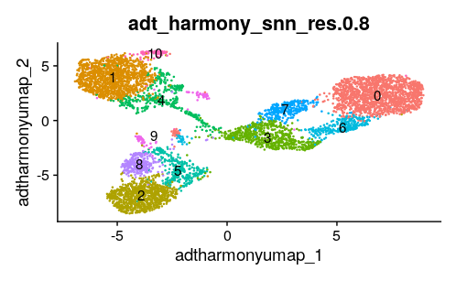
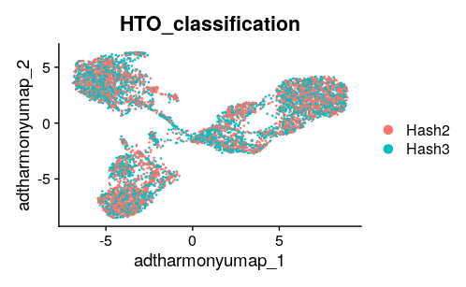
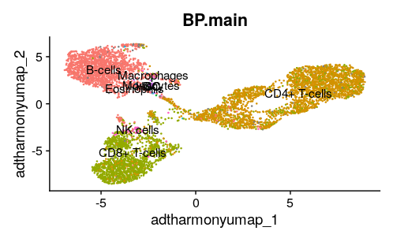
ADT clustering and integration
obj <- RunHarmony(obj, group.by.vars = "HTO_classification", reduction = "adt_pca", reduction.save = "adt_harmony")
obj <- FindNeighbors(obj, assay = "ADT", reduction = "adt_harmony", graph.name = c("adt_harmony_nn","adt_harmony_snn"))
obj <- FindClusters(obj, assay = "ADT", graph.name = "adt_harmony_snn", resolution = 0.8)
obj <- RunUMAP(obj, reduction = "adt_harmony", reduction.name = "adt_harmony_umap", dims = 1:11)

Slide 17
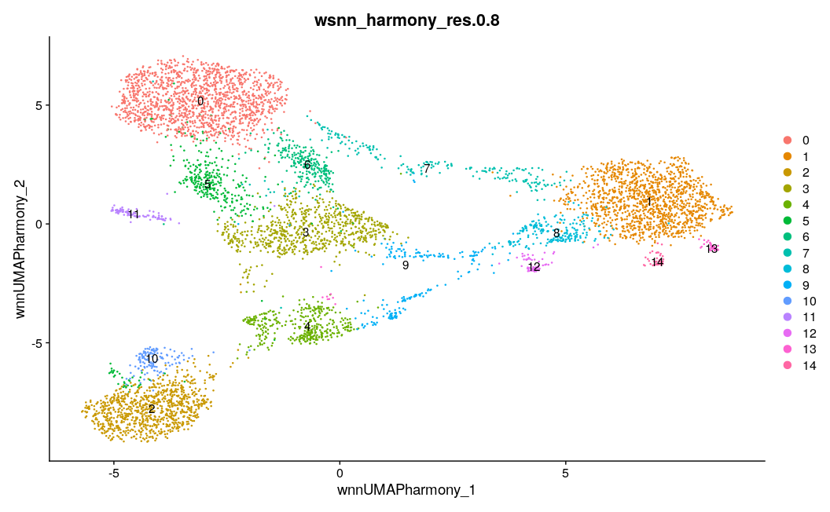
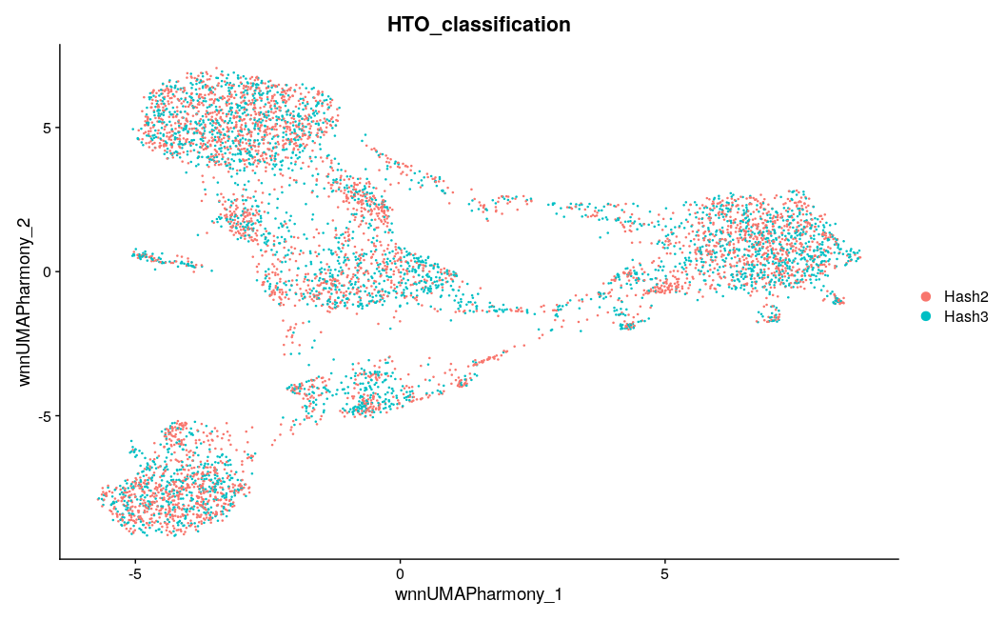
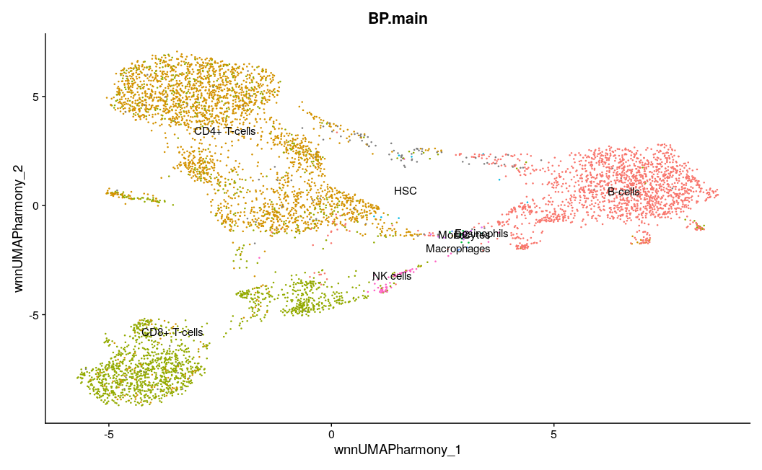
WNN modal integration
obj <- FindMultiModalNeighbors(obj, reduction.list = list("rna_harmony","adt_harmony"),
dims.list = list(1:30,1:11),
knn.graph.name = "wknn_harmony",
snn.graph.name = "wsnn_harmony",
weighted.nn.name = "weighted.nn_harmony",
modality.weight.name = list("mmn.weight.rna_harmony","mmn.weight.adt_harmony"))
obj <- FindClusters(obj, graph.name = "wsnn_harmony", resolution = 0.8)
obj <- RunUMAP(obj, nn.name = "weighted.nn_harmony",
reduction.name = "wnn.umap.harmony",
reduction.key = "wnnUMAP.harmony_")

