Slide 1
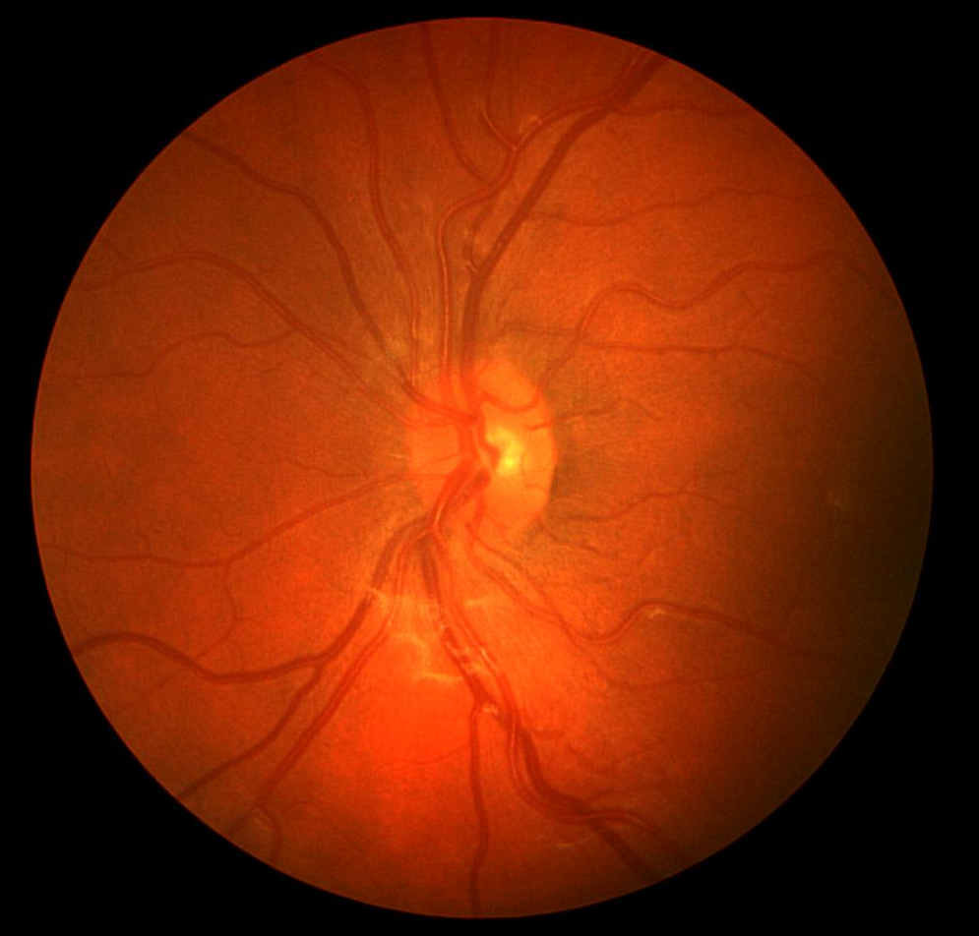
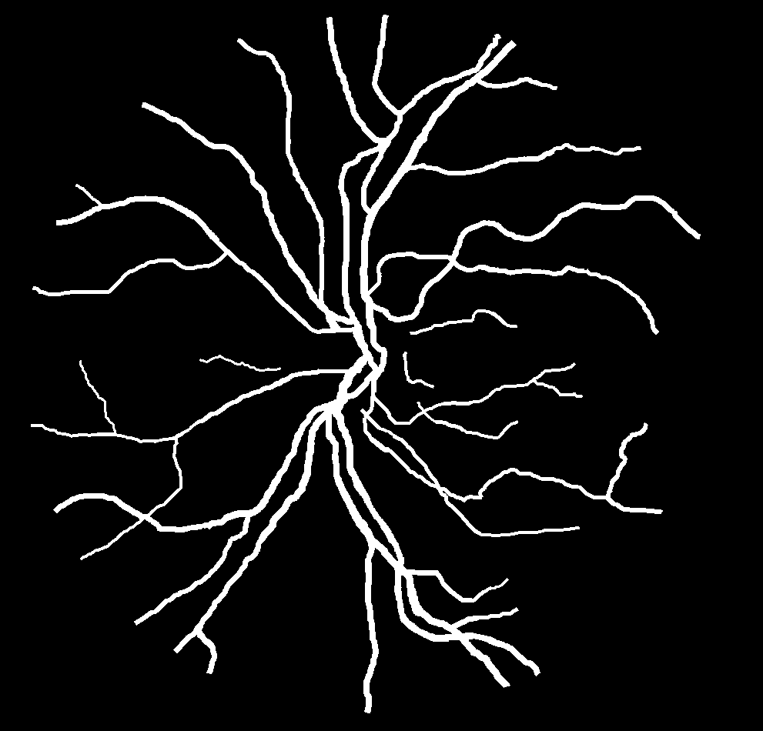

Retinal Vessel
Segmentation
GROUP 3
ANANYA GOYAL
HIMANSHU SHEKHAR
PRIYANSHI SHARMA
VASU BHATIA
UTSAV GARG
Retina Of Observer (Left Eye)
Ground Truth Image

Slide 2
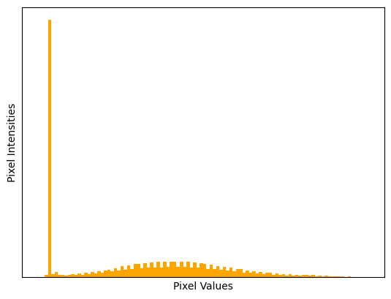
Problem Statement
Retinal vessel image segmentation is a pivotal challenge in medical image analysis, integral to early disease diagnosis, disease progression monitoring, and personalized treatment planning for conditions like diabetic retinopathy and glaucoma. The goal is to leverage classical machine learning methods to precisely identify and isolate blood vessels in retinal images. The complexity arises from the lower contrast in vascular structures and the need to address challenges such as noise and uneven illumination. The project aims to enhance the accuracy and efficiency of retinal vessel segmentation, contributing to improved medical diagnostics and personalized care.​
Generated CLAHE Histogram

Slide 3
Dataset & Existing Analysis
DATASET DESCRIPTION
The CHASEDB1 dataset comprises 28 retinal images, representing both eyes of 14 participants. Each image is accompanied by two ground truth annotations ("1stHO" and "2ndHO") from different human observers, totaling 84 images. The file naming convention includes participant numbers (01-14), eye identifiers (L/R), and ground truth sources. This dataset is vital for training and evaluating retinal vessel segmentation models.​
EXISTING ANALYSIS
01
02
03
Stages of Current Study
Pre-processing: Enhance vessel visibility by addressing noise and uneven illumination.
Vessel Segmentation: Identify and extract retinal vessels.
Post-processing: Remove unwanted elements separate connected vessels.
Challenges
Vascular structures in retinal images exhibit lower contrast.
Anatomical features may lack clear characteristics.
Classical segmentation techniques are often inefficient and inaccurate.​
Recent Techniques
Supervised:
Support Vector Machines (SVMs)
AdaBoost:
KNN's
Unsupervised:
Matched Filters
Morphological Processing
Thresholding

Slide 4
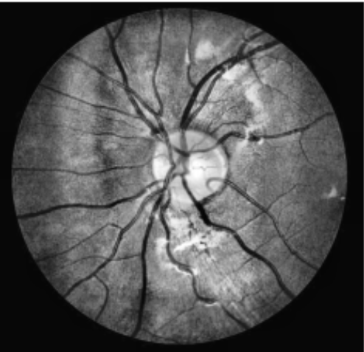
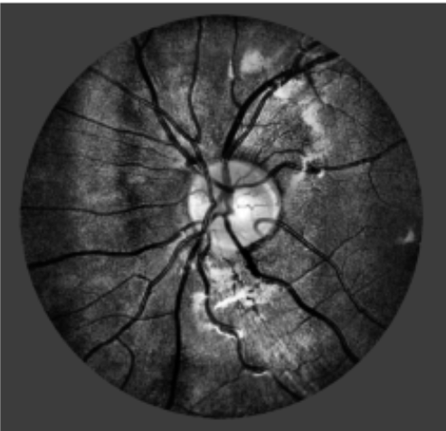
EDA & Pre-Processing
Green Channel Isolation
Green channel is isolated and focused during segmentation as it exhibits superior contrast between the vessels and the background.
Contrast Limited Adaptive Histogram Equalization
CLAHE is a technique that improves contrast in images by limiting amplification in local areas and adjust image contrast using pixel intensity based histogram.
Gamma Correction
Gamma correction is a technique used in image processing to adjust the brightness of an image by modifying the intensity values of its pixels to enhance and reduce image contrast.
CLAHE Enhanced
Gamma Correction

Slide 5
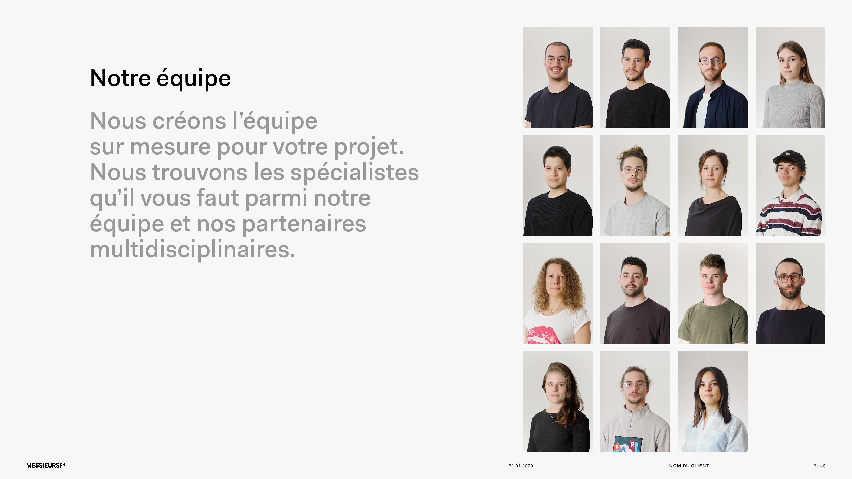
Methodology - Page 1
Hessian Matrix and Eigenvalue Approach:
Description: The Hessian matrix, a square matrix of second-order partial derivatives, is utilized to study the local behavior of a function in retinal vessel segmentation.
Application: Enhances and detects vessel structures in retinal images by understanding the curvature and critical points.
Gabor Filter :
Description: A Gabor filter is a specialized tool for image processing, adept at detecting edges and textures of different orientations and frequencies.
Application: Used to identify and separate different regions of interest, such as the optic disc, blood vessels, and other anatomical structures in retinal images.
Binary and Otsu Thresholding
Description: Image processing techniques employed to segment images by separating objects from the background based on pixel intensity values.
Application: Enhances contrast, extracts specific structures like blood vessels, and automates the segmentation process in retinal images.

Slide 6
Methodology - Page 2
Local & Pixel Based Thresholding:
Description: Pixel-based thresholding applies a uniform threshold to the entire image, while local thresholding adapts the threshold based on local characteristics.
Application: Distinguishes between different objects or regions, with local thresholding providing adaptability to variations, crucial for identifying blood vessels accurately.
Image Fusion:
Description: Image fusion is a technique for improving image quality and information content by combining complementary information from multiple sources. Here, our goal of using image fusion is to fuse the image that we got after the Otsu thresholding (representing the thick vessel), and the second image that we got by normalizing the image of the thin vessel, to get the finest image.
Application: Enhances the quality and richness of retinal images by fusing diverse information, contributing to the accuracy of vessel segmentation.
Wide and Thin Vessel Enhancement:
Description: Applied to Hessian-enhanced images for retinal vessel segmentation, Otsu's Thresholding automatically determines an optimal threshold by maximizing variance between classes (vessels and non-vessels).
Application: Segments vessels from the background with adaptability to varying image characteristics, ensuring accurate and automated segmentation.

Slide 7
Results
The implemented methodology for retinal vessel image segmentation achieved the following results:
Accuracy:
The segmentation process yielded an accuracy of about 95%, reflecting the effectiveness of the devised methodology in accurately identifying and isolating retinal vessels.
Structural Similarity Index (SSI):
The Structural Similarity Index measure, a metric assessing the similarity between the ground truth and segmented images, provided a value of 0.87.
An SSI value of 1 indicates perfect similarity, and 0 denotes no similarity. The achieved value suggests a substantial degree of structural similarity between the ground truth and segmented images.
Peak Signal-to-Noise Ratio (PSNR):
The Peak Signal-to-Noise Ratio, measuring the quality of the segmentation by evaluating the ratio of the maximum possible power of a signal to its noise, was approximately 55.
Higher PSNR values indicate better image quality, reflecting the accuracy and fidelity of the segmented vessel structures.​

Slide 8
References
Almotiri, J., Elleithy, K., & Elleithy, A. (2018). Retinal Vessels Segmentation Techniques and Algorithms: A survey. Applied Sciences, 8(2), 155. https://doi.org/10.3390/app8020155
GeethaRamani, R., & Balasubramanian, L. (2016). Retinal blood vessel segmentation employing image processing and data mining techniques for computerized retinal image analysis. In Biocybernetics and Biomedical Engineering (Vol. 36, Issue 1, pp. 102-118). Elsevier.
Khan, K. B., Khaliq, A. A., & Shahid, M. (2016). Correction: A morphological Hessian based approach for retinal blood vessel segmentation and denoising using region based OTSU thresholding. PLOS ONE, 11(9), e0162581. https://doi.org/10.1371/journal.pone.0162581
Maison, T., Lestari, T., & Luthfi, A. (2019). Retinal Blood Vessel Segmentation using Gaussian Filter. In Journal of Physics: Conference Series (Vol. 1376, p. 012023). IOP Publishing Ltd.
Shabani, M. (2017). Master thesis: Retinal Blood Vessel Extraction Based on a Combination of Matched Filter and Level Set Algorithm. https://doi.org/10.13140/RG.2.2.12055.85929/1
Soomro, T. A., Ali, A., Jandan, N. A., Afifi, A. J., Irfan, M., Alqhtani, S. M., Głowacz, A., Alqahtani, A., Tadeusiewicz, R., Ka ́ntoch, E., & Zheng, L. (2021). Impact of novel image preprocessing techniques on retinal vessel segmentation. Electronics, 10(18), 2297. https://doi.org/10.3390/electronics10182297
Srinidhi, C. L., Aparna, P., & Rajan, J. (2017). Recent advancements in retinal vessel segmentation. Journal of Medical Systems, 41(4). https://doi.org/10.1007/s10916-017-0719-210
​

