Slide 1

Using unsupervised learning to create a book recommendation system
Project 4 – UoB data analytics bootcamp

Slide 2
Intro
There ‘s different of ways of exploring the world and one of them is reading a book.
In the vast expanse of literature, finding the perfect book tailored to one's preferences can often feel challenging.
Whether you're a fan of gripping thrillers, heartwarming romance, thought-provoking non-fiction, etc. our Book Recommendation System is your trusted companion in navigating the vast literary landscape. Say goodbye to endless browsing and hello to a world of literary delight at your fingertips
In today’s presentation we’ll take you through to the online book recommendation system which we have created with help of Kaggle
Our innovative system harnesses the power of data analysis and artificial intelligence to revolutionize the way you explore literature. By analyzing your reading habits, genre preferences, and past favorites, our algorithm curates a bespoke list of recommendations tailored exclusively to you.
Join us as we embark on a quest to connect readers with their next great read, one recommendation at a time. Welcome to the future of personalized reading experiences. Welcome to the Book Recommendation System.

Slide 3
Data prep
In order to clean the data Imported Pandas: To handle and manipulate the dataset.
Loaded the Dataset: Read data from bookdata.csv into a pandas DataFrame.
Dropped Rows with Missing Values: Cleaned the dataset by removing any incomplete records.
Expanded the 'Authors' Column: Separated multiple authors into individual entries to accurately count and analyze them.
Counted Unique Authors: Calculated the total number of different authors in the dataset.
Identified Most Frequent Authors: Determined which authors appeared most often in the dataset
Printed Results: Output the findings regarding the number of unique authors and the most frequent authors.

Slide 4

Enhancing Book Discoverability through Clustering
Challenges in book discovery.
Information Overload
Diverse Preference
Limited Visibility
Importance of Personalized Recommendation in Improving User Experience
Our Objective: To recommend books based on user preferences and book characteristics.

Slide 5

Why Clustering?
It uncovers hidden patterns in book features, aiding in discovering similar titles.
Enables dynamic recommendation without needing explicit user input.
Adaptable and scalable approach for a growing dataset.

Slide 6

Methodology Overview
Data Preparation: Dropping unnecessary columns, one-hot encoding, scaling).
Finding the Best K: Mention the use of the Elbow and Silhouette methods for optimal cluster number.
Implementation and Evaluation: Running K-means model, optimising with PCA, and assessing the model using The Calinski-Harabsz Index

Slide 7
Model Optimisation
Methods Used to Optimise the K-Means Algorithm Model:
Dropped the “categories” column
Filtered the “published year”
Binned the “published year”
Dropped the “authors” column
Eliminating outliers

Slide 8
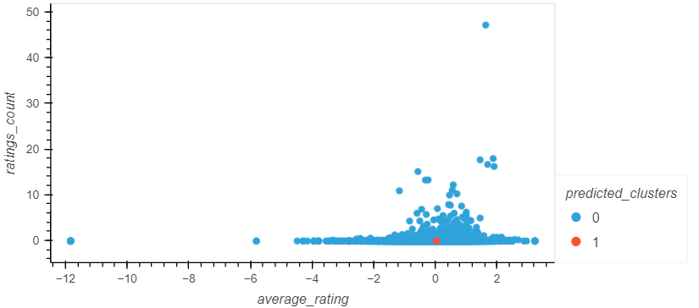
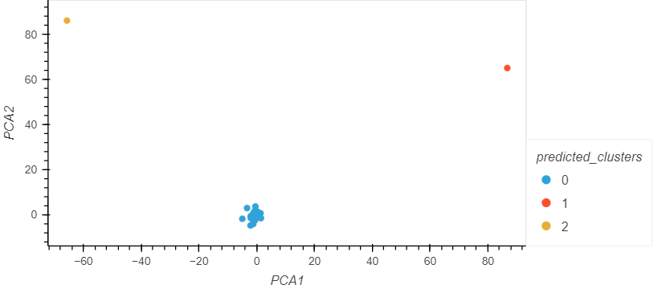
Model Optimisation: Dropping the authors column
Elbow/Silhouette Method:
The silhouette method suggests the optimum k-value is 2
Running a K-means model with 2 clusters results in a Calinski-Harabasz Index score of 20.89.
PCA:
The optimum k-value is 3.
Running the K-means algorithm increases the Calinski-Harabasz Index to 177156.05
Result seems highly determined by 2 outlier books.

Slide 9
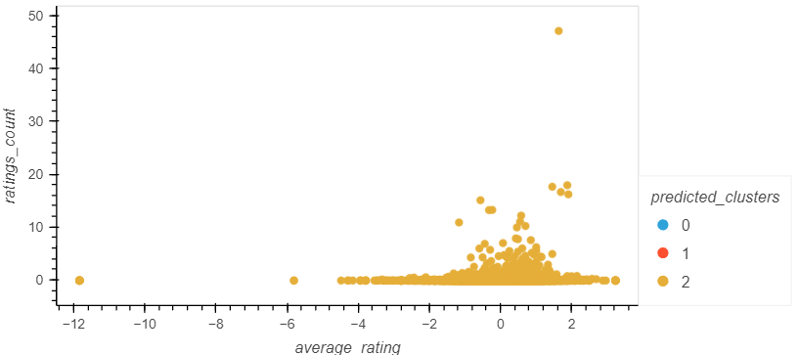
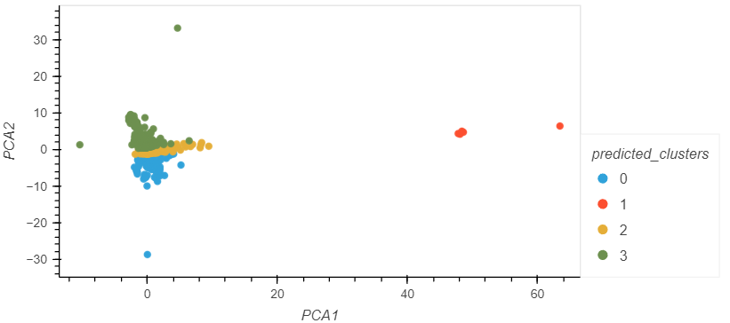
Model Optimisation: Dropping the categories column
Elbow/Silhouette Method:
The silhouette method suggests 3 as the best value for k.
Running a K-means model with 3 clusters resuts in a Calinski-Harabasz Index score of 1.95.
PCA:
The optimum value for k is 4
Running the K-means algorithm increased the Calinski-Harabasz Index to 5600.92.

Slide 10
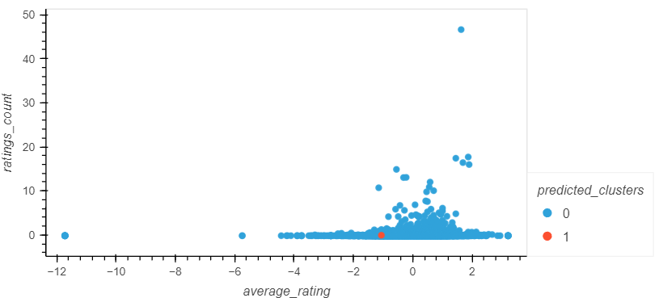
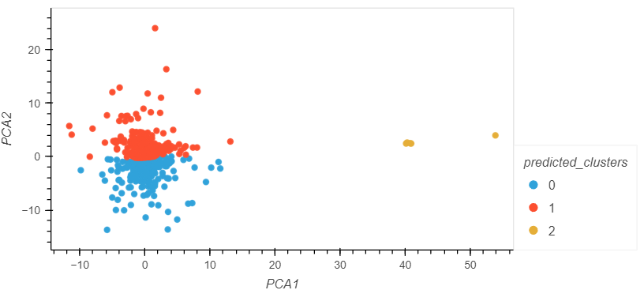
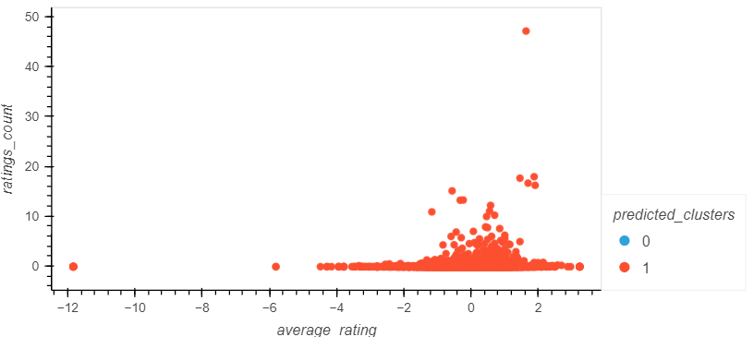
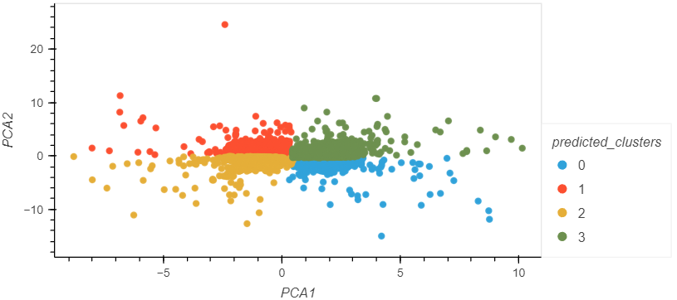
Model Optimisation: Filtering and Binning published year
Elbow/Silhouette Method:
Running a K-means model resulted in a Calinski-Harabasz Index score of 2.95 and 2.35 for the filtered and binned models respectively.
PCA:
Running the K-means algorithm on filtered and binned data resulted in a Calinski-Harabasz Index score of 4010.15 (k=3), and the binned data in a score of 4031.18 (k=4).

Slide 11
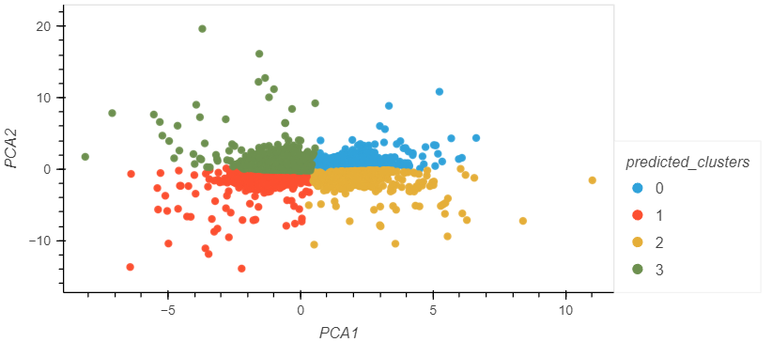
Model Optimisation: Eliminating Outliers
Running the k means algorithm on the pca model gives a Calinski-Harabasz Index of 6247.65
Results not biased by outlier books and clusters are more accurate

Slide 12


Website
Software and libraries used:
Created database using SQLite to serve an API
Set up API route to serve the data using Flask
Created book recommendation website using a combination of HTML, CSS and JavaScript
How it works:
User clicks on a book
JavaScript calculates the 5 closest books (Euclidean distance) in the same cluster, and displays recommendation

Slide 13
Conclusions
Limitations
Complex dataset (huge number of features after one-hot-encoding)
No user data

