Slide 1

So, you want to be a data analyst?
Job and salary trends in data-related careers

Slide 2
The team:
Catarina Ferreira
Elcin Kobya Imanci
Godswill Anyasor
Yuk Hang Hui
© 2024 DataInsight Lab

Slide 3
"Employer demand for specialist data skills is growing across a wide range of industries"
https://researchbriefings.files.parliament.uk/documents/POST-PN-0697/POST-PN-0697.pdf

Slide 4
1. What countries offer more job opportunities?
2. How much can I expect to ear in the UK?
3. What companies in the UK hire more entry-level employees?
4. What trends can we observe over the past years in the UK?

Slide 5
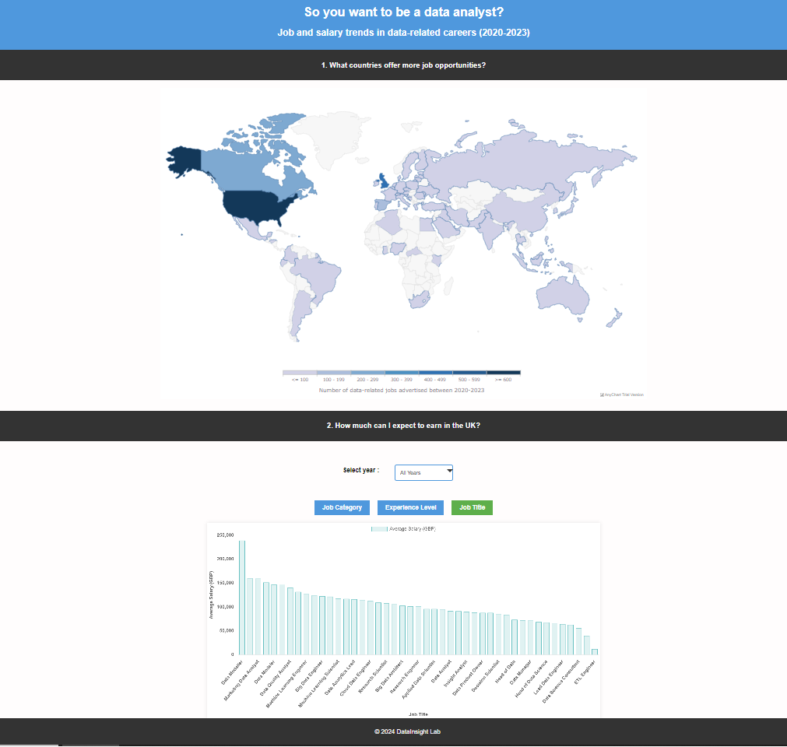
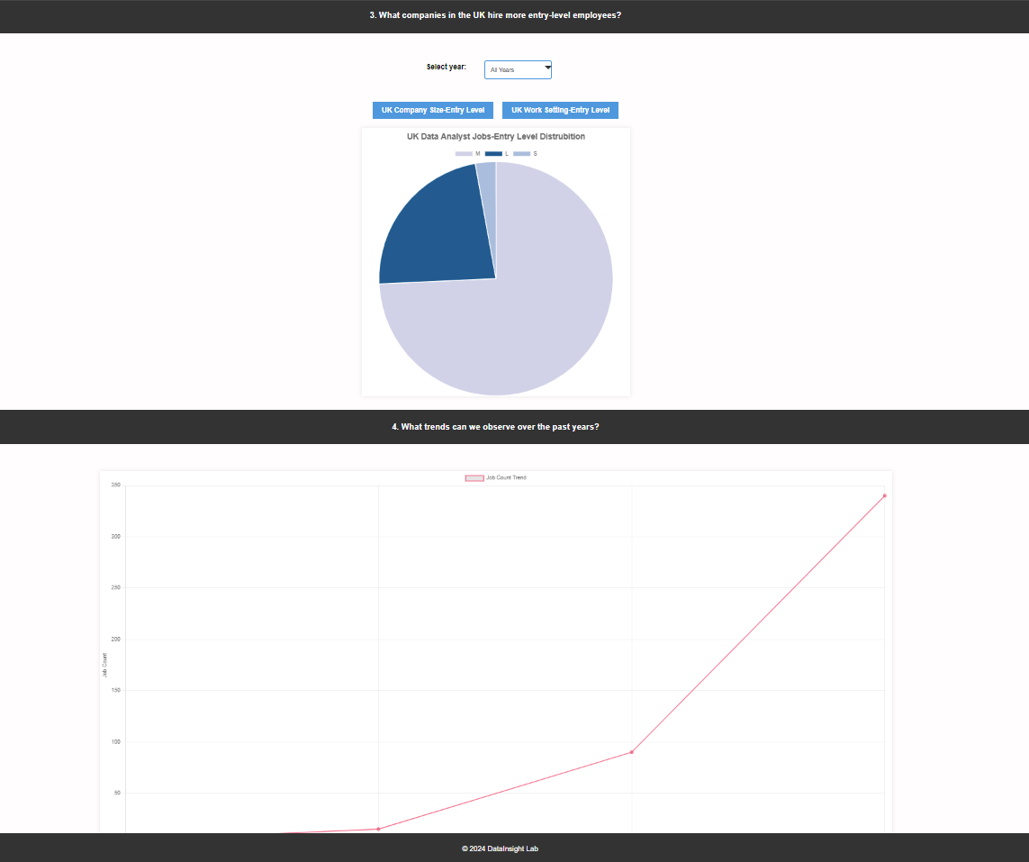

Slide 6
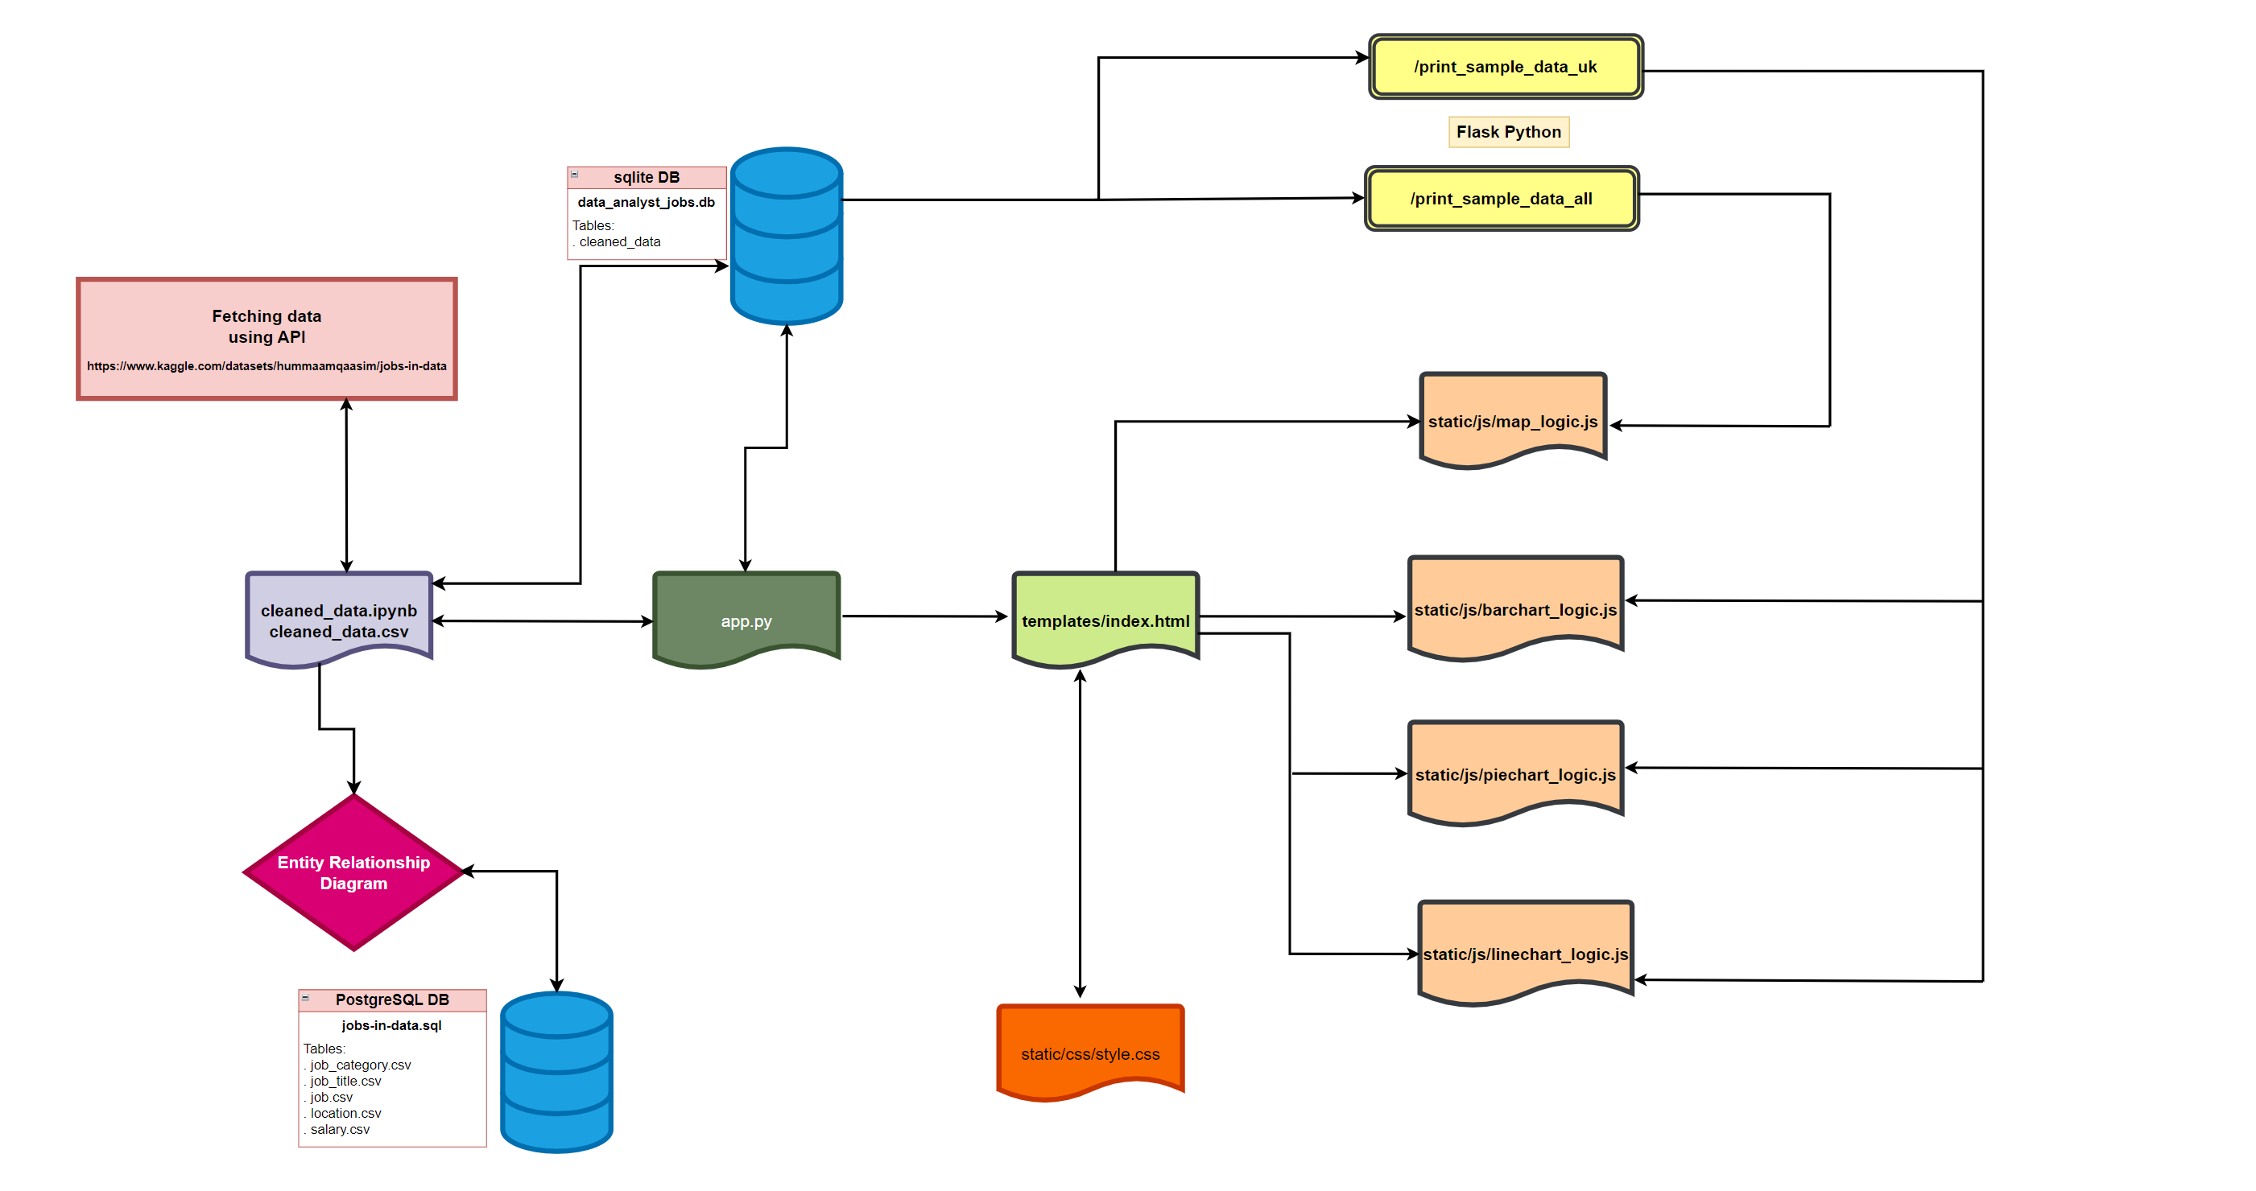
Development stages

