Slide 1
CAPSTONE PROJECT REPORT
Find the best location to open a fast food restaurant in NY

Slide 2
CATEGORY
Project Introduction
Data
Project background
Business problem
Street-easy rent data
GeoPy location data
Foursquare neighborhood data
Methodology
Conclusions
Less competitor
Cluster neighborhood
Lower rent
Result
Limitations

Slide 3
Project Introduction
Background
Selecting a location for a business is one of the most important decisions in running a business.
Business decision makers need to consider different factors in finding the right location for the business, such as financial factors, market factors, and the factors that will affect their demand and revenue.
This project can help those who are planning to open a new fast food resturant and need to find the best location for the shop in a city.
Business Problem
Selecting a location for a business is one of the most important decisions in running a business.
An fast food resturant is good to be near a place where many people visit such as near a cinema, park, garden, playground, etc.
A neighborhood that has fewer competitors is less risky for starting a new business and is affordable to rent

Slide 4
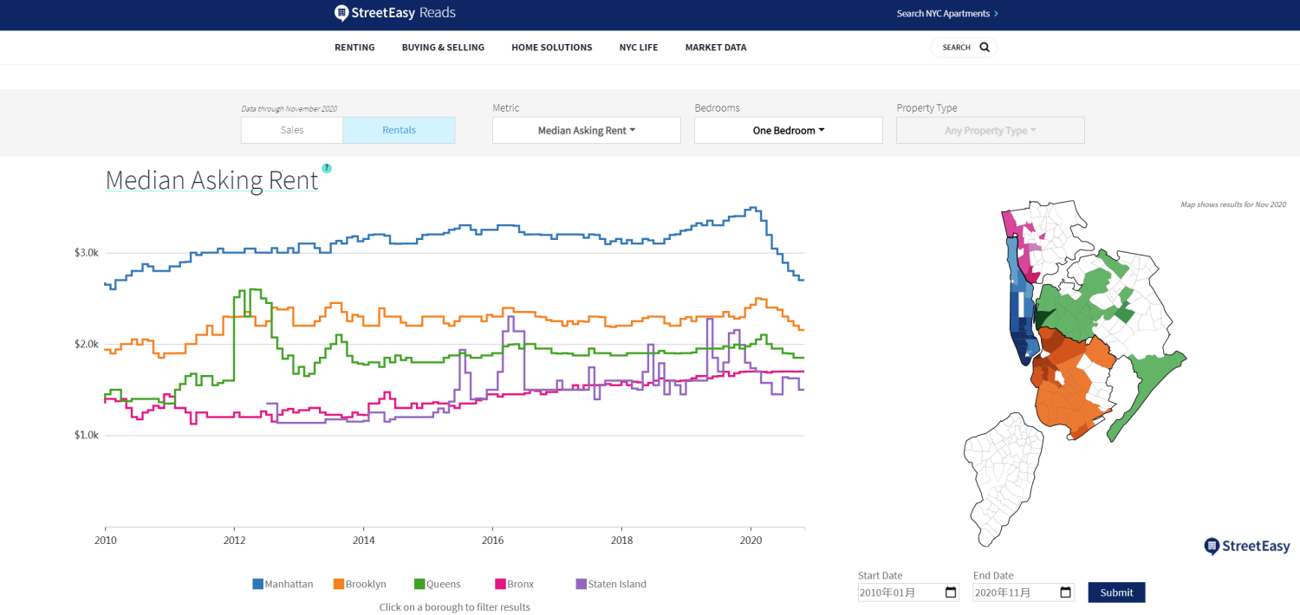
Data
Neighborhood Rent Data
Download NY rent data from https://streeteasy.com
Choose data from Nov 2019 to Oct 2020 to calculate the average rent for each neighborhood

Slide 5
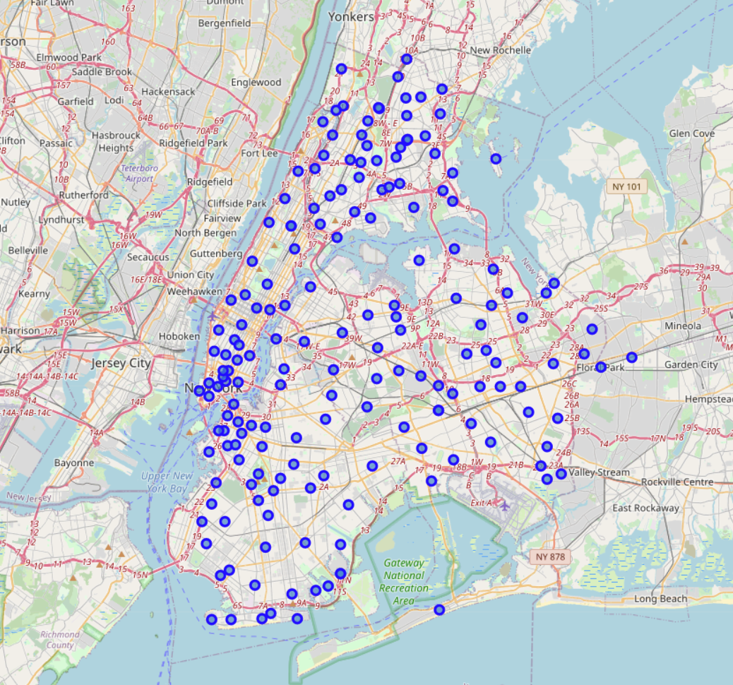
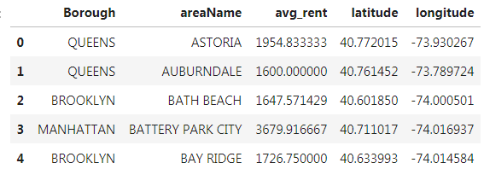
Data
Neighborhood Location
Download the coordinates for each neighborhood through geopy API
Merge the coordinates with rent data
Dataframe that include rent and coordinate
Coordinate of each neighborhood

Slide 6
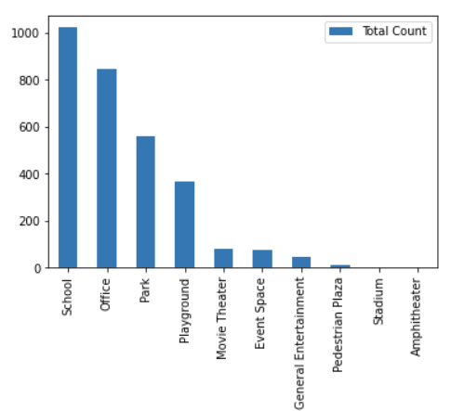
Data
Venues
Search venues for each neighborhood through foursquare API
Looking for Movie Theater, Playground, Park, Event Space, General Entertainment, Stadium, Amphitheater, Aquarium, School, Pedestrian Plaza, and Office venues in walking distance (500 meters) from each of these neighborhood
Identify most common venues for each neighborhood
No of venues for each category

Slide 7
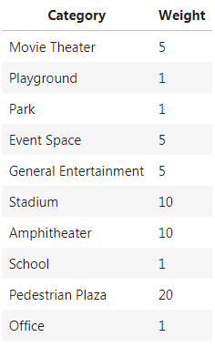
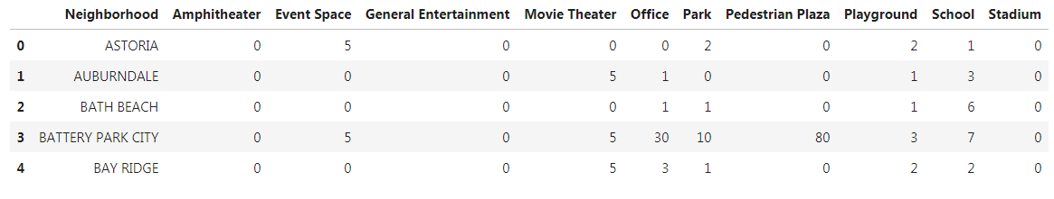
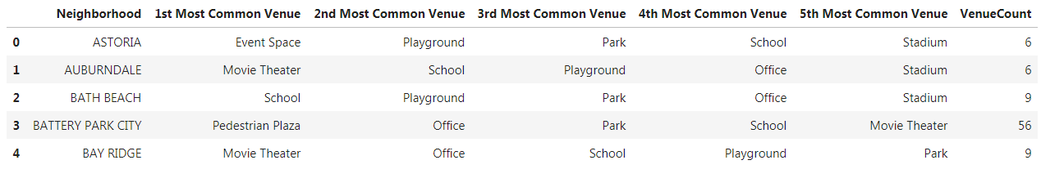
Data
Venues Data Processing
As different type of venues attract different no of people, need to apply weight for each category of venues
After apply weight, identify most common venues for each neighborhood
…
No of venues for each category (examples)
Weight for each category
…
Most common venue for each category (examples)

Slide 8
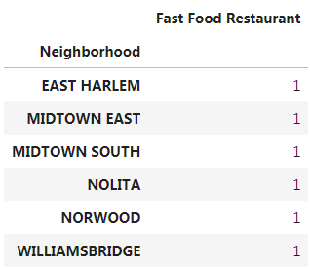
Data
Competitor Data
Use foursquare API to search fast food restaurant for each neighborhood
No of fast food restaurant for each category

Slide 9
Methodology
Less Competitor
01
Remove neighborhood with fast food restaurant
Cluster Neighborhood
Lower Rent
Using k-means to cluster the neighborhood into 5 clusters
The clustering is done base on no of venues
Identify clusters that has more venues
In each cluster, sort neighborhood by rent price
02
03

Slide 10
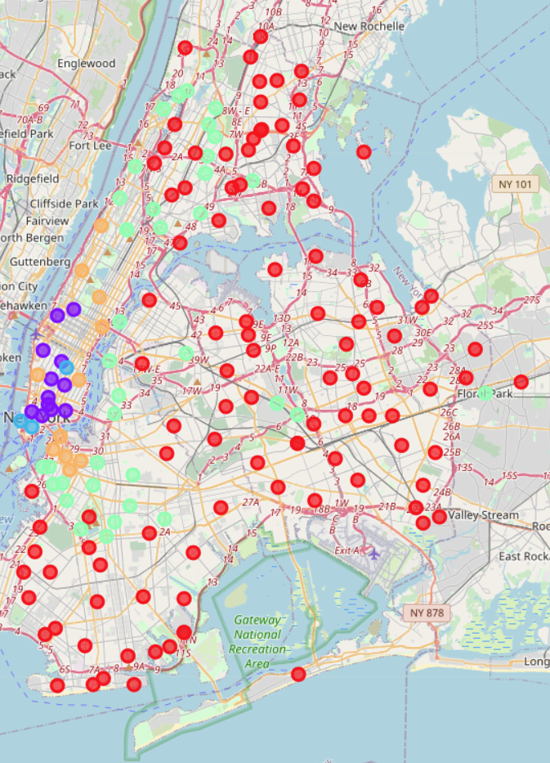
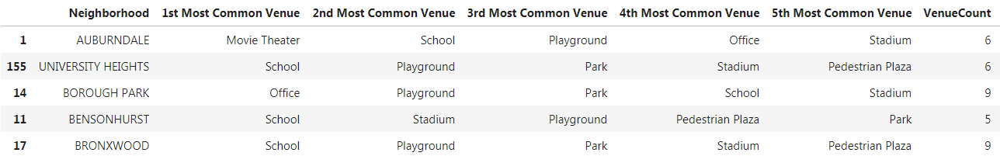
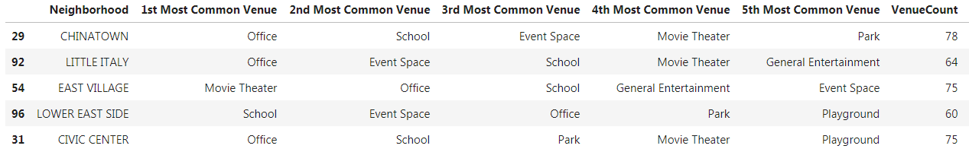
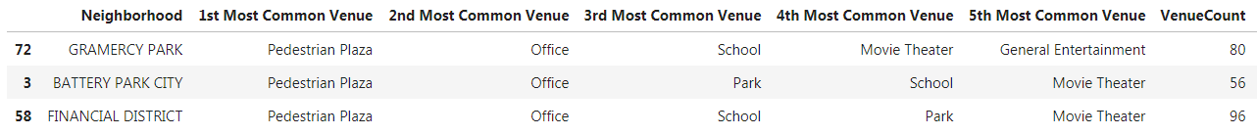
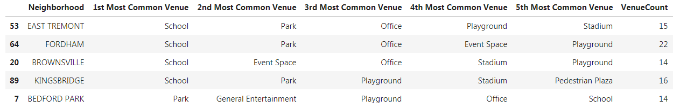
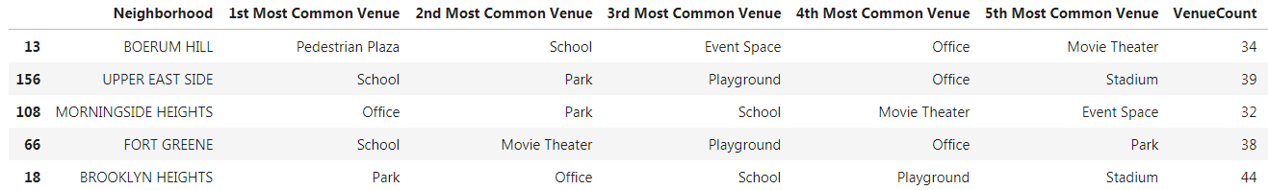
Methodology
Neighborhood Clusters
Cluster 1 (Mean of total venue count: 5)
Cluster 2 (Mean of total venue count: 67)
* Cluster 3 (Mean of total venue count: 77)
Cluster 4 (Mean of total venue count: 18)
Cluster 5 (Mean of total venue count: 42)
Clustered Neighborhood Coordinates
Cluster 1, Cluster 2, Cluster 3, Cluster 4, Cluster 5

Slide 11
Conclusion
Result
GRAMERCY PARK (in cluster 3) is the best neighborhood to open an fast food restaurant in NY.
It has the most number of total venues and is expected to attract many people to visit.
This neighborhood has 2 Pedestrian Plaza, 7 playground, 30 offices and no fast food restaurant within walking distance is the best option.
Furthermore, the average rent in this neighborhood is the lowest one in cluster 3.
Limitation
We have limited the location options to the neighborhoods of NY, however considering more specific locations such as particular streets can improve the accuracy of our decision
We used the average one bedroom rent price in each neighborhood as an estimate of the rent price.
We limited our investigation for the venues within 500 meter of the neighborhoods and changing it can affect the clusters.

