Slide 1
Evaluating the Robustness of Invisible Watermarking Against Adversarial Attacks in Deepfake Detection
Cat Lewin | Dr. Rui Duan | UMKC NSF REU 2025
Week 5: June 23-29

Slide 2
Problem Statement
This project aims to examine the resilience and robustness of invisible image watermarks to adversarial manipulation, with the goal of enhancing media integrity verification in cybersecurity contexts. In particular, it supports proactive deepfake detection—an emerging privacy and misinformation threat—by identifying how image transformations degrade watermark integrity. It also informs design decisions for models that balance watermark imperceptibility with attack resistance, aiding in the development of watermark-based tamper detection tools.

Slide 3
Research Questions & Hypotheses
Research Questions:
How robust are perceptual watermarks under attack?
What are the trade-offs between imperceptibility vs resilience?
Can certain transformations reliably remove or degrade embedded watermarks?
Hypotheses:
Adversarial attacks will degrade watermark detection accuracy, particularly when designed to preserve perceptual fidelity.
Hybrid watermarking techniques (e.g., DWT-DCT-SVD) will outperform simpler methods under distortion attacks.

Slide 4
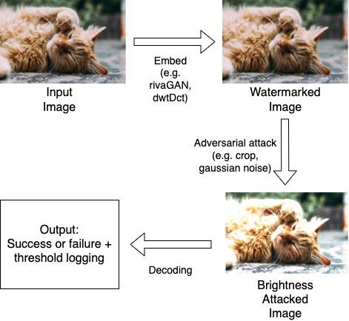
Conceptual Diagram

Slide 5
Experimental Design Table
Experiment | Model | Dataset | Metric | Baseline | Preliminary Results
Exp 1 | DWT-DCT | Unsplash (512×512) | Bitwise Decode Accuracy | Unattacked image | Fails on most clean 512×512 images
Exp 2 | DWT-DCT-SVD | Unsplash (512×512) | Bitwise Decode Accuracy | Unattacked image | Slightly more robust than DWT-DCT
Exp 3 | RivaGAN | Unsplash (512×512) | Bitwise Decode Accuracy | Unattacked image | Most robust overall, but image-sensitive
Exp 4 | DWT-DCT | Unsplash (Original) | Bitwise Decode Accuracy | Unattacked image | Performs better than 512×512, but still weak to crop/rotate
Exp 5 | DWT-DCT-SVD | Unsplash (Original) | Bitwise Decode Accuracy | Unattacked image | More stable at high-res, esp. resize/JPEG

Slide 6
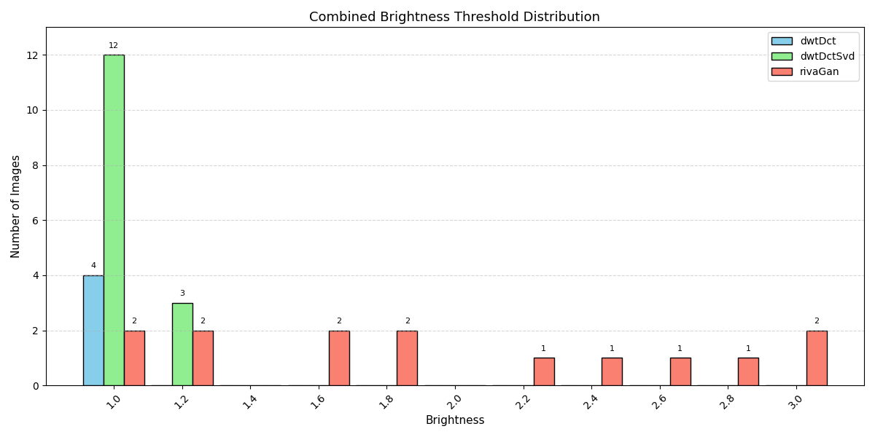

Slide 7
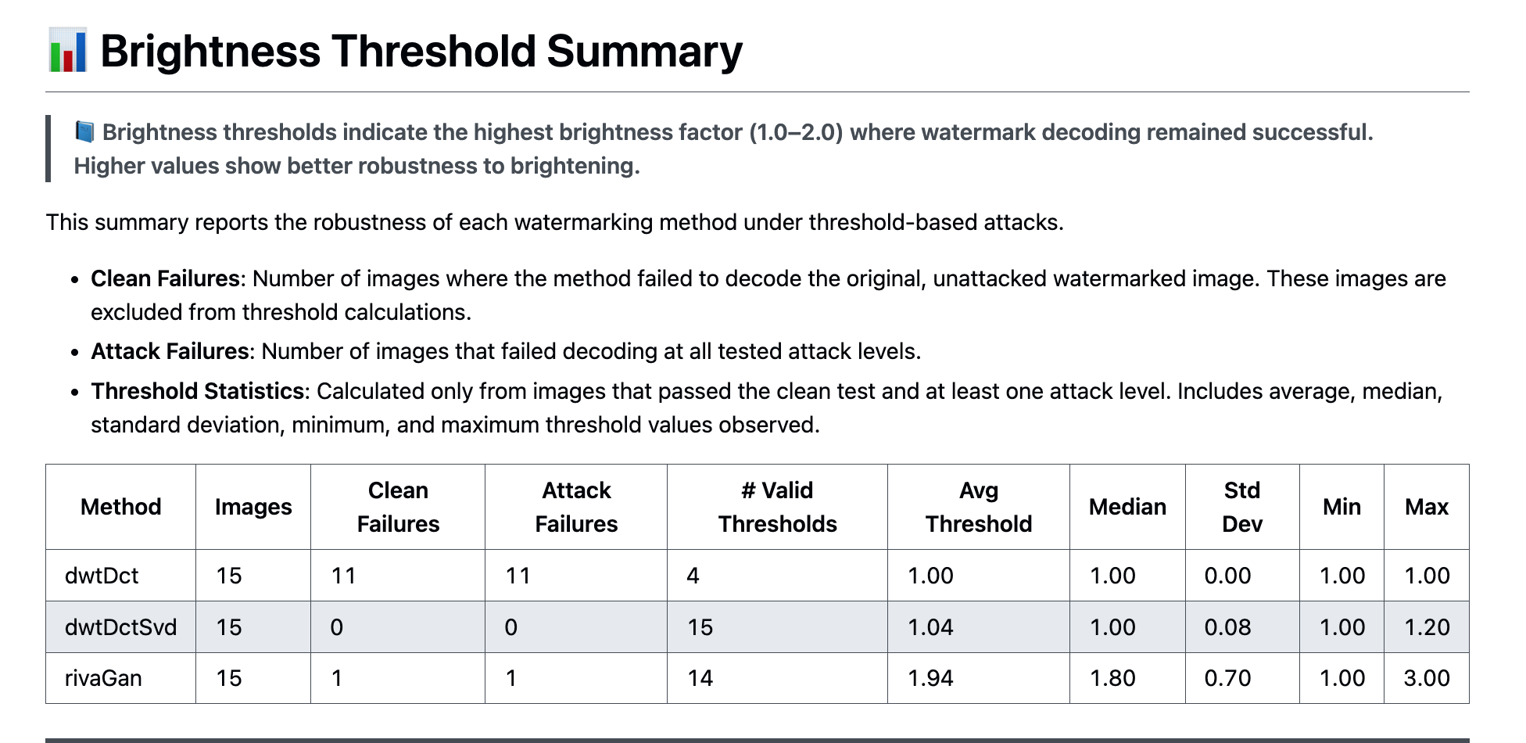

Slide 8
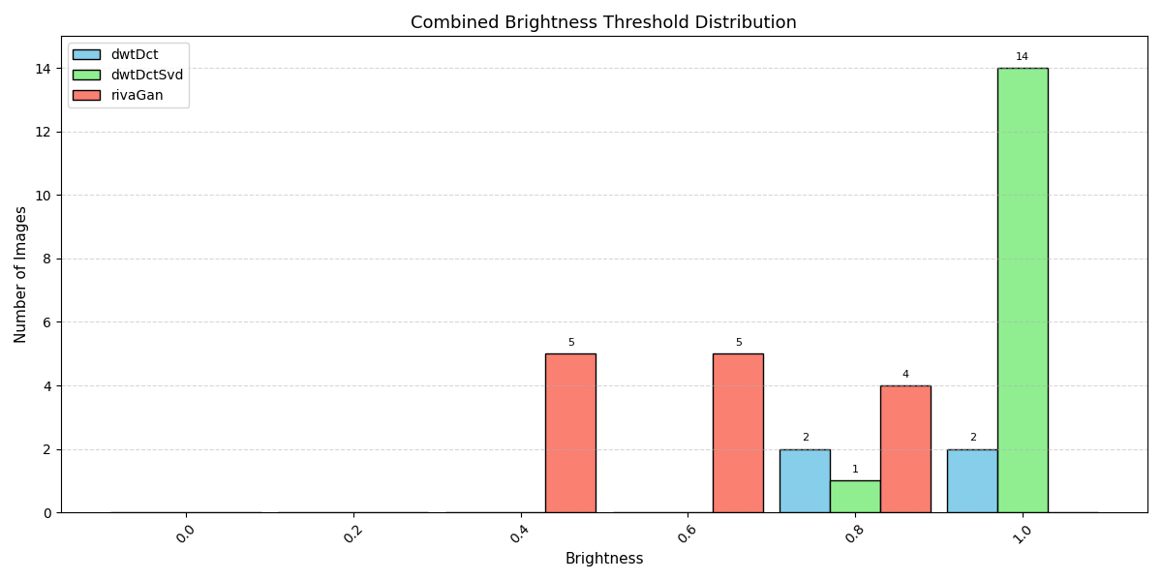

Slide 9
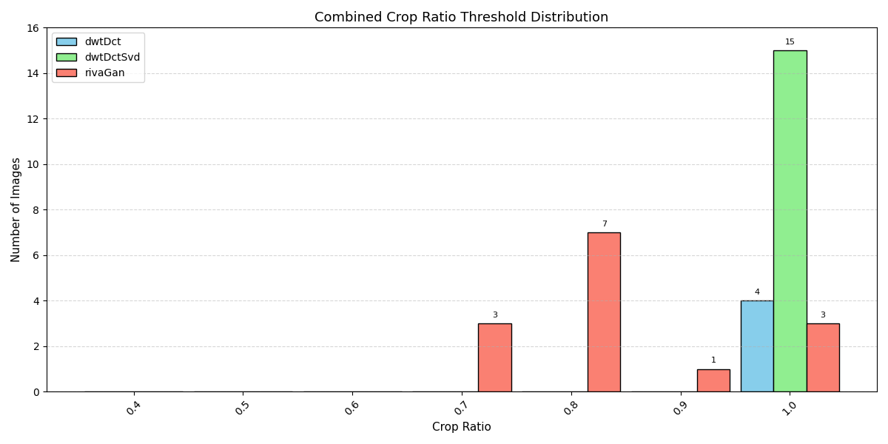

Slide 10
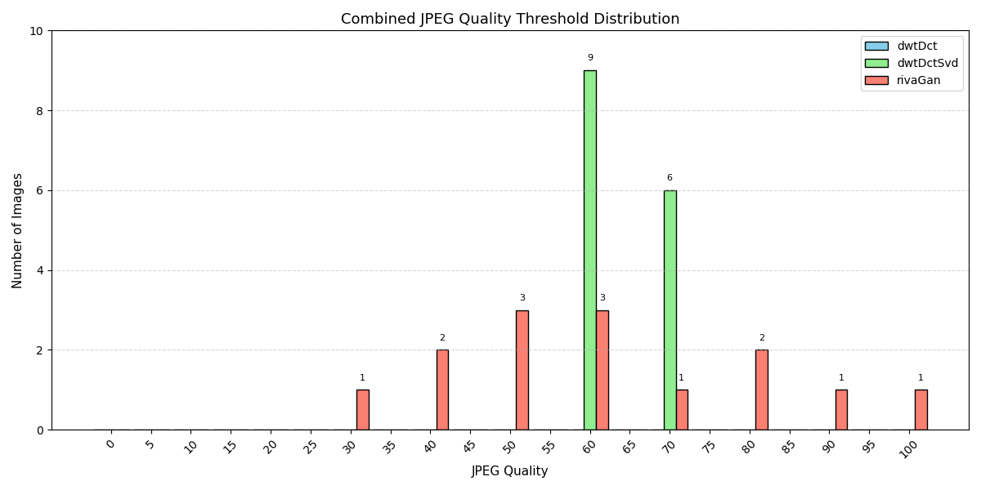

Slide 11
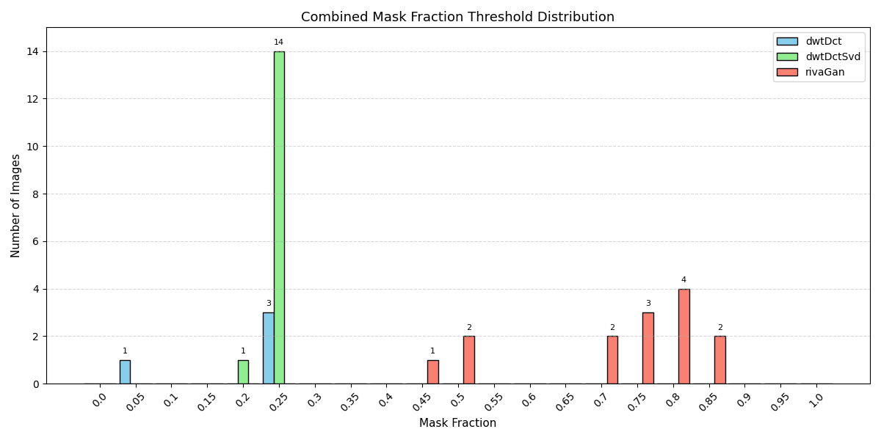

Slide 12
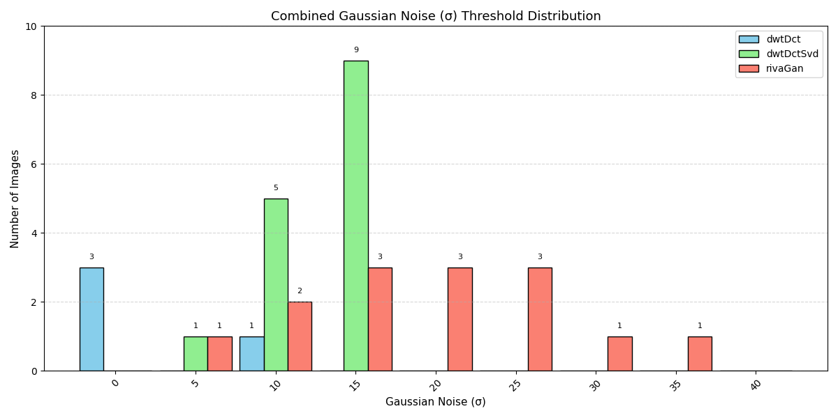

Slide 13
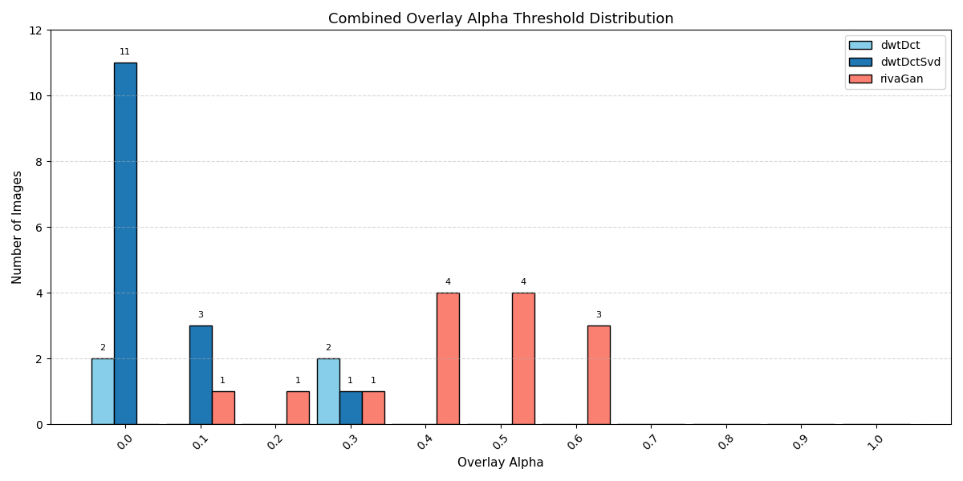

Slide 14
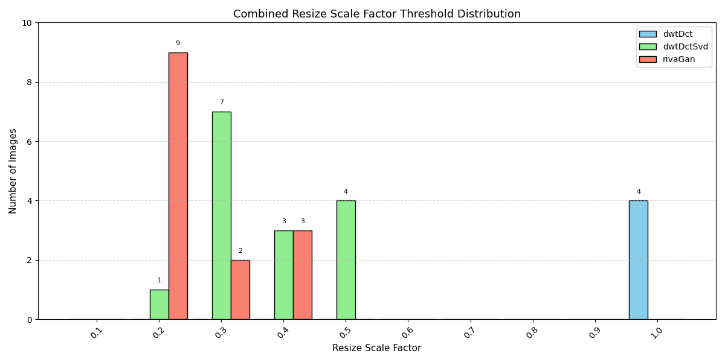

Slide 15
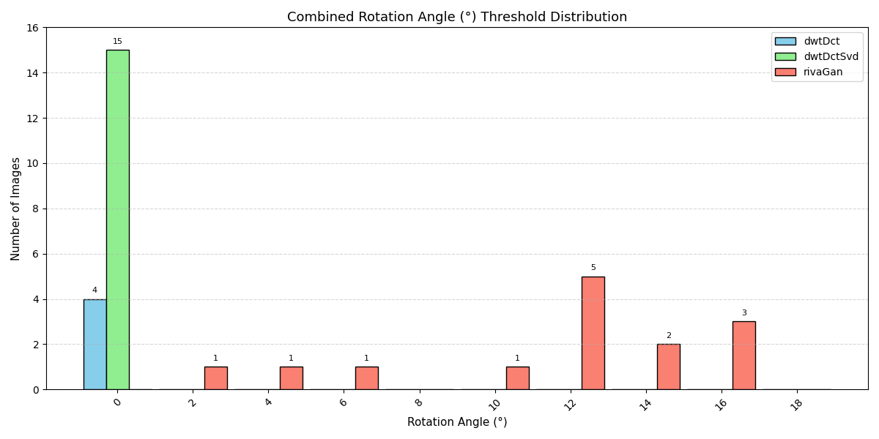

Slide 16
Notable Results
RivaGAN consistently outperforms classical methods across most attacks, especially crop, rotate, JPEG compression, and brightness variations.
Classical methods show moderate performance under resize and mask attacks, with DWT-DCT-SVD slightly outperforming DWT-DCT overall.
Testing on original high-resolution images (in addition to resized) revealed that image quality has a clear impact on watermark survival for DWT-DCT-based methods.

Slide 17
Unexpected Observations
DWT-DCT failed to decode most clean 512×512 images (only 4/15 successful), but did better on high-res originals.
RivaGAN failed on one unattacked image, suggesting some content sensitivity.
Some images decoded only after being attacked (e.g., after brightness increase or masking), which may indicate that certain alterations unintentionally enhance decoder alignment — a possible direction for perceptual analysis.

Slide 18
Reflections & Next Steps
Integrate perceptual modeling (e.g., SSIM, LPIPS) to evaluate decode variance
Introduce generative transformations (e.g., GAN-based face swaps) to assess post-synthesis watermark survival

Slide 19
References
[1] T. Wang, S. Yang, and Y. Wang, LampMark: Proactive Deepfake Detection via Training-Free Landmark Perceptual Watermarks, Proceedings of the ACM International Conference on Multimedia (MM), 2024. [Online]. Available: https://dl.acm.org/doi/10.1145/3664647.3680869
[2] H. Zhang, Y. Liu, C. Yu, J. Chen, and Y. Chen, Robust Invisible Video Watermarking with Attention, arXiv preprint arXiv:1909.01285, 2019. [Online]. Available: https://arxiv.org/pdf/1909.01285
[3] T. Karras, T. Aila, S. Laine, and J. Lehtinen, Progressive Growing of GANs for Improved Quality, Stability, and Variation, arXiv preprint arXiv:1710.10196, 2018. [Online]. Available: https://arxiv.org/abs/1710.10196
[4] K. T. Patil and S. A. Patil, Robust and Secure Watermarking Scheme Based on DWT-DCT-SVD with Matrix Encryption for Medical Images, Journal of King Saud University – Computer and Information Sciences, Elsevier, 2023. [Online]. Available: https://doi.org/10.1016/j.jksuci.2022.10.020
[5] B. D. Rouhani, H. Chen, and F. Koushanfar, DeepSigns: An End-to-End Watermarking Framework for Ownership Protection of Deep Neural Networks, ACM MM 2019. [Online]. Available: https://dl.acm.org/doi/10.1145/3297858.3304051

