Slide 1
Evaluating the Robustness of Invisible Watermarking Against Adversarial Attacks in Deepfake Detection
Cat Lewin | Dr. Rui Duan | UMKC NSF REU 2025
Week 6: June 30-July 6
Working repo: invisible-watermark-cat
REU repo (not fully functioning): reu2025-cybersec-lewin

Slide 2
Problem Statement
This project aims to examine the resilience and robustness of invisible image watermarks to adversarial manipulation, with the goal of enhancing media integrity verification in cybersecurity contexts. In particular, it supports proactive deepfake detection—an emerging privacy and misinformation threat—by identifying how image transformations degrade watermark integrity. It also informs design decisions for models that balance watermark imperceptibility with attack resistance, aiding in the development of watermark-based tamper detection tools.

Slide 3
Research Questions & Hypotheses
Research Questions:
How robust are perceptual watermarks under attack?
What are the trade-offs between imperceptibility vs resilience?
Can certain transformations reliably remove or degrade embedded watermarks?
Hypotheses:
Adversarial attacks will degrade watermark detection accuracy, particularly when designed to preserve perceptual fidelity.
Hybrid watermarking techniques (e.g., DWT-DCT-SVD) will outperform simpler methods under distortion attacks.
Invisible watermarking methods are vulnerable to certain perceptually minimal distortions.

Slide 4
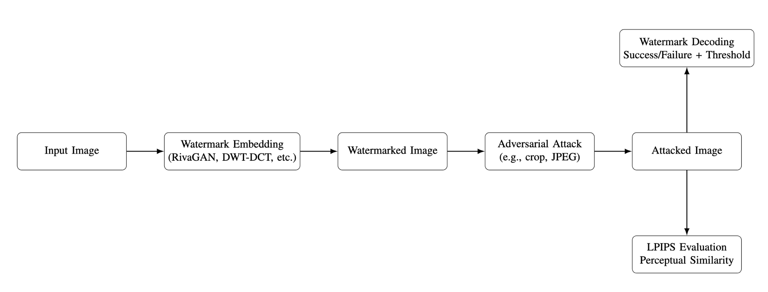


Conceptual Diagram

Slide 5
Method Overview
Models: DWT-DCT, DWT-DCT-SVD, RivaGAN, LPIPS perceptual similarity (AlexNet backbone)
Dataset: 15 diverse Unsplash images, 512×512
Attacks: Brightness adjustment (↑ / ↓), JPEG compression, Gaussian noise, Cropping, Rotation, Masking (with occlusion blocks), Overlay (with logos), Resizing (downscale + upscale)
Tools: PyTorch, LPIPS, OpenCV, matplotlib, Unsplash
New: “Perceptual similarity analysis with LPIPS (AlexNet-based)”

Slide 6
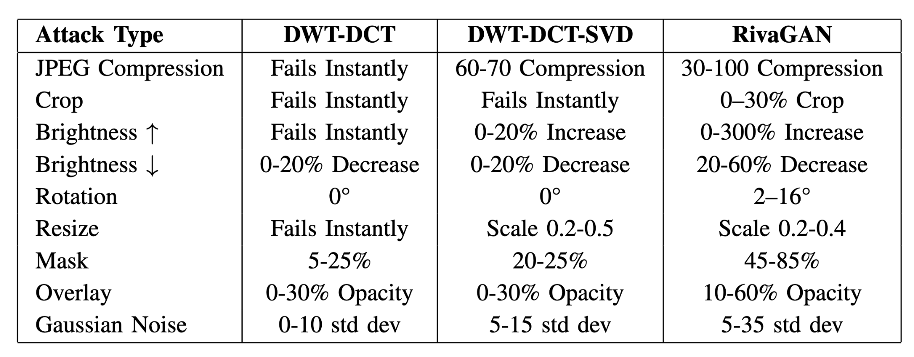
Preliminary Results
Table I summarizes the threshold ranges for each attack under which the embedded watermark remained decodable across the tested methods.

Slide 7
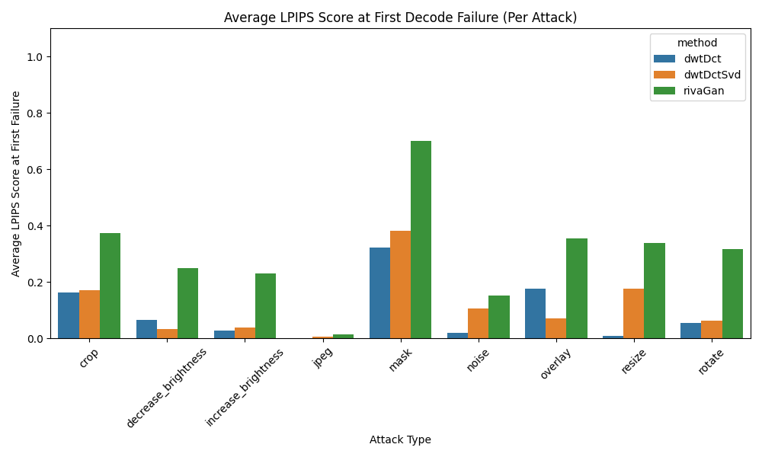
Preliminary Results, cont.

Slide 8
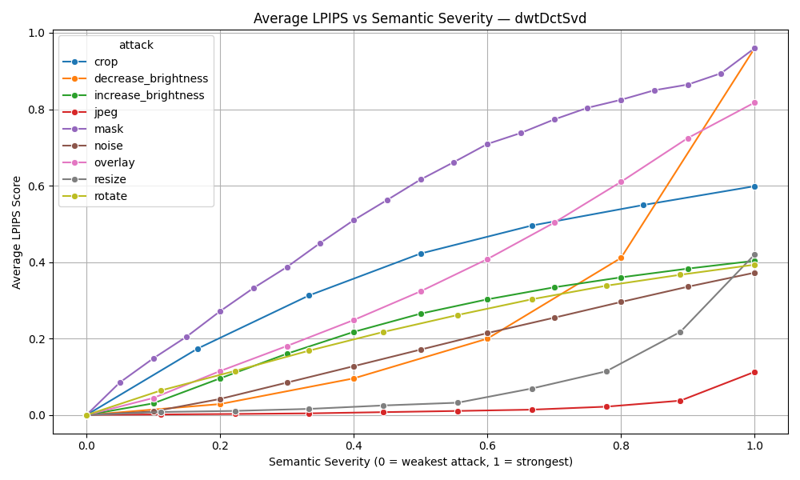
Preliminary Results, cont.

Slide 9
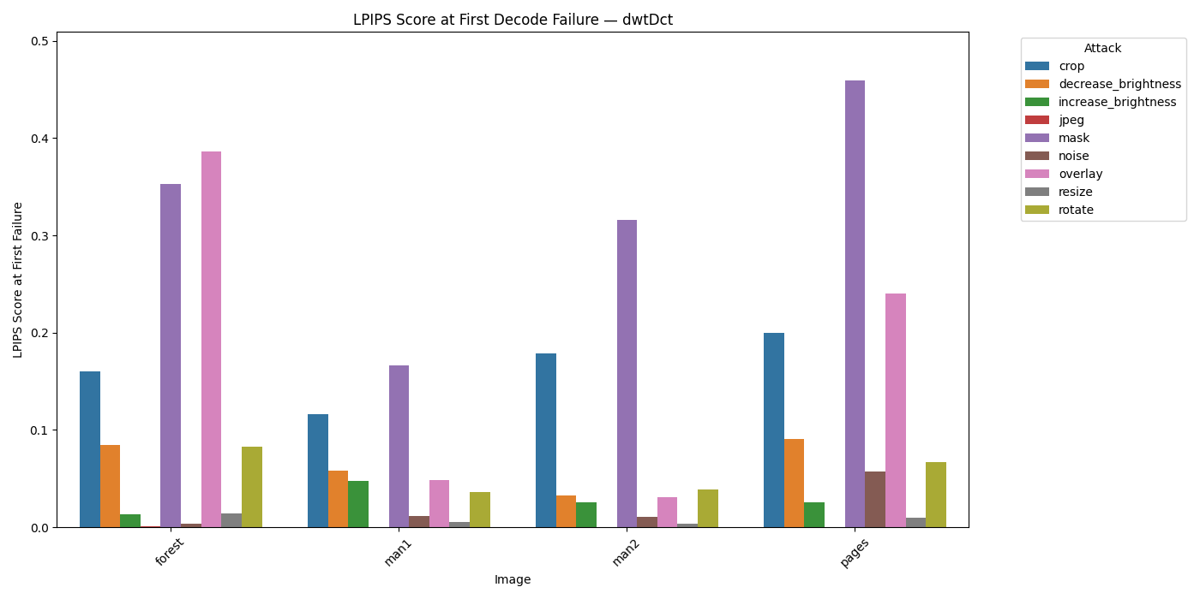
Preliminary Results, cont.

Slide 10
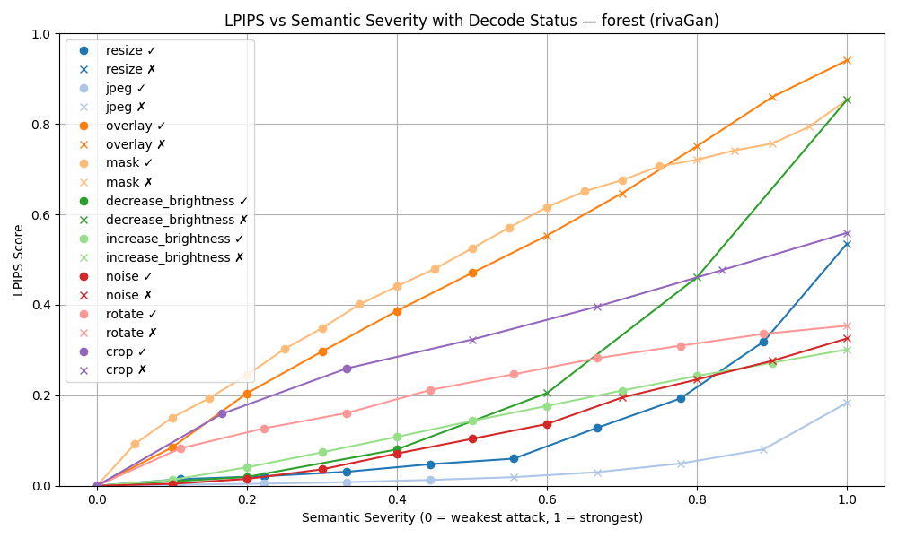
Preliminary Results, cont.

Slide 11
Preliminary Results, cont.
JPEG compression was particularly effective at disabling watermark decoding while maintaining low LPIPS scores, indicating that these distortions were often imperceptible to human observers but highly disruptive to watermark integrity.
In contrast, attacks such as overlay, masking, and cropping produced significantly higher LPIPS values, reflecting more noticeable visual degradation.
Failure cases in RivaGAN were often image-specific and did not consistently correspond to attack severity. This suggests that its decoder may be sensitive to content-dependent structural features rather than simple distortion magnitude.

Slide 12
Key Observations
What’s Working: LPIPS pipeline integrated & threshold testing automated for 9 attacks.
What’s Challenging: GitHub push limits for image results, trouble with initial AI image resolution tool – switching to another, how to include Stable Diffusion and/or transformer
Next Steps:
Get AI image resolution tool running, and other generative attacks
Potentially integrate transformer/diffusion-based watermarking

Slide 13
References
[1] T. Wang, S. Yang, and Y. Wang, “LampMark: Proactive Deepfake Detection via Training-Free Landmark Perceptual Watermarks,” in Proc. ACM Int. Conf. Multimedia (MM), 2024. [Online]. Available: https://dl.acm.org/doi/10.1145/3664647.3680869
[2] H. Zhang, Y. Liu, C. Yu, J. Chen, and Y. Chen, “Robust Invisible Video Watermarking with Attention,” arXiv preprint arXiv:1909.01285, 2019. [Online]. Available: https://arxiv.org/pdf/1909.01285
[3] T. Karras, T. Aila, S. Laine, and J. Lehtinen, “Progressive Growing of GANs for Improved Quality, Stability, and Variation,” arXiv preprint arXiv:1710.10196, 2018. [Online]. Available: https://arxiv.org/abs/1710.10196
[4] K. T. Patil and S. A. Patil, “Robust and Secure Watermarking Scheme Based on DWT-DCT-SVD with Matrix Encryption for Medical Images,” J. King Saud Univ. Comput. Inf. Sci., Elsevier, 2023. [Online]. Available: https://doi.org/10.1016/j.jksuci.2022.10.020
[5] ShieldMnt Team, “Invisible Watermark GitHub Repository,” GitHub, 2025. [Online]. Available: https://github.com/ShieldMnt/invisible-watermark
[6] T. Wang, “LampMark GitHub Repository,” GitHub, 2025. [Online]. Available: https://github.com/wangty1/LampMark/tree/main/imagedata
[7] T. Karras et al., “Progressive Growing of GANs (TensorFlow Implementation),” GitHub, 2025. [Online]. Available: https://github.com/tkarras/progressivegrowingofgans
[8] B. D. Rouhani, H. Chen, and F. Koushanfar, “DeepSigns: An End-to-End Watermarking Framework for Ownership Protection of Deep Neural Networks,” in Proc. ACM Int. Conf. Multimedia (MM), 2019. [Online]. Available: https://dl.acm.org/doi/10.1145/3297858.3304051
[9] C. Wang, C. Shi, S. Wang, Z. Xia, and B. Ma, “Dual-Task Mutual Learning With QPHFM Watermarking for Deepfake Detection,” IEEE Signal Process. Lett., vol. 31, pp. 2740–2744, 2024. [Online]. Available: https://ieeexplore.ieee.org/document/10623297

