Slide 1
Speech Copyright Detection
Cat Lewin | Dr. Rui Duan | UMKC NSF REU 2025
Week 3: June 9-15

Slide 2
Problem Statement
This project examines the limitations of automated copyright detection systems by evaluating whether pure speech content can evade detection, thereby revealing potential vulnerabilities in existing enforcement mechanisms.

Slide 3
Research Objective
Goal: Investigate whether pure speech content can trigger automated copyright detection on platforms like YouTube.
Motivation: Understand system vulnerabilities and limitations to inform future robust AI media protections.

Slide 4
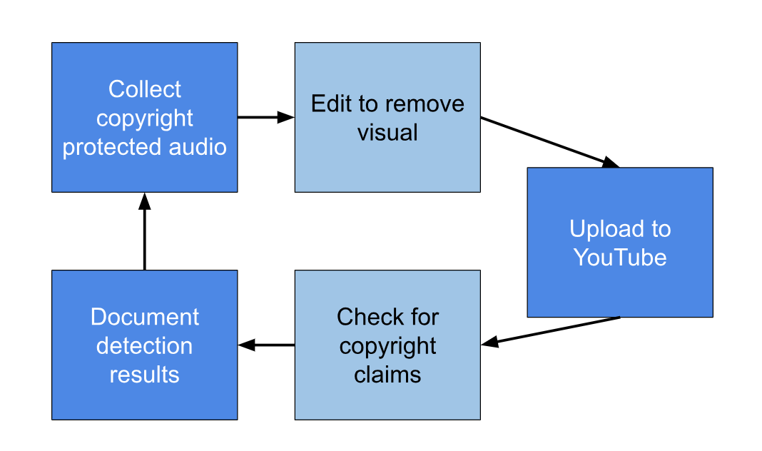
Methodology Overview

Slide 5
Content Tested
Speech: Martin Luther King Jr., Greta Thunberg, Barack Obama, John F. Kennedy, Wendy Suzuki (TEDxTalk)
Podcasts: RadioLab, Joe Rogan
Movies: Star Wars: The Empire Strikes Back, How to Train Your Dragon (2025), The Dark Knight

Slide 6
Clip Type | Clip Name | Claim? | Source | Notes
Speech | MLK Jr. – I Have a Dream | Yes | To the Left by DjeefSound | Likely false positive
Speech | Greta Thunberg – How Dare You | Yes | Eines Tages by MUSA & Oga Beats | Speech sampled in music
Speech | Barack Obama – A More Perfect Union | No | -
Speech | JFK – Inaugural Address | No | -
Speech | Wendy Suzuki TEDxTalk | No | -
Podcast | Radiolab - Everybody's Got One Episode | No | -
Podcast | Joe Rogan #2312 | No | -
Movie | Star Wars V - “I am your father" | No | -
Movie | How to Train Your Dragon | No | -
Movie | The Dark Knight – Joker Monologue | Yes | Intermezzo by UanmNess | Background audio matched

Slide 7
Key Findings & Implications
Most pure speech did not trigger Content ID.
All claims were related to musical components, not the speech itself.
Conclusion: A speech-only copyright attack is currently not feasible using detection YouTube’s system. Highlights a blind spot in automated copyright enforcement & demonstrates need for improved speech recognition in detection systems.

Slide 8
Transition to Next Domain
Initial efforts focused on implementing LampMark, a perceptual watermarking method for proactive deepfake detection, using the CelebA-HQ dataset.
Due to technical challenges with dataset reconstruction and implementation complexity, that approach was paused.
To continue exploring watermark-based deepfake detection, I am transitioning to a more accessible approach using the Invisible Watermark framework described in: "Invisible Watermarking of Deep Neural Networks for Intellectual Property Protection" (Zhang et al., 2019).

Slide 9
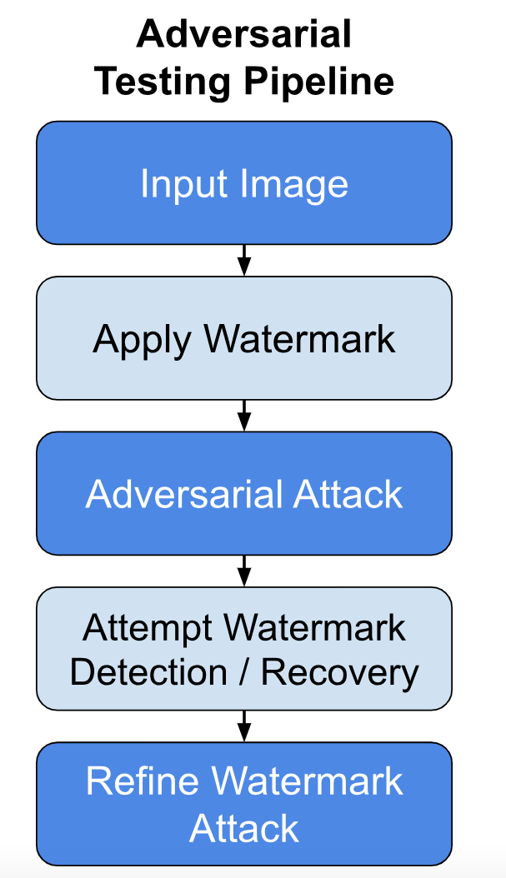
Upcoming Work
Implement Invisible Watermark framework.
Design and apply adversarial attacks to test watermark robustness.
Evaluate effectiveness of watermarking as a proactive deepfake detection mechanism.
Develop metrics to quantify robustness and imperceptibility trade-offs.

Slide 10
References
[1] R. Duan, L. Ding, Z. Qu, Y. Liu, S. Zhao, and Z. Lu, “Perception-Aware Attack: Creating Adversarial Music via Reverse-Engineering Human Perception,” in *Proc. ACM Multimedia (MM)*, 2022, pp. 5535–5543. doi: 10.1145/3503161.3548378.
[2] H. Zhang, Y. Liu, C. Yu, J. Chen, and L. Liu, “Invisible Watermarking of Deep Neural Networks for Intellectual Property Protection,” arXiv preprint arXiv:1909.01285, 2019.
[3] T. Wang, S. Zhang, and Y. Wang, “LampMark: Proactive Deepfake Detection via Training-Free Landmark Perceptual Watermarks,” in *Proc. ACM Int. Conf. on Multimedia (MM)*, 2024. [Online]. Available: https://dl.acm.org/doi/10.1145/3664647.3680869
[4] T. Karras, T. Aila, S. Laine, and J. Lehtinen, “Progressive Growing of GANs for Improved Quality, Stability, and Variation,” arXiv preprint arXiv:1710.10196, 2018.

