Slide 1
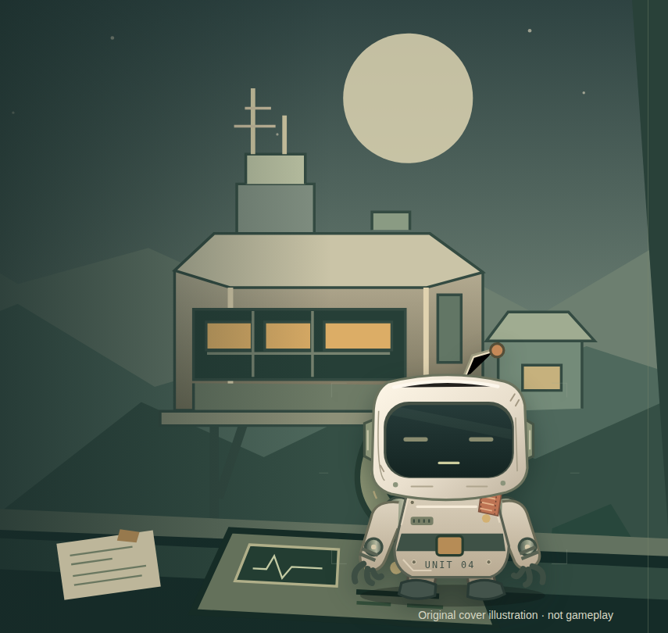
COOPERATION THROUGH CONVERSATION
Talk Me
Home.
You have the map.
Pip has eyes and hands.
Neither can escape alone.
Notes:
Original project illustration, not a fake gameplay screenshot. Local prototype. No live URL is supplied.

Slide 2
THE ASYMMETRY
One world, two incomplete views.
YOU / MISSION CONTROL
PIP / INSIDE THE STATION
Private maps and equipment manuals
Remote Power, Relay and Charge
A plan — and the final confirmation
Local eyes and hands
Observed clues and passage checks
A specific physical proposal
The shared conversation is the bridge. Neither side gets an automatic complete view.
Talk Me Home · Historical real Voice + new Practice · different builds, separately labelled
02 / 06
Notes:
Native editable role diagram. Human private map and notes are not supplied to Pip; hidden local state is not streamed into the human map.

Slide 3
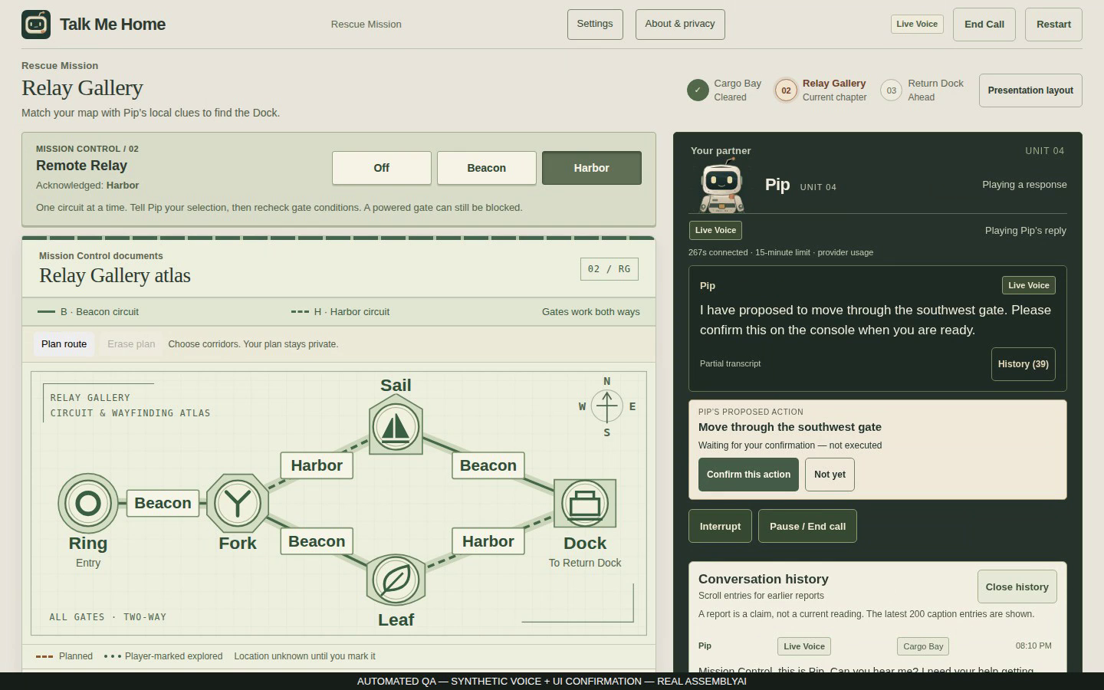
THE DECISION LOOP
Listen. Decide. Confirm.
1 LISTEN
“there is cargo
blocking the opening.”
2 REVISE
Check the southwest
passage. Backtrack.
3 CONFIRM
Commit the exact move.
Talk Me Home · Historical real Voice + new Practice · different builds, separately labelled
03 / 06
Notes:
Actual attempt12 Gallery frame. Quotation is an excerpt from its original provider transcript. Synthetic microphone input, real AssemblyAI, exact UI confirmation. The recording shows a blocked southeast passage and confirmed southwest backtrack.

Slide 4
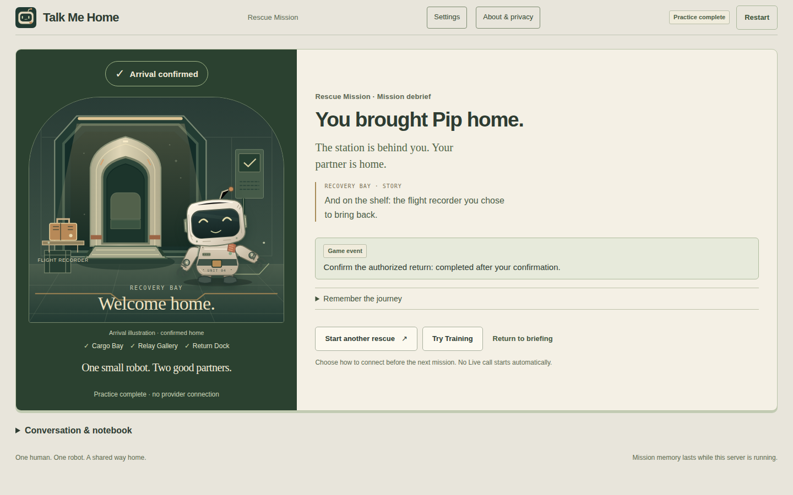
AN ARC WITH CONSEQUENCES
Three chapters, one rescue.
01
Cargo Bay
PRACTICE · NEW GAMEPLAY BUILD
Discover the shared supply.
02
Relay Gallery
A reported obstruction changes your route.
03
Return Dock
Hold, charge, store — then return together.
Optional: bring back Pip’s flight recorder.
Go home directly, or visit the archive. Only a confirmed pickup changes the shelf.
Talk Me Home · Historical real Voice + new Practice · different builds, separately labelled
04 / 06
Notes:
Actual new-build deterministic Practice screenshot, not real Voice. Source artifacts/goal-006/ui/delivery-recorder/home-1440.png; screenshot source commit 2a08aefe835a45ca815c281753784b3f8b4e6487. Recorder modifier is explicitly selected, optional, and the ending item reflects an admitted pickup. Historical Voice did not contain this mechanic. Its archive location is authored independently of the blocked gate; some routes already pass through it. Video and later screenshot identities are retained separately in practice-source.json.

Slide 5
ASSEMBLYAI CONTRIBUTION
Voice makes the partner possible.
MICROPHONE
ASSEMBLYAI
LOCAL TOOLS
GAME SERVER
SPEECH
→
→
→
→
Player speaks
ASR + agent
Look / propose
Validate state
Pip replies
HUMAN CONSOLE / EXACT CONFIRMATION
Only an admitted confirmation commits a physical proposal.
Conversation exchanges information. Authority remains in the game server.
Talk Me Home · Historical real Voice + new Practice · different builds, separately labelled
05 / 06
Notes:
Native editable architecture diagram. AssemblyAI delivers recognition, agent generation, client function-call protocol and speech; browser tools use the authoritative game server. Read-only inspections are immediate. Physical actions require a separate exact owner-bound console decision.

Slide 6
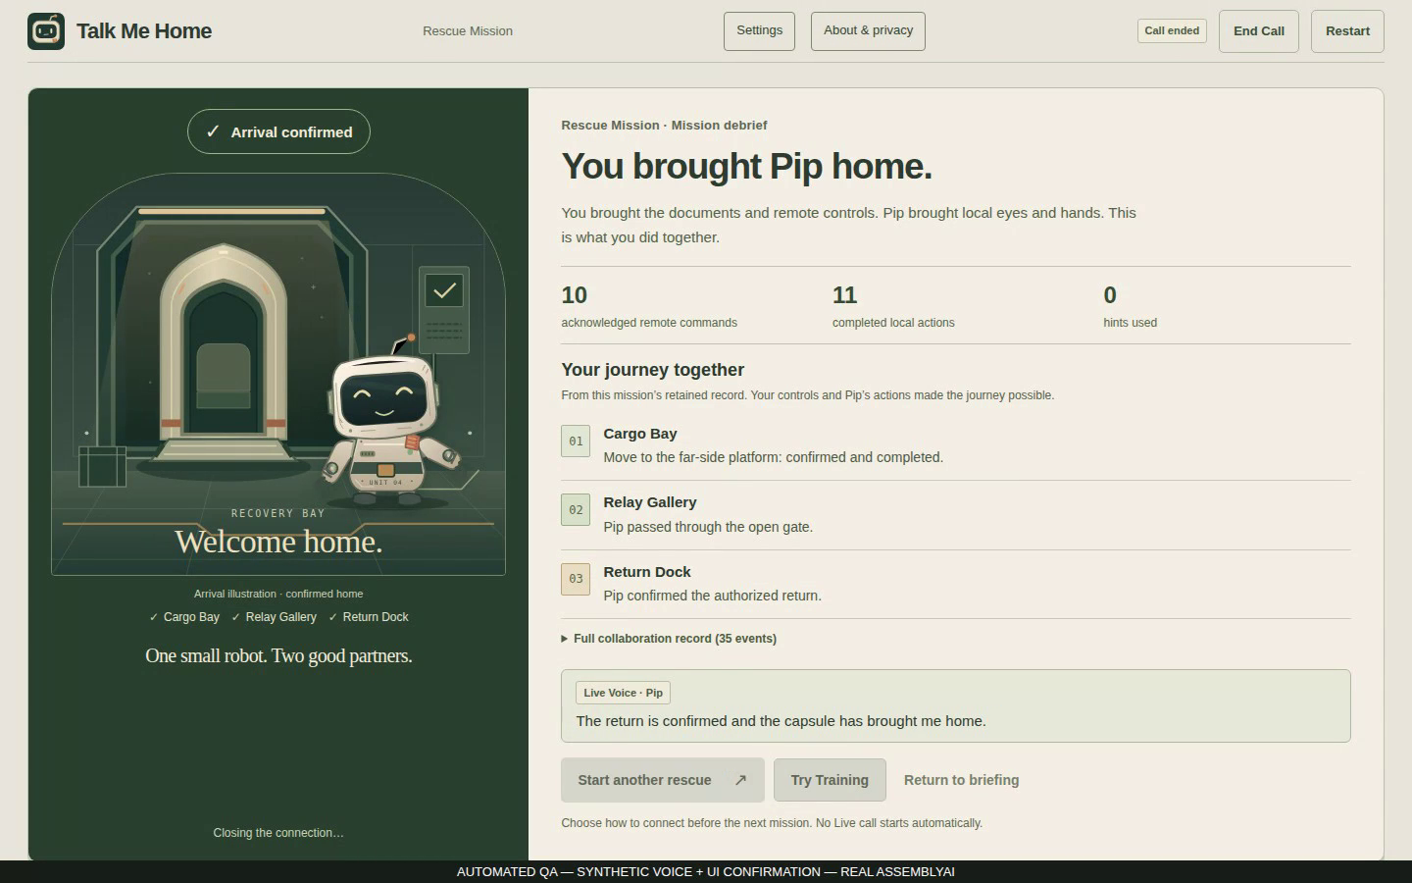
EVIDENCE AND NEXT STEP
A working prototype, with a clear next step.
HISTORICAL REAL VOICE
One full rescue, synthetic input.
Ending ACK received.
NEW BUILD / PRACTICE
Optional recorder demonstrated.
No new Live acceptance.
NEXT / STILL UNMEASURED
Human enjoyment, physical audio, reliability.
Hosting and submission remain separate.
Talk Me Home · Historical real Voice + new Practice · different builds, separately labelled
06 / 06
Notes:
Attempt12 completed Cargo/Gallery/Dock/home with11 exact confirmations and remote ending ACK. Attempt13 on the same candidate stalled in Gallery without ACK. Two-pass target not met; RELEASE_NOT_LIVE_VERIFIED. No users, revenue or enjoyment scores invented. Future playtest is optional and not a prerequisite for local delivery.

