Slide 1
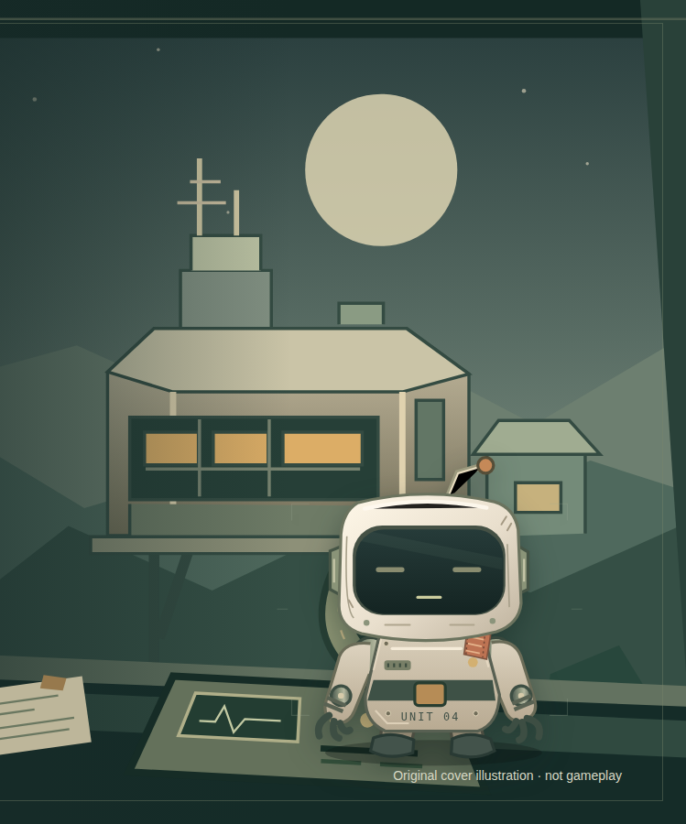
VOICE-LED CO-OP RESCUE
Talk Me
Home.
You have the map.
Pip has eyes and hands.
Explore through conversation.
Choose the route. Confirm the action.
Goal 005 draft · live acceptance in progress
Notes:
Existing original cover illustration, not a gameplay screenshot. Goal 005 versioned local draft. Final results are controlled by status.json; no public link is invented.

Slide 2
THE COOPERATION PREMISE
Neither partner has the whole picture.
Three chapters: Cargo Bay → Relay Gallery → Return Dock.
MISSION CONTROL
PIP
Read private documents.
Choose a route.
Set remote equipment.
Observe nearby rooms.
Report what is known.
Propose a local action.
Confirm each exact physical proposal.
Looking and checking need no permission.
The server validates the current conditions. Spoken agreement does not press Confirm.
Goal 005 draft · live acceptance in progress
02 / 06
Notes:
Sources: game/server/proposals.ts, sessions.ts and private records; existing shared contracts. Human documents and notes do not enter Pip context. Robot-local perception does not automatically position the human atlas. This is a normal gameplay split, not a developer-tools secrecy guarantee.

Slide 3
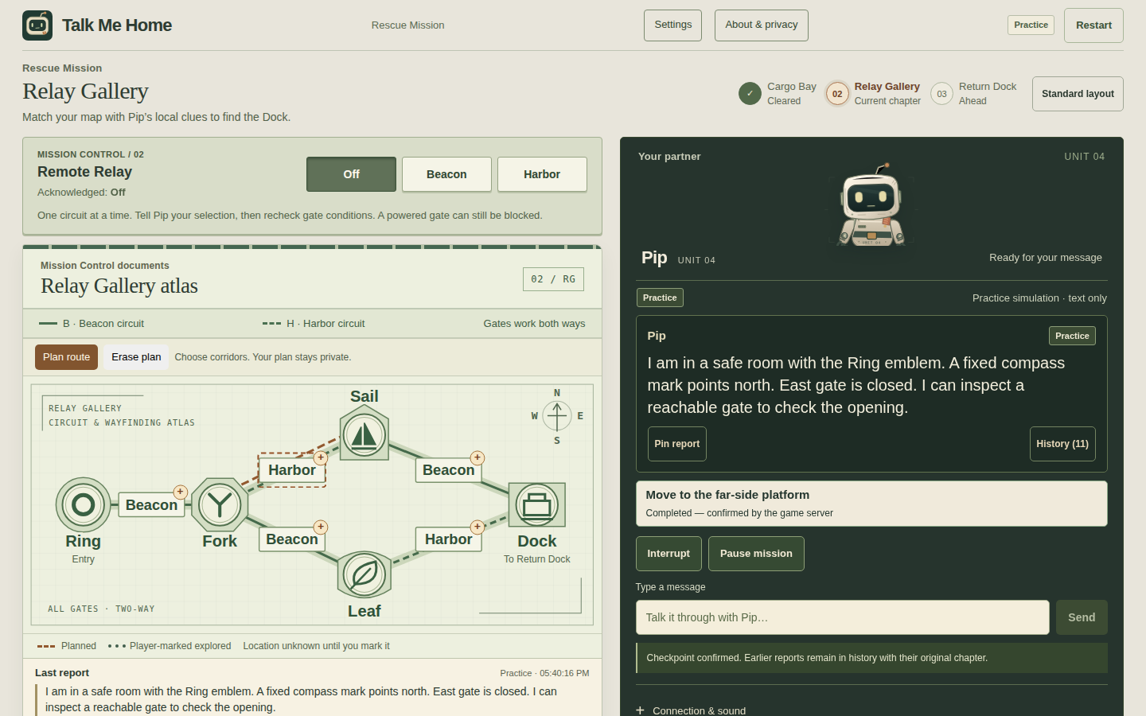
A GALLERY WORTH EXPLORING
Let a report change your plan.
Distinct emblems. Fixed compass. Circuit patterns. Your own route marks.
PLAN
Mark a corridor.
Revise the plan.
COMPARE
Keep explored paths and
reported obstructions distinct.
Goal 005 draft · live acceptance in progress
03 / 06
Notes:
Actual Goal 005 compiled Practice UI, artifacts/goal-005/ui/gallery-validation.json. Capture is deterministic offline gameplay, not real-model completion. Planned and explored routes are deliberate private player annotations. Both authored Gallery configurations and topology remain finite; no automatically solved safe path is drawn.

Slide 4
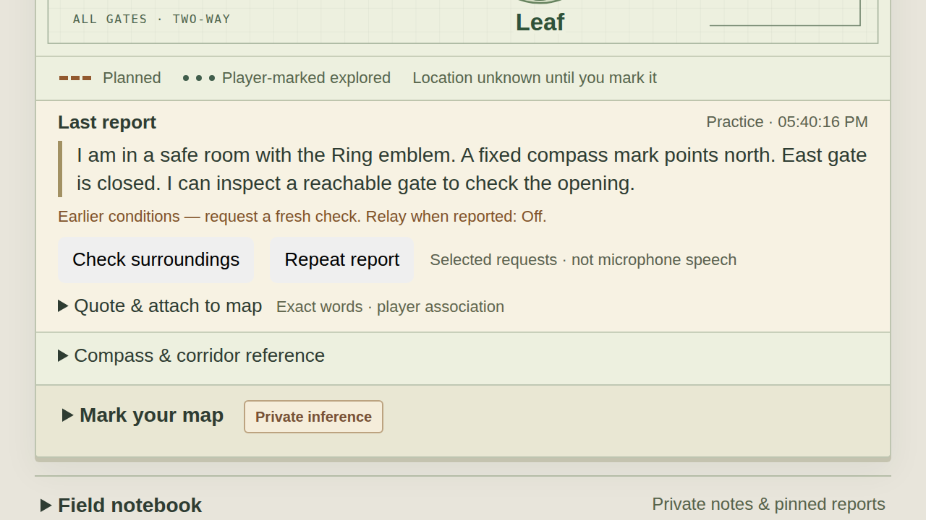
USEFUL FIELD REPORTS
Exact words, with their source and age.
A report is a communicated claim, not a live sensor reading.
Keep the quote.
Attach it to a room or corridor.
The association belongs to you.
Recheck what changed.
Relay changes age gate notes.
Stable clues remain historical quotes.
Ask for a fresh surroundings report.
Goal 005 draft · live acceptance in progress
04 / 06
Notes:
Actual Practice screenshot at CSS 200% zoom, not a visual mockup. Exact saved messages and original report time/source are preserved. Report freshness is server-stamped at receipt; a Relay change and change-back cannot revive a gate reading. Selected quick requests are explicitly labelled Selected request, never microphone speech. Private associations do not enter robot context.

Slide 5
A COMPANION THAT HELPS YOU ORIENT
“I moved” should not be the end of the exchange.
Goal 005 connects a confirmed arrival to a useful local report.
1 CONFIRMED ARRIVAL
2 USEFUL ORIENTATION
3 A HUMAN CHOICE
One confirmed action.
A scoped local observation.
Its source and time retained.
Report the nearby emblem.
Name visible directions.
Keep the response bounded.
Compare with the atlas.
Check an uncertain branch.
Replan without resetting.
Pause, Interrupt and End still win. A missing report leaves room to ask again.
Goal 005 draft · live acceptance in progress
05 / 06
Notes:
Implemented Goal 005 product design; schema/adapter and compiled injected-provider tests establish local behavior, not a guarantee of real-model compliance. Arrival data is robot-eligible only and has no hidden global graph. Existing one-shot scheduler preserves safe tool/playback boundaries and cancellation. Final live efficacy must be supplied from completed batch evidence.

Slide 6
EVIDENCE AND AVAILABILITY
The final live result is still being established.
CURRENT EVIDENCE
LOCAL PROTOTYPE
Current images show deterministic Practice. Final-candidate Voice completion, recovery and ending evidence will replace this status after the approved batch.
Playable Rescue and Training.
No public demo is deployed.
No upload or event entry is submitted.
Synthetic QA is not a human
playtest or physical-device test.
Evidence: artifacts/goal-005/ui/gallery-validation.json
Goal 005 draft · live acceptance in progress
06 / 06
Notes:
This slide must be updated from actual final-candidate results. Do not convert Practice, fake-peer tests, selected requests or historical failed calls into a Voice completion. No claim about human enjoyment, physical audio quality, revenue, customers or statistical reliability. Public URLs intentionally remain unset. {"phase": "IN_PROGRESS", "displayStatus": "Goal 005 draft \u00b7 live acceptance in progress", "acceptanceHeadline": "The final live result is still being established.", "acceptanceCopy": "Current images show deterministic Practice. Final-candidate Voice completion, recovery and ending evidence will replace this status after the approved batch.", "verifiedBuild": null, "publicDemoUrl": null, "uploadedVideoUrl": null, "evidencePath": "artifacts/goal-005/ui/gallery-validation.json", "uiCaptures": {"wide": "artifacts/goal-005/ui/goal-005-gallery-chromium-1440.png", "report": "artifacts/goal-005/ui/goal-005-gallery-zoom-chromium-1280.png"}}

