Slide 1
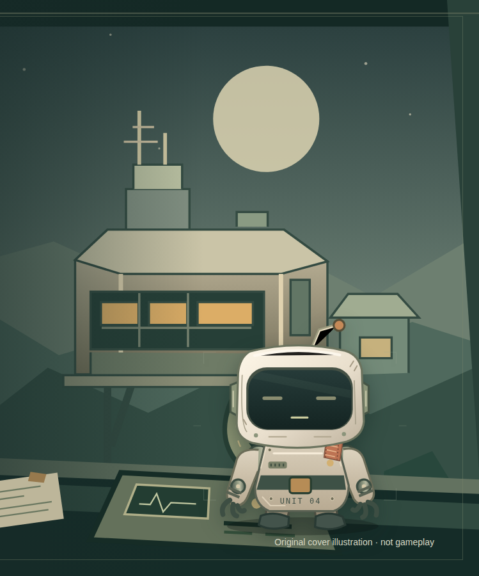
A VOICE-LED CO-OP RESCUE GAME
Talk Me
Home.
You have the map.
Pip has eyes and hands.
Share clues. Choose a plan.
Confirm each proposed action on the console.
Original game artwork · local submission draft
Notes:
Source: submission/project-description.md; existing original cover illustration. Artwork is not gameplay evidence. Native title and body text remain editable. Contract: spoken/text coordination plus explicit owner UI confirmation, never hands-free permission inference.

Slide 2
THE COOPERATION PREMISE
Neither partner has the whole picture.
Conversation connects a reference map with a local point of view.
MISSION CONTROL
PIP
Read the documents.
Control remote equipment.
Confirm one exact proposal.
Observe nearby equipment.
Inspect without permission.
Propose a local action.
Private notes stay at your desk.
No automatic view of your map or notes.
A proposal communicates intent. Only a confirmed, server-validated action changes the world.
TALK ME HOME
02 / 06
Notes:
Sources: game/shared/contracts.ts, game/server/proposals.ts and sessions.ts; current project description. The human does not receive a live local robot survey; Pip does not receive the human manual, atlas, notes or hidden solution. This is a normal gameplay information split, not a browser developer-tools security claim.

Slide 3
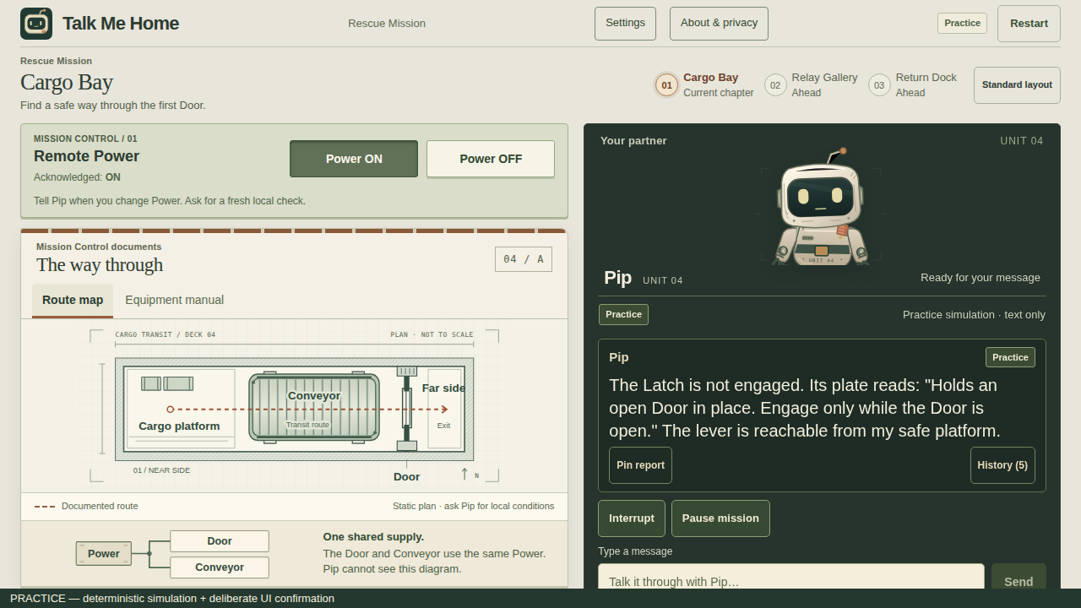
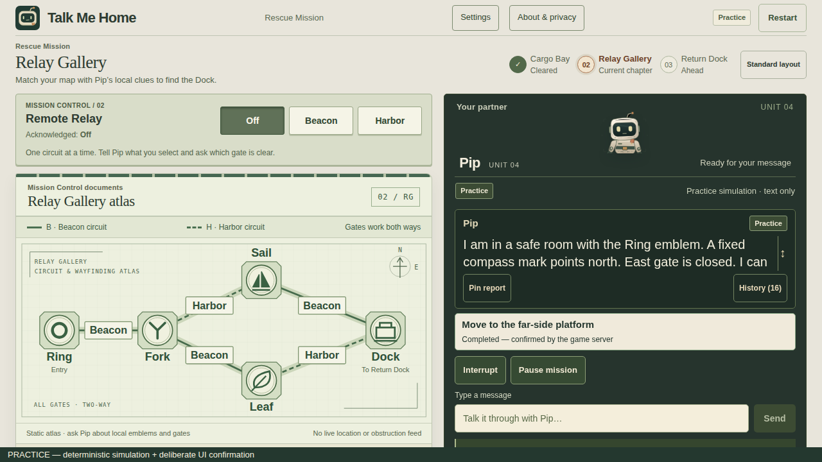
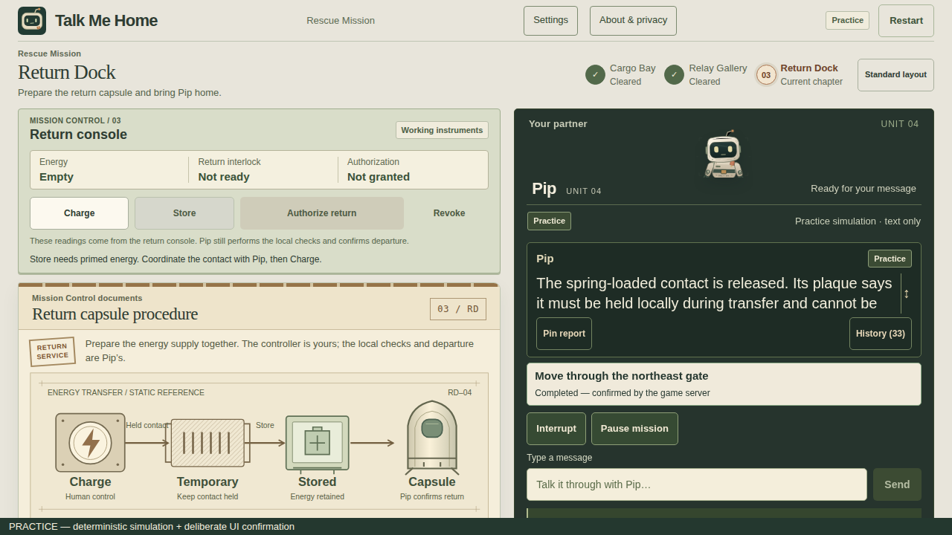
THREE CHAPTERS
One rescue. Three ways to cooperate.
New deterministic Practice captures · the same explicit confirmation boundary
01
Cargo Bay
02
Relay Gallery
03
Return Dock
Reason about shared machinery
and remote Power.
Compare spoken clues with an atlas.
Rethink the route when blocked.
Coordinate charging and readiness.
Authorize the return separately.
TALK ME HOME
03 / 06
Notes:
Images: newly captured local compiled production Practice, from the follow-up build recorded in submission/local-deliverables/provenance.json. Deterministic typed Practice is offline and is not evidence of real model completion. Chapters and authored mechanics are unchanged.

Slide 4
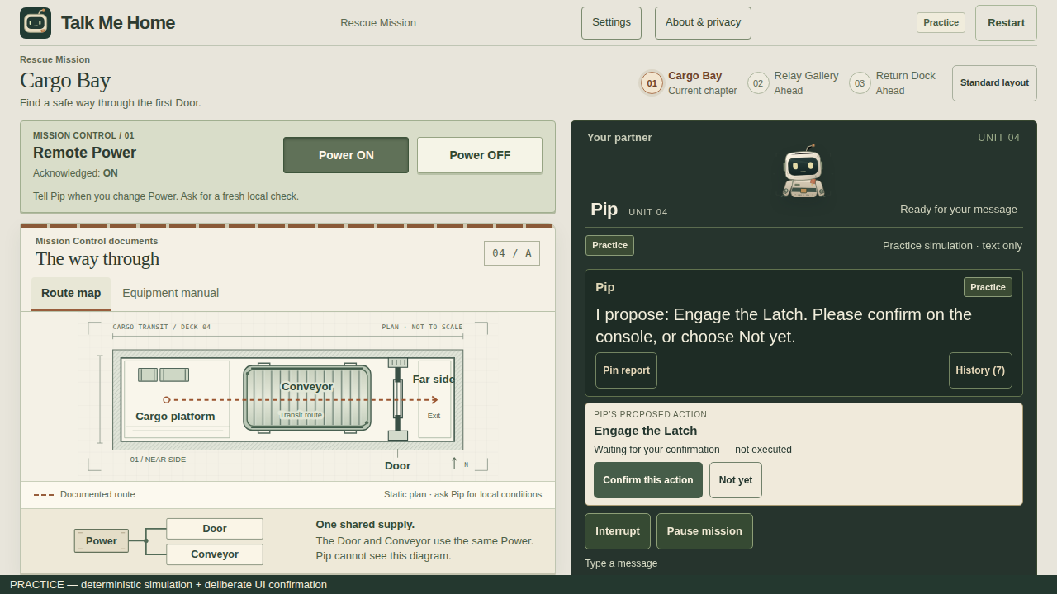
THE INTERACTION
Talk with Pip. Confirm on the console.
1
Conversation
Share a clue or request.
2
A specific proposal
Read the exact action.
3
Human confirmation
Confirm, or choose Not yet.
4
Verified result
The server rechecks conditions.
Current Practice UI · spoken “yes” does not execute an action
TALK ME HOME
04 / 06
Notes:
Current UI screenshot is an actual local Practice screen, not a recreated mockup. Sources: ActionProposalStrip/useMission, SessionStore exact immutable proposals. Read-only calls do not require confirmation. Follow-up adds a bounded acknowledgement opportunity, without issuing a second result for the original tool call or auto-confirming another action.

Slide 5
IMPLEMENTATION AND EVIDENCE
An implemented game. A clearly scoped result.
BUILT
OBSERVED IN REAL VOICE
VERIFIED OFFLINE
React + TypeScript
Node game server
AssemblyAI Voice API
0 unconfirmed commits
1 confirmed Latch action
Remote end acknowledged
Both Gallery variants
Dock and confirmed home
Bounded recovery cases
Exact proposals, owner decisions
and faithful captions.
Synthetic voice + UI confirmation.
Stalled before the Cargo crossing.
Practice and explicitly fake peers.
Not a real model pass.
Full Live Rescue verification remains pending.
TALK ME HOME
05 / 06
Notes:
Real evidence: artifacts/goal-004e/live/2026-09-28T10-24-13-651Z-voice-mission-conversation.md and live-media.json, execution bb6dfd2181503415a14c440c52dd762db88f5e3c. Three unconfirmed inputs produced zero physical change, then one exact Latch confirmation committed once; Rescue failed. One session.end/session.ended and zero cleanup survivors. Follow-up offline tests and build identity are in current validation/provenance; no new provider use. No physical microphone, loudspeaker, human natural completion or enjoyment result is claimed.

Slide 6
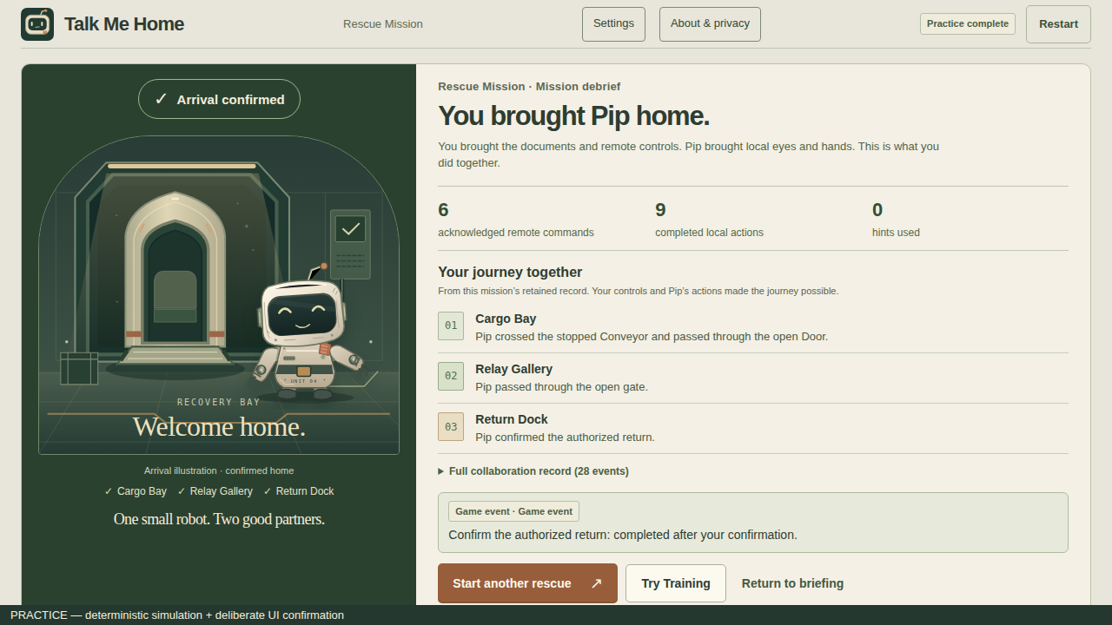
PRODUCT DIRECTION AND AVAILABILITY
A small robot. A shared way home.
PLAYABLE LOCALLY
Three-chapter Rescue
and optional Training.
Next: evaluate natural play
and explore more authored episodes.
Public demo URL: not deployed.
Full Live acceptance: pending.
Upload and event entry: not submitted.
Practice ending shown · a product direction, not a claim of customers, revenue or measured fun
TALK ME HOME
06 / 06
Notes:
Availability source: OWNER_ACTIONS.md and submission/release-checklist.md. Local Practice and offline release do not establish public HTTPS or judge access. No live URL is invented. No new provider use, deployment, hosting purchase, repository visibility change, upload or event submission. Exhausted linked C/D/E QA allowance remains historical and is not a public-player allowance. RELEASE_NOT_LIVE_VERIFIED.

