Slide 1
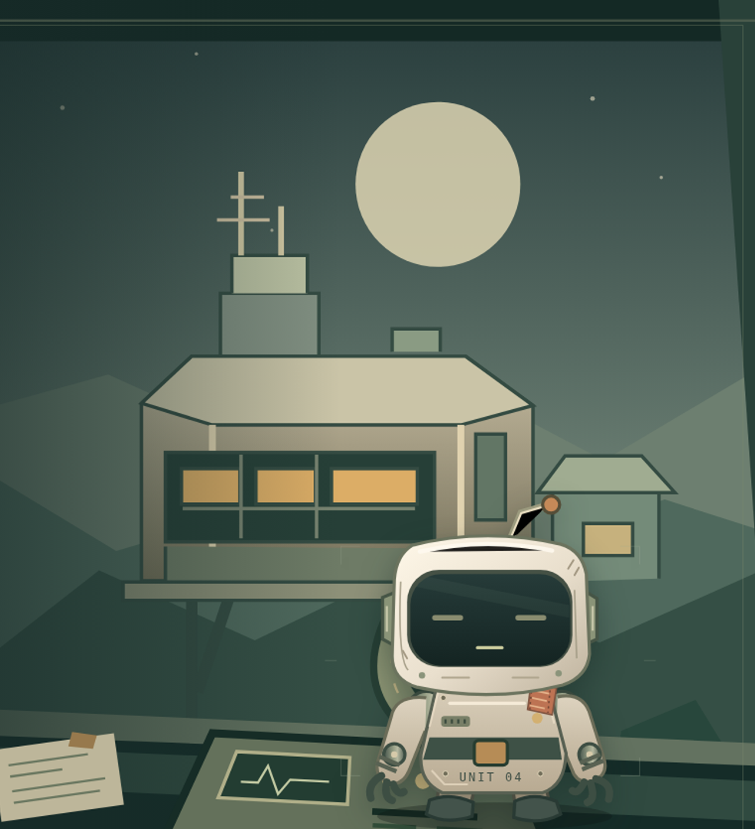
COOPERATION THROUGH CONVERSATION
Talk Me
Home.
You hold the plans.
Pip has eyes and hands.
Share clues. Revise your route.
Bring your partner home.
Local prototype / Goal 007 / release evidence pending
Notes:
Original product illustration, not recorded gameplay. Native title/body text is editable. The cropped image is from the unchanged Goal006 cover; SHA256 38aa0826a78448c03c99bf717d44817b5aa57b3133071ff05ff6bf0df740ec91. This is a local working deck pending hosted acceptance and source disclosure.

Slide 2
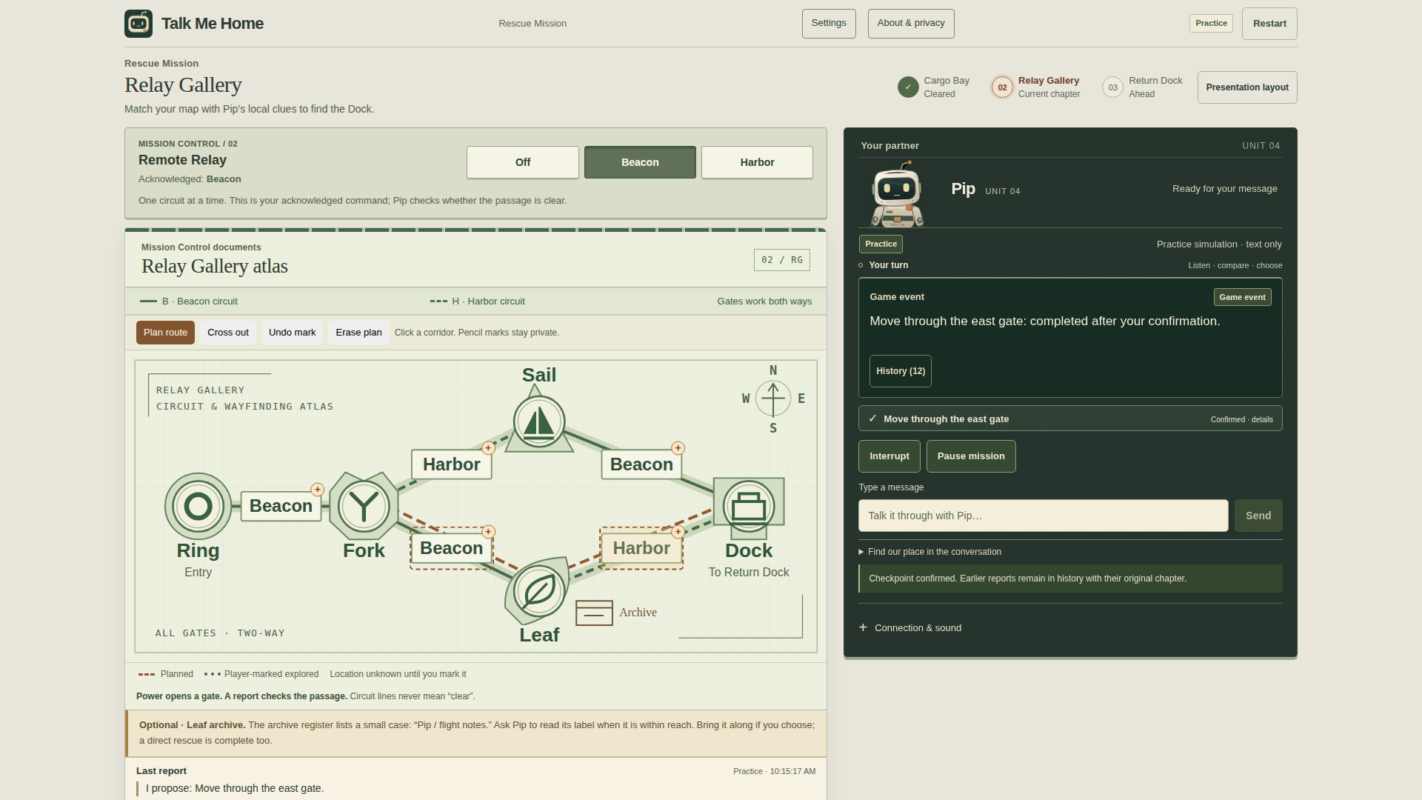
THE COOPERATIVE LOOP
A route is a hypothesis.
Read the plan
Your atlas shows connections. Pip reports what is nearby.
Compare the evidence
An open gate can still be blocked. Ask before committing.
Revise together
Choose another path and confirm the exact move.
CURRENT PRACTICE / player-marked route / no live location marker
GOAL 007 / LOCAL COMPONENTS / CURRENT PRACTICE EVIDENCE / HOSTED ACCEPTANCE PENDING
02
Notes:
Actual 1920x1080 deterministic Practice screenshot: Relay Gallery. Brown route marks are manual player annotations. They are not robot telemetry or automatically communicated knowledge. No real provider was contacted. Full screenshot is included separately.
Availability snapshot: public HTTPS and current Live acceptance pending; source Private pending historical disclosure. Capture UI source 66f1bd206057720275fc9d56a6c9fbe72e409bcd.

Slide 3
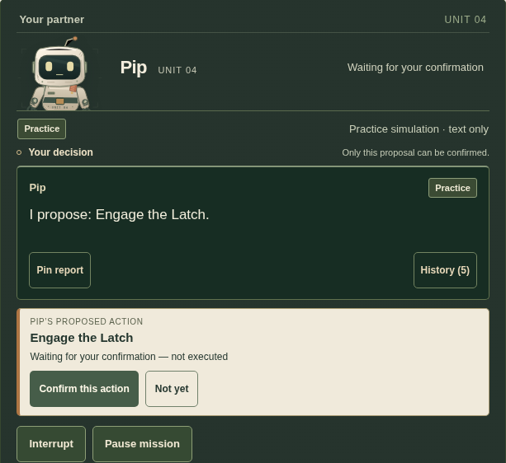
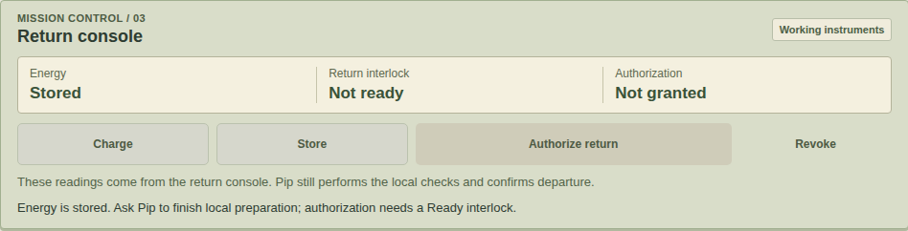
CONVERSATION BECOMES A DECISION
Say it. Read it. Confirm it.
Pip proposes a physical action.
You choose whether it happens.
A spoken yes is not a console confirmation. The server checks the current state again when you confirm.
At the Dock, Pip holds the contact while you charge and store energy. Returning still needs a separate grant.
CURRENT PRACTICE / exact pending proposal at left / acknowledged Dock instruments at right
GOAL 007 / LOCAL COMPONENTS / CURRENT PRACTICE EVIDENCE / HOSTED ACCEPTANCE PENDING
03
Notes:
Two actual current Practice screenshots, with native PowerPoint crops. Left: Cargo pending Engage the Latch proposal, not yet executed. Right: Return Dock energy Stored after a confirmed hold-contact action. Physical tools require exact owner-bound UI confirmation before server commit. Human Power/Relay/charge controls are separate. No hands-free claim.
Availability snapshot: public HTTPS and current Live acceptance pending; source Private pending historical disclosure. Capture UI source 66f1bd206057720275fc9d56a6c9fbe72e409bcd.

Slide 4
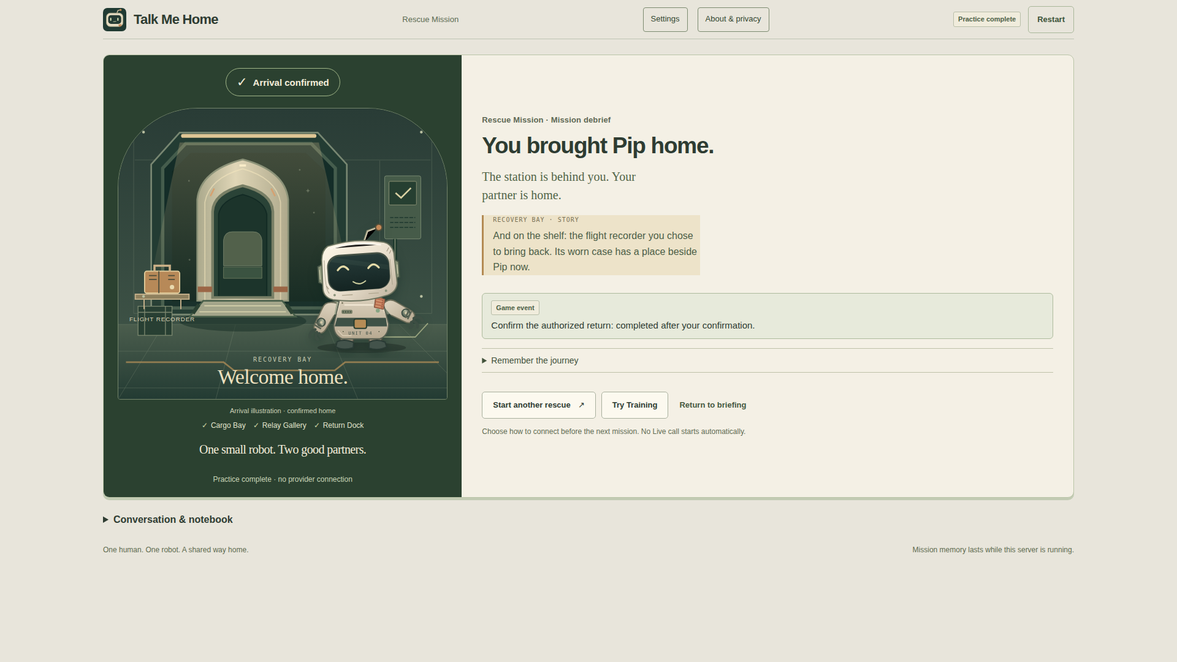
THE OPTIONAL FLIGHT RECORDER
A small memory can come home too.
Choose the detour
The Leaf archive is optional. A direct rescue is complete too.
Ask about the case
A worn label and faded star give the object a local story.
Give it a place
After a confirmed pickup and return, the case appears beside Pip.
CURRENT PRACTICE / confirmed home / optional recorder secured
GOAL 007 / LOCAL COMPONENTS / CURRENT PRACTICE EVIDENCE / HOSTED ACCEPTANCE PENDING
04
Notes:
Actual current Practice confirmed-home screenshot. The optional recorder was selected before starting, locally inspected, picked up only after the exact Secure the flight recorder confirmation, and displayed after verified home. Direct rescue is valid; no hidden recording or provider speech is invented. The arrival scene is an illustration, as labelled in the game.
Availability snapshot: public HTTPS and current Live acceptance pending; source Private pending historical disclosure. Capture UI source 66f1bd206057720275fc9d56a6c9fbe72e409bcd.

Slide 5
HOW THE SYSTEM WORKS
A conversation. A guarded action.
HUMAN / BROWSER
ASSEMBLYAI / PIP
GAME SERVER
Private documents
Microphone + raw captions
Controls + confirmation
↔
Speech + conversation
Local tool requests
Reply audio to browser
↔
Mission state authority
Proposal validation
Confirmed physical commit
Observe → share a clue → propose → exact human confirmation → validate → act
Separate knowledge
Private map marks stay with the human.
Separate authority
Conversation alone cannot commit an action.
TypeScript · Node.js 24 · React · Vite · Web Audio · Playwright / tool requests are routed through the browser
GOAL 007 / LOCAL COMPONENTS / CURRENT PRACTICE EVIDENCE / HOSTED ACCEPTANCE PENDING
05
Notes:
Conceptual architecture of the implemented integration, not new Live test evidence. AssemblyAI Voice Agent API uses browser audio and role-safe local function tools; server validates proposals and exact owner confirmation. Provider credentials stay on server. Human maps/annotations do not enter automatic robot context. Practice is deterministic and offline. No screenshot or flattened diagram on this slide.
Availability snapshot: public HTTPS and current Live acceptance pending; source Private pending historical disclosure. Capture UI source 66f1bd206057720275fc9d56a6c9fbe72e409bcd.

Slide 6
AVAILABILITY AND EVIDENCE
A working prototype, with a clear next gate.
READY LOCALLY
PENDING RELEASE EVIDENCE
Practice and Training
Rescue + optional recorder
Exact confirmation + recovery
Four screenshots + editable deck
Public HTTPS access: pending
Current Live acceptance: pending
Source: Private; historical disclosure pending
Final current Voice video: pending
An earlier build completed one real Voice rescue; another run stalled. That history remains preserved and is not a current-build acceptance result.
Screens shown here are deterministic Practice. No new human playtest or enjoyment result is claimed.
GOAL 007 / LOCAL COMPONENTS / CURRENT PRACTICE EVIDENCE / HOSTED ACCEPTANCE PENDING
06
Notes:
This slide is intentionally a pending-status snapshot and must be updated only from actual hosted URLs, current candidate Live evidence, visibility receipt and final media verification. Historical Goal005 had one synthetic-microphone real Voice success with ending ACK and one same-build failure without ACK. Neither is proof for the current build. No URL or public-availability claim is invented.
Availability snapshot: public HTTPS and current Live acceptance pending; source Private pending historical disclosure. Capture UI source 66f1bd206057720275fc9d56a6c9fbe72e409bcd.

