Slide 1
FINAL PROJECT
www.monamiagro.ro
AUTHOR: RÎPEANU Catrinel Alexandra
DATE: 27.11.2023

Slide 2

Introduction
Testing approach
Testing tools
Table Of Content
Testing types and testing levels
Test cases overview
Test cases results
Bugs overview
Conclusions and lessons learned

Slide 3

INTRODUCTION
Monamiagro.ro:
Software Application
National retailer – provides a wide range of phytosanitary products, fertilizers, tools and equipment for solariums, green spaces, irrigation systems and gardening
E-commerce Website

Slide 4
TESTING APPROACH
01
02
03
04
05
06
07
08
Test Preparation - select a website
Perform exploratory testing for learning the app
Test Planning
Design Test Cases and Test Data
Smoke Testing to verify that important features are working
Perform Test Execution
Report identified Bugs
Write the Test Report

Slide 5






TESTING TOOLS
Microsoft 365 (Office)
Snipping Tool for Windows
TestLink 1.9.20 –
Test Case Management (Design and Execution)
Screenpresso
Mantis Bug Tracker –
Bug Reporting
Fake Filler Chrome extension

Slide 6
TESTING TYPES USED
SMOKE TESTING
BLACK BOX
TESTING
COMPATIBILITY TESTING
USABILITY TESTING
EXPLORATORY TESTING
POSITIVE /
NEGATIVE TESTING
UI TESTING
FUNCTIONAL
/ NON-FUNCTIONAL

Slide 7
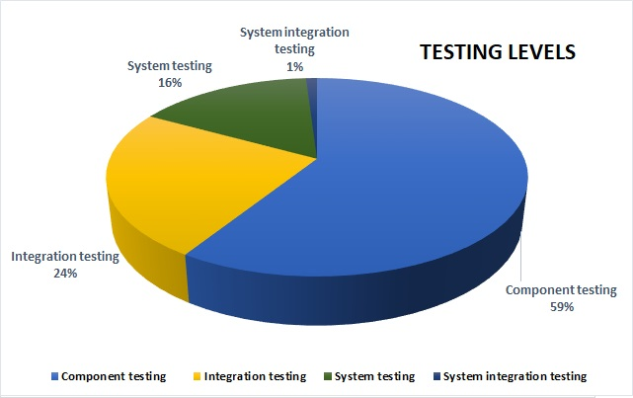
TESTING LEVELS
Component Testing
Indiv. testing of features: Login, Shopping Cart – largest share
Integration Testing
Simultaneous testing of minimum 2 components
System Testing
All internal components – end to end flows
System Integration
Testing
External payment system

Slide 8
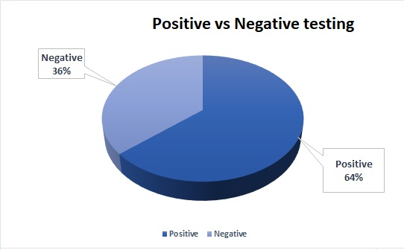
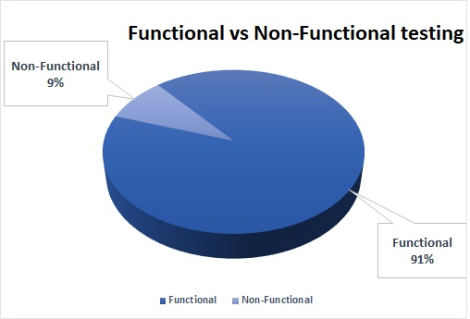
TEST CASES OVERVIEW
The executed tests can be included into Functional and Non-Functional types of testing. A number of 73 test cases are checking the functionalities of the software system; the remaining 7 test cases are testing the non-functional aspects: compatibility, usability, security.
Smoke suite includes 8 test cases which were executed, representing 10 % of the total number of test cases and having a pass rate of 100 %.

Slide 9
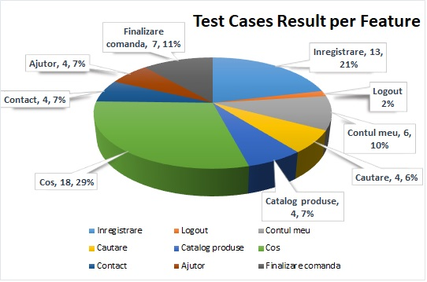
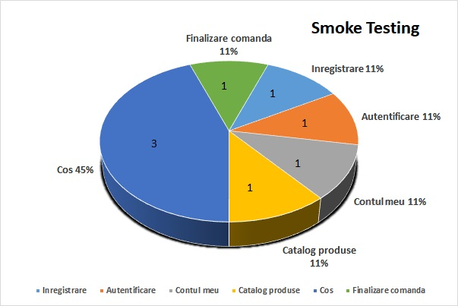
TEST CASES OVERVIEW

Slide 10
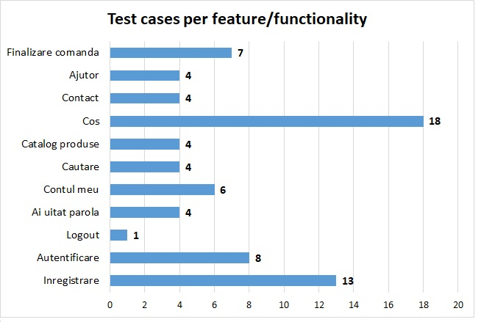
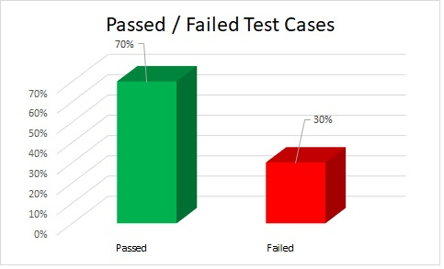
TEST CASES OVERVIEW

Slide 11
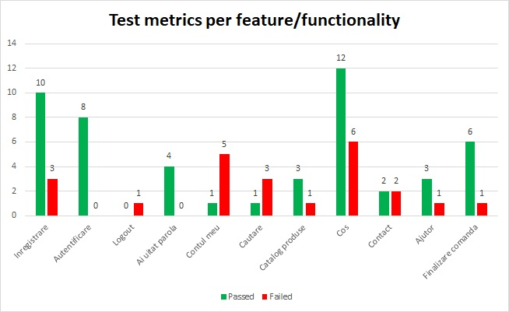
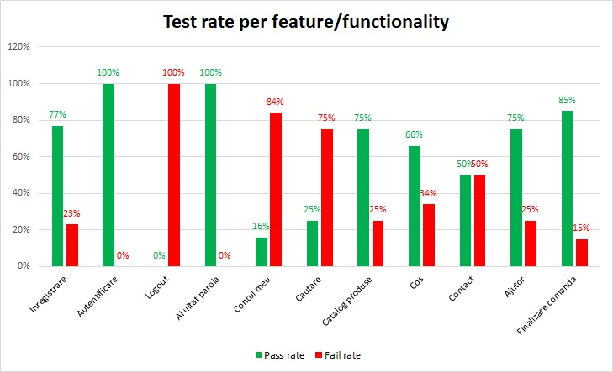
TEST CASES RESULTS
A total of 88 test cases have been designed for this session and 88 (100%) - all of them were executed: 62 test cases passed and 26 test cases failed. “Cos” feature has been identified as the section with the highest number of bugs identified during testing (6). The severity of these bugs is from major to minor.

Slide 12
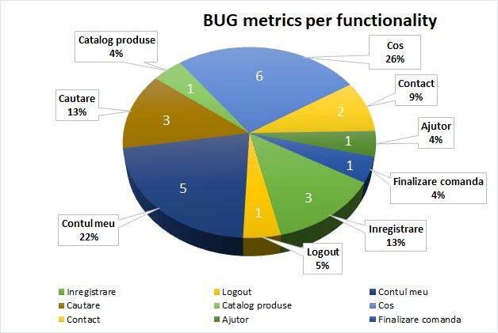
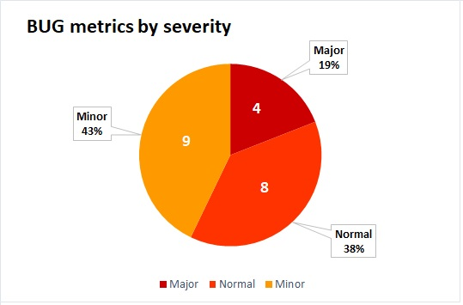
BUGS OVERVIEW
A total number of 21 Bugs were identified: 4 major, 8 normal and 9 minor severity affecting 26 test cases. There were 18 defects and 3 Improvements logged into Mantis Bug Tracker. Most of the bugs were identified by performing Exploratory Testing and Negative Testing, in “Cos”, “Cautare” and “Inregistrare” functionalities.

Slide 13
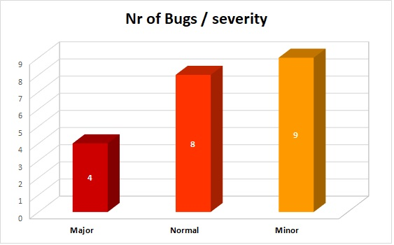
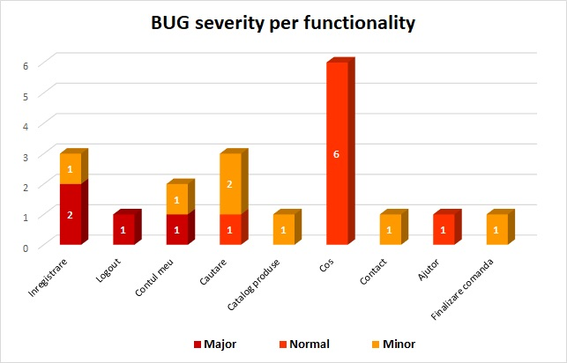
BUGS OVERVIEW

Slide 14
Conclusions
A total of 88 Test Cases were executed,
62 passed and 26 failed
UI/UX elements are not properly developed - warning messages misspelled, the lack of information, pages or buttons.
21 Bugs identified: 4 major, 8 normal and 9 minor, affecting 26 test cases. Most of the bugs were identified performing Exploratory Testing and Negative Testing, in “Cos”, “Cautare” and “Inregistrare” functionalities.
Shopping cart Bugs, such as incorrect item quantities, pricing discrepancies, or inability to empty or update shopping cart, can discourage users from completing purchases.
The system has a significant number of issues, that affect various areas, including registration, shopping cart, my account and search option.
From the user’s perspective, the website can be used for its intended purpose – user is able to create account, login, navigate the website, search for products, add them to cart and place an order.
The issues and the lack of validation for input fields could lead to incorrect data being inputted into the system database or the system not working as intended.
Identified bugs demonstrate that the website needs improvements to make it more accessible and user-friendly.

Slide 15
Lessons learned
It was very helpful to stay in touch with the team, learning from their experience, sharing ideas and helping to overcome a deadlock
Always start with a plan!
Follow the main deadlines as much as possible to avoid delays
Double check as much as possible
Write simple steps for designing test cases / reporting bugs and listen to the team manager directions
The testing session helped me learn better time management, better organizing and better focusing on details and correlating data. I improved my testing skills and staying focused for a higher purpose.

Slide 16
THANK YOU!

