Slide 1
Tópicos avanzados de aprendizaje de máquina
(Advanced topics in machine learning) 2019-I
Carlos Alejandro Trujillo Anaya – carlostrujillo@itm.edu.co
Electronics and telecomunications department
Course belonging to “Maestría en Automatización y Control Industrial”.
Tuesday 18-21

Slide 2
Description
Study and development of techniques and automatic systems for data processing and analysis
Masters in Automatización y Control Industrial
Computational intelligence research line

Slide 3


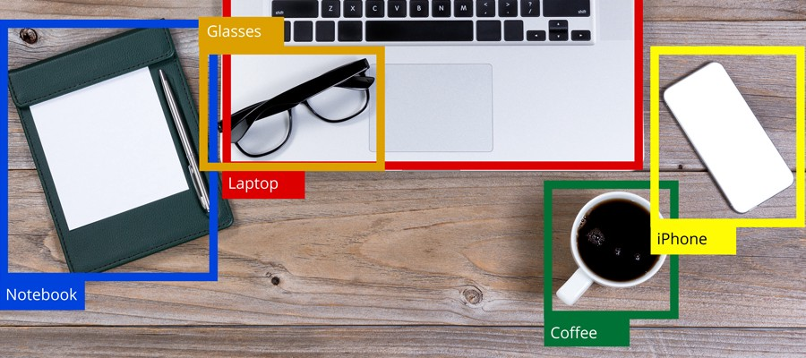
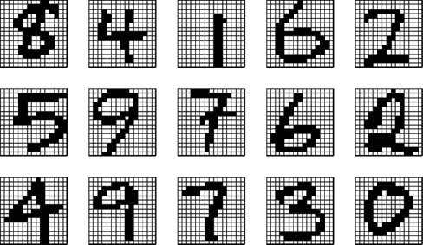
Signal processing
Description
Perception
https://www.meridian-audio.com/about-meridian/digital-signal-processing-dsp/
Object recognition
Structure and/or pattern identification
https://chucksblog.typepad.com/.a/6a00d83451be8f69e201b7c7812858970b-popup
https://blog.paralleldots.com/market-research/how-visual-object-detection-can-transform-manufacturing-industries/
https://www.oreilly.com/library/view/combining-pattern-classifiers/9781118914540/c01.xhtml

Slide 4
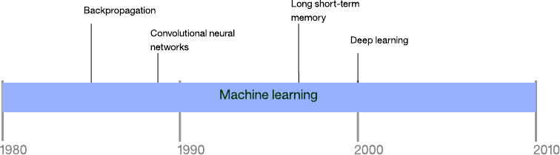
Timeline of machine learning approaches
https://developer.ibm.com/articles/cc-beginner-guide-machine-learning-ai-cognitive/

Slide 5
Contents
Detailed contents | Hours
Intro to new methods and tendencies in machine learning techniques | 3
Regression advanced techniques | 9
Classification advanced techniques | 9
Clustering advanced techniques | 9
Applications | 18

Slide 6
Course evaluation (grades)
Topic | %
Up to 3 exams to evaluate the theoretical knowledge acquired by the student during the course (average grade) | 20
Script development in advanced machine learning algorithms (average grade) | 20
Literature revision (average grade) | 30
Oral presentations (average grade) | 30

Slide 7
References
Theodoridis, S. Pattern Recognition (4th Edition). Elsevier, 2009.
Wasserman, L. All of statistics: a concise course in statistical inference. Springer, 2004.
Bishop, C. M. Pattern recognition and machine learning (Vol. 1, p. 740). New York: Springer, 2006.
Duda, R. O., Hart, P. E., & Stork, D. G. Pattern classification. John Wiley & Sons, 2012.
Research papers!
World Wide Web!

