Slide 1
Intro to new methods and tendencies in machine learning techniques Febrero 12 de 2019
Carlos Alejandro Trujillo Anaya – carlostrujillo@itm.edu.co
Electronics and telecomunications department
Course belonging to “Maestría en Automatización y Control Industrial”.
Tuesday 18-21

Slide 2
“A computer program is said to learn from experience E with respect to some class of tasks T and performance measure P if its performance at tasks in T, as measured by P, improves with experience E.”

Slide 3
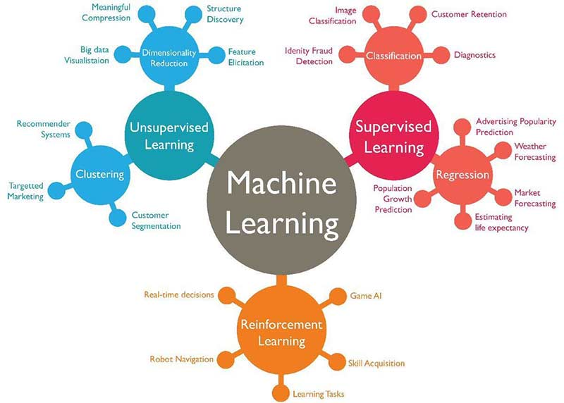
Machine Learning Algorithms
https://www.techleer.com/articles/203-machine-learning-algorithm-backbone-of-emerging-technologies/

Slide 4
Machine Learning Algorithms (in this course)
https://www.techleer.com/articles/203-machine-learning-algorithm-backbone-of-emerging-technologies/

Slide 5
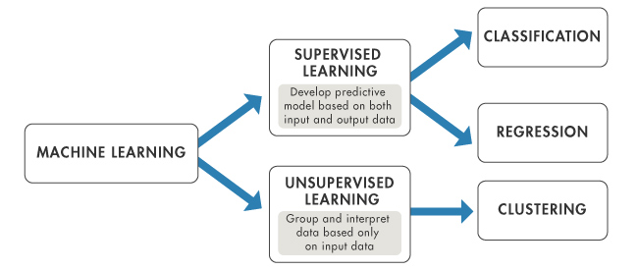
Machine Learning Algorithms (in this course)
https://in.mathworks.com/help/stats/machine-learning-in-matlab.html

Slide 6
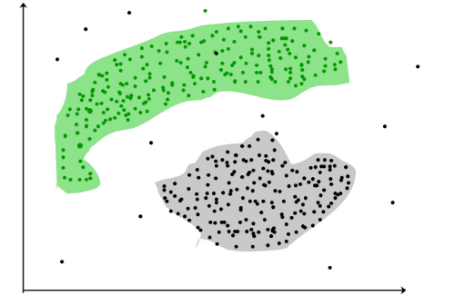
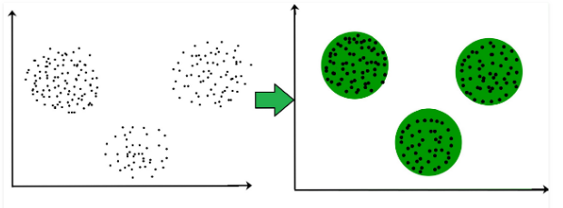
Clustering in machine learning
Clustering is the task of dividing the population or data points into a number of groups such that data points in the same groups are more similar to other data points in the same group and dissimilar to the data points in other groups

Slide 7
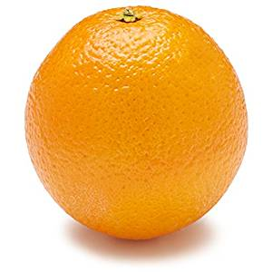
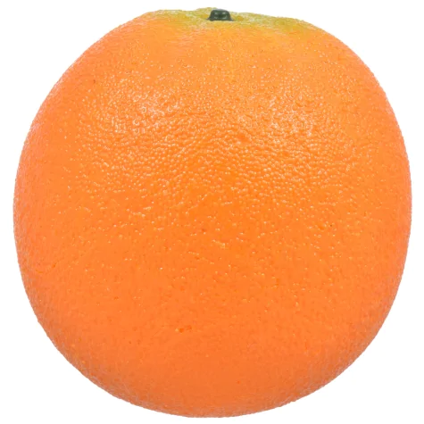
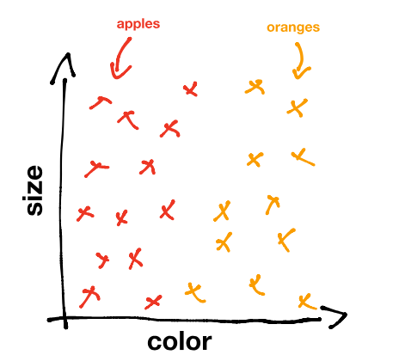
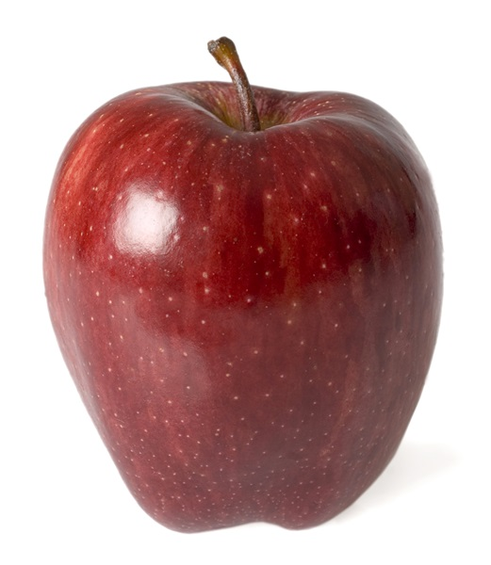
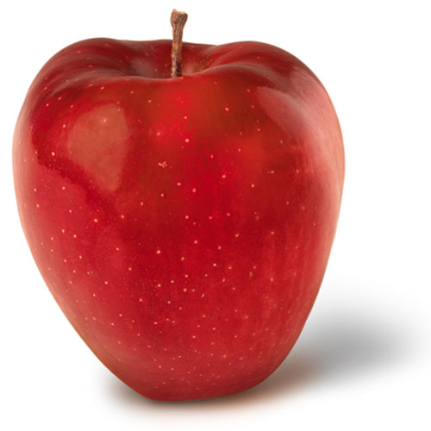
Classification in machine learning
https://www.kdnuggets.com/2017/05/machine-learning-crash-course-part-1.html

Slide 8
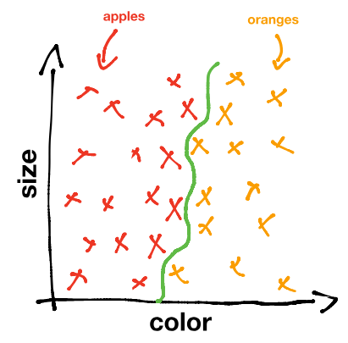
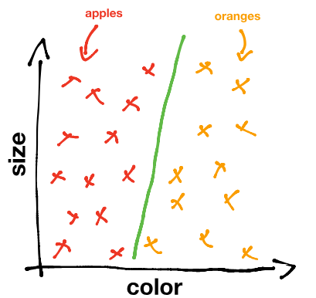
Goal: Decision boundary
Classification in machine learning
https://www.kdnuggets.com/2017/05/machine-learning-crash-course-part-1.html

Slide 9
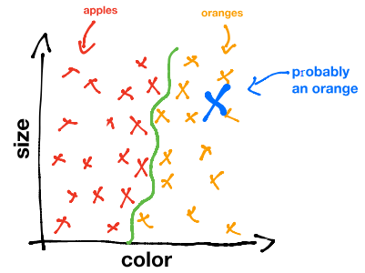
Classification in machine learning
By giving our algorithm examples of apples and oranges to learn from, it can generalize its experience to images of apples and oranges that it has never encountered before.
https://www.kdnuggets.com/2017/05/machine-learning-crash-course-part-1.html

Slide 10
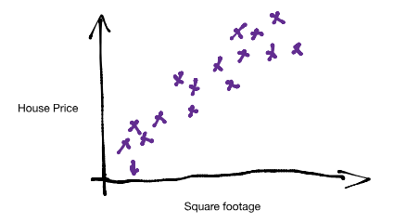
Regression in machine learning
In this case… we can define a pattern!
We want our algorithm to find and use this pattern to predict house prices based on house size.
https://www.kdnuggets.com/2017/05/machine-learning-crash-course-part-1.html

Slide 11
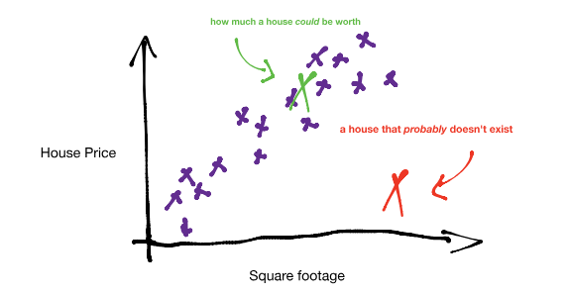
Regression in machine learning
Intuitively we can see that there is a diagonal strip in the graph that most houses seem to land on
https://www.kdnuggets.com/2017/05/machine-learning-crash-course-part-1.html

Slide 12
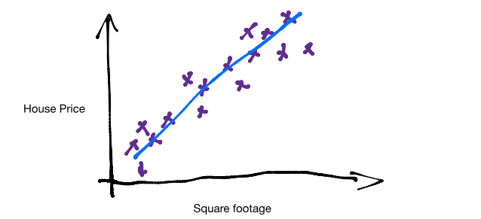
Regression in machine learning
The blue line, called a predictor, predicts the price of a house from its square footage.
So we’ve seen examples of one and two input variables, but many machine learning applications take into account hundreds and even thousands of variables.
https://www.kdnuggets.com/2017/05/machine-learning-crash-course-part-1.html

Slide 13
Regression in machine learning
The predictor
f(x) = c_{n}x_{n} +c_{n1}x_{n1} + … + c₀
x is a feature
c is a parameter or weight
In our example, the parameters could be the square footage and the number of power outlets!
https://www.kdnuggets.com/2017/05/machine-learning-crash-course-part-1.html

Slide 14
Regression in machine learning
The predictor (in our example with only two variables)
y(x) = c₁x + c₀
y(x): price of the house
x: size of the house
C₀: the base price of the house
The goal is to calculate the parameters!
The classical methods can get impractical when working with hundreds or thousands of variables, so we use machine learning algorithms.
https://www.kdnuggets.com/2017/05/machine-learning-crash-course-part-1.html

Slide 15
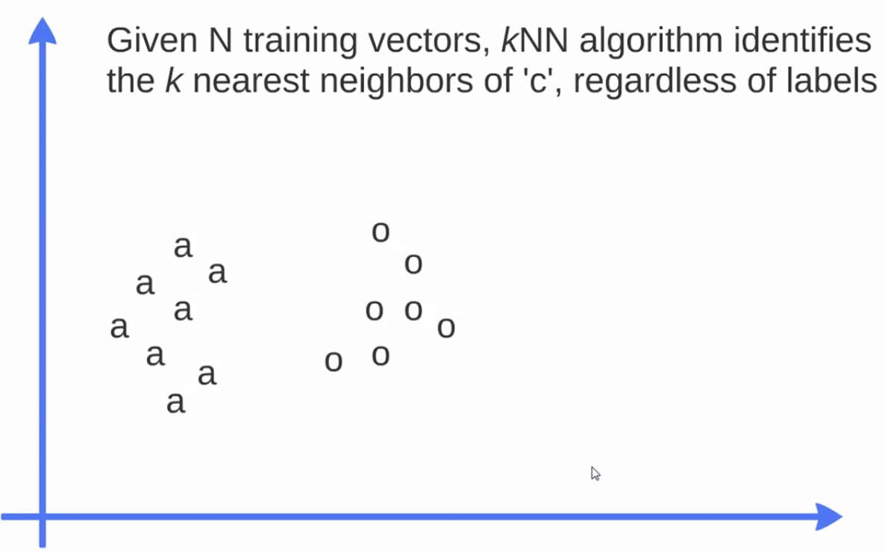
Traditional algorithms in machine learning
k-NN (k-nearest neighbor)
c
Thales Sehn Korting

Slide 16
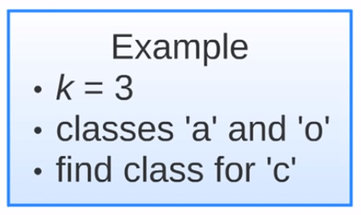
Traditional algorithms in machine learning
k-NN (k-nearest neighbor)
c
Thales Sehn Korting

Slide 17
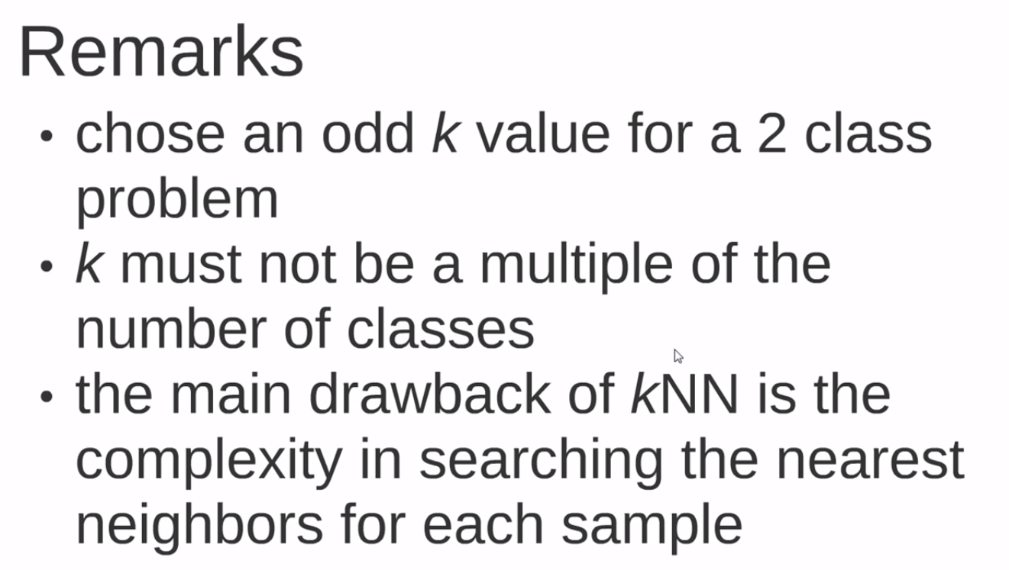
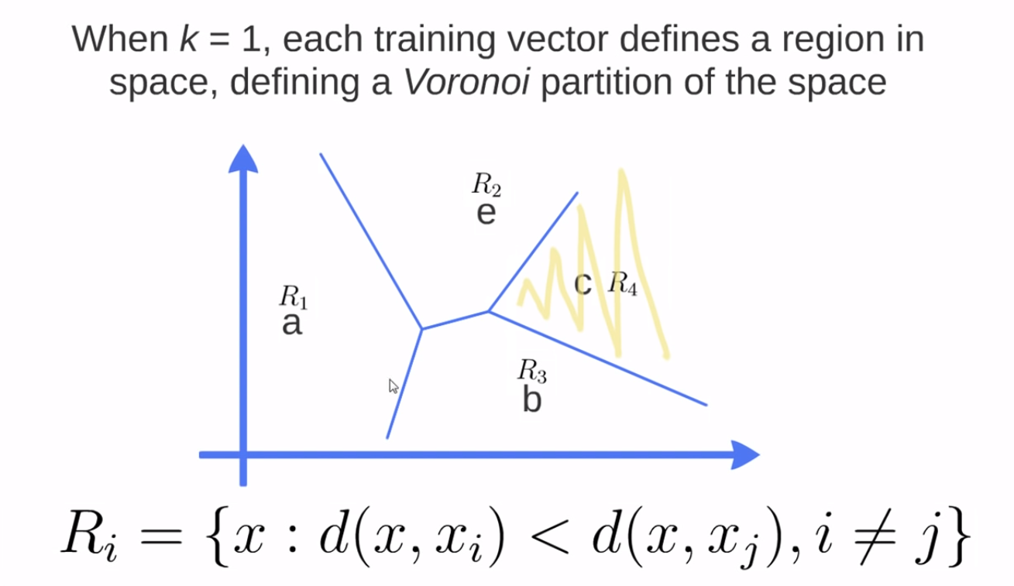
Traditional algorithms in machine learning
k-NN (k-nearest neighbor)
Thales Sehn Korting

Slide 18

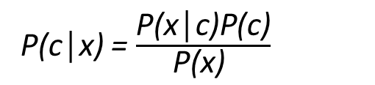
Traditional algorithms in machine learning
For example, a fruit may be considered to be an apple if it is red, round, and about 3 inches in diameter.
Naive Bayes algorithm
Likelihood
Class prior probability
P(c│x) = $\frac{\text{P}\text{(}\text{x}\text{│}\text{c}\text{)}\text{P}\text{(}\text{c}\text{)}}{\text{P}\text{(}\text{x}\text{)} }$
Posterior probability
Predictor prior probability
It is a classification technique based on Bayes’ Theorem with an assumption of independence among predictors.
Thales Sehn Korting

Slide 19
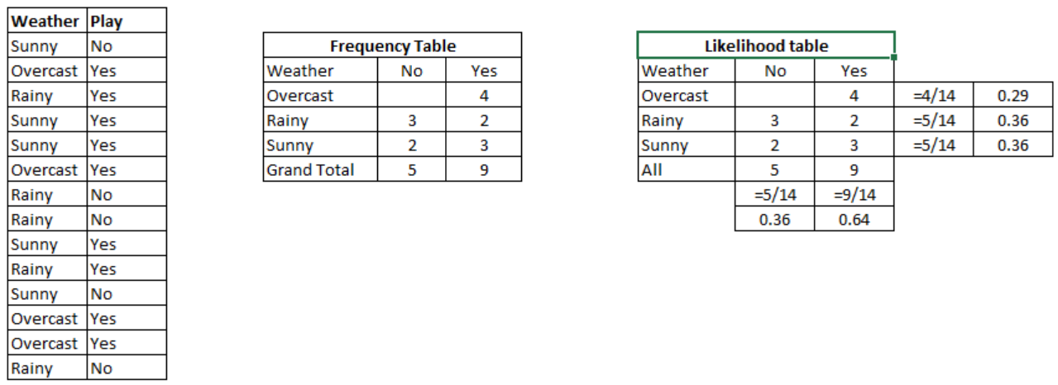
Traditional algorithms in machine learning
Naive Bayes algorithm (Example)
https://www.analyticsvidhya.com/blog/2017/09/naive-bayes-explained/

Slide 20
Traditional algorithms in machine learning
Naive Bayes algorithm (Example)
Problem: Players will play if weather is sunny. Is this statement is correct?
We can solve it using above discussed method of posterior probability.
P(Yes | Sunny) = P( Sunny | Yes) * P(Yes) / P (Sunny)
Here we have P (Sunny |Yes) = 3/9 = 0.33, P(Sunny) = 5/14 = 0.36, P( Yes)= 9/14 = 0.64
Now, P (Yes | Sunny) = 0.33 * 0.64 / 0.36 = 0.60, which has higher probability.
https://www.analyticsvidhya.com/blog/2017/09/naive-bayes-explained/

Slide 21
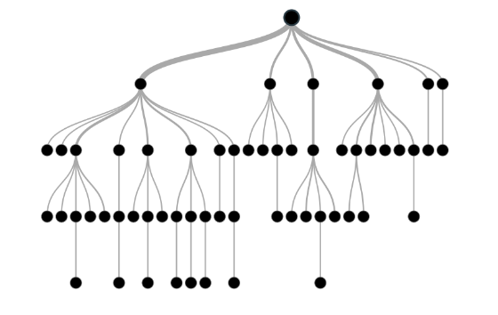
Traditional algorithms in machine learning
Decision tree algorithm
In this technique, we split the population or sample into two or more homogeneous sets (or sub-populations) based on most significant splitter / differentiator in input variables.
https://www.analyticsvidhya.com/blog/2016/04/complete-tutorial-tree-based-modeling-scratch-in-python/

Slide 22
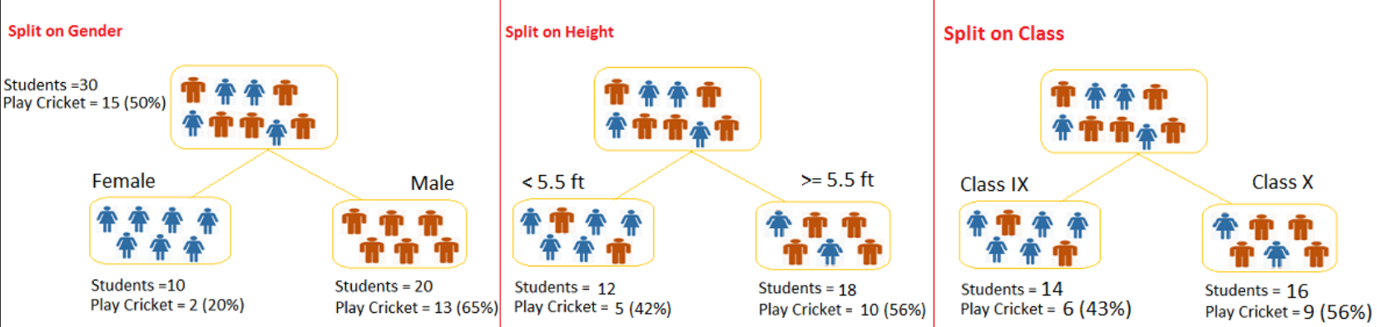
Traditional algorithms in machine learning
Let’s say we have a sample of 30 students with three variables Gender (Boy/ Girl), Class( IX/ X) and Height (5 to 6 ft).
Decision tree algorithm
https://www.analyticsvidhya.com/blog/2016/04/complete-tutorial-tree-based-modeling-scratch-in-python/

Slide 23
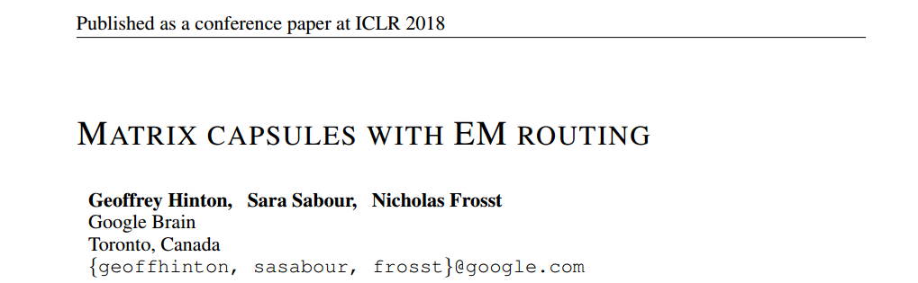
New trends in machine learning (a few examples)
Capsule Networks
A new structure inside neural nets!

Slide 24
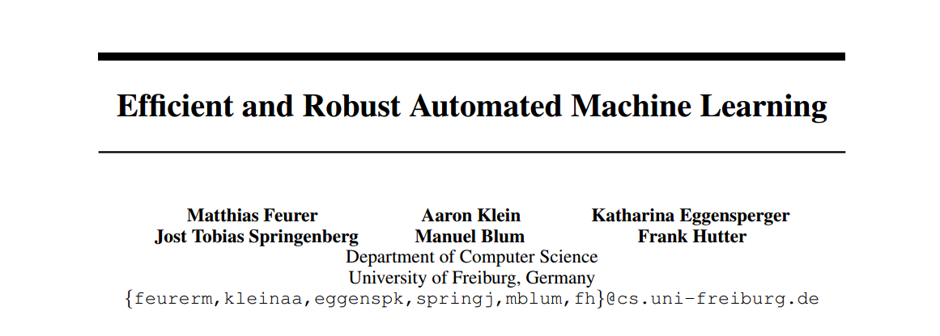
New trends in machine learning (a few examples)
Automated machine learning
The search to automatically choose a good algorithm!

Slide 25
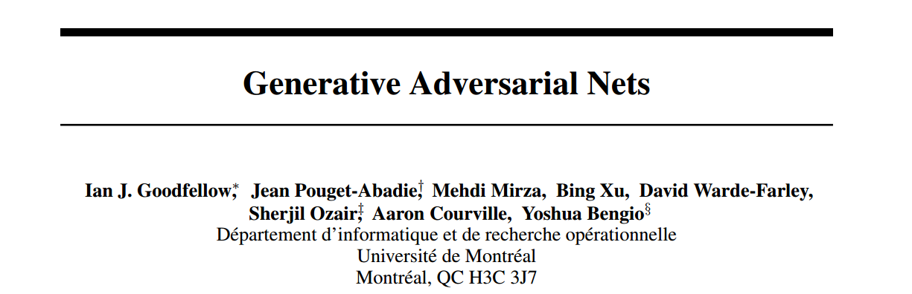
New trends in machine learning (a few examples)
Generative adversarial networks
Simultaneously training two adversarial models

Slide 26
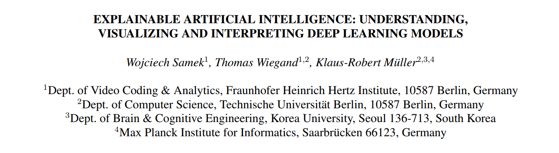
New trends in machine learning (a few examples)
Explainable artificial intelligence
“A plea for more interpretability in artificial intelligence”

Slide 27
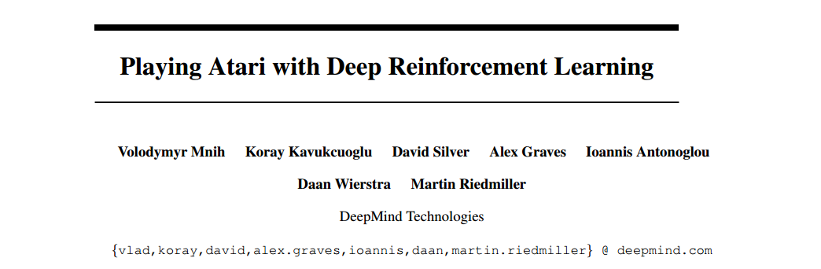
New trends in machine learning (a few examples)
Deep reinforcement learning
How to successfully learn control policies directly from high-dimensional input data

