Slide 1


Audio Moderator
A Chinese Machine Translation Model Using LSTM with Attention

Slide 2
Clicking Translate is Easy on a Facebook or Twitter Post
Translation features are already implemented on a variety of text-based platforms.
For employees who need to read posts and check for sensitive or forbidden content, such as hate speech, bullying, fake news, and incitements to violence, a written post is a piece of cake, even if it’s not their native language.
But what about when users post audio and video content?

Slide 3
The Problem of Audio
Monitoring foreign language audio and video content can be difficult because it takes time and moderators who understand the language.
If a moderator misses something because they do not speak the language well enough, both the safety and the happiness of the users is at stake.

Slide 4
Chinese – English Audio to Text Translation
This project addresses the issue of dealing with foreign language audio moderation
Builds a machine translation model from Chinese to English
Allows for input of audio files, which are converted to text and then translated

Slide 5
Building the Model
Natural Language Processing for Chinese to English Neural Machine Translation

Slide 6
Natural Language Processing for Machine Translation
Machine Translation requires different data cleaning than NLP tasks like Sentiment Analysis and Topic Matching
No need to stem or lemmatize
No need to remove stop words
We want the model to include these in the predictions!
For this project, I:
Lowercased and removed punctuation
Segmented Chinese text and converted to simplified characters
Vectorized and padded sequences

Slide 7
Natural Language Processing for Chinese Text
Chinese sentences are not written with spaces, so if we try to tokenize them as we do English, each sentence would be a unique token
Solutions to this problem:
Use a specialized libraries to segment Chinese at word boundaries
Take each individual character as a token
Both of these solutions have pros and cons

Slide 8
Using a Library to Segment Text
Libraries such as Jieba support Chinese text segmentation.
Sentences without spaces are converted to words separated by spaces so that they can be tokenized like English.
巴西的都是巴西利亚 → 巴西 的 首都 是 巴西利亚 “The capital of Brazil is Brasilia”
But sometimes segmentation might not be accurate.
队会赢 (“team will win”) [one segment] should be 队 (team) 会 (will) 赢 (win) [three segments].

Slide 9
Splitting Chinese Text by Individual Characters
No mis-segmenting, and no noisy data from mis-segmenting
Tokens per sentence increases because bigram and trigram words are split into unigrams
Some characters have distinct usage as unigrams and in bigram contexts, so separating them into only unigrams can potentially erase additional sense of the word
Ex.:
会 is frequently used as a verb meaning “will” or “can”
会议 is a noun, meaning “meeting” → When this is split into unigrams, we can lose the meaning of “meeting”

Slide 10
Data Exploration of 19,000 Paired Sentences
English sentences had:
5.6 words per sentence on average
A maximum sentence length of 11 words
A vocabulary of 5,449 unique words
40% of unique word vocabulary is words that occur only once
Chinese sentences had:
5.2 words on average
A maximum sentence length of 16 words
A vocabulary of 10,369 unique words
56% of unique word vocabulary is words that occur only once

Slide 11
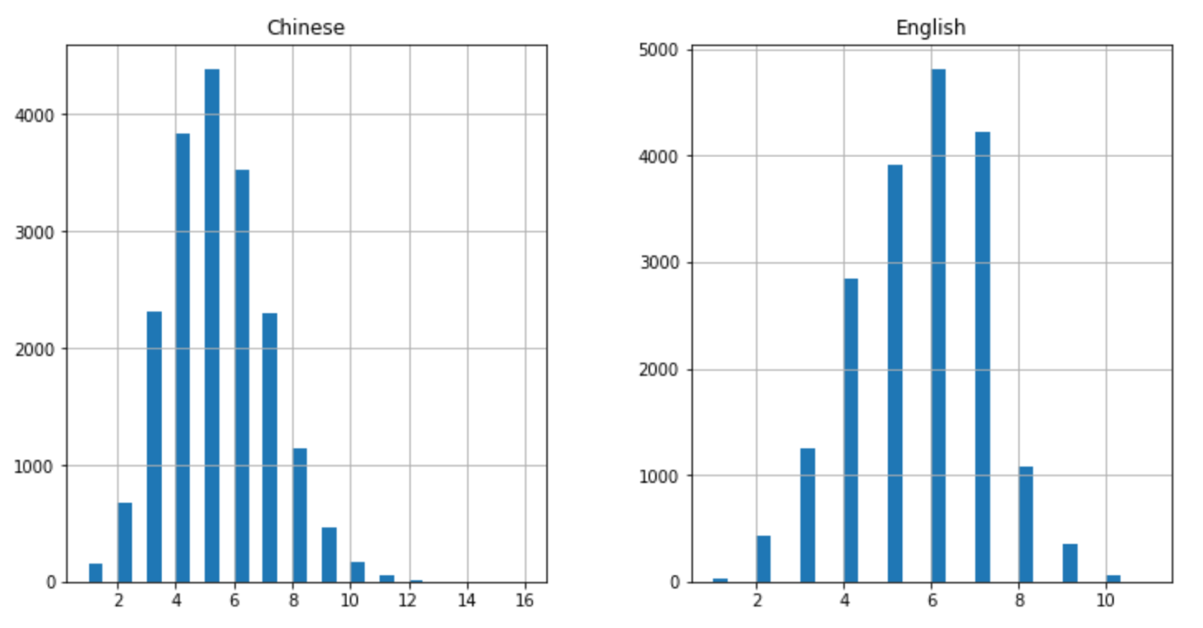
Sentence Lengths for Dataset of 19000 Sentences

Slide 12
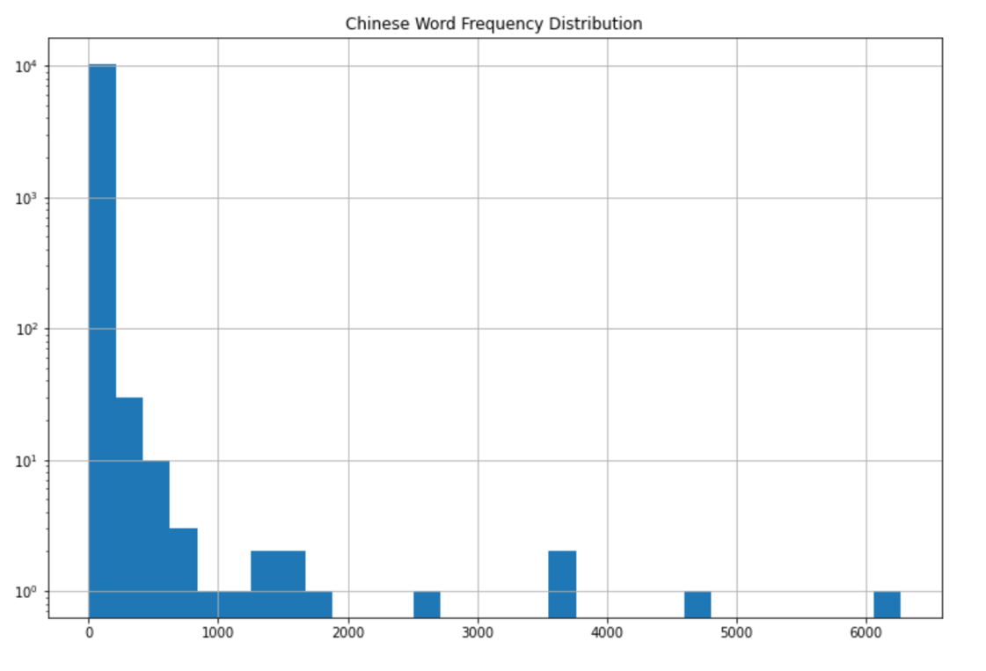
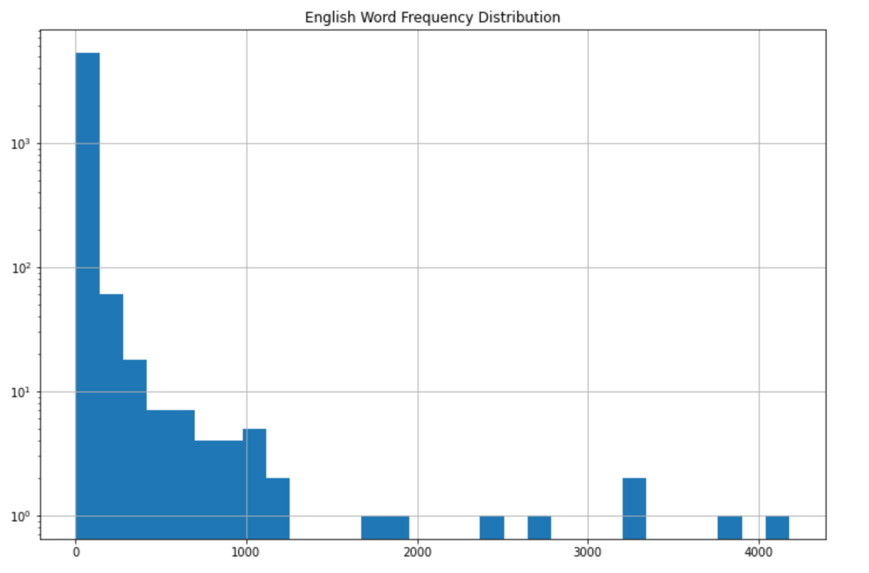
Words Frequencies for Chinese and English Words

Slide 13
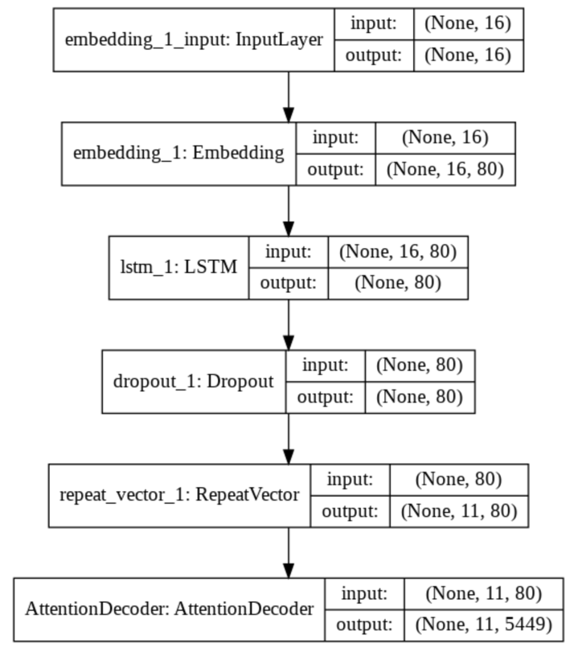
LSTM Model Building
This model contains:
An LSTM layer with 80 neurons
A Dropout layer with a rate of 50%
RepeatVector to reshape input to 3D for the decoder
An Attention decoder

Slide 14
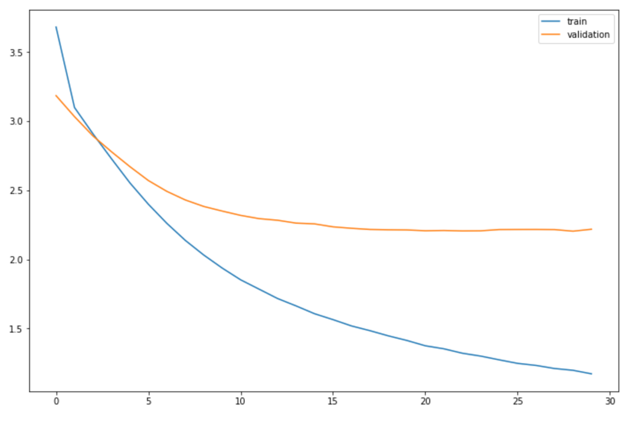
Model Training over 30 Epochs
We can see that there might be some overfitting when the performance on the validation data stops improving.

Slide 15

Model Performance Evaluation with BLEU Scores
BLEU scores are Bilingual Evaluation Understudy Scores, a common evaluation method for machine translation
BLEU scoring is a string-matching algorithm and compares matching n-grams in the prediction with human-translated target.
BLEU score between 60% to 70% are generally thought to be good
Highest score achieved so far for this model: 54.3% for unigrams on training data

Slide 16
Example Translations
Some Good Translations
Source | Target | Prediction
巴西 的 首都 是 巴西利亚 | The capital of Brazil is Brasilia | the capital of brazil is brasilia
他 7 点到 了 火车站 | He arrived at the station at seven | he arrived at the station at seven
你 的 父母 有 多 高 | How tall are your parents | how tall is your parents
Some Not-So-Good Translations
Source | Target | Prediction
那本书 很 旧 | That book is very old | that house is small
我 被 蚊子 叮 了 | I was bitten by a mosquito | i was drowned annoyed
汤姆 是 这个 班级 里 唯一 的 男生 | Tom is the only guy in this class | tom is only guy guy in class class

Slide 17

Audio Implementation
Adding a Function to
Take Audio Input

Slide 18
Speech → Text → Translation
Load a .wav file with a sentence in the source language (Chinese)
1
Use Python SpeechRecognition to convert to text
2
Clean the text and use Jieba to segment words
3
Encode as a numeric sequence
4
Load the model and predict the translation
5

Slide 19

Example
→ “我不明白” → “I don’t understand.”
Accurate translation!
→ “沒關係” → “It can’t.”
Inaccurate Translation! Should be “No problem.”

Slide 20
Conclusion
It’s not perfect yet!
Limitations include restrictions on the amount of data for training due to RAM runtime in Google Colaboratory
Smaller datasets lead to many words in the vocabulary only appearing once, which likely decreases the model’s ability to accurately embed them in the vector space.
Increases the likelihood of unseen data at the testing stage.
It is a step in the right direction!

