Slide 1
Hacking Kickstarter
Predicting Crowdfunding Project Success

Slide 2
What makes a successful Kickstarter project?
Kickstarter has hosted 473,134 projects since 2009
Only 37.49% have been successful. That’s almost twice as many failed projects as successful ones!
Can we figure out which factors lead to project success and which lead to project failure?

Slide 3
Who benefits?
Kickstarter users who want to maximize their chances of success.
Kickstarter the company, because more success means more people signing up.
Other crowdsourcing platforms and users, such as GoFundMe, IndieGoGo, Causes, Patreon, and LendingClub.
Start-ups in the investment phases of their growth.
Charity and non-profit fundraising campaigns.

Slide 4
Data Wrangling
Cleaned out rows with 1970 as the year
Cleaned out rows with N,0” as the country
Added “duration” column by subtracting launch date from deadline
Cleaned out rows classed as “undefined” and “live” in the status
Re-classed the suspended and cancelled projects as failed
Added a column to represent success and failure numerically as 1 and 0, respectively.

Slide 5
Exploratory Analysis
Were different project types more successful than others?
Is it harder for more expensive projects to meet their goals?
Do longer projects give more people more time to contribute?

Slide 6
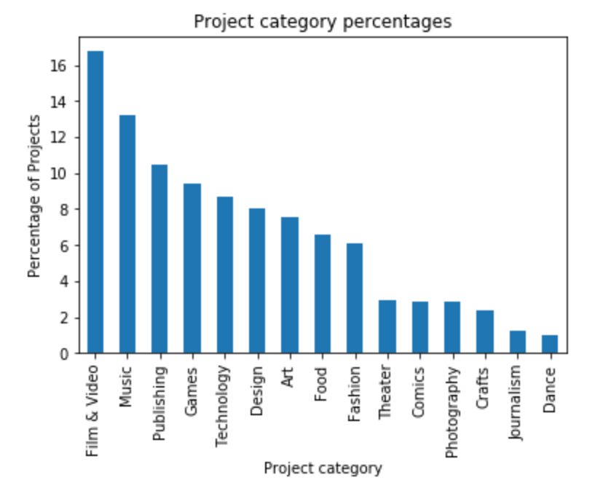
The distribution of project types overall

Slide 7
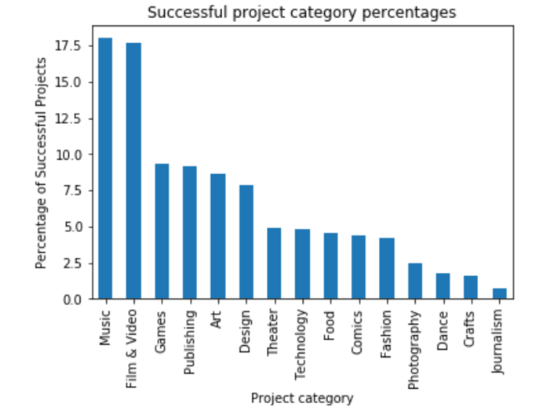
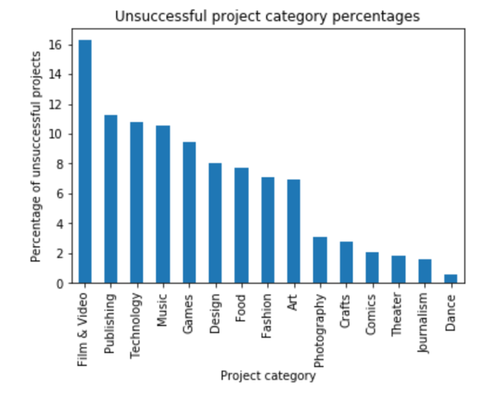
The distribution of project categories among successful and failed projects

Slide 8
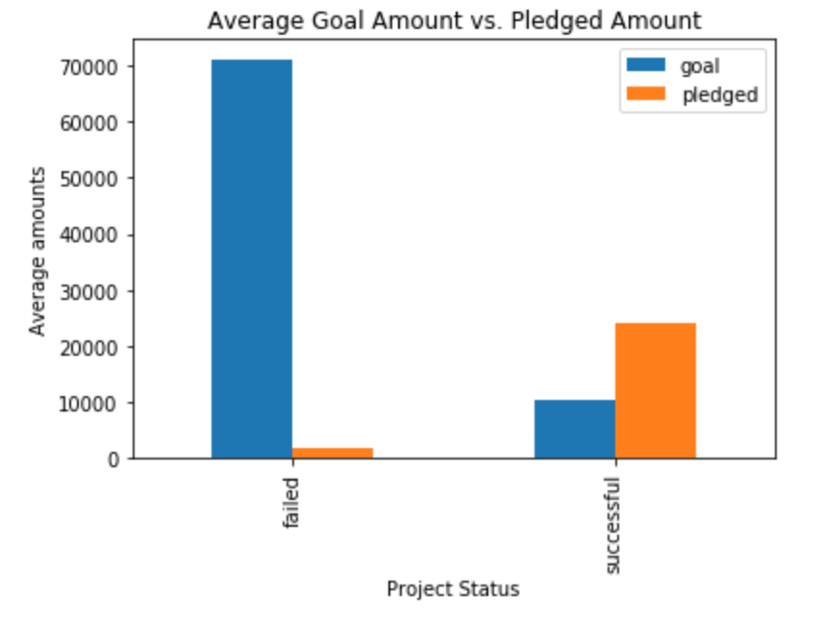
Average funding targets vs. average amounts pledged to the projects

Slide 9
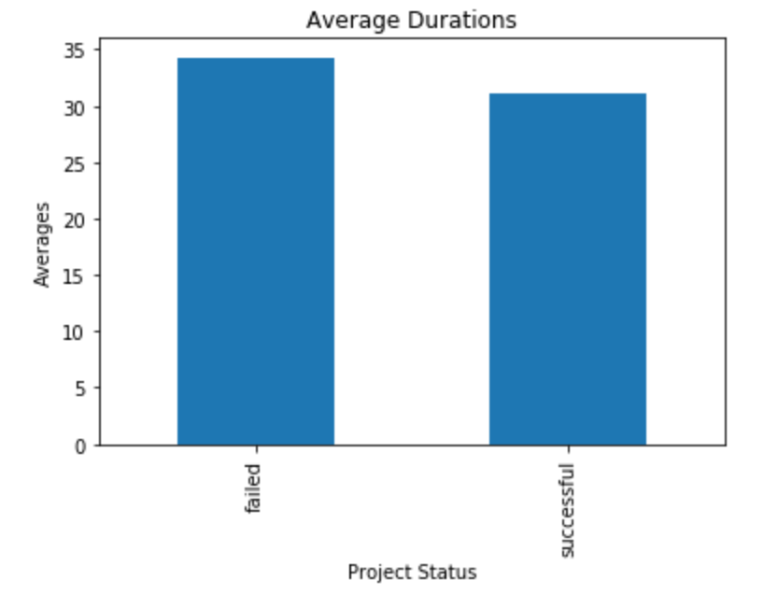
Average durations of successful and failed projects

Slide 10

Statistical Analysis
T-tests
Difference in means and standard deviations
Permutation tests
Chi-squared tests

Slide 11
Permutation tests for numerical data
For each column individually, success and failure were reassigned randomly to the data.
This was performed 1000 times and the difference of means between the reassigned successful and failed projects was taken in each instance.
The means were plotted, forming a normal distribution around 0.
This distribution was compared with the observed difference of means from the original data.

Slide 12
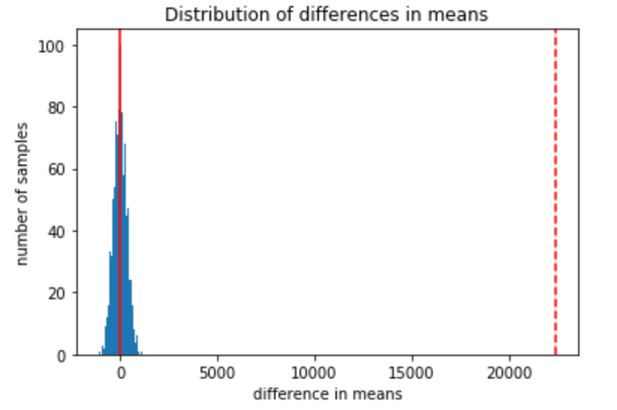
Goals column

Slide 13
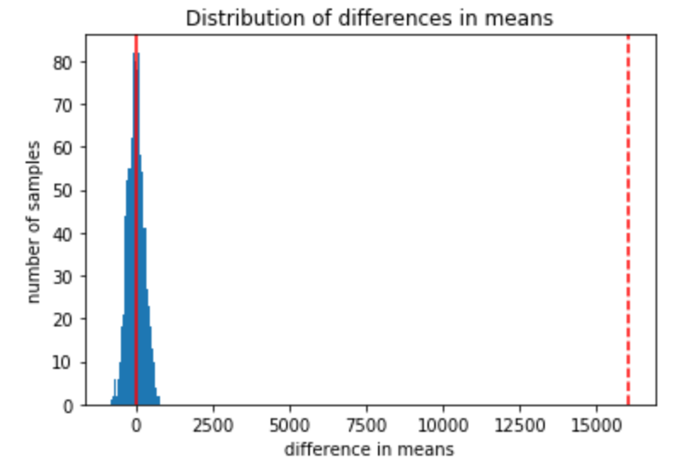
Pledged column

Slide 14
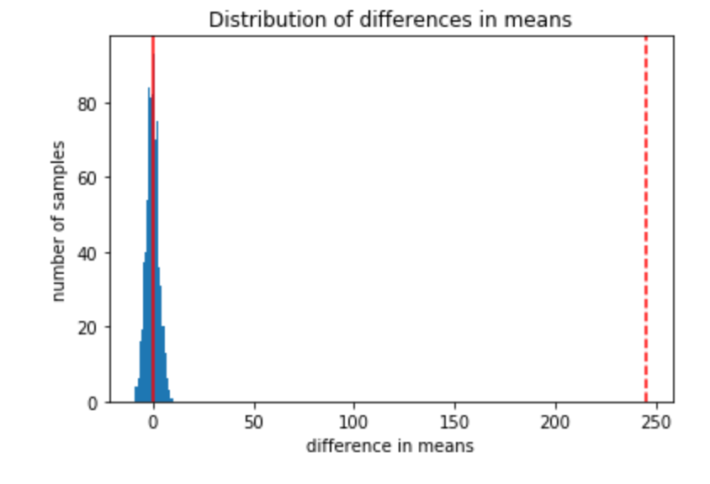
Backers column

Slide 15
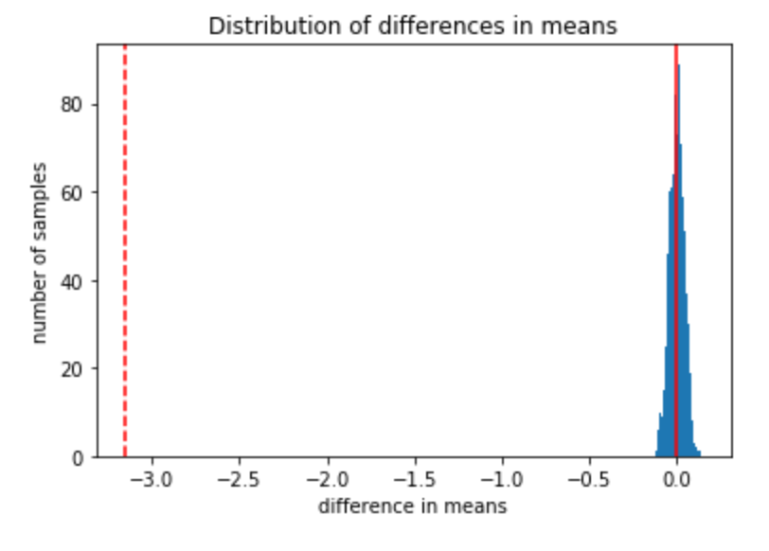
Duration column

